Slide 1

Speech Emotion Recognition using Deep Learning
Presented by -
Raja Sree Bukya
Sai Manideep Balmuri
Meghana Neti

Slide 2
Introduction
Emotions play a pivotal role in human communication, influencing how we express ourselves and perceive others. Recognizing and understanding emotions conveyed through speech is crucial in various domains, including human-computer interaction, customer service, and mental health assessment.
We aim to build a model that can efficiently identify and classify various audio files into 7 different emotions - anger, disgust, fear, happiness, sadness, surprise and neutral.

Slide 3
Datasets
TESS dataset (Toronto Emotional Speech Set) - has 2 actors aged 26 and 64, 2800 data points (audio files), each actor portraying audios with 7 distinct emotions.
RAVDESS dataset (Ryerson Audio-Visual Database of Emotional Speech and Song) - has 24 actors (12 male, 12 female),1440 audio files with each actor giving 60 trials, each expression is produced at two levels of emotional intensity (normal, strong).
SAVEE dataset (Surrey Audio-Visual Expressed Emotion) - has 4 male actors aged from 27 to 31 years, with 480 utterances in total.

Slide 4
Literature Review
[1] T. M. Wani, T. S. Gunawan, S. A. A. Qadri, M. Kartiwi and E. Ambikairajah, "A Comprehensive Review of Speech Emotion Recognition Systems"
GMM, HMM, SVM, ANN, KNN, Decision Tree, Naïve Bayes, DNN, DBN, DBM, RBM, RNN, CNN.
[2] Speech Emotion Recognition using Neural Network and MLP Classifier (Jerry Joy , Aparna Kannan , Shreya Ram , S. Rama)
MLP – 70.28%
[3]Voice Emotion Recognition using CNN and Decision Tree (Navya Damodar, Vani H Y, Anusuya M A)
Decision tree – 63%, CNN – 72%

Slide 5
Data Analysis
Waveplots - The waveplot generated by Librosa represents the amplitude envelope of an audio signal over time. In simple terms, it visualizes how the amplitude (or loudness) of the audio signal changes as time progresses.
Spectogram - A spectrogram is a time-frequency representation of an audio signal. The spectrogram reveals how the frequency content of the signal changes over time. It essentially decomposes the audio signal into its constituent frequencies and displays their intensity or magnitude as a function of time.

Slide 6
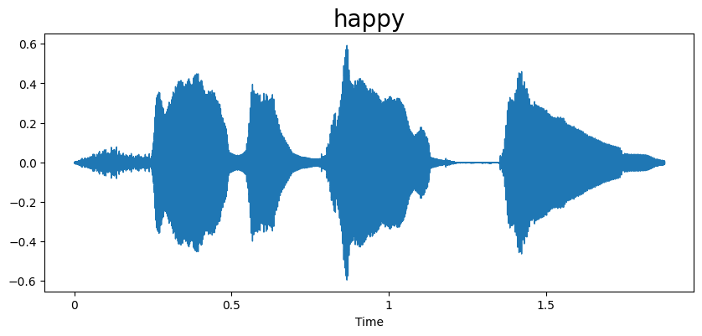
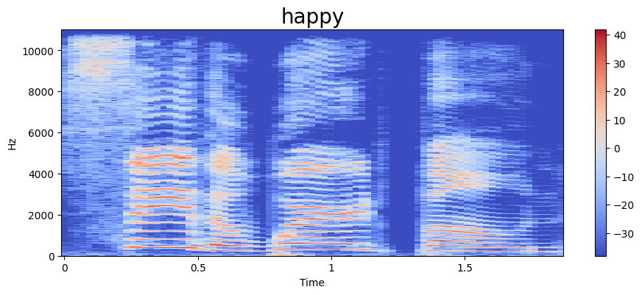

Slide 7
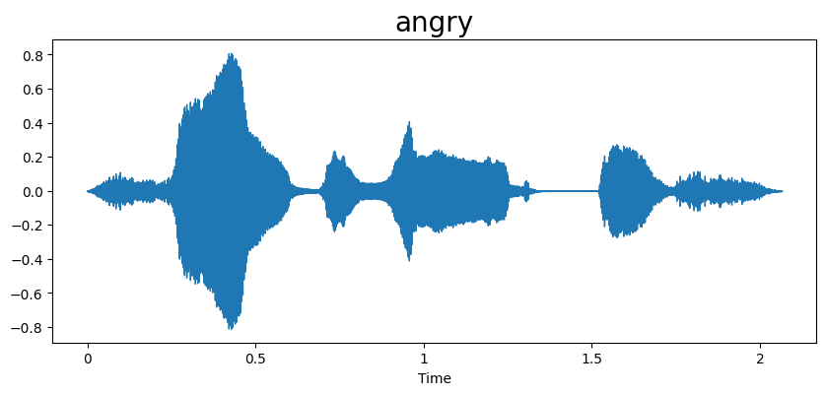
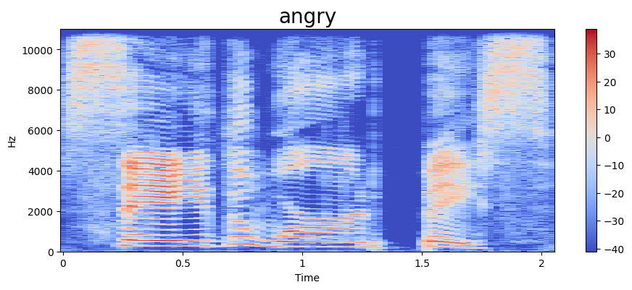

Slide 8
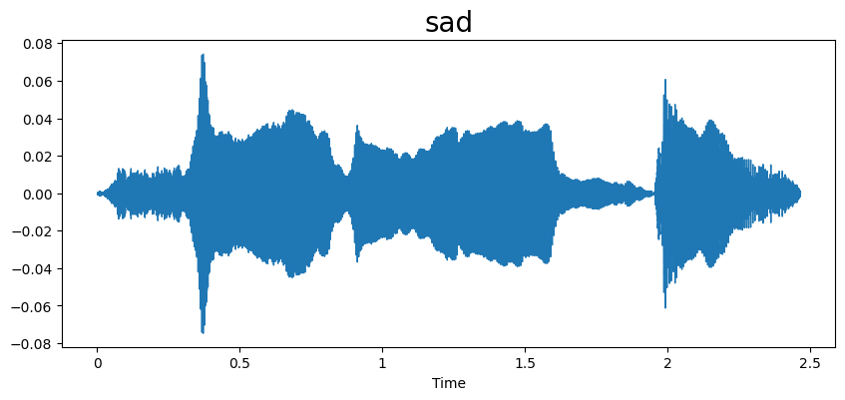
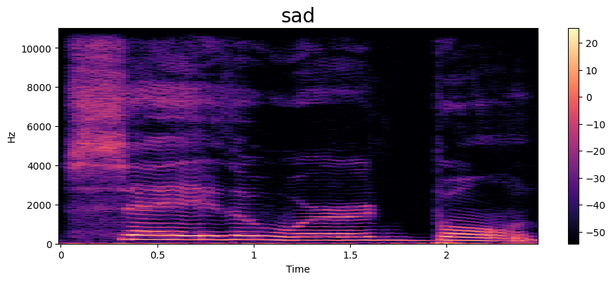

Slide 9
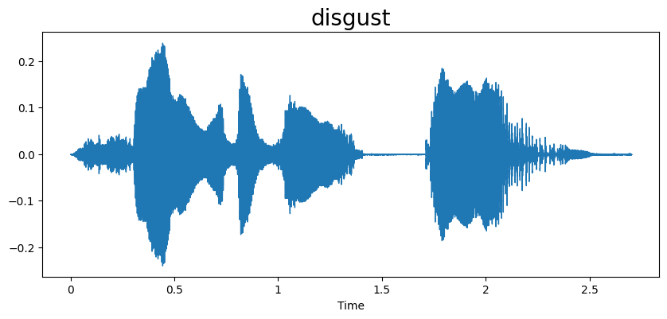
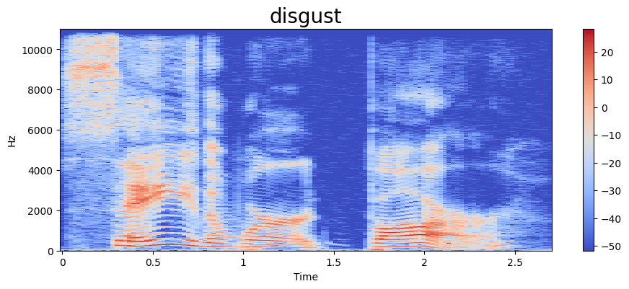

Slide 10
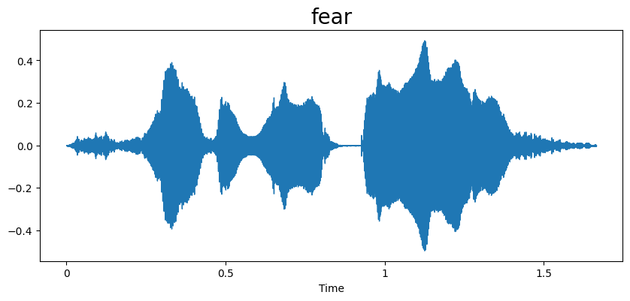
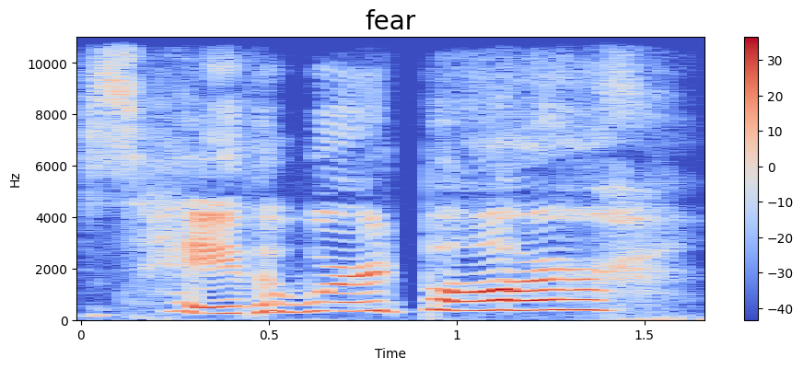

Slide 11
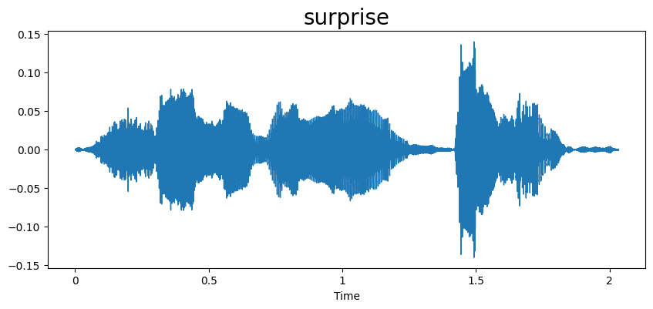
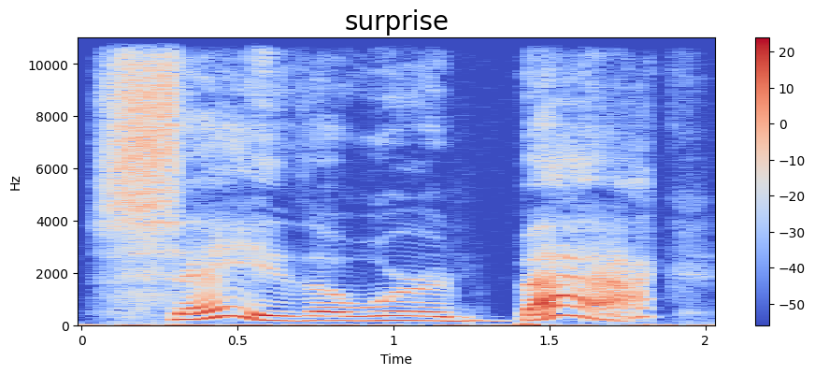

Slide 12
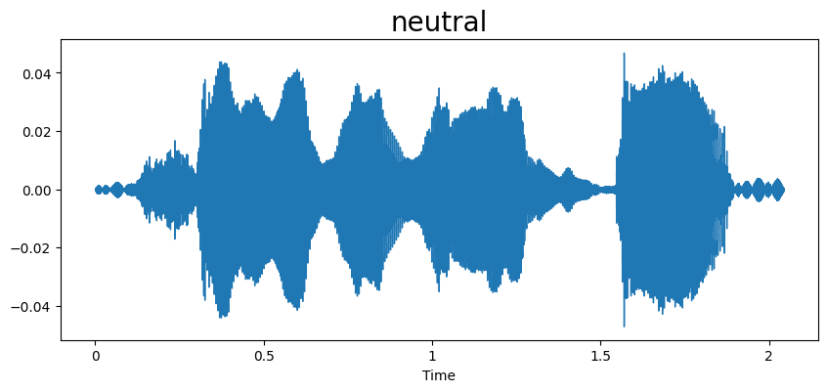
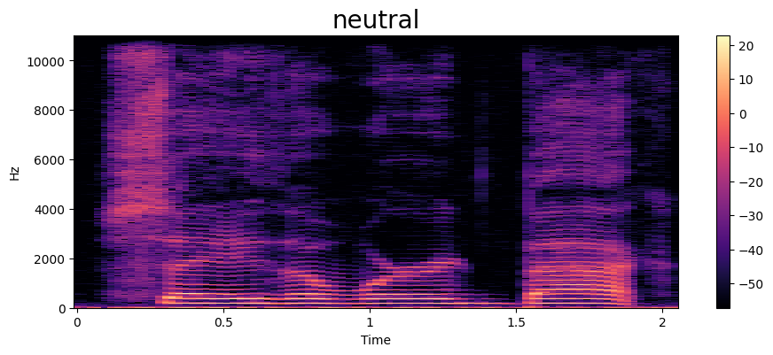

Slide 13
MFCC – Mel-Frequency Cepstral Coefficients
MFCCs are a feature extraction technique used in speech and audio processing.
They represent the spectral characteristics of sound, suitable for machine learning tasks like speech recognition and music analysis.
MFCCs capture the shape of the power spectrum by transforming the audio signal into the frequency domain using techniques like DFT and applying the mel-scale to approximate human auditory perception.
These coefficients emphasize important features for speech perception while discarding less relevant information, making them effective for tasks such as speaker recognition, emotion detection, and speech-to-text conversion.

Slide 14
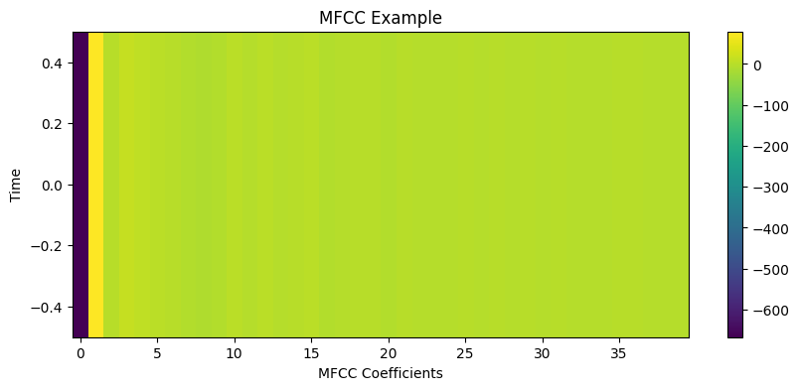

Slide 15
Chroma
Chroma feature extraction is a method used in speech emotion recognition and music analysis.
It represents the harmonic content of an audio signal by summarizing the energy distribution across the twelve pitch classes.
Chroma features are derived from the Fourier spectrum of the audio signal, followed by mapping the frequency bins to their corresponding pitch classes.
By focusing on the pitch content and disregarding information about timbre and loudness, chroma features provide a compact representation well-suited for tasks like speech emotion recognition, music genre classification, and melody tracking.

Slide 16
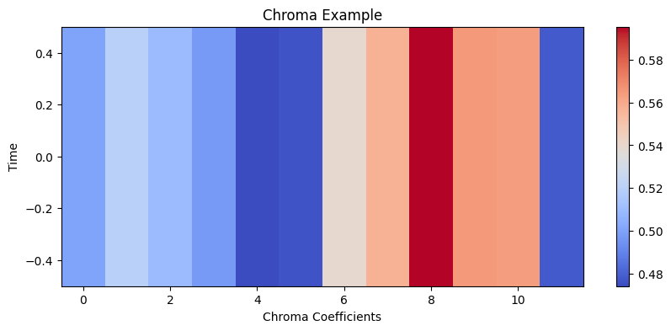

Slide 17
Zero – crossing rate
Zero Crossing Rate (ZCR) feature extraction is utilized in speech emotion recognition and audio signal analysis.
It measures the rate at which the audio signal changes its sign, indicating the frequency of crossings through the zero amplitude point.
ZCR is computed by counting the number of times the audio waveform crosses the zero axis within a specified time frame.
This feature provides insights into the temporal variations and the overall "noisiness" of the signal, offering valuable information for tasks such as speech emotion recognition, voice activity detection, and audio segmentation.

Slide 18
Root Mean Square Error
By computing the square root of the mean of squared differences between consecutive samples, RMSE captures variations in signal intensity, which can correspond to different emotional states. Higher RMSE values often correlate with louder or more intense speech, which might indicate emotions like anger.
It captures temporal dynamics, revealing how speech intensity varies over time, aiding in emotional pattern detection.
RMSE complements spectral features like MFCCs, offering additional information about speech amplitude.
Its computational efficiency makes it suitable for real-time applications, enhancing overall accuracy in speech emotion recognition systems.

Slide 19
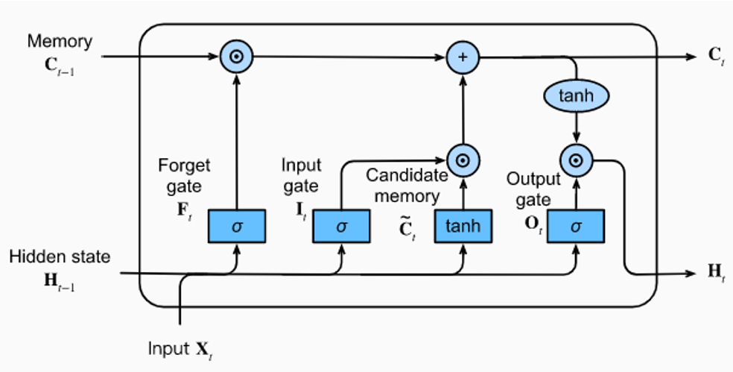
LSTM Model Implementation
LSTM consists of three gates (forget, input and output) and one cell state.
The forget gate decides what information from previous inputs to forget, the input gate decides what new information to remember, and the output gate decides which part of the cell state to output.
The model architecture consists of an LSTM layer with 256 units, followed by two Dropout layers to prevent overfitting, and two Dense layers with ReLU activation functions.
Training accuracy – 79.93%
Test accuracy – 75.72%

Slide 20
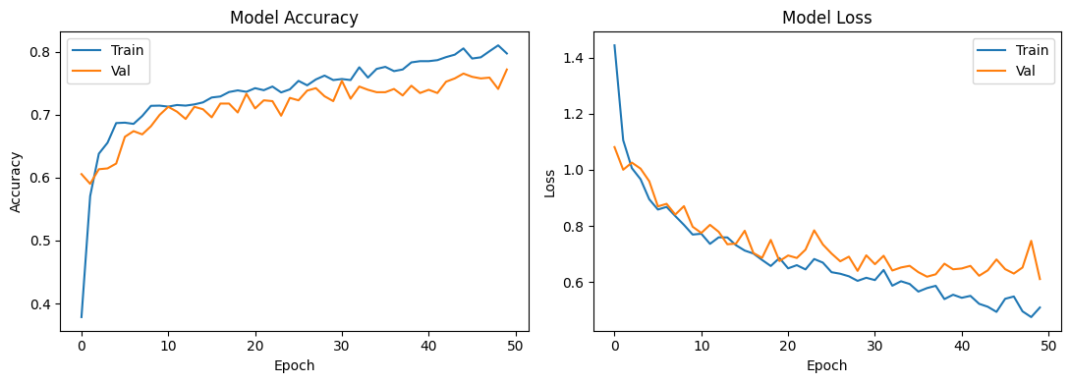
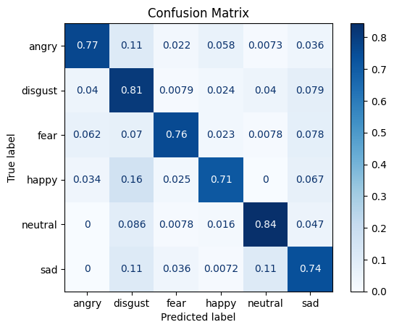

Slide 21
CNN Model Implementation
The CNN model consists of various convolution layers, pooling layers, fully connected layers, and a SoftMax unit.
The basis of CNN is convolutional layers, which constitute filters. These layers perform a convolutional operation and pass the output to the pooling layer.
The pooling layer’s main aim is to reduce the resolution of the output of convolutional layers, therefore reducing the computational load.
The resulting outcome is fed to a fully connected layer, where the data is flattened and is finally classified by the SoftMax unit, which extends the idea of a multiclass world.
Training accuracy – 90.47%
Test accuracy – 83.55%

Slide 22
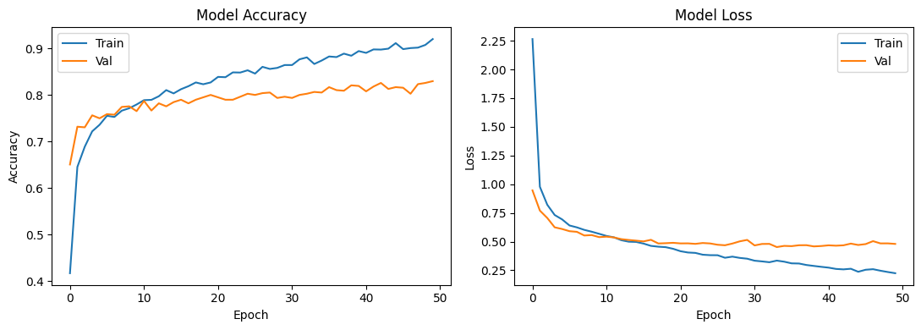
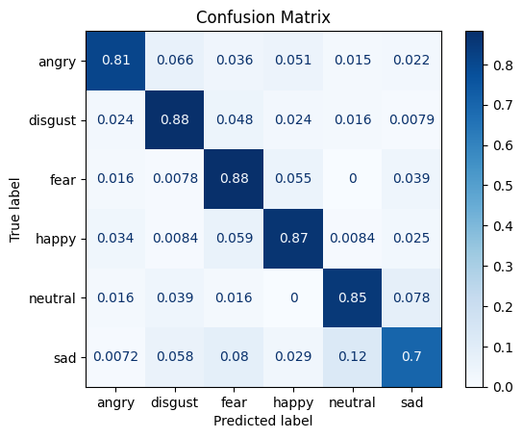

Slide 23
GRU Model Implementation
Gated Recurrent Units (GRUs) are suitable for speech emotion recognition due to their ability to capture long-range dependencies in sequential data.
GRUs possess a simpler architecture compared to LSTMs.
GRUs excel in modeling temporal dynamics of speech signals, allowing them to capture subtle variations in emotion expression over time.
Additionally, GRUs are robust to overfitting and can effectively handle sequences of varying lengths commonly encountered in speech data.
Training accuracy – 86.81%
Test accuracy – 75.28%

Slide 24
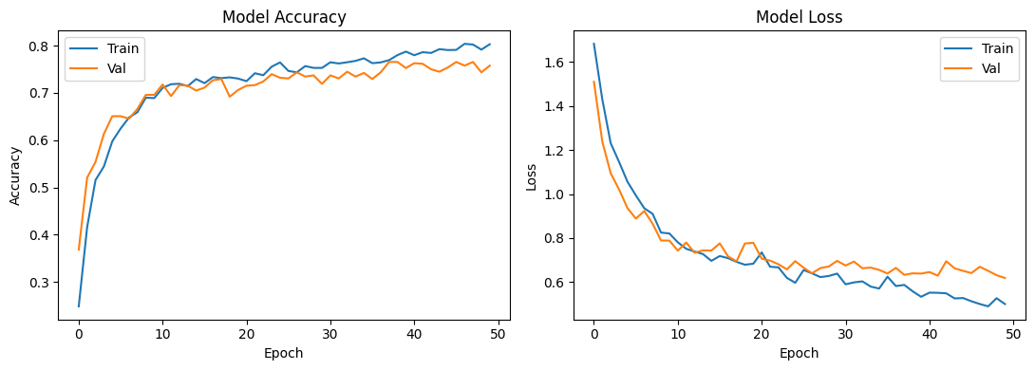
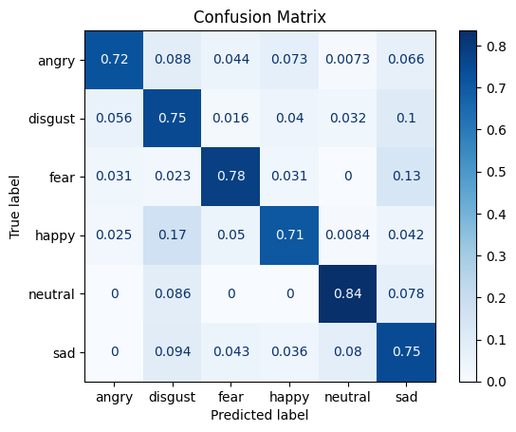

Slide 25
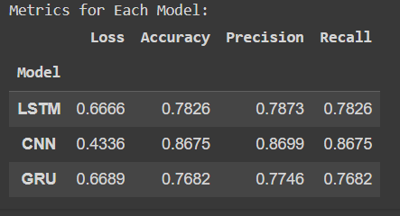

Slide 26
Applications
Virtual Mental Health Assistants
Deceptive Speech Detection
Fraud Detection
Call Center Analytics

Slide 27
Web Application demo

Slide 28
THANK YOU!

