Slide 1


Pathways+:
Presented by:
Robert Bunge,
Faculty Coordinator for IT
North Seattle College
Robert.Bunge@seattlecolleges.edu
Aligning Guided Pathways with AWS Educate Pathways
Notes:
Pathways+: Aligning Guided Pathways with AWS Pathways. Presented by Robert Bunge, North Seattle College. For Innovations 2020, 3/5/20

Slide 2
Goal: Discuss & Share
How might cloud services like AWS disrupt current educational pathways?
What problems and opportunities come with cloud-based services?
What might be good ways to incorporate cloud services into current programs?
Notes:
Discussion goals for the presentation

Slide 3
Outline
Seattle Pathways – a Guided Pathways model
IT program in Seattle Pathways
AWS Educate
AWS Academy
Discussion, sharing, wrap-up
Notes:
Presentation outline. 1) Seattle Pathways 2) IT program in Seattle Pathways 3) AWS Educate 4) AWS Academy 5) Discussion, sharing, wrap-up

Slide 4
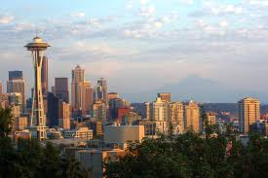
Seattle Pathways
Notes:
Photo of Seattle

Slide 5

Seattle Pathways
Seattle Pathways is a deliberate and comprehensive approach to achieve two strategic goals:
  Student Success
  Diversity, Equity, Inclusion, and Community.
It is an institutional mechanism used to achieve equity and builds upon the Seattle Colleges’ on-going Strategic Enrollment Management, Guided Pathways, and related student success and equity initiatives. All of these efforts are under the Seattle Pathways’ umbrella.
Notes:
Seattle Pathways goals: 1) Student Success 2) Diversity, Equity, Inclusion, and Community

Slide 6
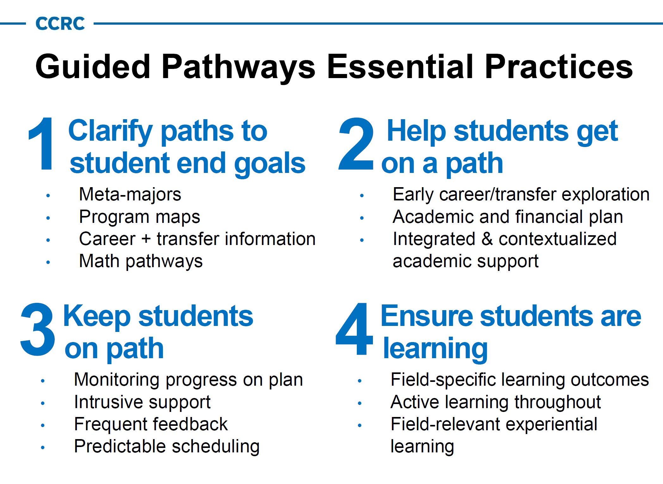
Notes:
CCRC Guided Pathways Essential Practices

Slide 7
IT Programs at NSC
Bachelors (180 credits)
  Bachelor of Applied Science (BAS) in Application Development
Associates (90 credits)
  Associate of Applied Science (AAS) in IT Controlled Electronics
  Associate of Applied Science (AAS) in Network & Server Administration
  Associate of Applied Science (AAS-T) in Programming and IT Network Support
  Associate of Applied Science (AAS-T) in Application Development (proposed)
Certificates (15-40 credits)
  Cisco Certified Network Associate (15)
  IT Controlled Electronics (40)
  Linux Networking & Security (20)
  Network & Server Administration (40)
  Web Application Technologies (20)
  Windows Network Administration (20)
Notes:
IT Programs at NSC. Summary of Bachelors, Associates, and Certificate programs.

Slide 8
North Seattle College
College-Level IT Pathways
Programming |  |  |  |  | Networking
 |  |  |  |  | Classic IT |  |  |  |  | IT with Electronics
Short-term Certificates
Web Application Technologies |  |  |  |  | Cisco Certified Network Associate (15 credits)
(20 credits) |  |  |  |  | Linux Networking & Security (20 credits)
 |  |  |  |  | Windows Network Administration (20 credits)
Long-term Certificates
Gap here! |  |  |  |  | Network & Server Administration |  |  |  | IT Controlled Electronics
 |  |  |  |  | (40 credits) |  |  |  | (40 credits)
Associates Degrees
Programming and IT Network Support (AAS-T) |  |  |  |  | Network & Server Administration |  |  |  | IT Controlled Electronics
Application Development (AAS-T) (proposed) |  |  |  |  | (AAS) |  |  |  | (AAS)
Bachelors Degrees
Application Development (BAS) |  |  |  |  | (BAS Networking at Seattle Central)
Notes:
Graphic of IT pathways at North Seattle College

Slide 9
IT+ 3 Pathway Architecture
 | Grade Levels | Courses |  | Milestones
High School | 9 | Gen Ed Course 1 | IT Course 1
 | 10 | Gen Ed Course 2 | IT Course 2
 | 11 | Gen Ed Course 3 | IT Course 3
 | 12 | Gen Ed Course 4 | IT Course 4 | HS Diploma, including 40 credits transferable to college
Seattle Colleges | Year One | 10 credits Gen Ed | 40 credits IT | AAS-T Degree (90 credits of college)
 | Year Two | BAS Year One
 | Year Three | BAS Year Two |  | BAS Degree (180 credits of college)
Notes:
Graphic of the IT+3 Pathway model. Part of a NSF grant for Seattle Colleges and Seattle Public Schools

Slide 10
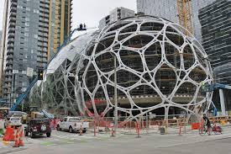
Enter Amazon
Notes:
Photo of Amazon construction in downtown Seattle

Slide 11
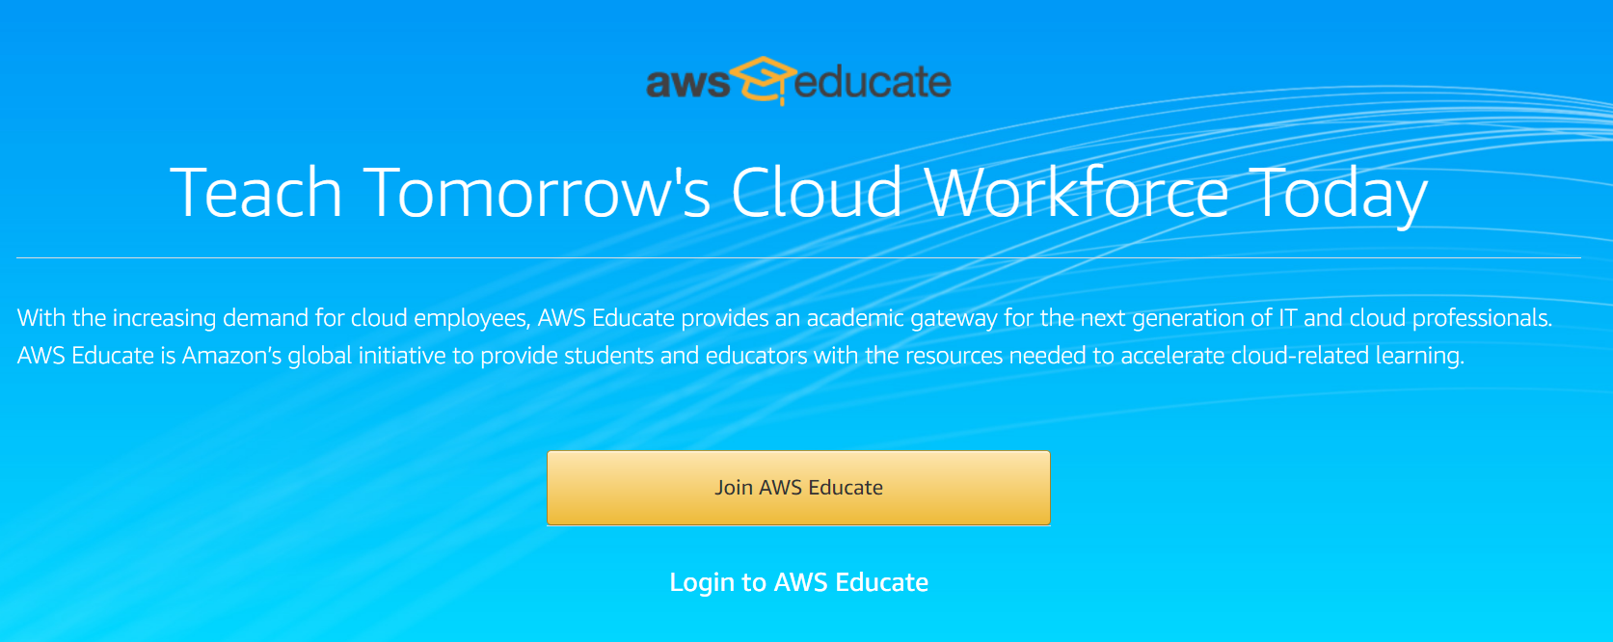
AWS Educate
https://aws.amazon.com/education/awseducate/
Notes:
AWS Educate login screen

Slide 12
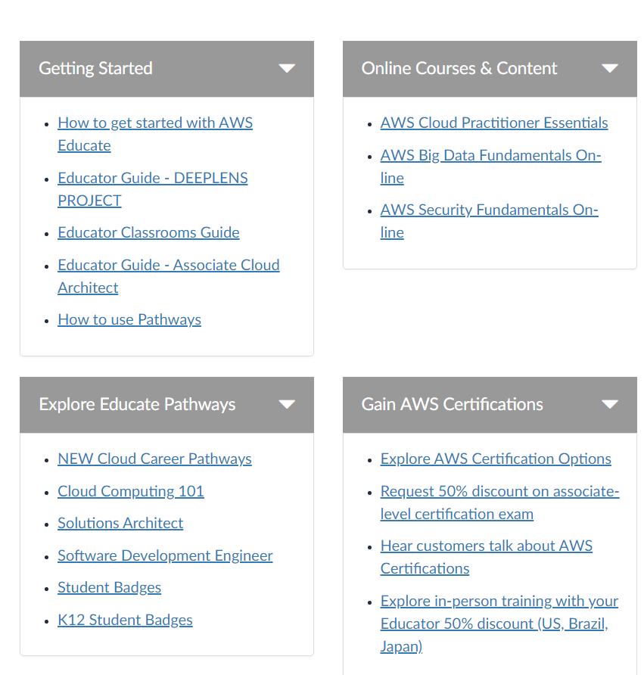
AWS Educate Pathways
Notes:
AWS Educate training menu

Slide 13
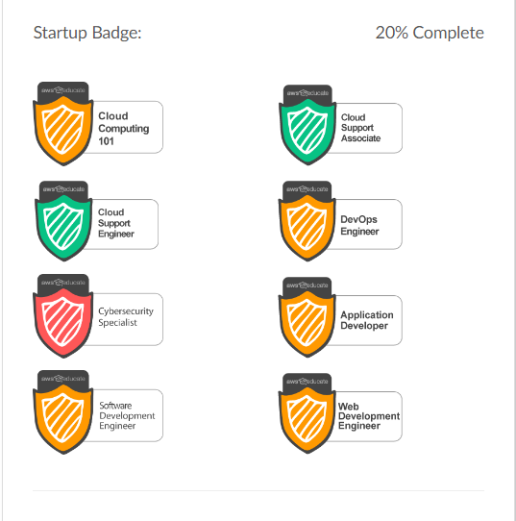
Pathways = Badges?
Notes:
Images for the completion of 8 AWS Educate pathways

Slide 14
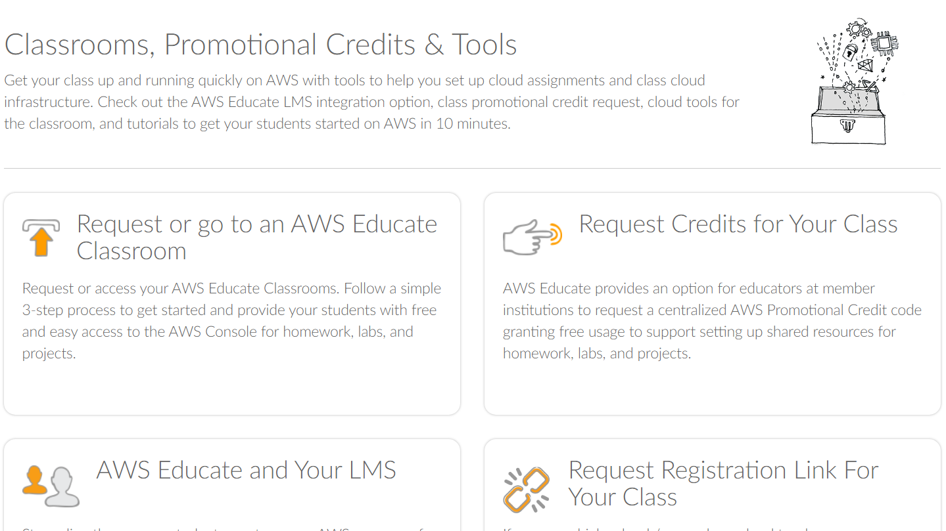
AWS Educate Classrooms
Notes:
AWS Educate classrooms screen

Slide 15
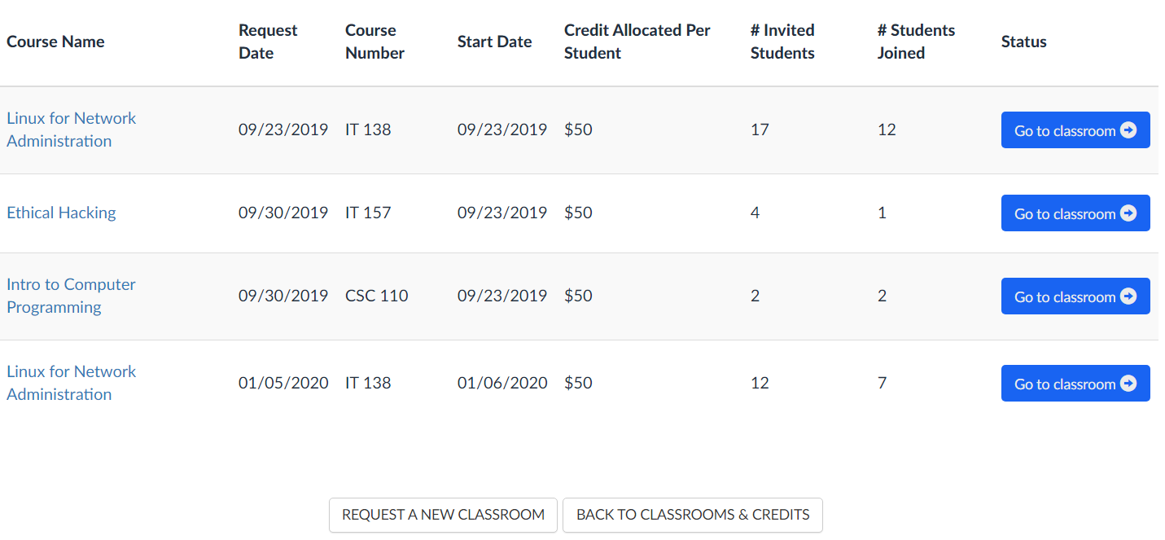
My Classrooms
Notes:
Menu of Robert Bunge’s current AWS Educate classrooms

Slide 16
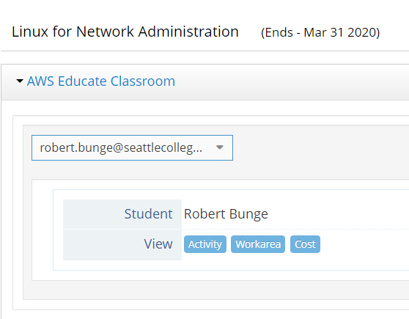
Instructor POV on Students
Notes:
Student management menu for the instructor in AWS Educate

Slide 17
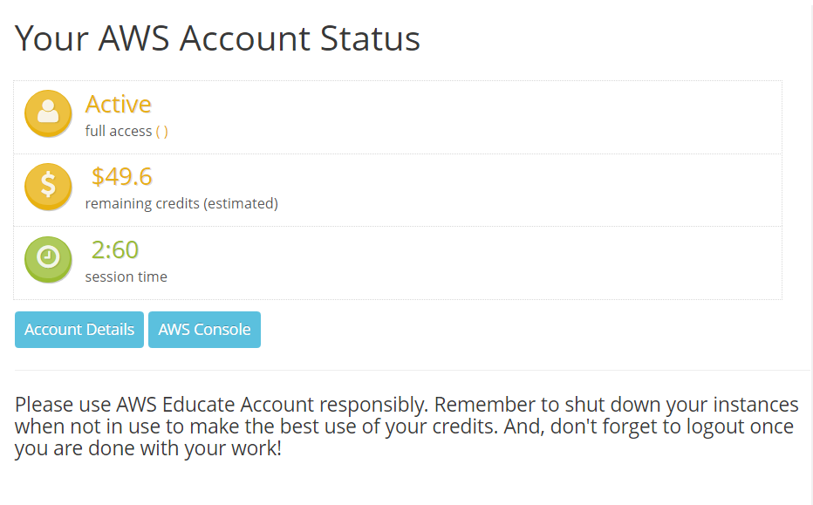
AWS Educate Account Status
Notes:
AWS Educate account status screen

Slide 18
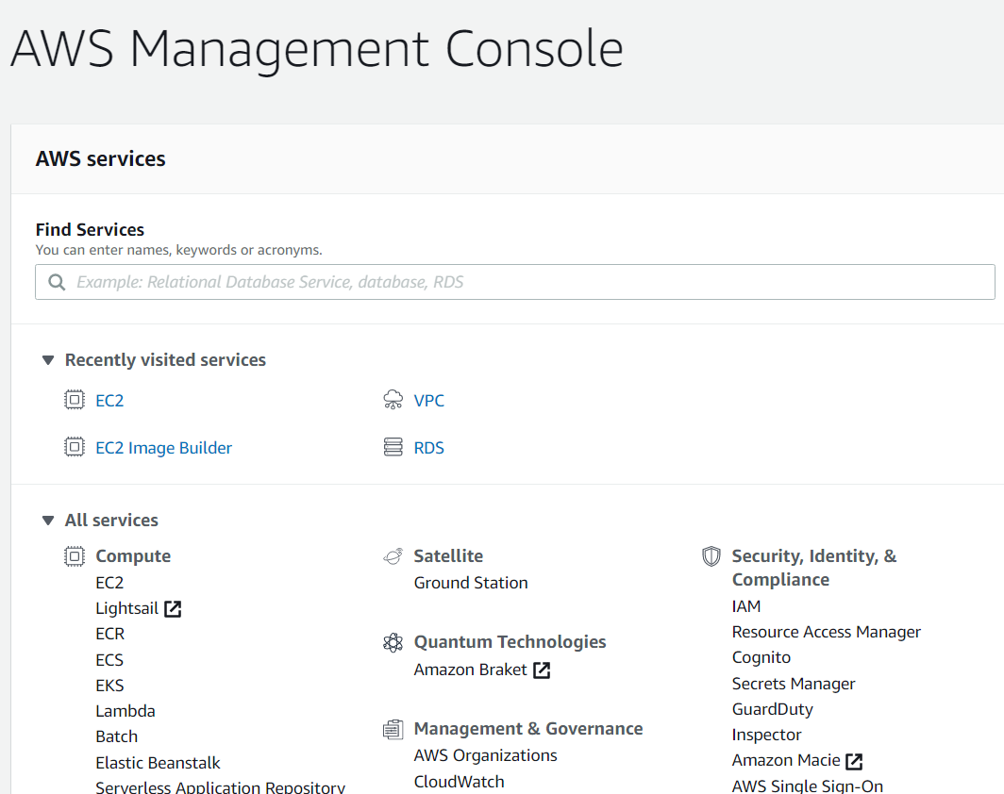
Notes:
AWS Management console, reached through AWS Educate

Slide 19
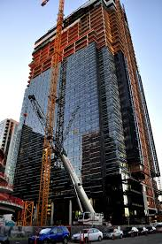
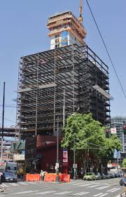
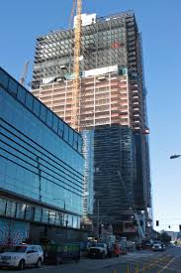
But Wait! There’s More!
Notes:
Images of three Amazon office tower construction projects

Slide 20
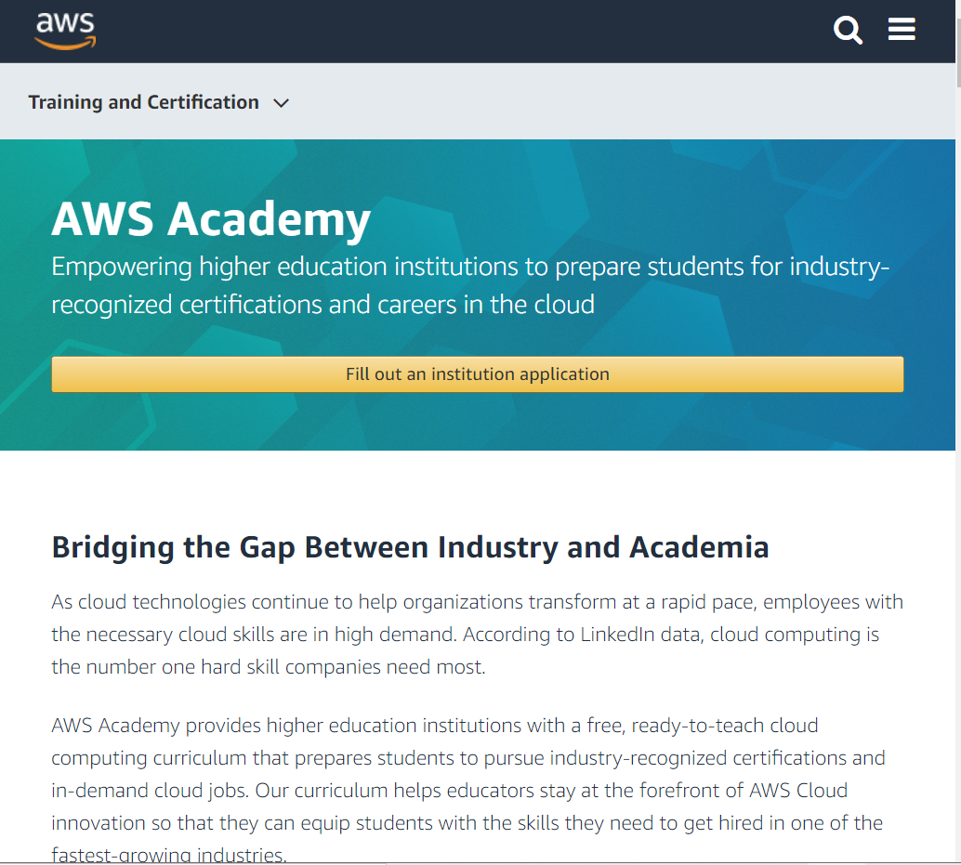
AWS Academy
https://aws.amazon.com/training/awsacademy/
Notes:
AWS Academy top level information screen

Slide 21
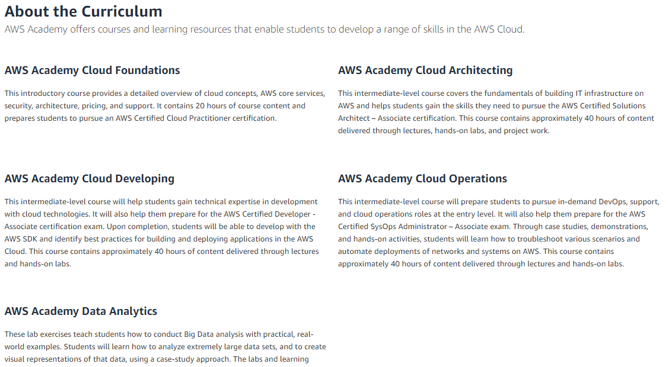
AWS Academy Curriculum
Notes:
AWS Academy curriculum

Slide 22
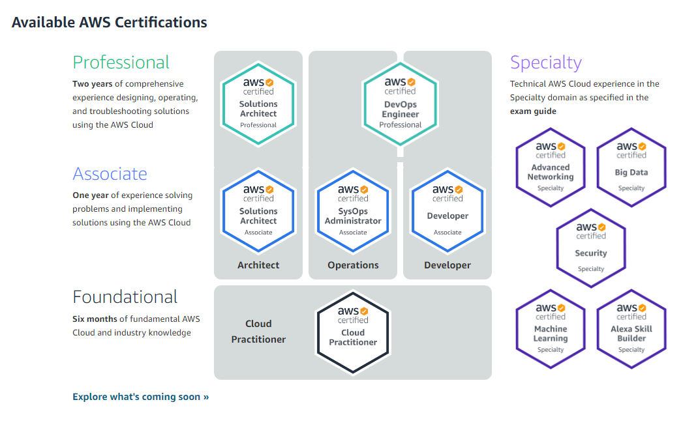
AWS Certifications
Notes:
AWS Certification pathways

Slide 23

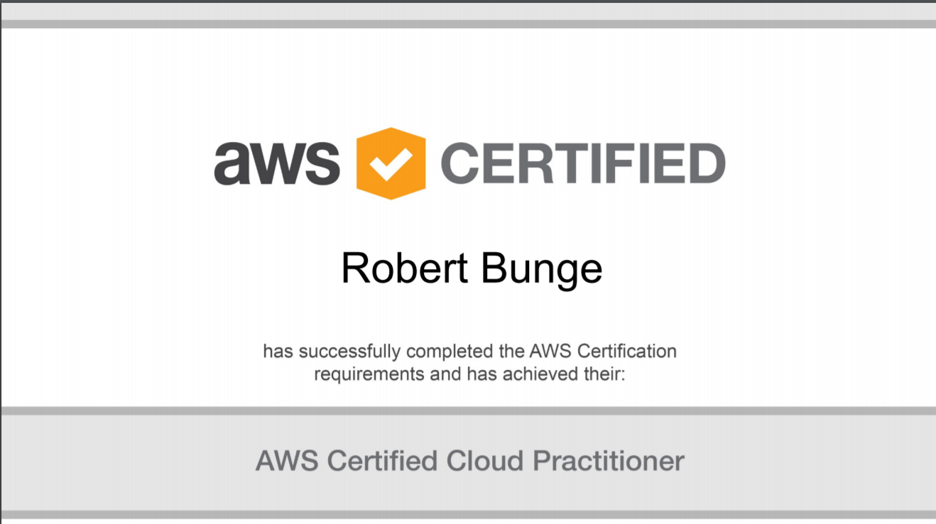
Freshly Certified!
Notes:
Robert Bunge AWS Certified Cloud Practitioner

Slide 24
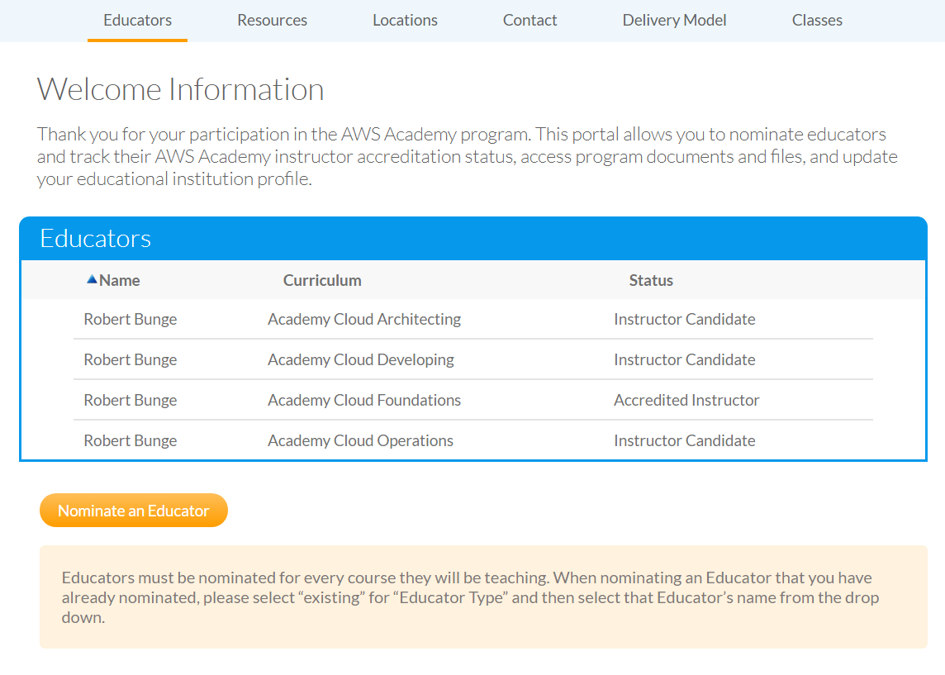
AWS Academy Qualifications
Notes:
AWS Academy Instructor qualifications

Slide 25


Side-by-Side
More informal More open More options Badges & pathways | More structured More restrictive Instructors must qualify Leads to industry certifications
Notes:
Side-by-side summary comparison of AWS Educate and AWS Academy

Slide 26
Let’s Discuss!
Are you using either AWS Educate or AWS Academy now?
Are you attracted to either of these services for your programs?
What threats/disruptions to a guided pathways model do you see with these?
Notes:
End of presentation discussion questions

