Slide 1
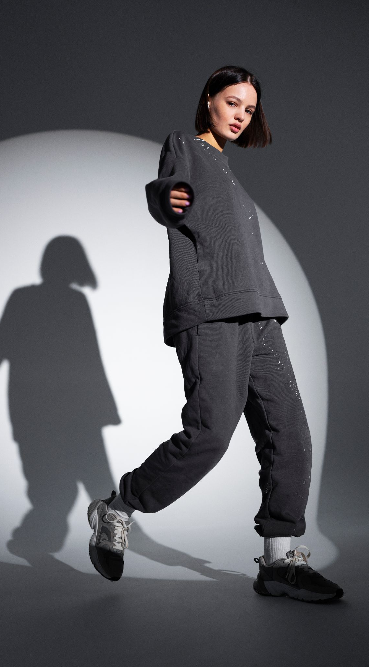
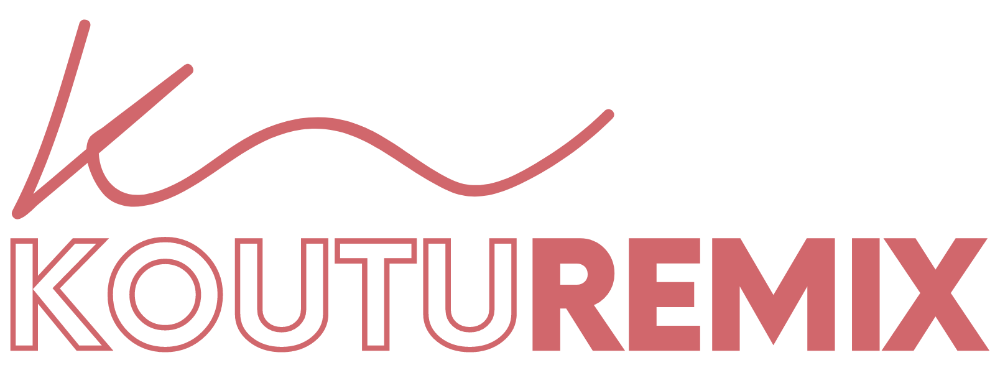

Remix your old clothes with the most creative minds on the internet.
Syed Touhid & Team
November 2023

Slide 2

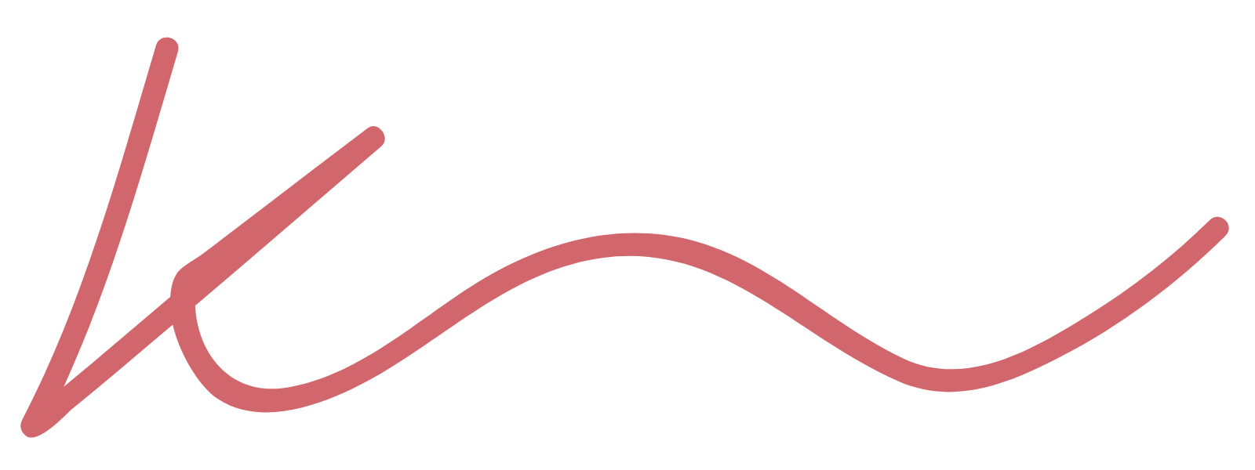
Sustainability problem
SOLUTION
92 million tonnes of waste garments go to landfill every year. Fashion brands spend billions on sustainability initiatives to no avail as people are used to always having access to new clothing and unique styles, so how can fashion move forward?
KoutuRemix is a digital platform that connects users with sustainable fashion designers / creators to remix their old clothing into new, unique garments. By giving the ‘waste’ textiles over to a remix community, old garments can become new treasures.
Notes:
Basic UX Flow:
User posts their current clothing as is, with a ceiling or range for how much they’d pay for it to be upcycled, designs they like
Other users can claim this clothing (from users) and some textile waste (from companies) to make a new upcycled design and give it a fair price
Anyone who decides to purchase this will pay within the price range (goes to the designer)
Sponsorships can come from large corporates and/or manufacturers, distributors, or Government initiatives
Over time, these rankings and publicity helps push small fashion designers to the top

Slide 3
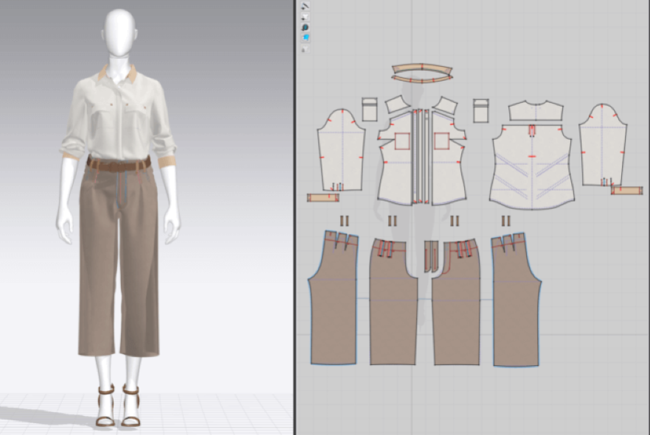

INNOVATION + TECH
Combines fashion designers with the availability of underused clothing and waste textiles.
Cutting edge web-based 3D rendering platform for designers and clients to collaborate and design unique garments
Clients can digitally scan old clothing and waste textiles to upload to the platform and work on new designs prior to any logistics
Repurposing marketplace more sustainable vs simply recycling clothing
Notes:
By combining the wardrobes of regular people and the creativity of designers, KoutuRemix Marketplace promotes sustainability and encourages users to reduce textile waste by repurposing their old clothing. The use of 3D rendering previews throughout the collaboration process ensures that users are able to see the final product before it is produced, reducing the risk of producing unwanted items and promoting a more sustainable and responsible approach to fashion.
idea has the potential to be more sustainable and produce less waste and carbon emissions than traditional clothing production and recycling methods. This is because it focuses on repurposing existing clothing and textiles, rather than producing new garments from virgin materials or recycling materials through energy-intensive methods. By using existing clothing and textiles as the raw materials for new garments, the KoutuRemix would be able to reduce the demand for new materials and reduce the amount of waste generated in the clothing production process. The use of 3D rendering technology to preview garments before they are produced could also help to reduce waste by allowing designers to create garments that are more precisely tailored to customers' needs, reducing the likelihood of garments being discarded or unused.
In terms of carbon emissions, the KoutuRemix could potentially have a lower carbon footprint than traditional clothing production and recycling methods. This is because the transportation and processing of existing clothing and textiles would generally require less energy than the production of new garments from virgin materials. Additionally, by keeping materials in use and out of landfills, the KoutuRemix could help to reduce methane emissions, which are a potent greenhouse gas.
Of course, the sustainability of the KoutuRemix would depend on a number of factors, such as the specific recycling and production methods used and the extent to which customers are willing to participate in the platform. However, in general, repurposing existing clothing and textiles is a promising approach to promoting sustainability in the fashion industry, and the KoutuRemix idea has the potential to be an innovative and effective way to do so.
Recycling clothing can still produce some waste and carbon emissions, but it is generally a more sustainable option than sending clothing to landfill or producing new clothing from virgin materials.
In the recycling process, textiles are sorted, cleaned, and processed into new materials. This process can produce waste, such as scraps and leftover materials that cannot be recycled. However, these waste materials can often be repurposed into other products or materials, reducing overall waste.
Carbon emissions can also be produced in the recycling process, as energy is required to transport and process the textiles. However, this is still generally less carbon-intensive than producing new clothing from virgin materials.
It's worth noting that not all clothing recycling methods are created equal, and some methods may be more sustainable than others. For example, mechanical recycling methods (such as shredding and re-spinning fibers) generally produce more waste and require more energy than chemical recycling methods (such as breaking down fibers with solvents). It's important to consider the specific recycling process being used and its environmental impact when evaluating the sustainability of a clothing recycling program.

Slide 4

COMPETITIVE ADVANTAGE
 | Fashion brands | Renttherunway | ThRift stores
Using existing clothing to make new products | Through closed channels for own designs only. Upcycling isn't as clean as repurposing | - | - | ✓
AI powered fashion design collaboration tool | - | - | - | ✓
Access to fashion designers | - | - | - | ✓
Waste Management | Doesn’t address overproduction or unsold | Lowers demand | Doesn’t address overproduction or unsold | Lowers demand and repurpose
Custom design | - | Limited | Limited | ✓
Pricing Model | Expensive if sustainable | $69 - $149 monthly (Not owned/ rent only) | Affordable, controlled by store | Market-driven, % fee
Notes:
https://www.renttherunway.com/ https://www.thredup.com/
By leveraging a democratized design strategy, the Remix Marketplace has an advantage over competitors that rely on a small group of designers, which may limit diversity and fresh perspectives in fashion. The Remix Marketplace offers a platform for a wide range of designers to collaborate and bring unique ideas to the table. This approach promotes inclusivity and encourages designers to think outside the box, leading to a more innovative and dynamic fashion industry.
virgin materials = Virgin materials refer to materials that are newly produced from raw resources, rather than being made from recycled or repurposed materials. In the fashion industry, virgin materials typically include fabrics such as cotton, wool, and polyester that are produced from new plant or animal fibers or synthetic materials. The production of virgin materials can have a significant environmental impact, including water and energy usage, greenhouse gas emissions, and pollution. Therefore, reducing the use of virgin materials in fashion production can help to promote sustainability and reduce the negative environmental impact of the industry.
Some fashion brands are using existing clothing to make new products, a process known as "upcycling". Upcycling involves taking used or discarded garments and transforming them into new products with higher value or quality than the original garments. The process often involves deconstructing old garments and reusing the materials to create new designs, which can include anything from patches, pockets, or decorative elements to entire garments. Upcycling can be a more sustainable alternative to traditional clothing production methods that rely on virgin materials, as it reduces the amount of textile waste and minimizes the need for new resource extraction. However, upcycling is still a relatively new concept in the fashion industry and is not yet widely adopted.

Slide 5
TEAM BIOS
Syed Touhid
CEO, CO-Founder
Mehedi Hasan
COO, CO-Founder
Gulrukh tasneem
CFO, CO-Founder
Entrepreneur of 20+ years, having built a French- Bangladesh joint venture powerhouse in the garment manufacturing industry. Experience across sectors, including product planning, engineering, costing and international licensing.
15+ years of experience as an managing director for a trading company, he also brings experience working with consumer-side commercial operations, high pressure workplaces, and a deep understanding of finances in operations.
Proven manager in finance & administration that can coordinate smooth operations, ensure good accounting practices, and work with people across demographics to ensure sustainable growth.

Slide 6
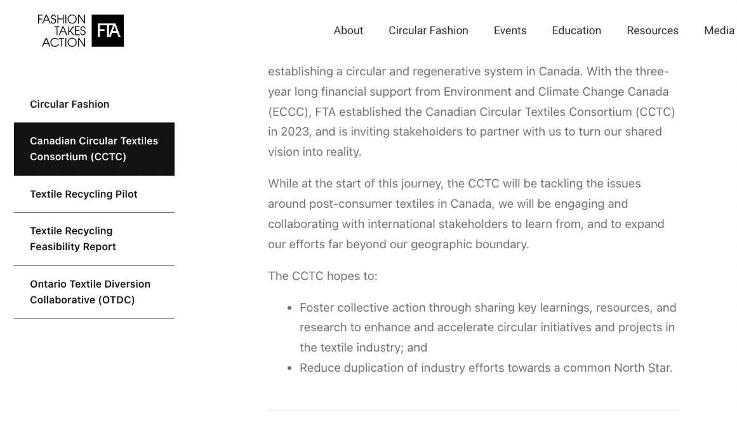
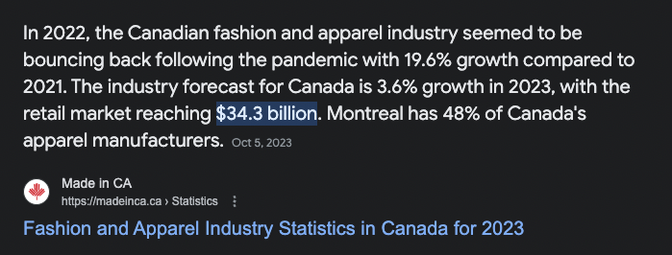
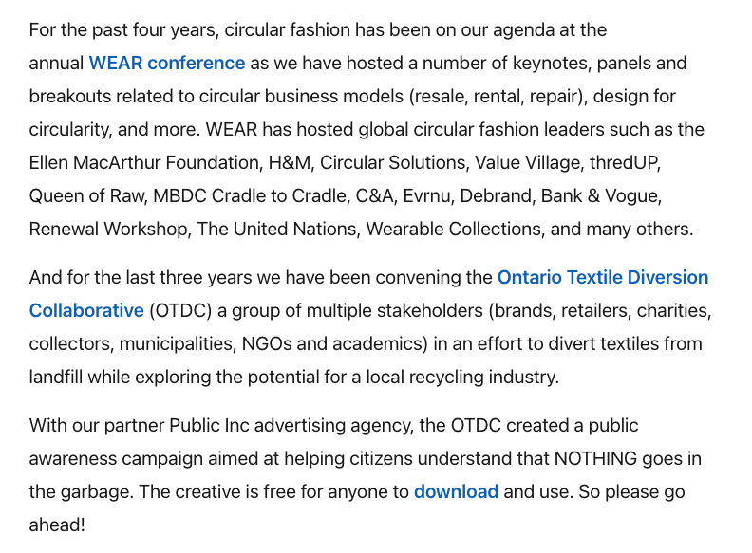
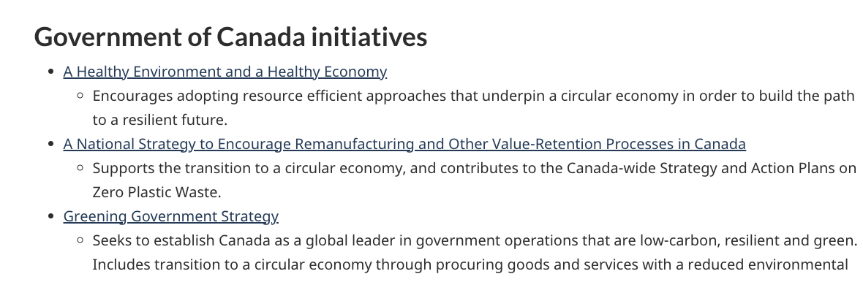
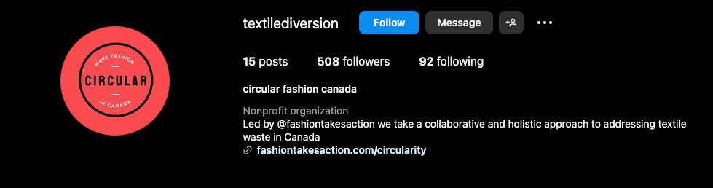
WHY CANADA
Canada is uniquely positioned to be an ideal foundational market because:
Strong support for circular economy initiatives in the form of groups and organisations (CCTC, FTA, OTDC)
Government initiatives aim to make Canada a circular economy beacon
Already a strong fashion designer base market and expected industry growth
Already strong support for upcycling and recycling programs, thrift stores, and university collaborations

Slide 7

Join the sustainable fashion movement and reduce textile waste with
Syed Touhid & Team
November 2023

