Slide 1
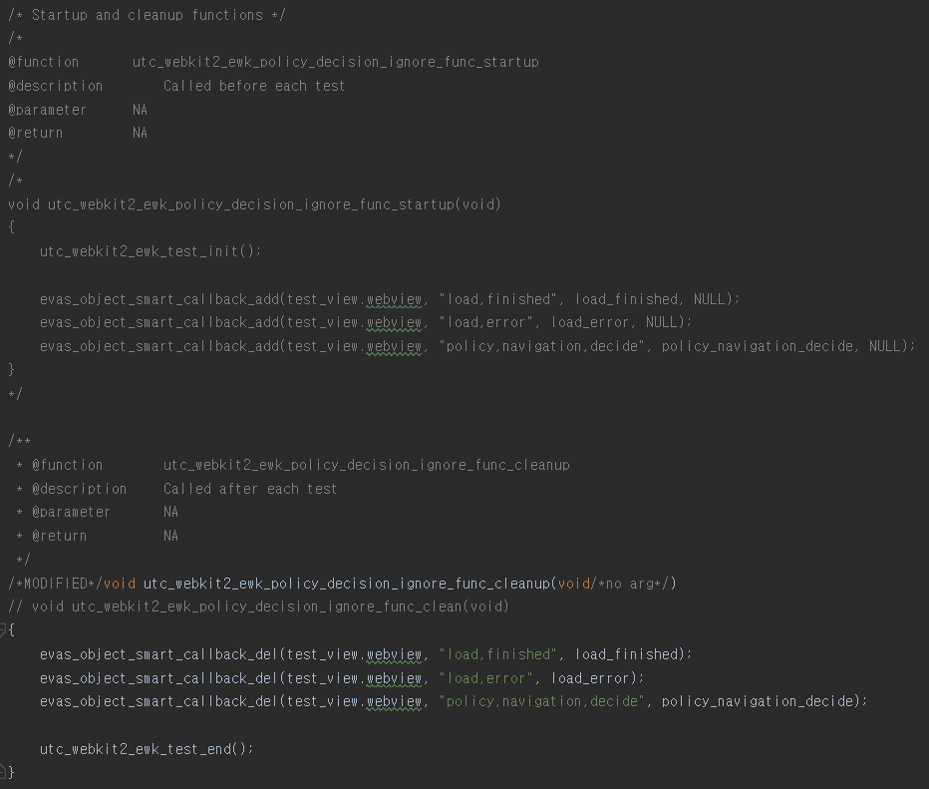
Antlr4 in a nut-shell for identifying test cases Some person says “It is a trivial thing to count or identify test cases”. They says “Just use the grep tool and I have done it at previous projects” irresponsibly. Is it possible t do that for the below example only with the grep tool so easily? Make a bet on this ! I’ll do that on ‘impossible’
This document shows how to define a set grammar rules
especially for pre-processing tasks in order to win the bet

Slide 2
Basic Concept & Usage
refer to readme.md
in the com.samsung.tcm.analysis or com.samsung.tcm.core.parser package

Slide 3
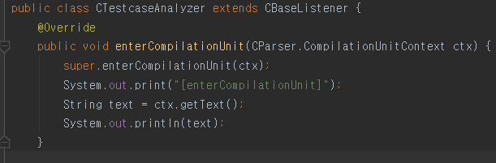
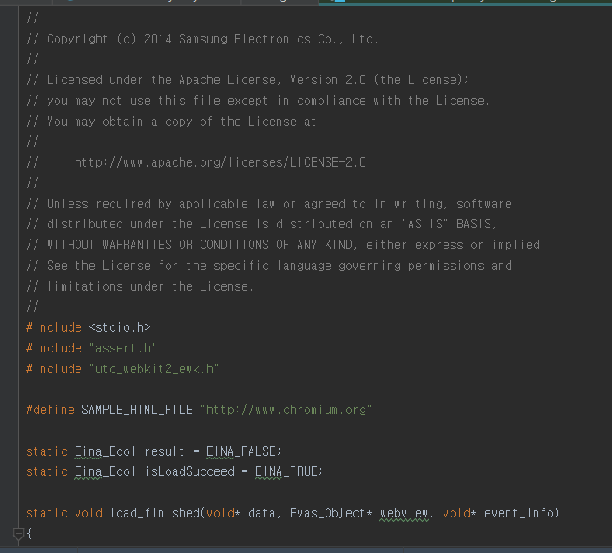
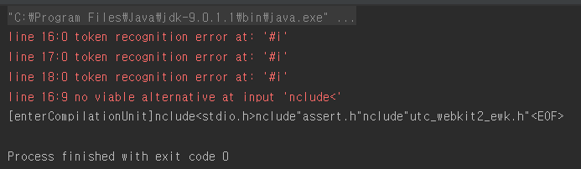
Current Problems @ C Language
① No rule for directive statements exists in C.g4
[A Simple Parser : Print out root node of parse tree]
[A Test Case File : Tizen EFL Unit Test]
You might expect
all the source code string
@ the root of the parse tree
[A Simple Parser Result : Parse Error → Stop Parsing]
Stop parsing @18 line
Parsing Errors
all the parsing unit that this parse recognizes

Slide 4
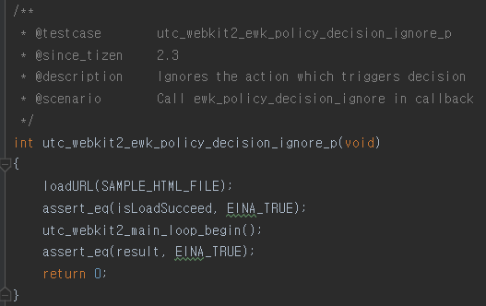
Current Problems @ C Language
① No rule for directive statements exists in C.g4
Why does this happen?
It is not possible to do the below tasks without these rules
Task-b.
Extract meta information from comments
Task-a.
Identify test case functions written in c language
due to parse errors

Slide 5
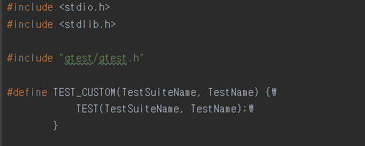
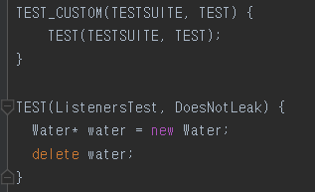
Current Problems @ C Language
① No rule for directive statements exists in C.g4
Why?
It is not possible to do the below tasks without these rules
Though this is a c++ example not the c,
it would be helpful for you to get feeling.
I added this intentionally for this purpose
Task-c.
Identify test case macros written in user-defined macro

Slide 6
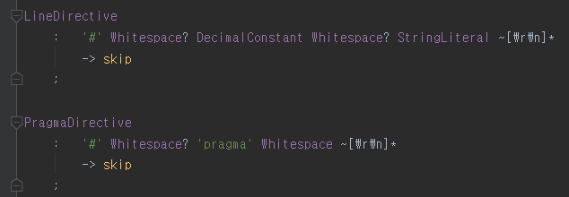
A Possibly Honest Solution : Define Required Grammar Rules
https://en.wikibooks.org/wiki/C_Programming/Preprocessor_directives_and_macros
Directives in the C languages
line directive
C.g4 contains rules for these
program directive
include directive
define directive
error directive
warning directive
We have to add rules for these, because the C.g4 does not handle this
undef directive
conditional directive
together with
comment blocks
ifdef/ifndef directive

Slide 7
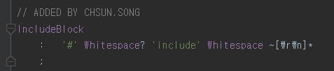
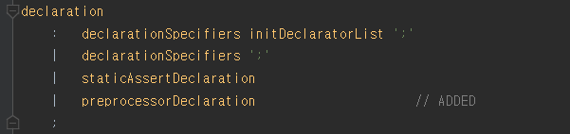
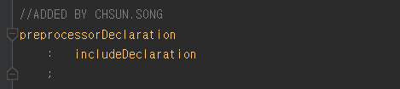

A Possibly Honest Solution : Define Required Grammar Rules
For the include directive,
ⓐ for the future use, it would be good to handle this directive node at the parser
ⓑ in order to do this, we have to two rules : a lexer rule and a parser rule
add ‘preprocessorDeclaration’ as
another type of declaration
[Rule for lexical analysis]
[Rule for semantic analysis]
when meeting this char sequence satisfying this rule,
we call this token as ‘IncludeBlock’
we consider the ‘IncudeBlock’ token itself is
a declaration statement. And we categorize
this declaration as ‘precprocessorDeclaration’

Slide 8
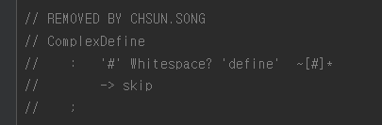

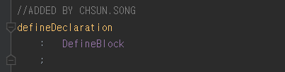
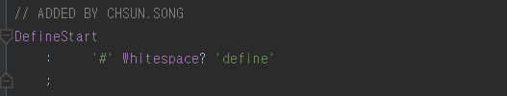
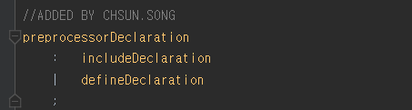
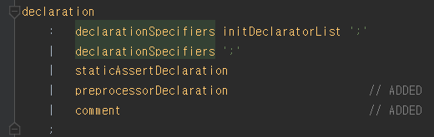

A Possibly Honest Solution : Define Required Grammar Rules
For the define directive,
additionally comment out an existing rule
ⓐ for the future use, it would be good to handle this directive node at the parser
ⓑ in order to do this, we have to two rules : a lexer rule and a parser rule
[Rule for lexical analysis]
[Rule for semantic analysis]
In order to handle multi-line define statements,
I split into two tokens : staring block and its body. For example,

Slide 9
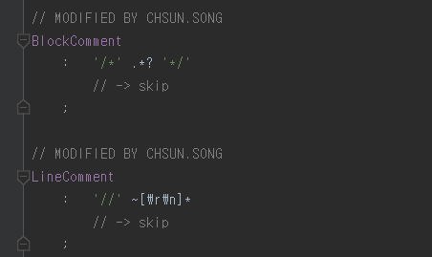

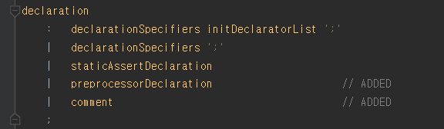
A Possibly Honest Solution : Define Required Grammar Rules
Additionally, for the comments,
ⓐ we need to extract meta information from comments
ⓑ in order to do this, we have to two thing : modification of lexer rule , addition of a parser rule
[Rule for lexical analysis]
[Rule for semantic analysis]
define comment as a parse tree node
remove skip so as to toss this token information to parser
add comment node as one of declaration types

Slide 10
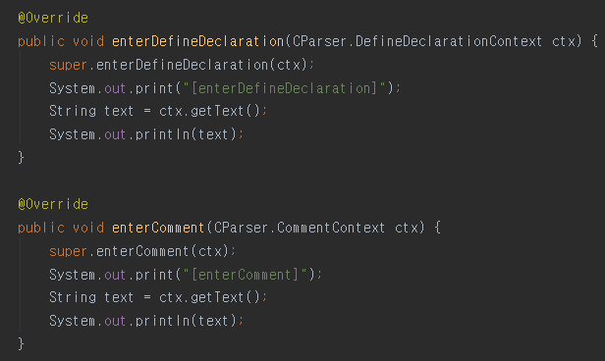
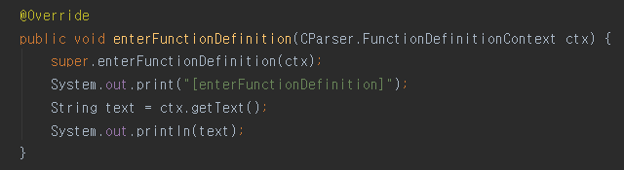
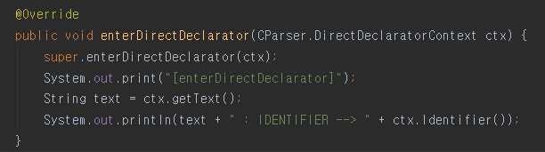
A Possibly Honest Solution : Define Required Grammar Rules
If all the previous threes are performed successfully,
ⓐ it is able to generate C parser and related stuffs such as listener, lexer, etc.
ⓑ it is able to develop test case analyzer with the generated listener
[New listener functions added by our C.g4 modification]
[Listener functions originally given]

Slide 11
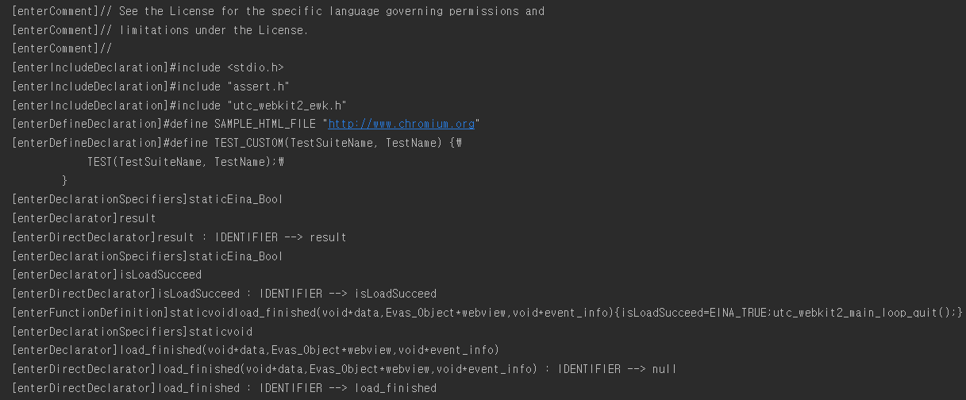
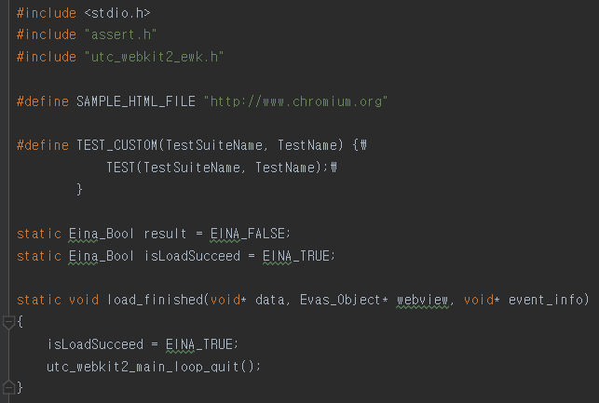
A Possibly Honest Solution : Define Required Grammar Rules
[Output from an simple analyzer example]

Slide 12
A Possibly Honest Solution : Define Required Grammar Rules
If all the previous threes are performed successfully,
ⓐ the errors shown at the first page are gone
ⓑ possibly able to extract our required information only if other remaining directives are not used
No More Previous Parsing Error !!!
Stop parsing @18 line
Parsing Errors
all the parsing unit that this parse recognizes
Really No Error In The Future ?? No Way !!!

Slide 13
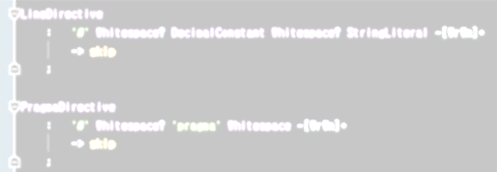
A Possibly Honest Solution : Define Required Grammar Rules
https://en.wikibooks.org/wiki/C_Programming/Preprocessor_directives_and_macros
Directives in the C languages
line directive
C.g4 contains rules for these
program directive
include directive
define directive
error directive
This is the reason of ‘No Way!!!’
The parser is gonna be die when meeting these statements.
We need to handle these directive statements.
Because we do not want to extract information from these,
it’s enough to skip all these five directives!
warning directive
We have to add rules for these, because the C.g4 does not handle this
undef directive
conditional directive
ifdef/ifndef directive
comment blocks

Slide 14
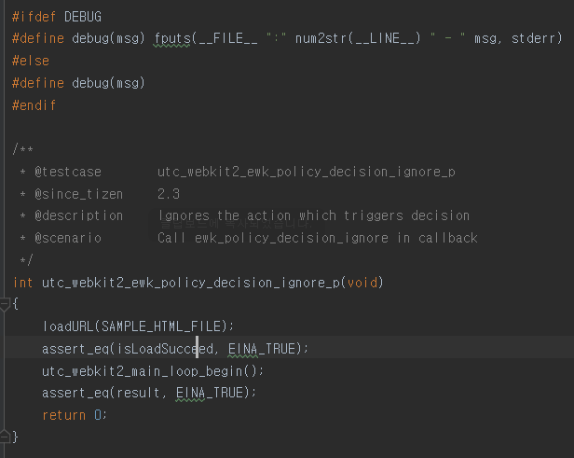
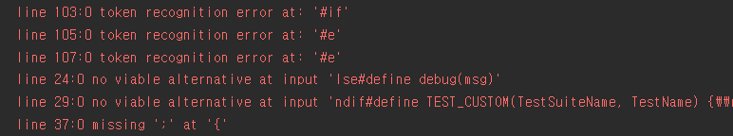
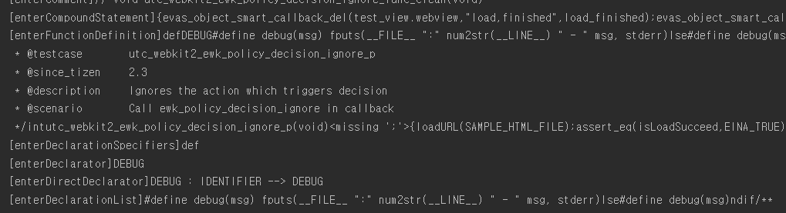
A Possibly Honest Solution : Define Required Grammar Rules
Parse Error !!
Totally Wrong!!

Slide 15
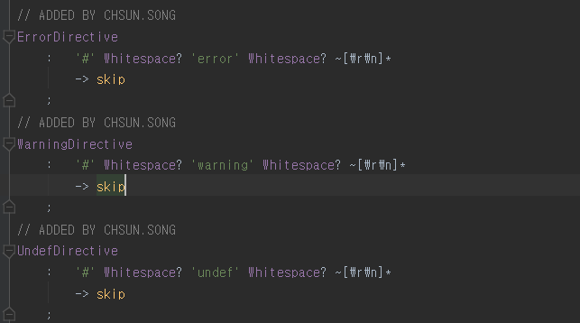
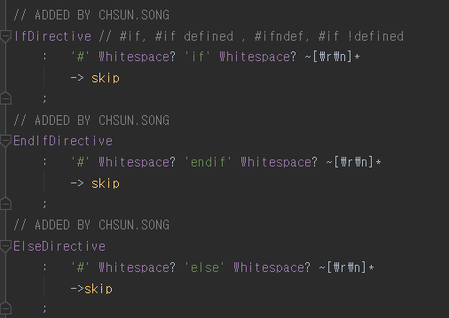
A Possibly Honest Solution : Define Required Grammar Rules
In order to save parser,
ⓐ define lexer rules for all the remaining directives and ignore them
[Ignoring rules for directives]
[Ignoring rules for directives]

Slide 16
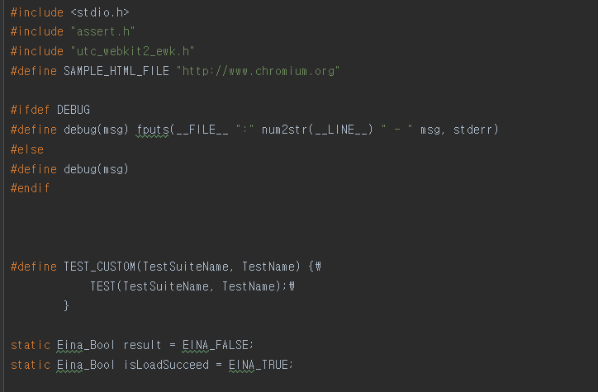
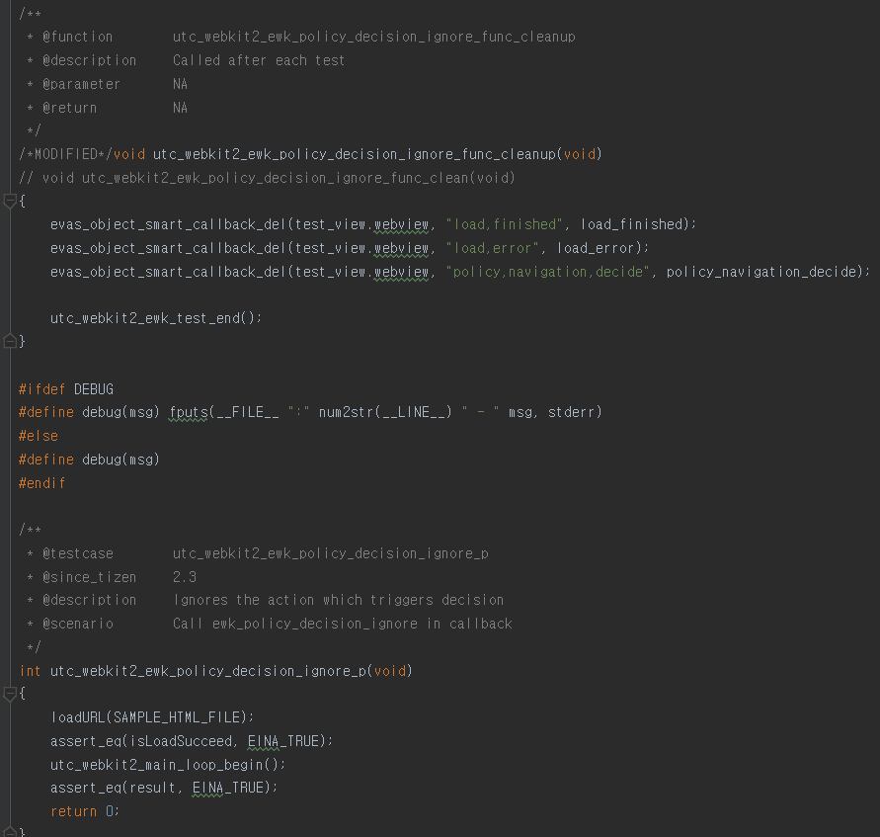
A Possibly Honest Solution : Define Required Grammar Rules
The previous error was because of this!!

Slide 17
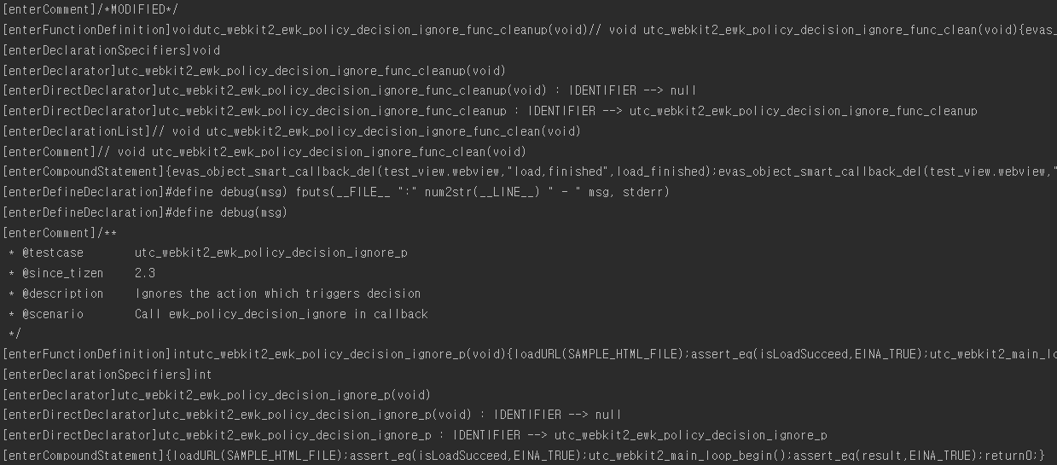
A Possibly Honest Solution : Define Required Grammar Rules
Now .. perform parsing successfully

Slide 18
For The Other Languages
If a pre processor parser is prepared by Antlr4,
you can do these using the preprocess parser (e.g., C#)
However, the preprocess parser is not given,
you must follow the guide in this document.
But there are so many possible approaches to handle these kinds of issues.
For example, you can define your own g4 files only for pre-processing, etc.

