Slide 1
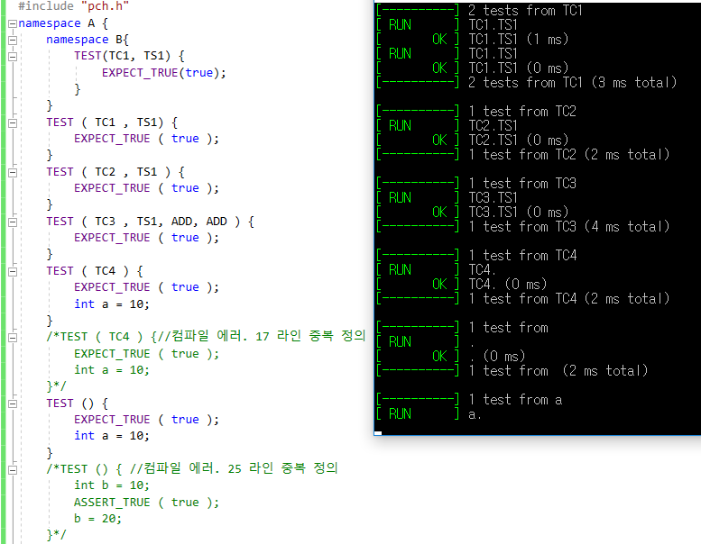

Slide 2
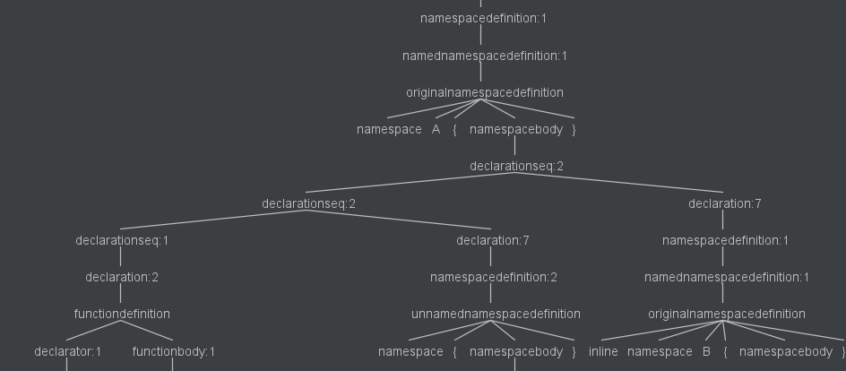

Slide 3
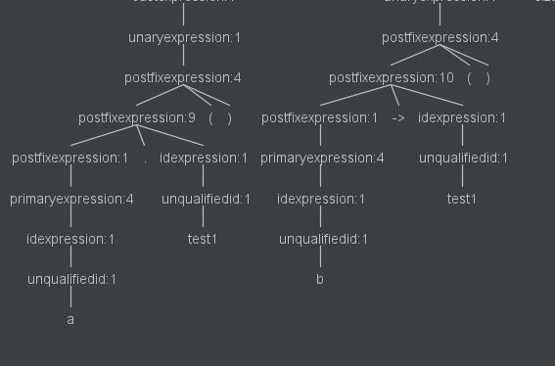
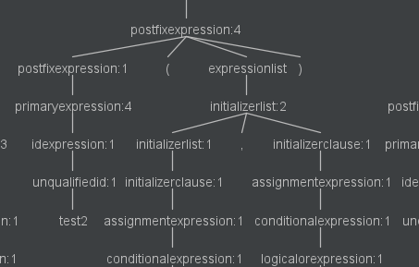
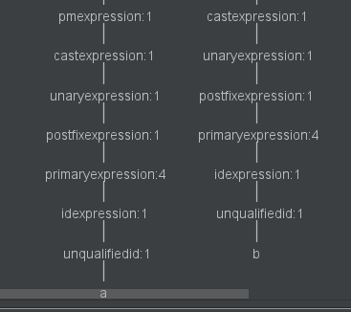
a.test1();
b->test1();
test2(a,b);

Slide 4
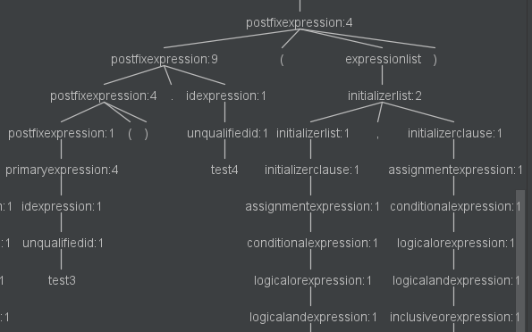
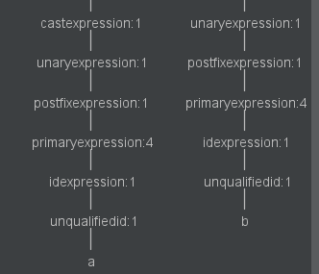
test3().test4(a,b);

Slide 5
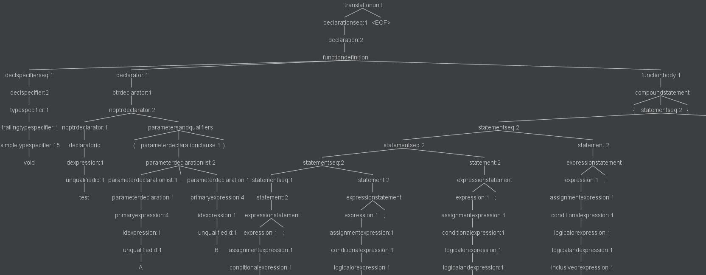

Slide 6
“해결 문제"
함수 호출 구문의 대상 함수의 이름과 파라미터 개수를 구하라

Slide 7
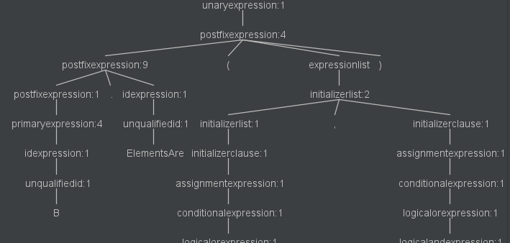
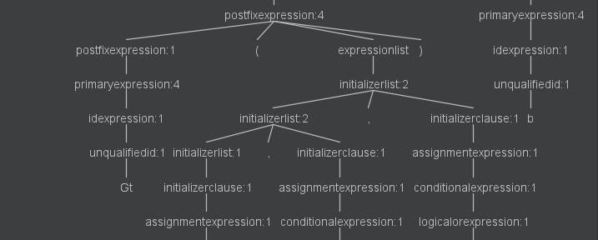
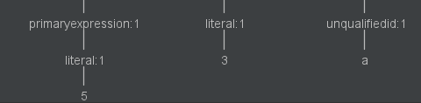
B.ElementAre( Gt( 1, 3, a), b )
덮어쓰기

Slide 8
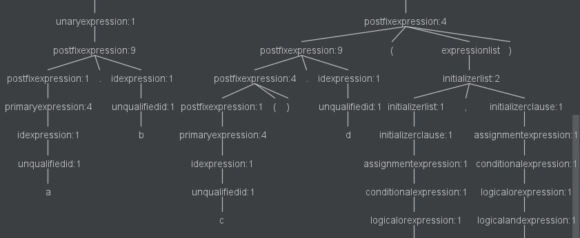
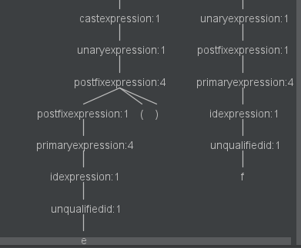
a.b>c().d(e(), f);

Slide 9
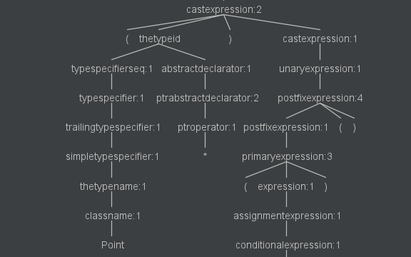
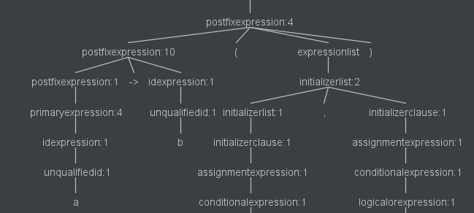
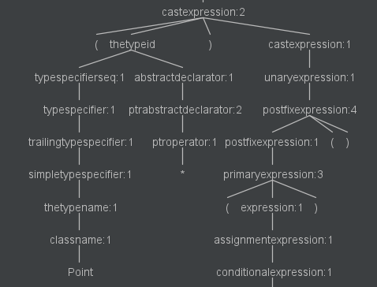
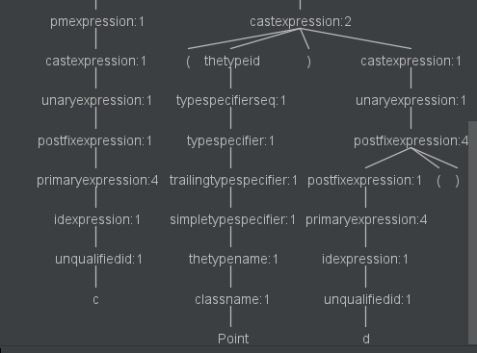
(Point*)(a->b(c, (Point)d()))();

Slide 10
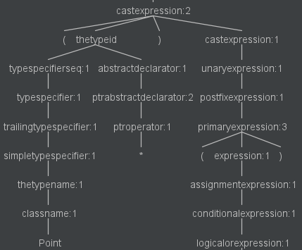
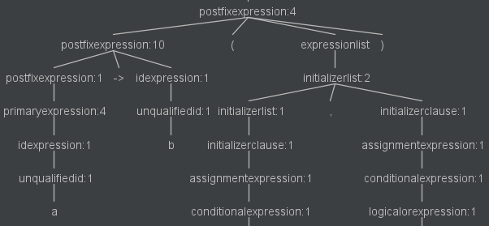
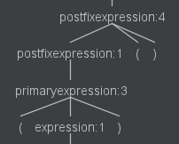
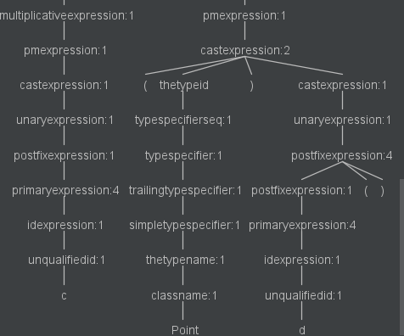
a → b
(Point*)((a->b(c, (Point)d()), e)());

Slide 11
postfixexpression
: primaryexpression
| postfixexpression '(' expressionlist? ')'
expressionlist
: initializerlist
;
initializerlist
: initializerclause '...'?
| initializerlist ',' initializerclause '...'?
;
initializerclause
: assignmentexpression
| bracedinitlist
;
bracedinitlist
: '{' initializerlist ','? '}'
| '{' '}'
;
assignmentexpression
: conditionalexpression
| logicalorexpression assignmentoperator initializerclause
| throwexpression
;
https://github.com/bkiers/Mu

Slide 12
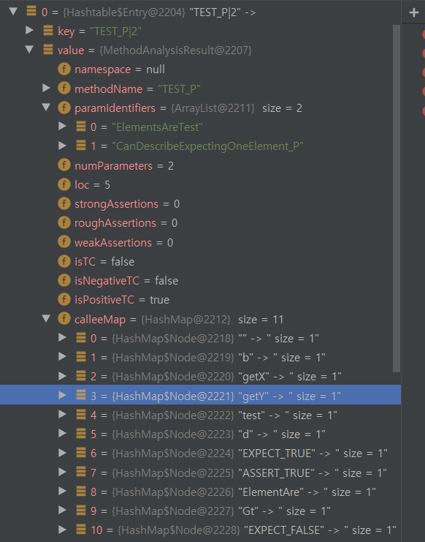
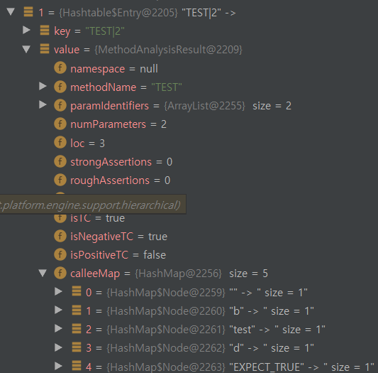

Slide 13
idexpression : unqualifiedid | qualifiedid ; unqualifiedid : Identifier | operatorfunctionid | conversionfunctionid | literaloperatorid | '~' classname | '~' decltypespecifier | templateid ;
operatorfunctionid : Operator theoperator ;
theoperator : New | Delete | New '[' ']' | Delete '[' ']' | '+' | '-' | '*' | '/' | '%' | '^'
conversionfunctionid : Operator conversiontypeid ;
conversiontypeid : typespecifierseq conversiondeclarator? ;
literaloperatorid : Operator Stringliteral Identifier | Operator Userdefinedstringliteral ;
classname : Identifier | simpletemplateid ;
simpletemplateid : templatename '<' templateargumentlist? '>' ;
templatename : Identifier ;
templateargumentlist : templateargument '...'? | templateargumentlist ',' templateargument '...'? ;

Slide 14
classname : Identifier | simpletemplateid ;
simpletemplateid : templatename '<' templateargumentlist? '>' ;
templatename : Identifier ;
templateargumentlist : templateargument '...'? | templateargumentlist ',' templateargument '...'? ;
templateargument : thetypeid | constantexpression | idexpression ;
typespecifier : trailingtypespecifier | classspecifier | enumspecifier ;
thetypeid : typespecifierseq abstractdeclarator? ;
typespecifierseq : typespecifier attributespecifierseq? | typespecifier typespecifierseq ;
trailingtypespecifier : simpletypespecifier | elaboratedtypespecifier | typenamespecifier | cvqualifier ;

Slide 15
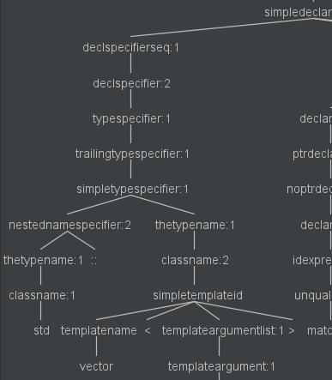
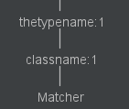
std::vector<Matcher> matchers{Ge(1), Lt(2)};
simpletemplateid : templatename '<' templateargumentlist? '>' ;
재귀적 선언이 지원되지 않는다..

