Slide 1
Our collaboration
① SR uses the CRUISE server at SRA
② by RESTful API set with json format payload
③ with a kind of API token
④ via HTTPS protocol
⑤ in order to use CRUISE’s paraphrase generation feature
for the auto evaluation of Bixby 2.0 capsule
main focus today
assuming that these will be shared later to SR

Slide 2
Objectives of discussion
Until now, most of all the requirements are reflected, though some of them are still being refined
전체
반영 확인
상세화 中
During this discussion,
The current requirements will be refined into a kind of detail design
Additional detail requirements will be elicited and refined into a rough design
Deliverables will be defined
Delivery schedule will be defined
Long term collaboration plan (2~3 years) will be roughly defined

Slide 3
Discussion points
Bixby
Server
CRUISE
Server
Auto Evaluation
System
A pair (utterances vs its generated paraphrases) set is stored
A subset(unused paraphrases) of the pair is kept unused for the capsule training augmentation
The unused paraphrases is retrieved by a query from the auto evaluation system
Utterance Extraction
5 - Talking Points
Paraphrase
Generation I/F
Utterance
Relation DB
① Search existing paraphrases
Search Exists
② Set-up mode & its required input
Generate News
Stack Driver
Logs
Paraphrase
Generation
③ Pruning steps
④ Variation Types
CES
(capsule execution service)
⑤ Get generated paraphrases
Testing
CES Test Client & Stack Driver

Slide 4
[Use Case] Searching existing paraphrases
Test engineers use previously generated paraphrases if any for a given utterance
During generating utterances for the ‘In Capsule NLU’ ,
Some of the generated utterances are kept unused for training for the evaluation.
The keep-ratio can be configured outer-side of system and defined by discussion and experiments
SRA 문서에
발췌
In Capsule NLU

Slide 5
[Discussion] ① Search existing paraphrases
Request
Method & URL
GET https://{server address}/paraphrases/
Header
Content-Type : application/json
Authorization : {API Access Token}
Body
{ // each search criteria item is combined with ‘OR’
“search_criteria” : [
{ // each criteria attribute is logically combined with ‘AND’
“input_utterance” : {a string value denoting a utterance text to be paraphrased} ,
“intent” : {a string value denoting an intent of this utterance (a goal for Bixby 2.0) },
“annotation” : [
{
“slot” : {an integer value denoting the order-index on which this annotation is placed. This index starts with zero.} ,
“parameter” : {a string value denoting an attribute ( a concept for Bixby 2.0)} ,
“value” : {a string value expressing an instance for the parameter}
}, // …. array
] ,
“variation_type” : {a string value denoting a variation type}
}
, // …. array
] // end of array
}
① VERB_REPLACEMENT, ② TO_STATEMENT, ③ TO_AUX_QUESTION , ④TO_ WH_QUESTION,
⑤ TO_ NORMAL_QUESTION, ⑥ POSSIBLY_ALL

Slide 6
[Discussion] ① Search existing paraphrases
Response
Body
To be defined
{
“paraphrases” : [
{
“input_utterance” : {original utterance for this paraphrase} ,
“paraphrase” : {paraphrased utterance text} ,
“variation_type” : {variation type that is applied to generate this paraphrase} ,
“goal” : {Bixby 2.0 format goal for this paraphrased utterance} ,
“value-set” :
[
{
“slot_index” : {the order index on which this annotation is tagged on the utterance sentence, This index starts with zero.} ,
“parameter” : “{Bixby 2.0 parameter string for the paraphrase}” ,
“value” : “{value string for the parameter}”
}
, …
] // an array of value-set
} // a paraphrase object
, …
] // an array of paraphrase set
}

Slide 7
[Discussion] ① Search pre-generated/existing paraphrases
Error Code
Body
To be defined
{
error_code : “{proper error code for each context}”
}
① Invalid Input Argument, ② Not Found Paraphrase, ④ Not Supported Yet

Slide 8
[Use Case] Creating paraphrases by test engineer
Test engineers create paraphrases following three steps :
They set a generation mode, variation type, and utterances for an paraphrase iteration
During an paraphrasing iteration, they filter out unwanted suggestions given by the CRUISE
After an iteration, they get fully annotated and filled paraphrases
Setup
Generation mode : without-expansion or with-expansion
A variation type
An input utterance : utterance-text, goal, tagging-parameter and its value
Auxiliary utterances grouped as the same goal with the input utterance (only for without-exp. mode)
Auto
Evaluation Sys
CRUISE
Server
Iteration Begin
Pruning loop
Request suggestions
Pruning
Suggest interim list
Choose & filter-out
Iteration End
filling
If needed
Get Result

Slide 9
[Use Case] ② Setup mode & its required input
Test engineers use the ‘without-expansion’ to paraphrase a input utterance only with the context in their giving utterances :
auxiliary utterances (whose goal is same with the input utterance) are given together with an input utterance
generates paraphrases using attributes and their instances (i.e., Bixby concepts and values) in the given utterances
generates paraphrases only through the utterance combination step together with filling blanks
a variation type is given to denote a paraphrasing predicate
Input utterance example in a real capsule
Auxiliary utterance example in a real capsule
Paraphrase example in a real variation
A variation type example

Slide 10
[Discussion] ② Setup mode & its required input
Request
Method & URL
POST https://{server address}/paraphrases/settings
Header
Content-Type : application/json
Authorization : {API Access Token}
Body
{
“input_utterance” : {
“utterance” : {a string value denoting an utterance text} ,
“intent” : “{a string value denoting an intent of this utterance (a goal for Bixby 2.0)}”,
“annotation” : [
{
“slot” : {an integer value denoting the order-index on which this annotation is placed. This index starts with zero.} ,
“parameter” : “{a string value denoting an attribute ( a concept for Bixby 2.0)}” ,
“value” :”{a string value expressing an instance for the parameter}”
} , // … array
] // end of array
},
“generation_mode” : “without_expansion’” ,
“variation_type” : “{a string value denoting a paraphrasing predicate}” ,
① VERB_REPLACEMENT, ② TO_STATEMENT, ③ TO_AUX_QUESTION , ④TO_ WH_QUESTION,
⑤ TO_ NORMAL_QUESTION, ⑥ POSSIBLY_ALL

Slide 11
[Discussion] ② Setup mode & its required input
Request
Body (continued)
“auxiliary_utterances” : [
{
“utterance” : {a string value denoting an utterance text} ,
“intent” : “{a string value denoting an intent of this utterance (a goal for Bixby 2.0)}” ,
“annotation” : [
{
“slot” : {an integer value denoting the order-index on which this annotation is placed. This index starts with zero.} ,
“parameter” : “{a string value denoting an attribute ( a concept for Bixby 2.0)}” ,
“value” :”{a string value expressing an instance for the parameter}”
} , // … array
]
} , // … array
] // end of array
} //end of body

Slide 12
[Discussion] ① Search pre-generated/existing paraphrases
Error Code
Body
To be defined
{
error_code : “{proper error code for each context}”
}
① Invalid Input Argument, ② Not Found Paraphrase, ④ Not Supported Yet

Slide 13
[Use Case] ② Setup mode & its required input
Test engineers use the ‘with-expansion’ to paraphrase a utterance with context not in the input utterance :
only an input utterance is given (no auxiliary utterances is given)
generates paraphrases through the iterations together with knowledge construction and filling the placeholders : knowledge construction → utterance expansion → utterance combination → utterance paraphrasing → filling blanks
a variation type is given to denote a paraphrasing predicate
Need all the steps
from the KB construction ??

Slide 14
[Discussion] ② Setup mode & its required input
Request
Method & URL
POST https://{server address}/paraphrases/settings
Header
Content-Type : application/json
Authorization : {API Access Token}
Body
{
“input_utterance” : {
“utterance” : {a string value denoting an input utterance to be paraphrased} ,
“intent” : {a string value denoting a Bixby 2.0 goal for this utterance} ,
“annotation” : [
{
“slot” : {an integer value denoting the order-index on which this annotation is placed. This index starts with zero} ,
“parameter” : {a string value denoting an attribute for this slot (a concept for Bixby 2.0)} ,
“value” : {a string value denoting an instance for this attribute (a value for Bixby 2.0)}”
}, // …. array
]
},
“generation_mode” : “with_expansion” ,
“variation_type” : “{a string value denoting a paraphrasing predicate}”
} // end of body
① VERB_REPLACEMENT, ② TO_STATEMENT, ③ TO_AUX_QUESTION , ④TO_ WH_QUESTION,
⑤ TO_ NORMAL_QUESTION, ⑥ POSSIBLY_ALL

Slide 15
[Discussion] ② Setup mode & its required input
Response
Header
To be defined
Content-Type : application/json
Authorization : {API Access Token}
Body
{
}

Slide 16
[Discussion] ② Setup mode & its required input
Error Code
Body
To be defined
{
error_code : “{proper error code for each context}”
}
① Invalid Input Argument, ② Not Found Paraphrase, ④ Not Supported Yet

Slide 17
[Use Case] ③ Iterations for paraphrasing
Test engineers do iterations using a set of APIs
They begin its iteration by invoking a creating iteration API
During the created iteration, they repeat the below steps for pruning:
they get suggestions from the CRUISE server by invoking request suggestion API
they choose some of the suggestions and denote their choice by invoking choose suggestion API
They denote a completion of generating paraphrase set by invoking a deleting iteration API
Invocation of the deleting iteration API does not mean deleting the iteration results

Slide 18
[Discussion] ③ Iterations for paraphrasing
Create Iteration API
Method & URL
Request
CREATE https://{server address}/paraphrases/iteration
Header
Authorization : {API Access Token}
Response
To be defined
200 OK
400 Bad Request

Slide 19
[Discussion] ③ Iterations for paraphrasing
Delete Iteration API
Method & URL
Request
DELETE https://{server address}/paraphrases/iteration
Header
Authorization : {API Access Token}
Response
To be defined
200 OK
400 Bad Request

Slide 20
[Discussion] ③ Iterations for paraphrasing
Request Suggestion API
Method & URL
Request
GET https://{server address}/paraphrases/iteration
Header
Authorization : {API Access Token}
Body
Response
{
“interims” : [
“utterance” : {a string denoting paraphrased utterance text} ,
“utterance_id” : {an integer value , unique in this response, denoting key to this utterance}
“intent” : “{Bixby 2.0 goal string same with the input utterance’s one. this is auxiliary information}” ,
“value-set” : [
{
“slot” : {an integer value denoting the order-index on which this annotation is placed. This index starts with zero} ,
“parameter” : {a string value denoting an attribute for this slot (a concept for Bixby 2.0)} ,
“value” : {a string value denoting an instance for this attribute (a value for Bixby 2.0)}”
}, // … array
] // end of array
] // end of array
}

Slide 21
[Discussion] ③ Iterations for paraphrasing
Choose Suggestion API
Method & URL
POST https://{server address}/paraphrases/iteration
Header
Authorization : {API Access Token}
Response
{
“utterance_ids” : {an set of integer values denoting utterances that is chosen by test engineers}
}

Slide 22
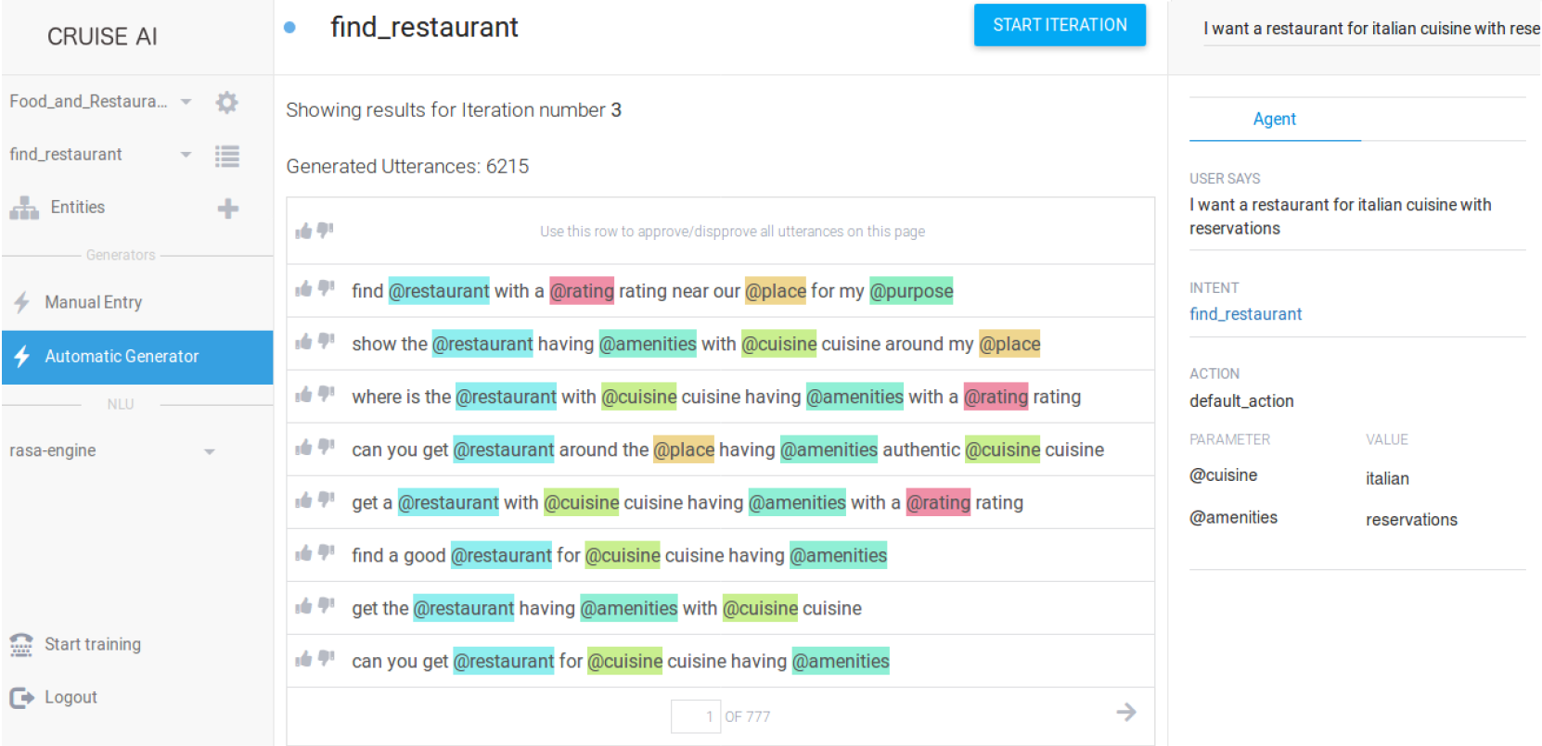
[Discussion] ④ variation types – quality and quantity
Provide high-usability with utterance prioritization for large volume of generated utterances
the below example implies “users have to choose 2,000 from 6,125 x 2,000” at maximum
(* capsule is able to have 2,000 utterances at maximum)
paraphrased into 6,125 utterances

Slide 23
[Discussion] ④ variation types – quality and quantity
A prioritization can be a possible approach to resolve this
From the testing view point, the prioritization need to consider coverage and effectiveness
Good Test Suite
Follows
Variation Guide
Test Coverage
Lexical Diversity
In One Variation Type
Prioritization
Algorithm
Semantic Similarity
Test Effectiveness
Usage Statistics
@ Market
※ if possible to use usage log and failure review result from ViV

Slide 24
[Use Case] ⑤ getting generations
Test engineers can get paraphrasing result only after finishing iteration steps
They get the result by invoking a get result API

Slide 25
[Discussion] ⑤ getting generations
Get Result API
Method & URL
Request
GET https://{server address}/paraphrases/iteration
Header
Authorization : {API Access Token}
Body
Response
{
“finals” : [
“utterance” : {a string denoting paraphrased utterance text} ,
“utterance_id” : {an integer value , unique in this response, denoting key to this utterance}
“intent” : “{Bixby 2.0 goal string same with the input utterance’s one. this is auxiliary information}” ,
“value-set” : [
{
“slot” : {an integer value denoting the order-index on which this annotation is placed. This index starts with zero} ,
“parameter” : {a string value denoting an attribute for this slot (a concept for Bixby 2.0)} ,
“value” : {a string value denoting an instance for this attribute (a value for Bixby 2.0)}”
}, // … array
] // end of array
] // end of array
}

Slide 26
[Plan] Deliverables & Schedule

Slide 27
[Additional] For The Next …
Is it possible to provide the below features ?
Automatic annotation into a unannotated utterance with existing training utterances for a goal in a capsule
Is there any chance to try to use current version of CRUISE?
It is hard to infer whole detail features of CRUISE only with papers.
Language expansion plan is needed if this approach is successful
Does your internal plan have this ?
Can you share stuffs at code level ?

Slide 29
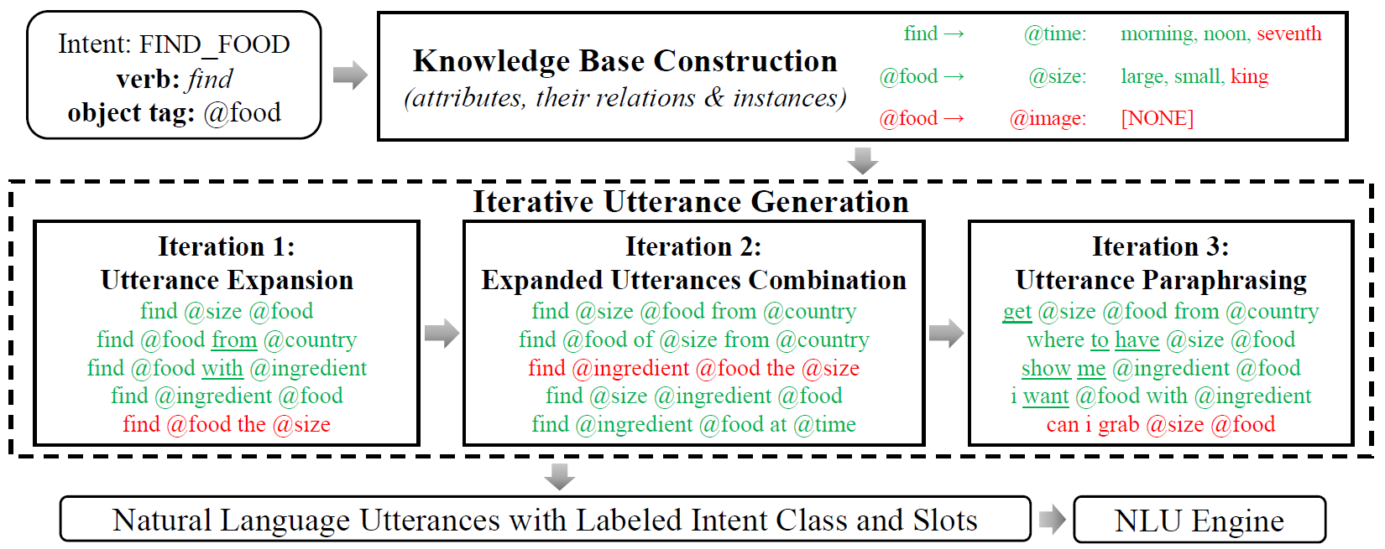
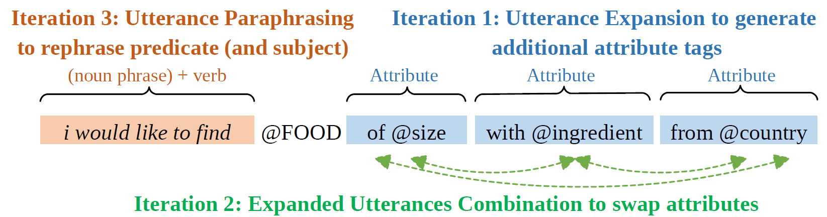
Cold Start
Need this mode in SR ?

Slide 30
