Slide 1

Top Gen AI Advances: CW23, 2026

Slide 2

01
KNOWLEDGE-WORK AUTOMATION / DEVELOPER-ADJACENT PRODUCTIVITY
OpenAI expands Codex beyond coding into knowledge work
What changed
Role-specific Codex plugins, Sites, and in-place annotations extend Codex into reports, dashboards, internal apps, presentations, contracts, and workflow automation.
5M+
20%
weekly users
knowledge workers
Enterprise relevance
AI coding infrastructure is moving into broader productivity and internal-tool creation.
reports
dashboards
internal apps
workflows
Source: CW23 internal briefing; OpenAI
1/5

Slide 3

02
OPEN MODEL / CODING MODEL / PRIVATE DEPLOYMENT
JetBrains Mellum2: open MoE model for code and enterprise AI systems
12B
2.5B
Apache 2.0
parameters
active per token
license
Where it fits
Designed for routing, RAG, summarization, sub-agents, high-throughput coding, and private deployment.
Enterprise relevance
A lower-latency, privately deployable option for software engineering and AI application pipelines.
Source: CW23 internal briefing; Hugging Face / JetBrains
2/5

Slide 4

03
AI FOR CLIMATE / OPEN-SOURCE RESEARCH / DISASTER RESILIENCE
Google open-sources hydrology framework for AI flood forecasting
Signal
Google Research open-sourced its hydrology modeling framework on 03 Jun 2026 to help national meteorological and hydrological services integrate AI flood forecasting into workflows.
Why it matters
A strong AI-for-good example: applied research that gives responders more time to act during climate resilience events.
Frontline
response workflows
Source: CW23 internal briefing; Google Research
3/5

Slide 5
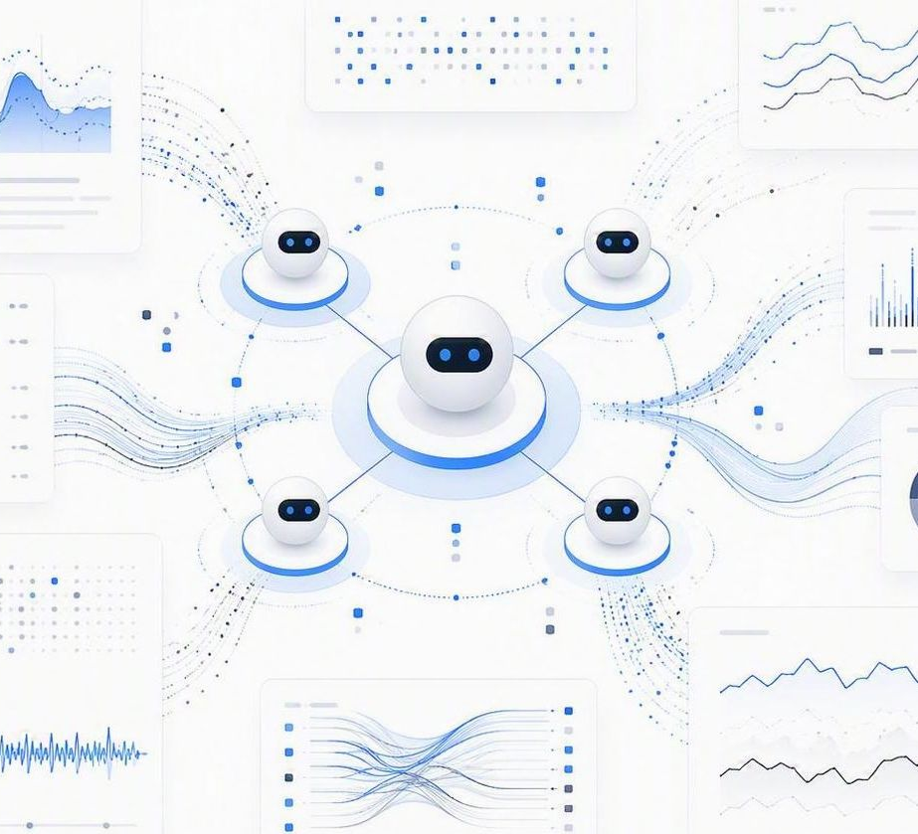
04
FUNDING / AI OBSERVABILITY / ENTERPRISE INFRASTRUCTURE
Coralogix raises $200M to build the monitoring layer for AI systems
$200M
$1.6B
new funding
post-money valuation
Market signal
As AI agents and AI-powered software move into production, enterprises need observability, incident response, reliability tracking, and operational control.
Enterprise relevance
AI observability is becoming core infrastructure for autonomous systems at scale.
Source: CW23 internal briefing; TechCrunch
4/5

Slide 6
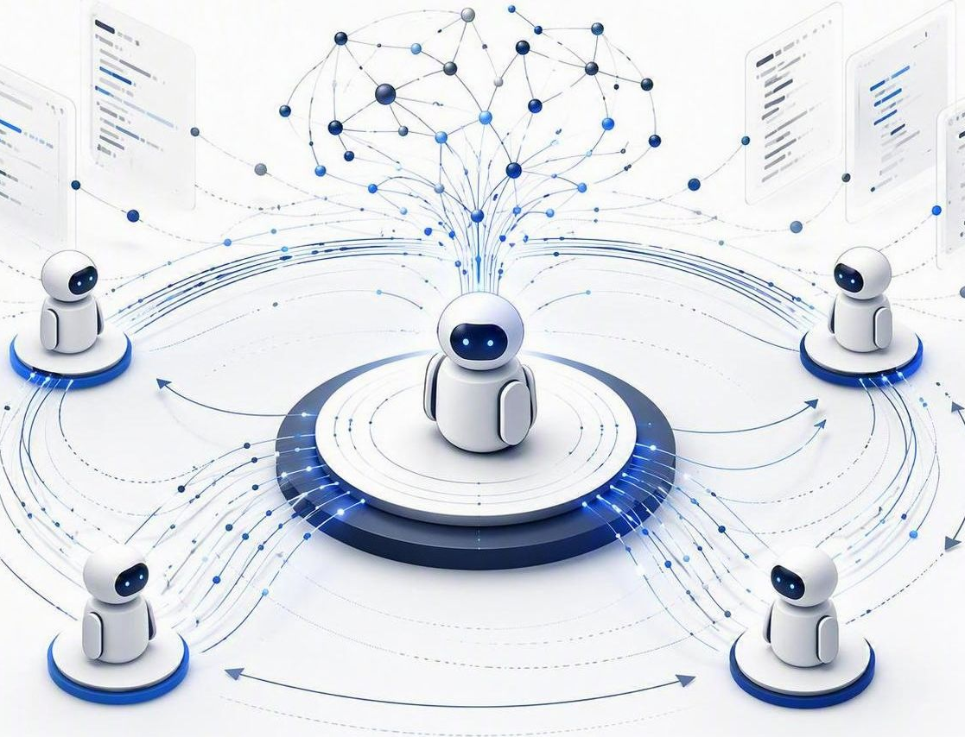
05
ACADEMIC RESEARCH / SOFTWARE ENGINEERING AGENTS / AI TRAINING METHODS
Socratic-SWE points toward self-evolving coding agents
Research direction
The arXiv paper proposes a closed-loop method where coding agents reuse historical solving traces as training signal, learning from failures, weaknesses, and progress.
Enterprise relevance
Future software-engineering agents may improve through production-like experience instead of relying only on fixed synthetic tasks.
Trace
Skill
Agent
historical paths
derived training
next task
trace reuse · closed-loop learning · agent skills
Source: CW23 internal briefing; arXiv
5/5

