Slide 1



AirPulse Global
Environmental Intelligence & Personalized Action Platform

Slide 2






Vision: From Data to Awareness
Accessible Intelligence
Personalization
Sustainability
Transforming complex air quality data into clear, actionable insights that everyone can understand in seconds.
Moving beyond general reports to provide tailored health advice based on your exact location and wind context.
Acting as a catalyst by turning "monitored problems" into "personal solutions" through carbon footprinting.

Slide 3


The Problem & Opportunity
Why AirPulse exists — transforming raw environmental data into everyday decisions
01 Fragmented data
02 Technical complexity
03 Low actionability
Air quality data exists across public feeds, station networks and weather APIs, but users rarely see one coherent picture.
AQI and pollutant metrics are often difficult to interpret without scientific context or health guidance.
People may know the number, but they often do not know whether to exercise, commute differently, or protect indoor air.
AirPulse Opportunity
Convert monitored problems into personalized, location-aware climate and health actions.
Originally designed around Istanbul’s dense urban air-quality network, AirPulse evolved into a global environmental intelligence platform with scalable data ingestion, forecasting and export-ready reporting.
Istanbul foundation
Global scaling
Personal action layer
Decision support

Slide 4
Platform Flow & User Journey
A complete journey from city-level awareness to measurable personal action
1
Search City
2
View AQI
3
Explore Stations
4
Check Forecast
5
Act & Export
User selects any city or station to establish local context.
Dashboard translates pollutant readings into a clear health status.
Map reveals neighborhood-level hotspots and station variation.
Predictive module estimates short-term pollutant movement.
Health advice, CO₂ savings, checklist and reports close the loop.
Value Chain
Live Data → Environmental Intelligence → Personalized Recommendation → Behavioral Impact → Exportable Evidence
This flow positions AirPulse as a platform, not a single-purpose AQI dashboard.

Slide 5
System Architecture
Live source data is unified, enriched with wind context, then converted into forecast, analytics and export-ready user outputs.
Modular Data Pipeline
Inputs
WAQI live feed
Open-Meteo fallback
Tomorrow.io wind
Process
Normalize
merge sources
rank stations
Intelligence
Forecast
analytics
health guidance
Output
Dashboard
reports
CSV / JPEG / PDF

Slide 6
The Product Stack
Core technologies powering data ingestion, analytics, visualization and export-ready reporting.
Domain | Technology / Library | Strategic Role
Framework | Streamlit | High-speed reactive web application layer for dashboard interaction and session state.
Data Engineering | Pandas & NumPy | Data normalization, feature preparation and mathematical computation.
Visualization | Plotly & Folium | Interactive time-series charts and geographic station maps.
Reporting | ReportLab & Pillow | Dynamic PDF reports and social-ready image card generation.
Unified stack: live data → insight → action → export

Slide 7






Intelligence Integration
WAQI / AQICN
Tomorrow.io
Open-Meteo
Primary global feed for PM2.5, NO2, O3 readings and official station daily forecasts.
Real-time precision wind speed, direction, and gust data for dispersion context.
Global no-key fallback for dashboard overviews and auxiliary meteorological data.

Slide 8




Monitored Pollutants
PM2.5 / PM10
NO2 / SO2
O3 / CO
Particulate matter linked to lung health, visibility, and construction/combustion activities.
Gaseous pollutants primarily sourced from traffic emissions and industrial processes.
Ground-level ozone (smog) and carbon monoxide from incomplete combustion.

Slide 9

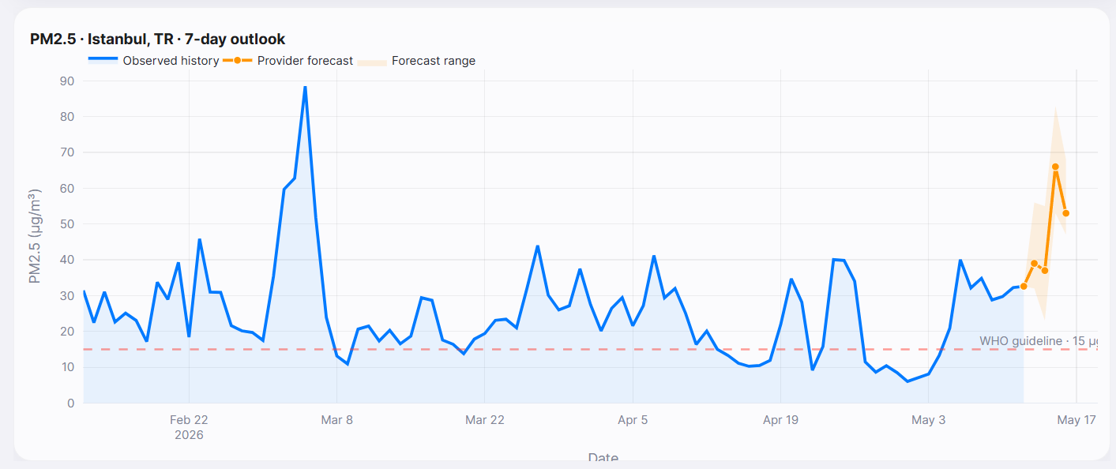
Predictive Intelligence
Forecasting Strategy & Validation
Official WAQI daily forecast is used first.
If upstream coverage is missing, AirPulse falls back to a conservative time-series estimate.
Offline PM2.5 champion: R² 0.77 and RMSE 16.27.
Cross-station benchmark: 8,236 rows with best sMAPE 18.9%.
Live validation store: 183 records collected; 49 already comparable to actuals.
Why this matters
The deck now shows both model logic and real evaluation evidence instead of a placeholder.

Slide 10


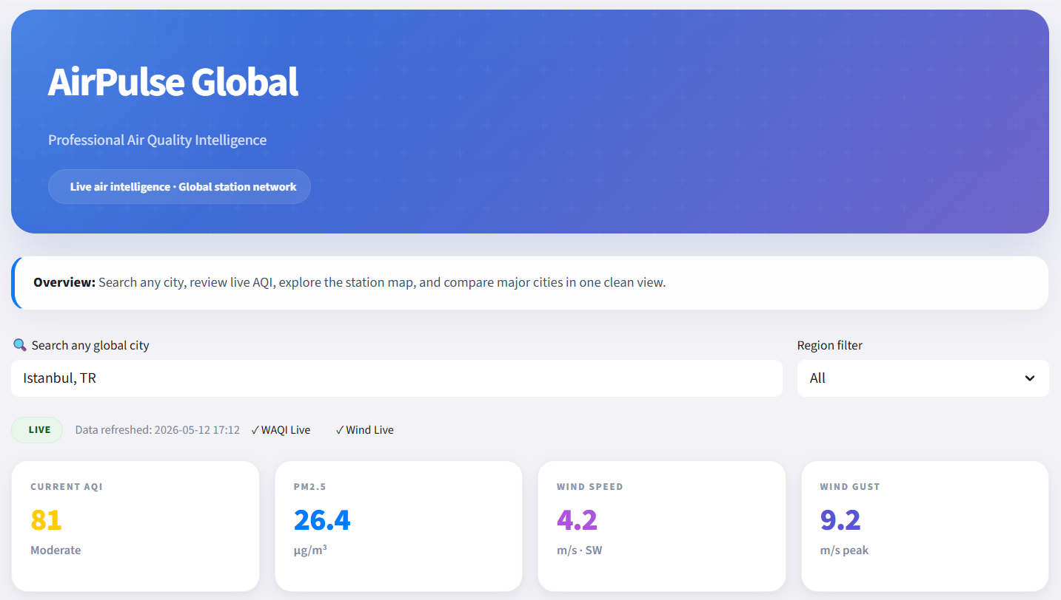
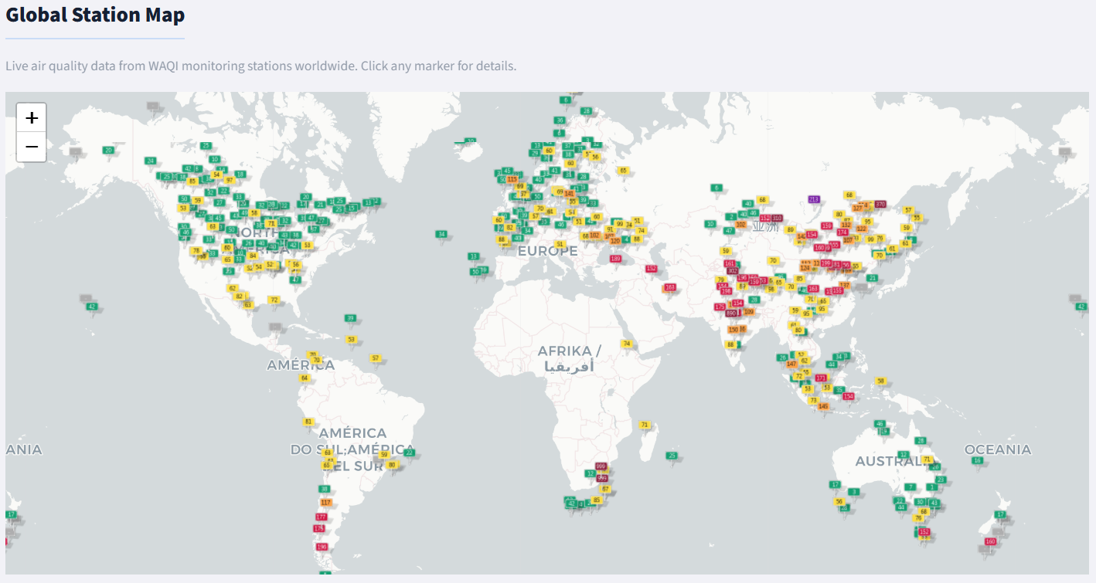
Interactive Exploration
The Dashboard
Station Map Explorer

Slide 11
Take Action: Sustainability Hub
From Insight to Impact
0.64
Carbon Calculator: Dynamic monthly footprinting based on diet, commute, and energy consumption.
Smart Commute: Real-time comparison showing CO2 savings when switching from car to bicycle or walking.
Action Checklist: Daily habit tracking with streak rewards for environment-first choices.
Tons CO2 / Month

Slide 12
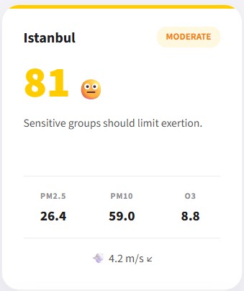
Analytical Depth
Meteorological correlation
Wind speed vs pollutant stagnation
Source identification
Traffic-linked NO2 vs industrial SO2 signals
Forecast validation
Actual vs estimate comparison on recent windows
Anomaly detection
Unexpected spikes beyond historical seasonality

Slide 13
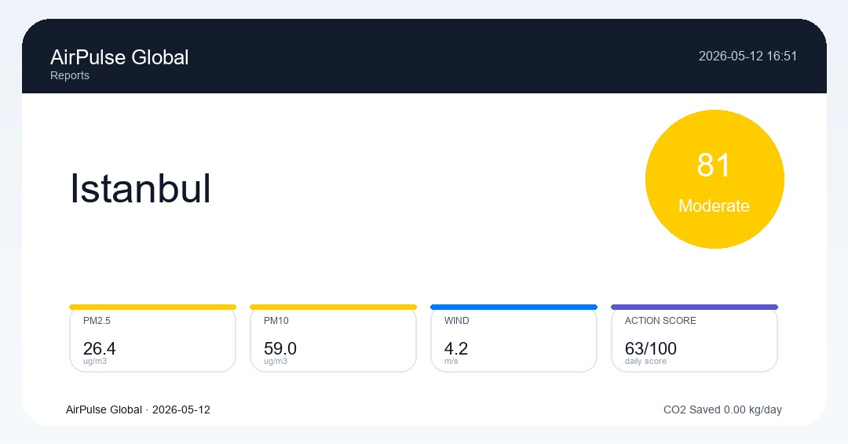
Professional Reporting
Export-Ready Results
A4 PDF Generation: Styled reports including pollutant tables, wind summaries, and personal scores.
Social Cards: 1080x566 JPEG assets designed for instant LinkedIn and Twitter awareness.
Raw Data Export: Full CSV access for independent research and further analysis.

Slide 14
Project Outcomes & Validation
What the project delivers — plus the signals that make it credible
Validation Signals
25+
3
Forecasting
WAQI daily forecast comparison + transparent confidence intervals
Global city presets
Live data providers
Coverage foundation
WAQI · Tomorrow.io · Open-Meteo
Station analytics
Multi-station AQI ranking highlights hotspot variation
3–10d
PDF/JPEG/CSV
Sustainability
CO₂ savings estimate links personal choices to measurable impact
Forecast horizon
Export formats
Short-term pollutant outlook
Report-ready outputs
Reporting
Export-ready PDF, JPEG and CSV prove product readiness
Evidence Snapshot
- 48 cached city / station histories support repeatable demos
- PM2.5 offline champion: R² 0.77 | RMSE 16.27
- Leave-station-out benchmark: 8,236 rows | best sMAPE 18.9%
- Validation store: 183 records captured for forecast follow-up

Slide 15
AirPulse Global
Roadmap + Limits
Turning environmental data into personal climate action.
Roadmap
- Alerts / notifications
- Stronger validation benchmark
- Institutional reporting view
Live intelligence. Local awareness. Measurable impact.
Demo / Q&A
Limits
- API dependency
- optional wind key
- coverage varies by city
airpulse-global.streamlit.app
Demo focus
- Live web app already available
- Best story: city search -> forecast -> take action -> report export
- Mention that wind enrichment is stronger when Tomorrow.io is configured

Slide 16

Thank You

