Slide 1
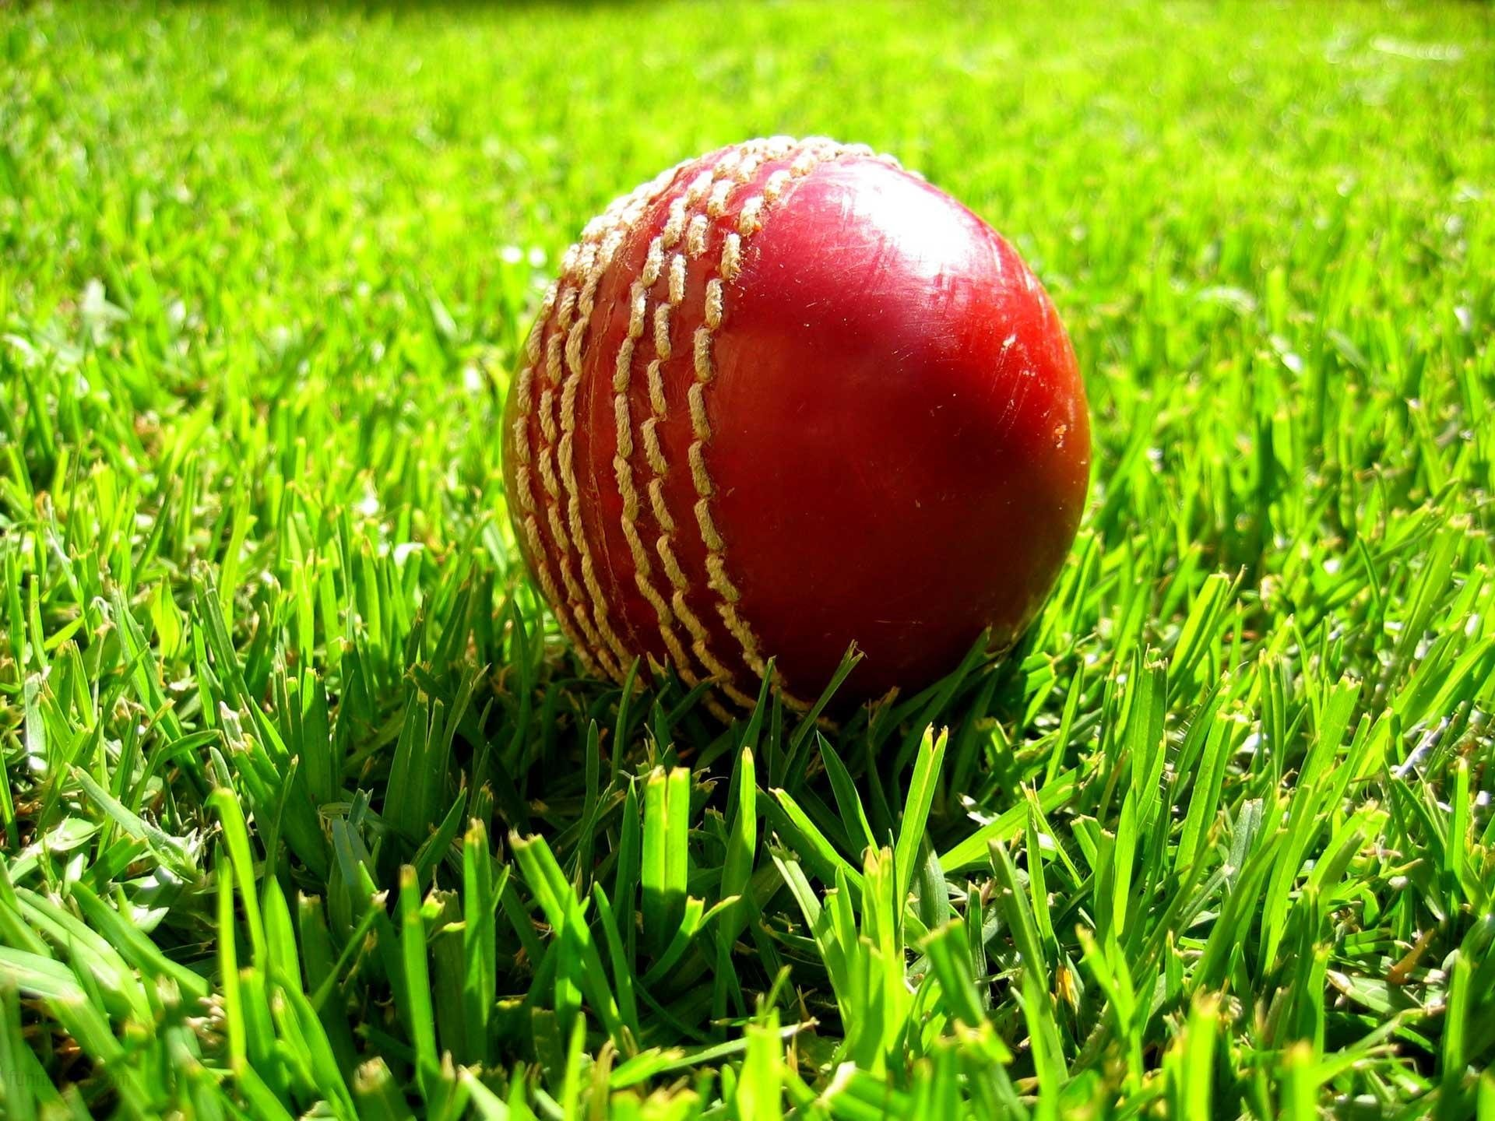
Data analysis and recommender System in ipl
Under the guidance of
Dr. Vijaya Kumar B P
Prof. and Head
Dept. of ISE, RIT
aTUL R H : 1MS16IS016
Hitesh M : 1ms16is028

Slide 2
Problem Statement
Our problem statement :
“ ”

Slide 3
Introduction
Statistics in Sports
SaberMetrics- Strategic preparation against specific teams
NBA data collection
Machine Learning in Sports
Google's score predictor
Game outcome prediction models
Fantasy League team selection
Statistics in Sports
Machine Learning in Sports
Cricket Season
IPL 2019 - The game theory of Auctions
Cricket World Cup 2019 - The science of team selection
Available data and implementation
Ball by ball data - Visualization and extrapolation of info.
Recommender Model - K-D Trees and Nearest Neighbour Seach
Cricket Season
Available Data and implementation

Slide 4
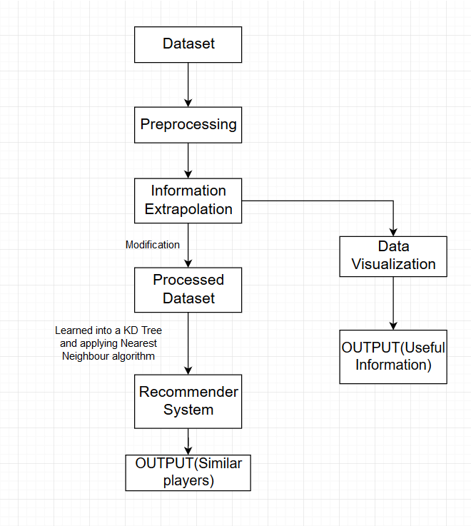
Implemented Modules
External modules implemented :

Slide 5
Testing our Model

Slide 6
Testing our Model
However , as the basis of our model is IPL data only, it doesn't account for overall similarity between players in all formats.

Slide 7
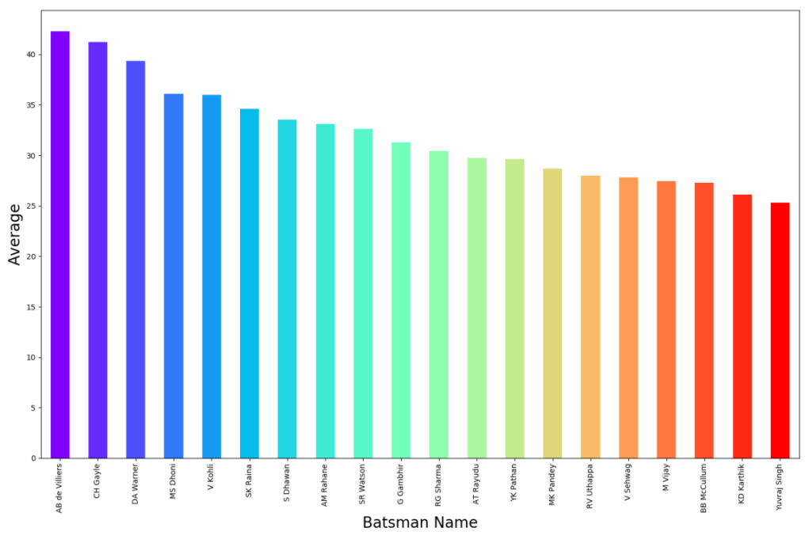
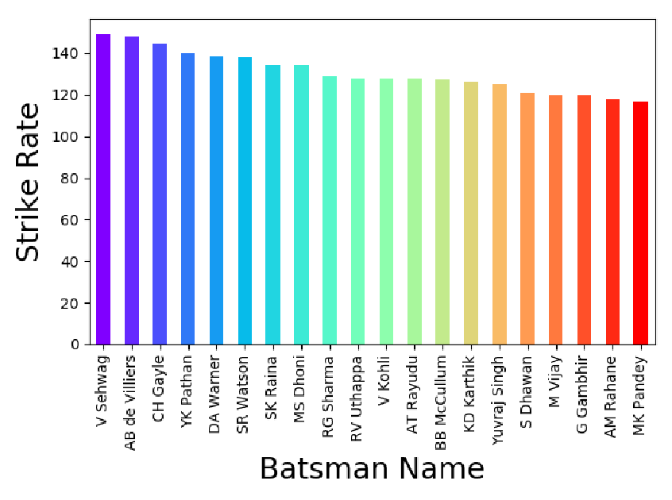
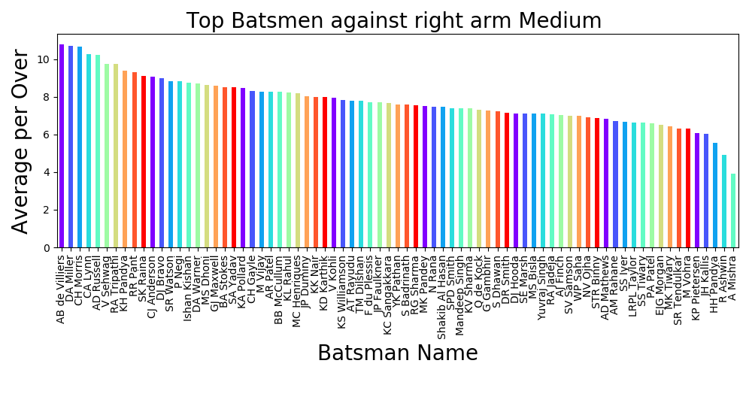
Results - Data Visualization
Batsmen with best averages, strike rates
Best performing batsmen v/s specific styles of bowling

Slide 8
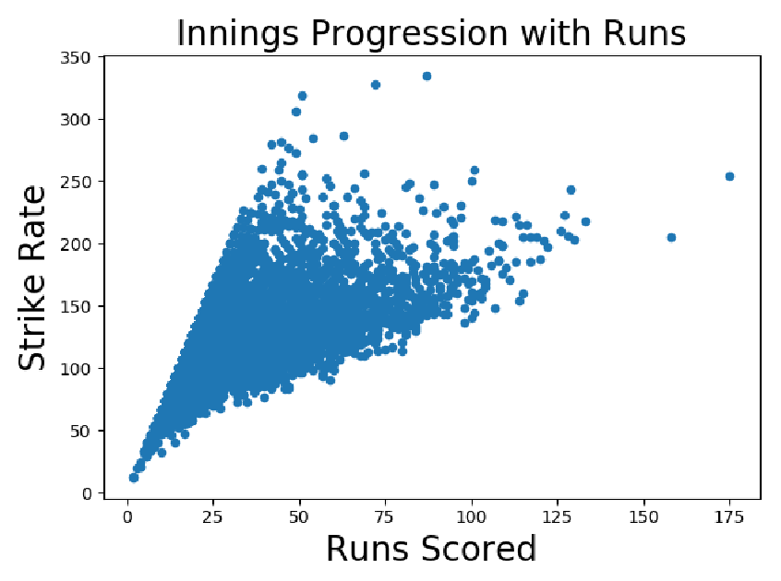
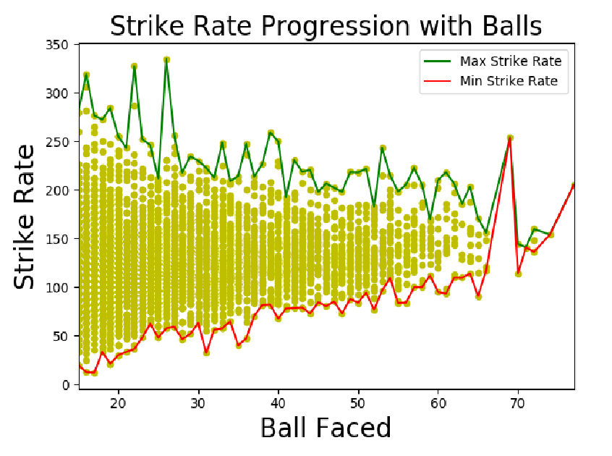
Results - Data Visualization
Corelation : total runs and strike rate
Corelation : number of balls faced and strike rate

Slide 9
Results - Recommender System
Similar batsman recommendation
Similar bowler recommendation
Recommendation v/s specific player

Slide 10
Conclusion
01
Statistical data regarding best batsmen, bowlers etc. can be extrapolated.
Inferences regarding trends in cricket games can be drawn.
All gleaned data can be easily visualized.
Data processing and visualization
02
Model recommends players that are similar to each other in the results they produce.
Model can be applied to both batting as well as bowling.
Can be applied in auctions, scouting for new talent, team selection etc.
Recommendation : Similar players
03
Recommendation :
Against a specific player
Model recommends best batsmen to field against specific bowlers.
Model can also be used to find best batsmen against a style of bowling.
Can be applied in team selections to strategize against weaknesses of opposing teams.

Slide 11
Future Directions
Improving nuance
Using data like speed of ball, swing of ball, degree of spin etc. , model can be improved
Improving nuances
Clustering
Using clustering, players could be divided into similar groups based on their performance which can be used to identify most skilled players. Attributes can also be used for clustering.
Using Clustering
Future Work
Coaching Strategy
Coaching Strategy
Coaching can be provided to players to learn styles that are effective against specific players based on recommendation model
Application in other sports
Other sports
Model can be implemented in other sports having similar data

Slide 12
References
P. Somaskandhan, G. Wijesinghe, L. B. Wijegunawardana, A. Bandaranayake and S. Deegalla, "Identifying the optimal set of attributes that impose high impact on the end results of a cricket match using machine learning," 2017 IEEE International Conference on Industrial and Information Systems (ICIIS), Peradeniya, 2017, pp. 1-6.
URL: http://ieeexplore.ieee.org/stamp/stamp.jsp?tp=&arnumber=8300399&isnumber=8300323
P. A. Gregory, D. H. M. S. N. Herath, D. S. L. Karunasekera, D. S.Deegalla, and A. U. Bandaranayake, “Cricket sabermetrics: A data mininganalysis of cricket,”in Proceedings of the 6th YSF Symposium, pp. 33–38,2017.
Lewis, A J (2005). “Towards Fairer Measures of Player Performance in One-Day Cricket,” The Journal of the Operational Research Society, 56(7), 804-815.
”An intelligent method for selecting and recommending best players to help build sports team”, N P Kurade
”Moneyballer: An Integer Optimization Framework for Fantasy Cricket League Selection and Substitution”, Debarghya Das

