Slide 1
WELCOME

Slide 2
WEB DEVELOPMENT
BALAJI C
Software Developer
KRISHTEC

Slide 3
LET’S START WITH THE DISCUESSION…!

Slide 4
LET’S MOVE INTO THE SESSION

Slide 5
BEFORE THAT ONE IMPORTANT THING

Slide 6
WHAT IS CODING..?
WHAT IS PROGRAMMING..?
WHAT IS DEVELOPMENT..?
WHAT IS ENGINEERING..?

Slide 7

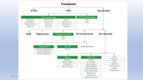
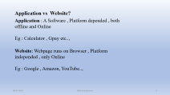
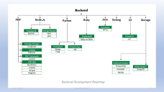
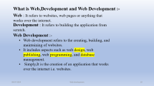

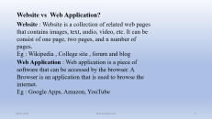
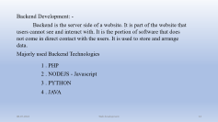
Web Development

Slide 8
Application vs Website?
Application : A Software , Platform depended , both offline and Online
Eg : Calculator , Gpay etc..,
Website: Webpage runs on Browser , Platform independed , only Online
Eg : Google , Amazon, YouTube..,

Slide 9
Website vs Web Application?
Website : Website is a collection of related web pages that contains images, text, audio, video, etc. It can be consist of one page, two pages, and n number of pages.
Eg : Wikipedia , College site , forum and blog
Web Application : Web application is a piece of software that can be accessed by the browser. A Browser is an application that is used to browse the internet.
Eg : Google Apps, Amazon, YouTube

Slide 10
What is Web,Development and Web Development :-
Web : It refers to websites, web pages or anything that works over the internet.
Development : It refers to building the application from scratch.
Web Development :-
Web development refers to the creating, building, and maintaining of websites.
It includes aspects such as web design, web publishing, web programming, and database management.
Simply,It is the creation of an application that works over the internet i.e. websites.

Slide 11
Web Development classifications:-
Web Development can be classified into two ways:
1 . Frontend Development
2 . Backend Development

Slide 12
Frontend Development : -
The part of a website where the user interacts directly is termed as front end. It is also referred to as the ‘client side’ of the application.
Majorly and Must used Frontend Technologies
1 . HTML (HyperText Markup Language)
2 . CSS (Cascading Style Sheets)
3 . JS (JavaScript)

Slide 13
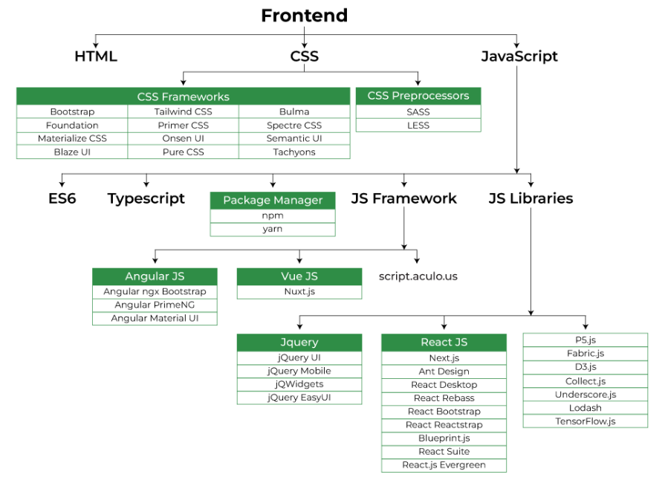

Slide 14
Backend Development: -
Backend is the server side of a website. It is part of the website that users cannot see and interact with. It is the portion of software that does not come in direct contact with the users. It is used to store and arrange data.
Majorly used Backend Technologies
1 . PHP
2 . NODEJS - Javascript
3 . PYTHON
4 . JAVA

Slide 15
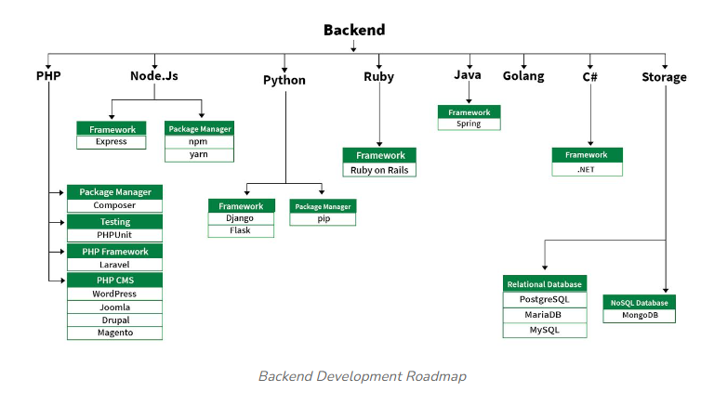
Setup

Slide 16


Slide 17
REFERENCES:-
https://www.geeksforgeeks.org/web-development/
https://www.geeksforgeeks.org/difference-between-web-application-and-website/

