Slide 1
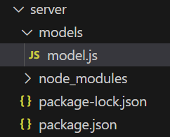
MongoDB
Create model schema for MongoDB

Slide 2
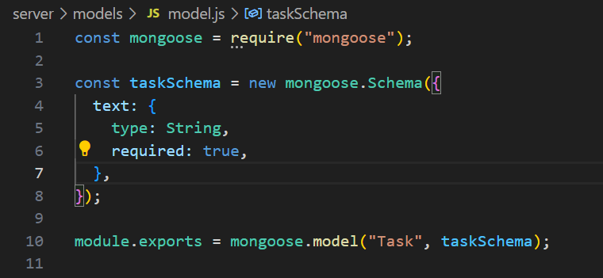
Node
Inside model.js

Slide 3
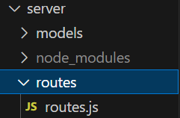
Express
Create routes for the express

Slide 4
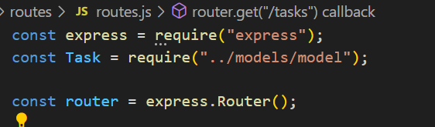
Express
Import necessary packages inside router.js

Slide 5
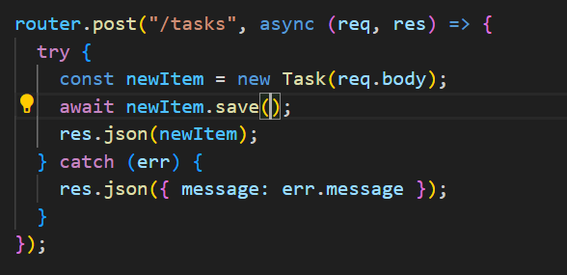
Express
Create an element

Slide 6

Express
Export the router

Slide 7
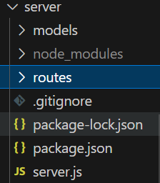
Node
Create server.js

Slide 8
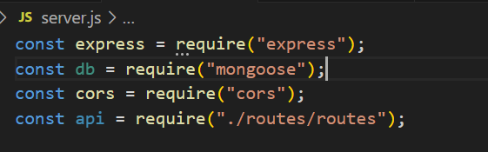
Node
Import necessary packages

Slide 9

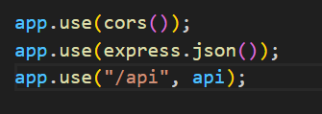
Node
Create a object for express & Set the PORT number
Includes cors ,json,routes

Slide 10
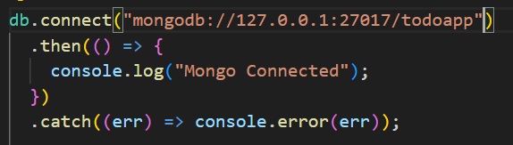
Node
Connect to the MongoDB

Slide 11
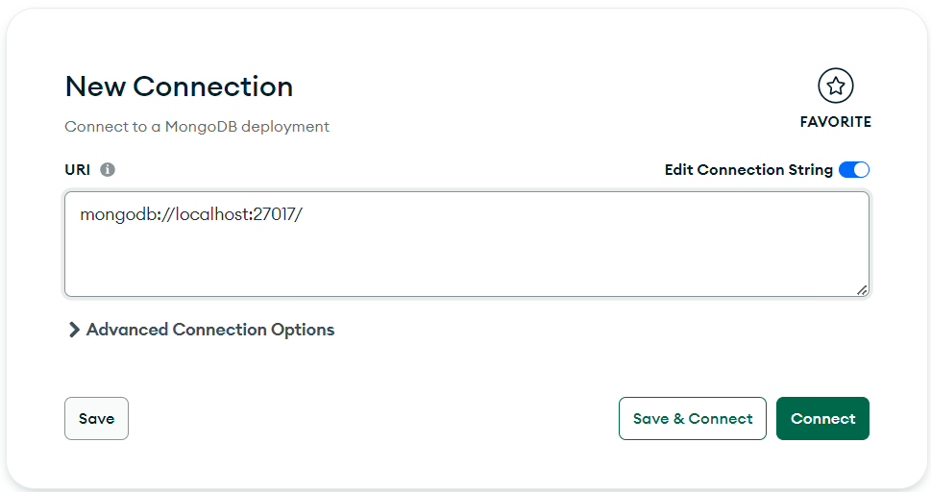
Node
Open MongoCompuss

Slide 12
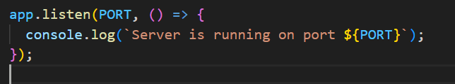
Node
Finally, Listen to the PORT:-

Slide 13
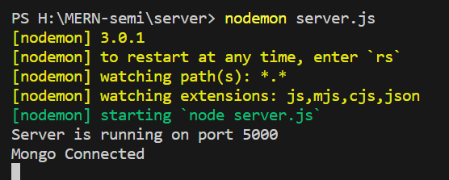
Node
Then start the server,

Slide 14

Node
Then start the server,

Slide 15
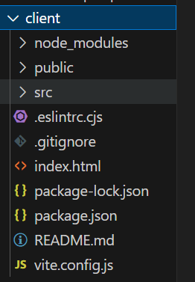
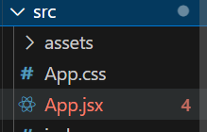
React
Design a frontend

Slide 16
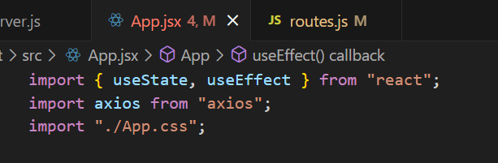

React
Import Necessary Packages
Create a variable :-

Slide 17
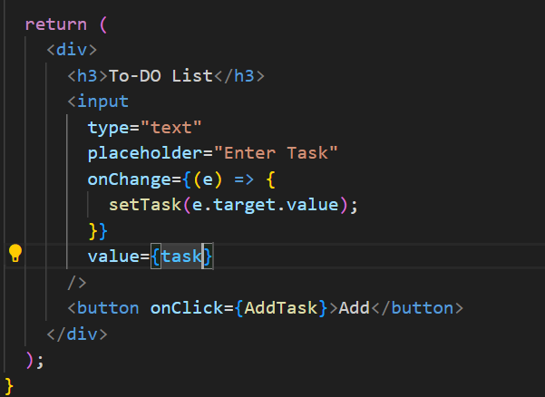
React
Create a element :-

Slide 18
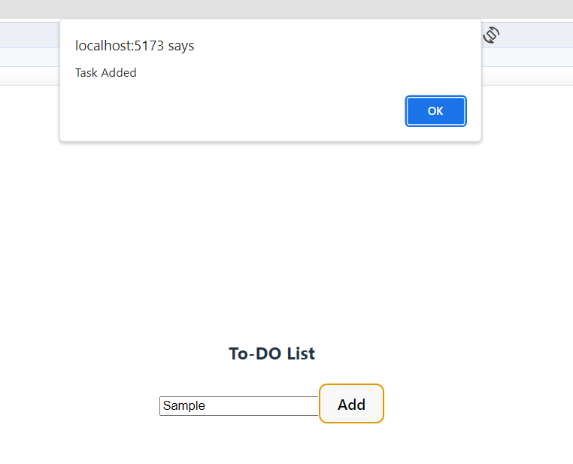
React
Create a element :-

Slide 19
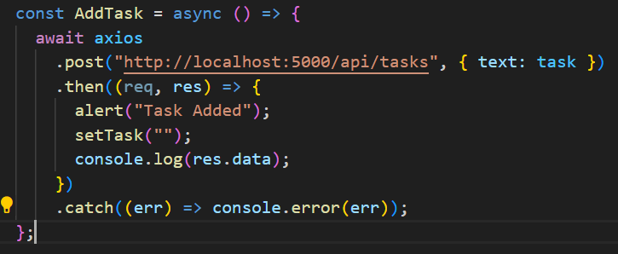
React
Create a fetch request for Create a element

Slide 20
React

Slide 21
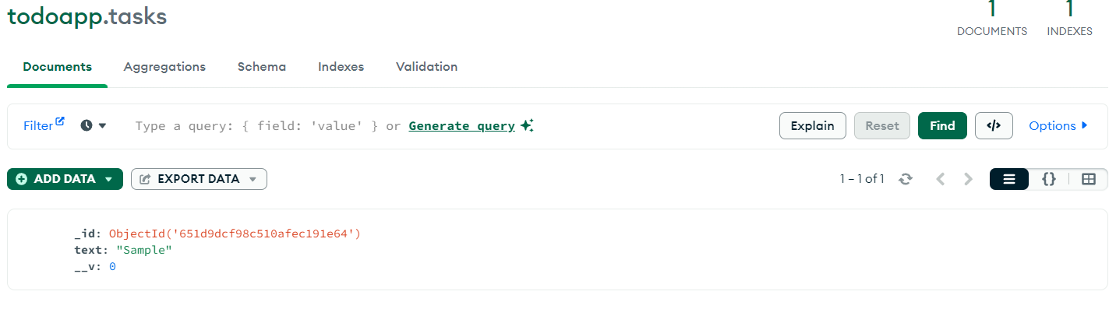
React

Slide 22
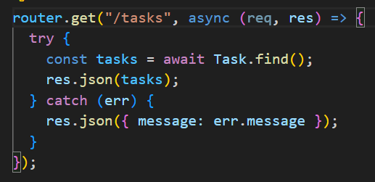
Express
Read an element

Slide 23
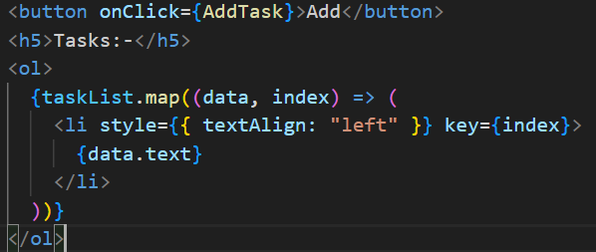
React
Read a element

Slide 24
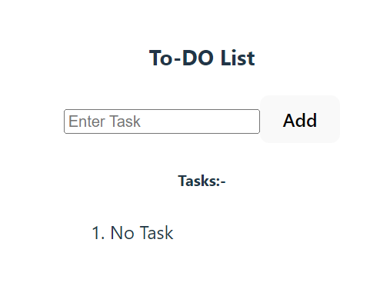
React
Read a element

Slide 25
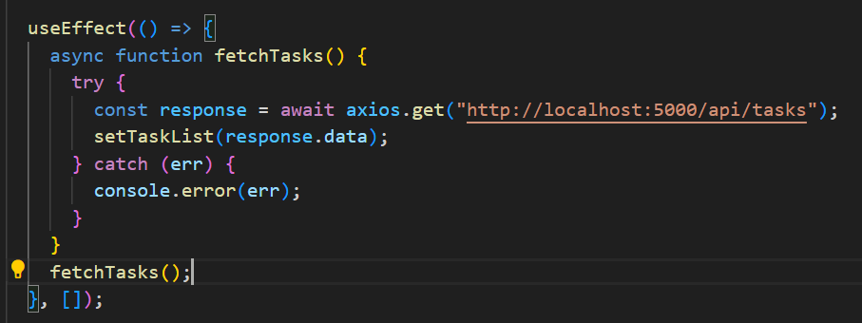
React
Create a fetch request for Read a element

Slide 26
React
Create a fetch request for Read a element

Slide 27
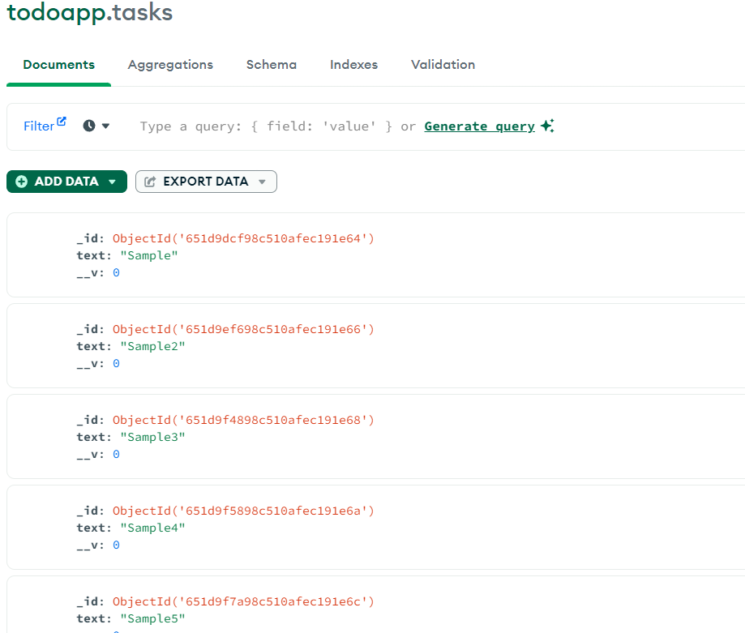
React
Create a fetch request for Read a element

Slide 28
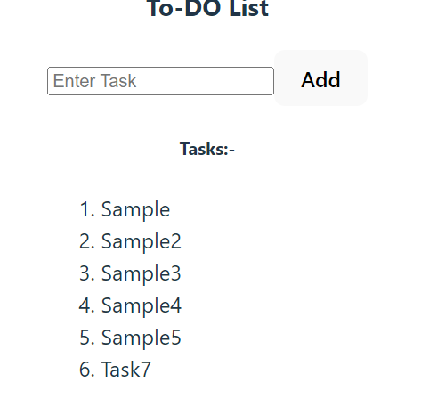
React
Create a fetch request for Read a element

Slide 29
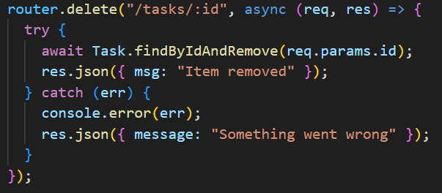
Express
Delete an element

Slide 30
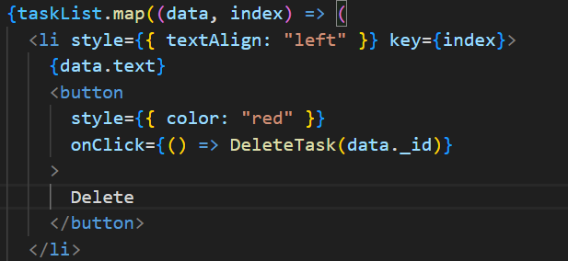
React
Add button for Delete a element

Slide 31
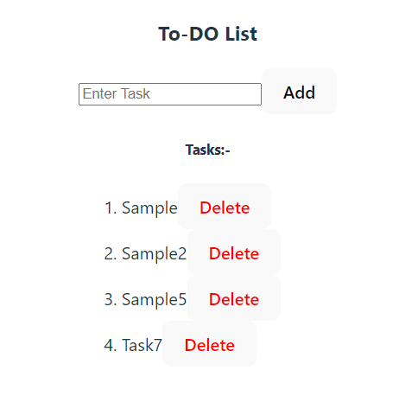
React
Add button for Delete a element

Slide 32
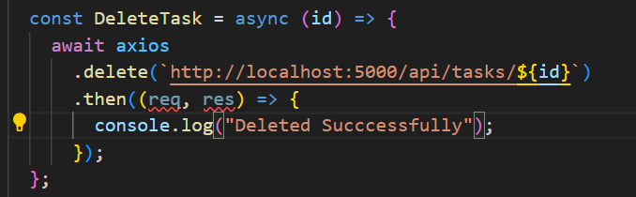
React
Create a method for delete

Slide 33
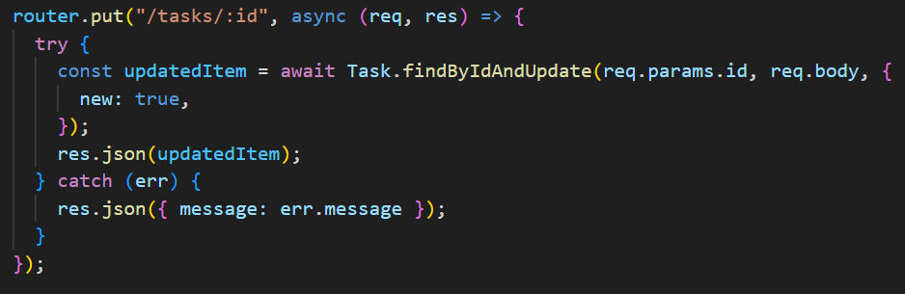
Express
Update an element

Slide 34
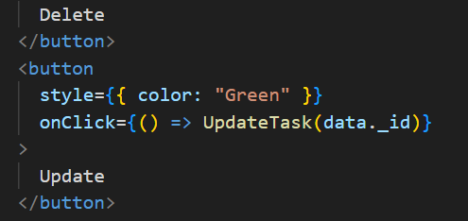
React
Create a button for update

Slide 35
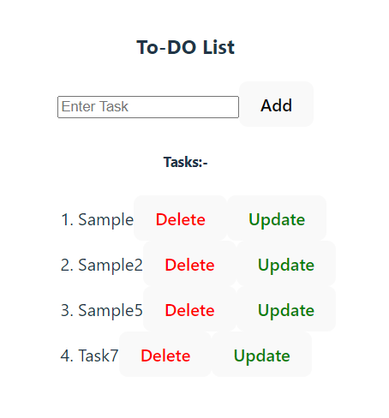
React
Create a button for update

Slide 36
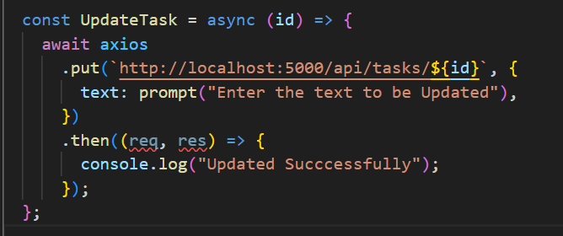
React
Create a method for update

Slide 37
React
Create a method for update

Slide 38
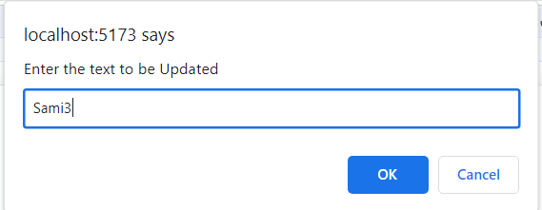
React
Create a method for update

Slide 39
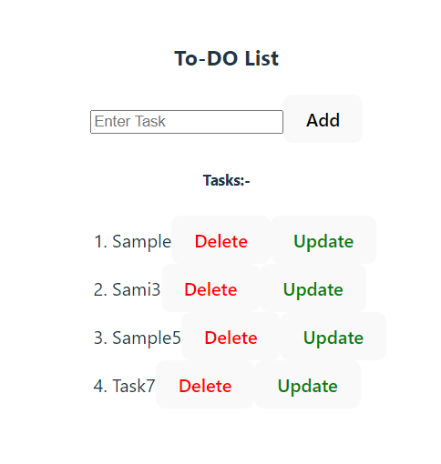
React
Create a method for update

Slide 40
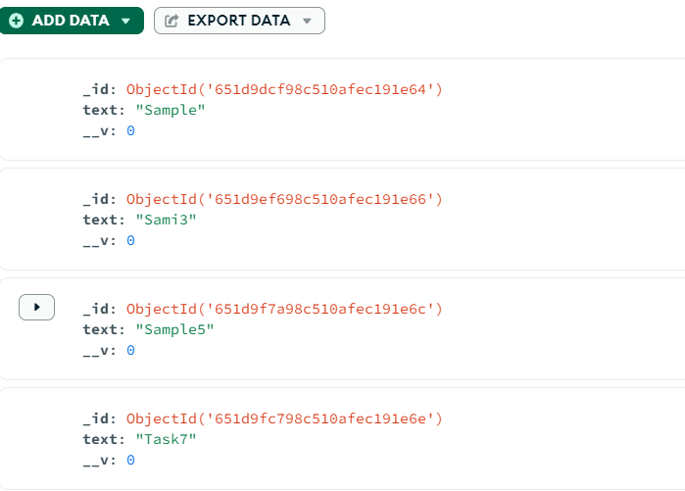

Slide 41
Congratulations!!!

Slide 42
OUR Final OUTPUT

Slide 43
Demo→→

Slide 44
Wait a Sec…Y?

Slide 45
Why>?

Slide 46
Which>?

Slide 47
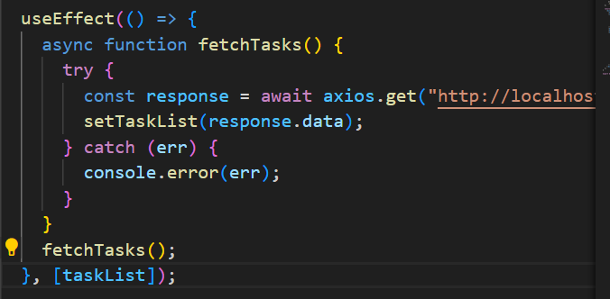

Slide 48
Now,Our Final Output

Slide 49
Demo→→

Slide 50
Congratulations!!!

Slide 51
Let’s Celeberate our Victory/..🤝<3

Slide 52
Any Queries???

Slide 53
Thank You

Slide 54
For reference use:
https://github.com/rc-balaji/MERN-semi.git

Slide 55
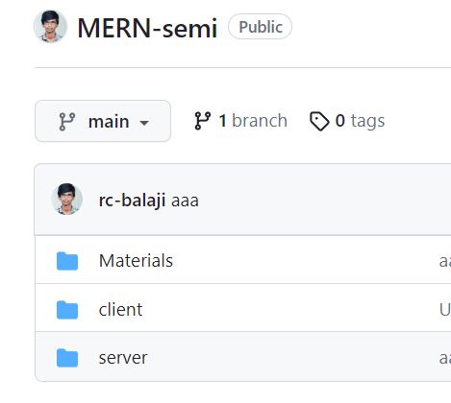
For reference use:
https://github.com/rc-balaji/MERN-semi.git

