Slide 1
#6 ODD + OOD Detection for
Safe Autonomy
Camera-based safety gate
Quick Overview
Members
• Tharun Reddy Challabotla
• HariChandana Srikurmum
• Srija Pentyala
Input: Front camera frame
Output: Trust / Abstain decision
Focus: ODD boundary detection & OOD uncertainty
Metrics: AUROC, False-Safe Rate, ECE
Notes:
[Sources] - (No external sources on this slide) [/Sources]

Slide 2
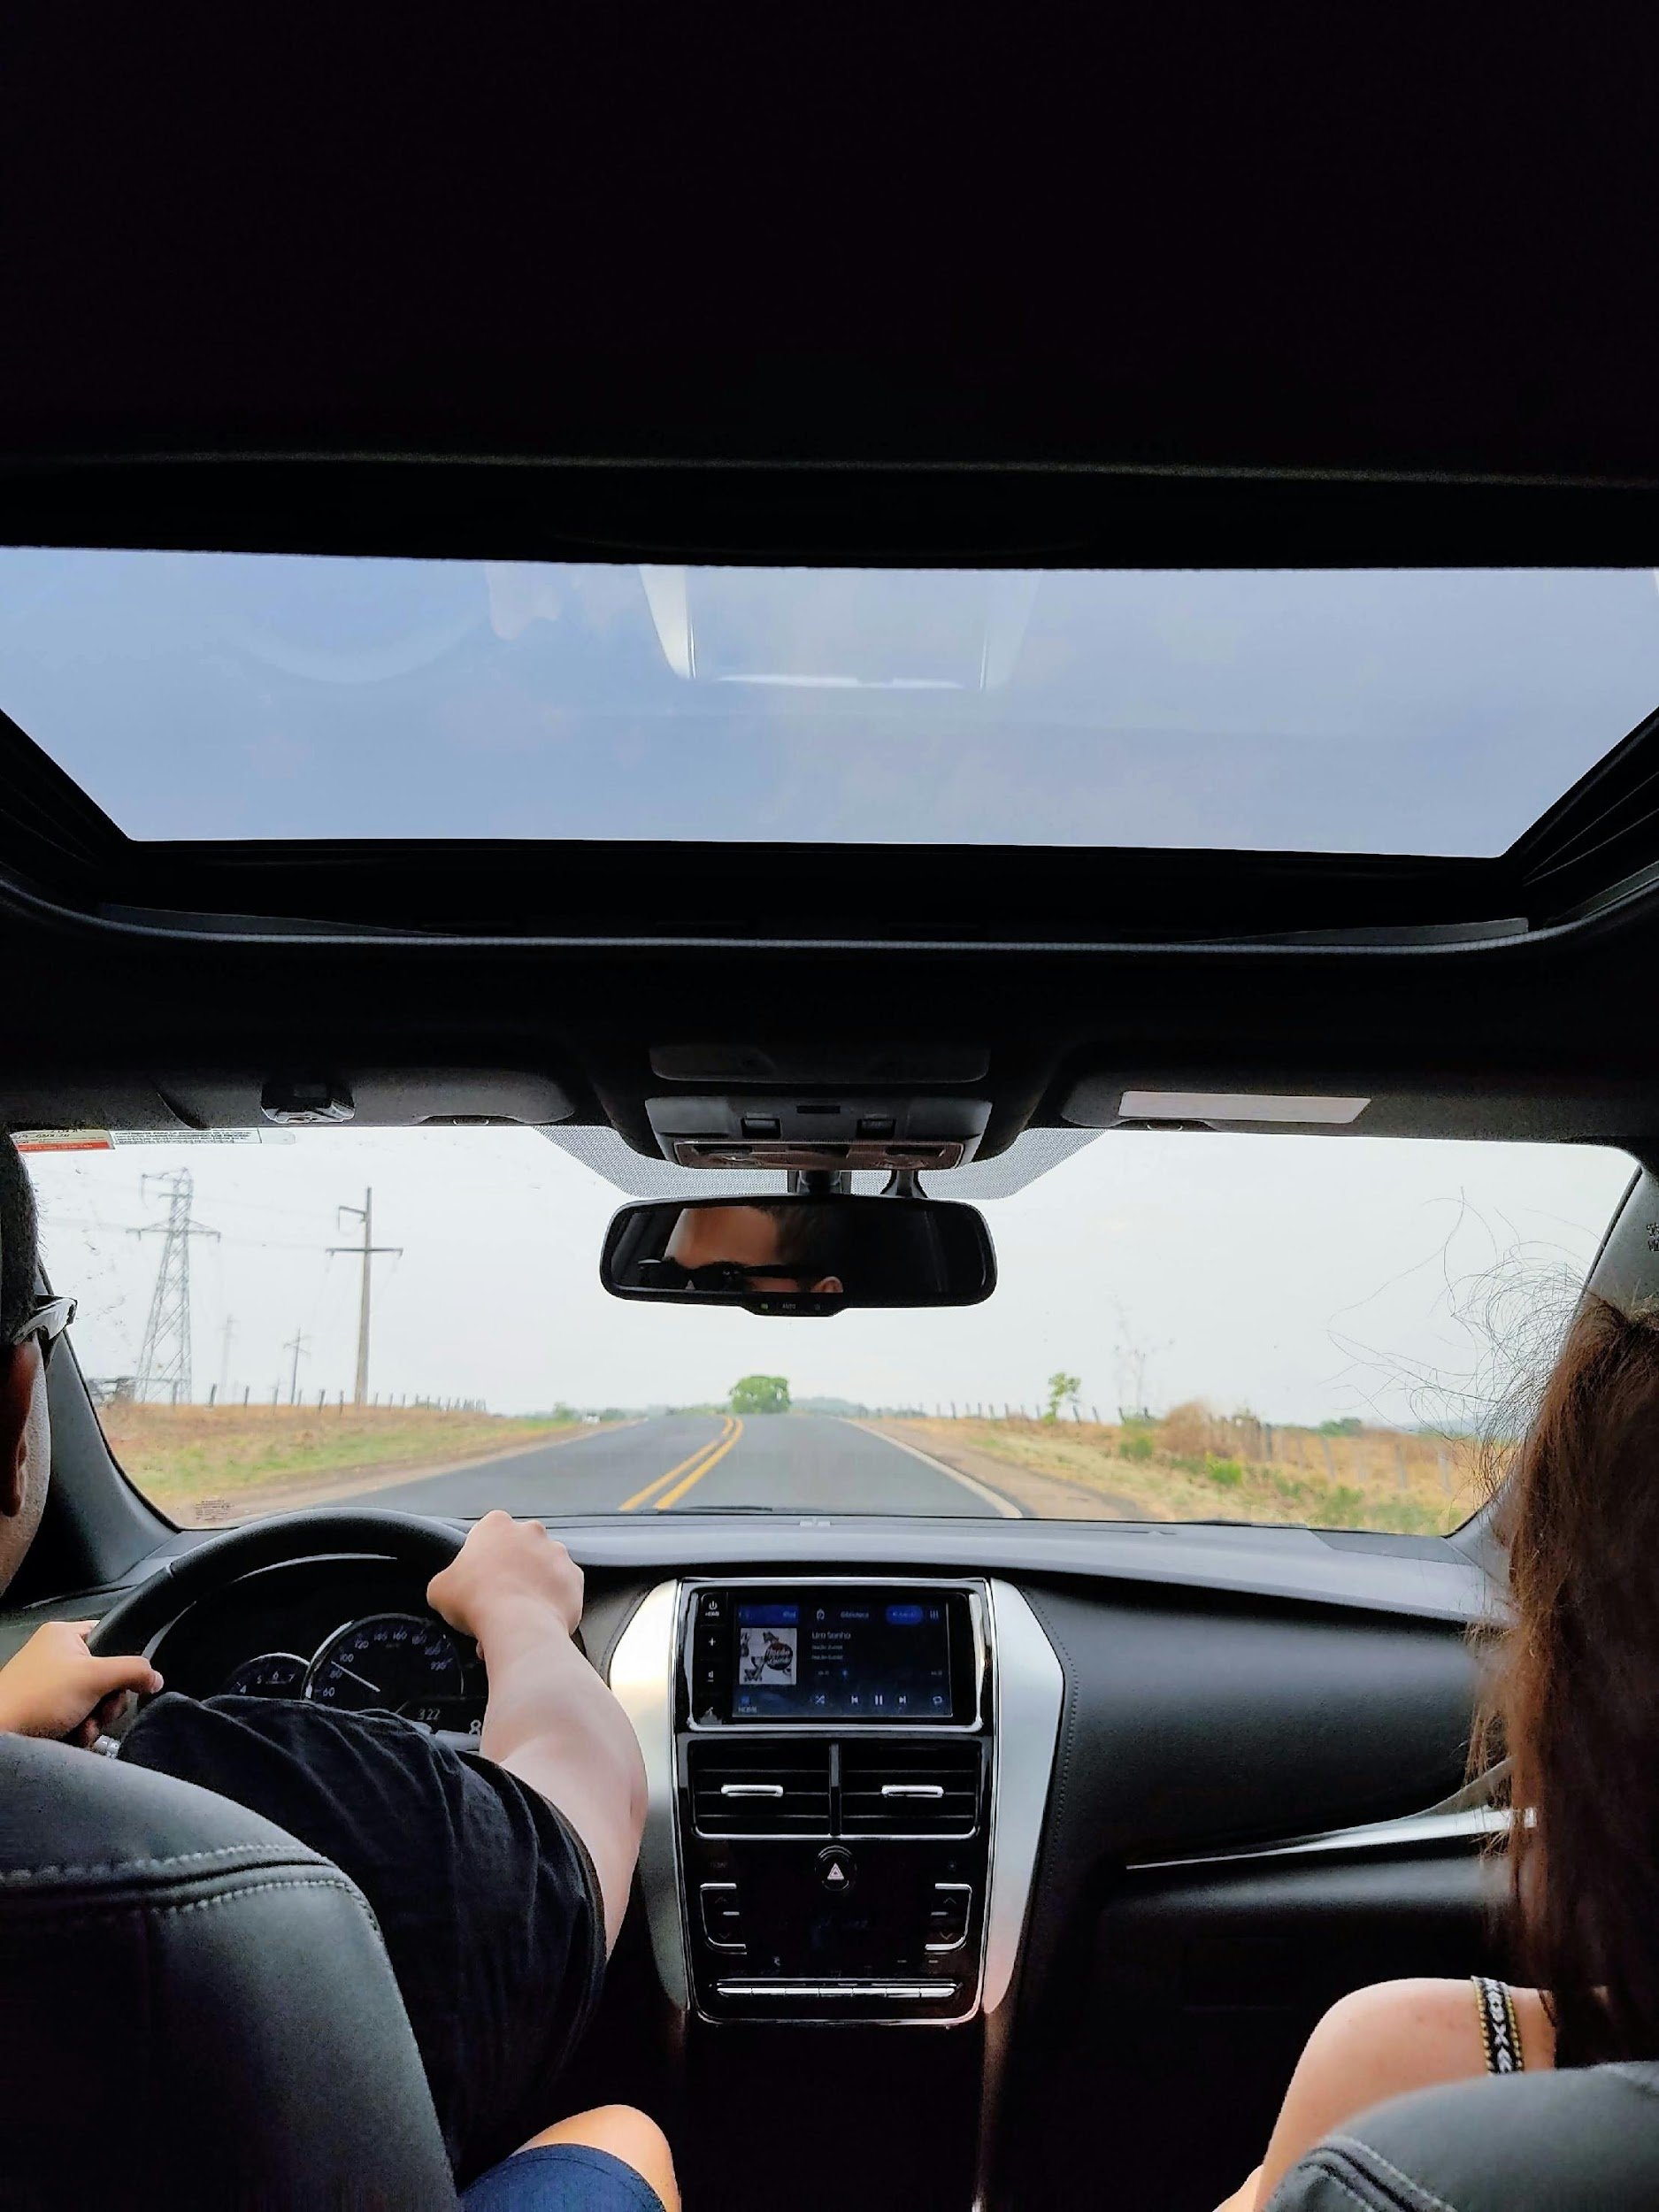
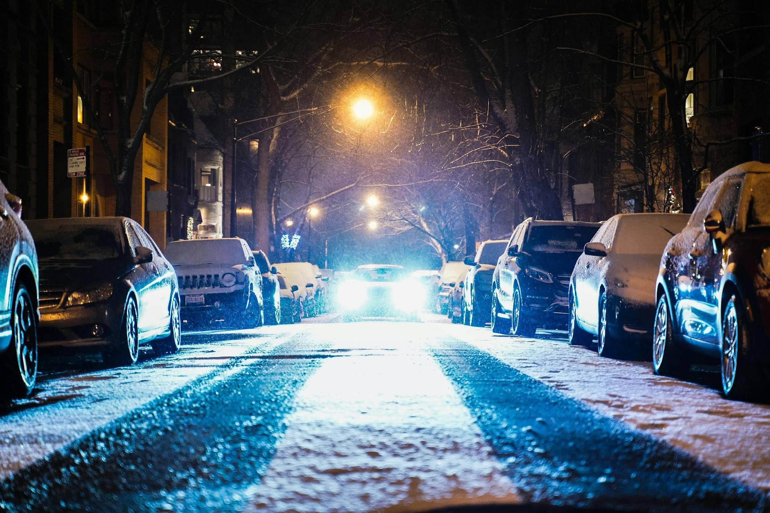

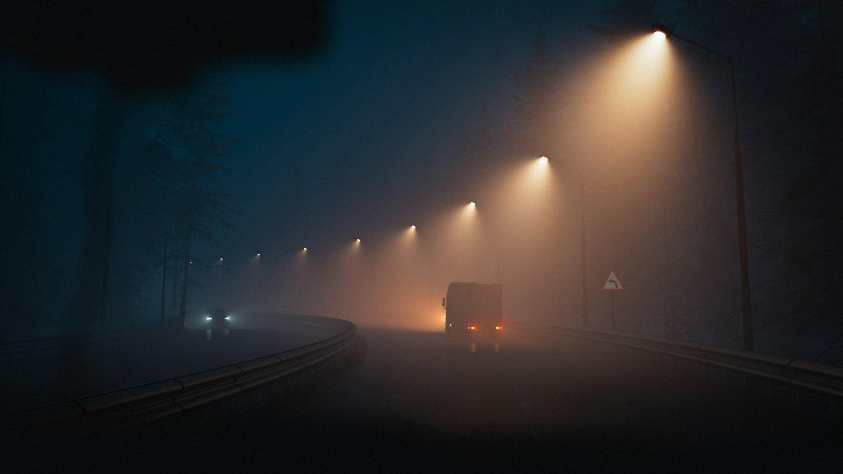
Project topic & goal
Problem
Illustration: same road, different conditions
Perception models can be overconfident when driving conditions shift (night, rain, fog, construction).
False confidence outside the Operational Design Domain (ODD) is safety-critical.
Goal
Day+Clear(In-ODD)
Night (OOD)
Build a safety gate that outputs:
1) In-ODD vs OOD score
2) Calibrated risk score → Trust / Caution / Abstain
If risk > τ → abstain / safe fallback (slowdown in sim).
Rain (OOD)
Fog (OOD)
Notes:
[Sources] - Day image (Unsplash): https://unsplash.com/photos/person-driving-car-during-daytime-GCTjpf8ExHk - Night image (Unsplash): https://unsplash.com/photos/cars-parked-on-both-sides-of-the-street-during-snowy-nighttime-snLCRc7ByI4 - Rain image (Unsplash): https://unsplash.com/photos/rain-drops-on-the-windshield-of-a-car-at-night-grOCtxtBrDg - Fog image (Unsplash): https://unsplash.com/photos/a-truck-driving-down-a-foggy-road-at-night-EFQg9MocIIY [/Sources]

Slide 3
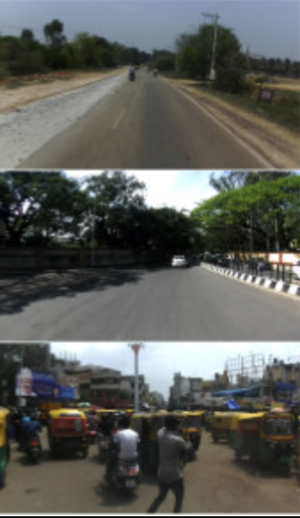
DataSet
Dataset plan (BDD100K+ IDD)
Define a clear ODD, then test shifts as OOD buckets.
In-ODD (ID)
Day + Clear
(choose city/highway)
OOD bucket
Night
OOD bucket
Rain
OOD bucket
Fog / Snow
“hard OOD” tests
OOD bucket
Construction (optional)
• Unseen locations (city/route split)
• Synthetic corruptions (blur, glare)
• Short clips: frame-to-frame stability
Notes:
[Sources] - Plots on this slide are illustrative placeholders generated by the team (not from external sources). [/Sources]

Slide 4
Baseline & related work
Existing OOD detection approaches:
Method comparison:
MSP [Hendrycks & Gimpel, 2017] — Max softmax as confidence; fast but overconfident.
Method
Calibrated?
Efficient?
OOD?
MSP
✗
✓
~
Energy [Liu et al., 2020] — Log-sum-exp score; stronger ID–OOD separation.
Energy
~
✓
✓
MC Dropout [Gal & Ghahramani, 2016] — Multi-pass dropout at test time for uncertainty.
MC Dropout
✓
~
✓
Ensembles [Lakshminarayanan et al., 2017] — 2–3 models; disagreement gives uncertainty.
Ensemble
✓
~
✓
Ours (gate)
✓
✓
✓
How we differ: We define a driving ODD + bucketed shifts, not generic ID/OOD. We tune a calibrated trust/abstain gate to cut false-safe errors.

Slide 5






Methodology & Plan: Camera-Based Safety Gate
Methodology & Plan: Camera-Based Safety Gate
High-level steps to build and validate an ODD-aware safety gate for camera inputs.
Feature Extraction
OOD Scoring
Encode images with ResNet-50 or CLIP,AutoEncoder/MAE
Compute anomaly scores for inputs
In-ODD Classifier
Calibration
Train model to detect in-ODD scenarios
Align scores to desired risk thresholds

Slide 6
Detailed Method: From Frame to Safe Decision
Feature Extraction (Frozen Backbone)
In-ODD vs. OOD Classifier
Pre-trained, frozen ResNet-50 or CLIP Or Autoencoder encodes each camera frame into a fixed embedding.
Frozen backbone keeps the gate lightweight and fast.
Small head (logistic regression or MLP) classifies embeddings as In-ODD or OOD.
Trained on labeled driving data (e.g., BDD100K).
OOD Scoring (Comparative)
Calibration & Safety Gate
Compare MSP (baseline), Energy score, and uncertainty methods (MC Dropout or 3-model ensemble).
Choose the method with best ID/OOD separation on validation data.
Apply temperature scaling to improve confidence calibration.
Set threshold τ on OOD score; if score exceeds τ → abstain / trigger takeover.

Slide 7


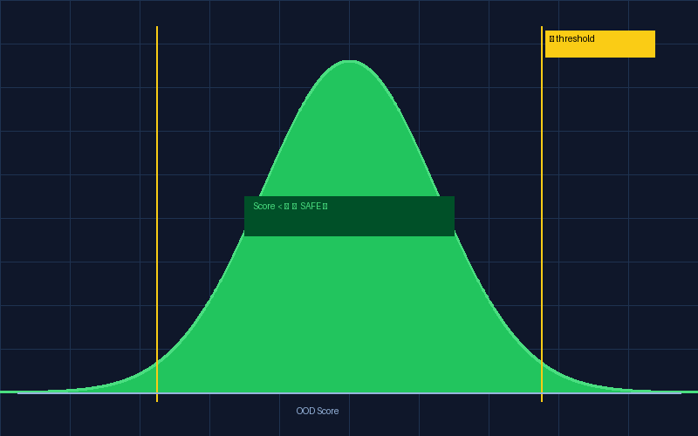
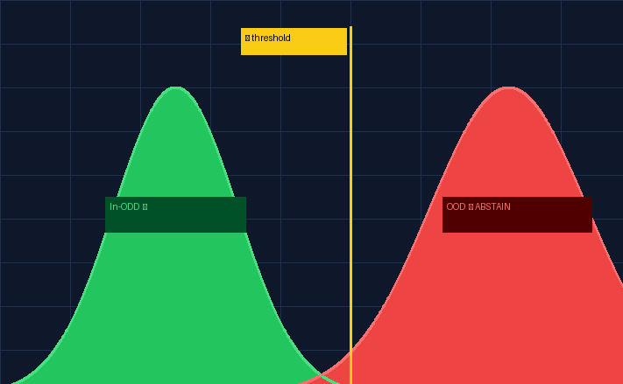
Experiments: Rigorous Evaluation of the Safety Gate Expected Results
Expected Results
Evaluated the safety gate on held-out BDD100K splits to measure detection, calibration, and runtime suitability for AVs.
ODD-Aware Safety Gate for Autonomous Vehicles
Binary In-ODD vs OOD: compare MSP, Energy, MC Dropout, Ensemble
Per-type analysis: Night, Rain, Fog, Construction
Threshold sensitivity: FSR vs. abstention rate trade-offs
Calibration: reliability diagrams before/after temperature scaling
In-Distribution (In-ODD)
Out-of-Distribution (OOD)
Target Metrics
AUROC > 0.90
Energy score vs. MSP baseline
Clear Day Score < threshold PROCEED
Fog / Night Score > threshold ABSTAIN
FSR < 5%
False-Safe Rate - primary safety metric
ECE < 0.05
Calibration after temperature scaling
Latency < 10ms
Real-time gate inference per frame
Energy Score outperforms MSP on fog, night, and rain OOD scenarios

