Slide 1
SOLID Principles in Python
Shapes Inheritance Project
Python OOP + Testing

Slide 2
S — Single Responsibility Principle
Each class should have one responsibility
Circle calculates only circle area
Square calculates only square area
Triangle calculates only triangle area
Code Example-
class Circle(Shape):
def calculate_area(self):
return math.pi * self.radius * self.radius

Slide 3
O — Open/Closed Principle
Software should be open for extension
But closed for modification
New shapes can be added without changing existing code
Code Example-
class Rectangle(Shape):
def calculate_area(self):
return self.length * self.width

Slide 4
L — Liskov Substitution Principle
Subclasses should replace parent classes safely
Any Shape subclass should work as a Shape
Code Example-
shapes = [Circle(5), Square(4), Triangle(3,2)]
for shape in shapes:
print(shape.calculate_area())

Slide 5
I — Interface Segregation Principle
Classes should not be forced to use methods they do not need
Shape only requires calculate_area()
Simple and focused interface

Slide 6
D - Dependency Inversion Principle
Depend on abstractions, not concrete classes
Program works with Shape abstraction
Not directly tied to Circle or Square
Code Example-
shapes = [Circle(5), Square(4), Triangle(3,2)]
for shape in shapes:
print(shape.calculate_area())

Slide 7
Pytest Unit Testing
Unit testing verifies individual classes
Pytest automatically discovers test functions
Example-
def test_square_area():
square = Square(4)
assert square.calculate_area() == 16

Slide 8
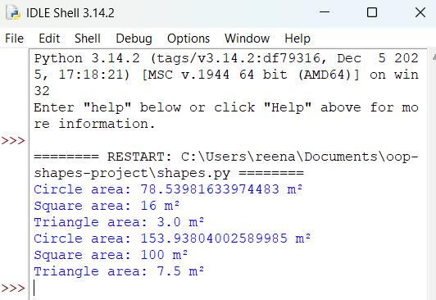
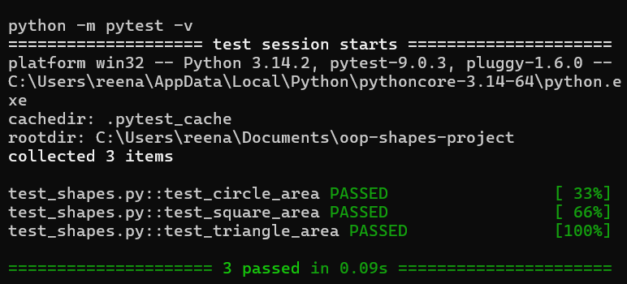
Program Execution and Testing
Program executed successfully in Python IDLE
pytest used for unit testing
All tests passed successfully

Slide 9
Conclusion
Demonstrated abstraction, inheritance, and polymorphism
Applied SOLID principles in Python
Used pytest for unit testing
Created reusable and maintainable code
References
University of Essex Online (2026) ‘Unit 2: SOLID Principles
of Object-Oriented Design’, Advanced Object-Oriented Design and Programming
module.

