Slide 1
Café Ordering System Using Design Patterns in Python
Decorator Pattern
Composite Pattern
pytest Testing

Slide 2
Project Overview
This project simulates a café ordering system using object-oriented programming and design patterns.
Features:
• Base coffee orders
• Milk and sugar decorators
• Menu structure
• Automated testing with pytest

Slide 3


Decorator Pattern
The Decorator Pattern allows behaviour to be added dynamically without modifying existing classes.
Example:
Result:

Slide 4
Composite Pattern
The café menu uses a tree-like structure.
MenuCategory
├── House Coffee
├── Latte
└── Cappuccino
This allows individual items and grouped menus to be treated uniformly.

Slide 5
OOP Concepts Used
Encapsulation
Inheritance
Polymorphism
Composition over inheritance
Decorators wrap coffee objects to extend behaviour dynamically.

Slide 6

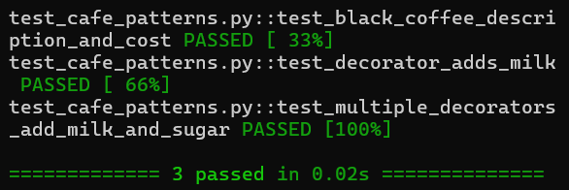
Automated Testing with pytest
Tests verify:
• Coffee descriptions
• Decorator functionality
• Pricing calculations
Example assertion:
pytest output:

Slide 7
Reflection
What I learned:
• Design patterns improve flexibility
• Composition reduces tight coupling
• Automated testing improves reliability
• Object-oriented design improves maintainability

