Slide 1
Front-End Web Development
Claim Academy
Notes:
Today we are going to be covering
How to embed a video on your webpage
We’re going to go over the CSS3 box property
Since we haven’t really gone into detail about margins and padding and float property
We’ll look at some examples and talk about them
Then we’re going over media queries
This is what web developers use to design responsive websites
So websites that are compatible on tablets and mobile devices
I’m gonna take the template design we’ve been working on and I’m gonna make it responsive
And then we’re going to start working on a new project
I’ll explain more about it later
So let’s get started (next slide)

Slide 2
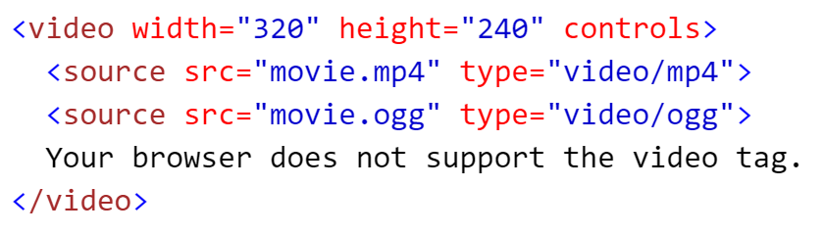
Embedding Video in HTML5
The <video> tag specifies video, such as a movie clip or other video streams.
Example:
Notes:
There are a several ways to embed a video on your website. We’re gonna look at three. Some of you have already added a video to your project. But if you haven’t yet and you don’t know how, you better be paying attention because I am going to ask you all to embed a video on your website.
The first way I’m going to show you is by using the HTML5 <video> element (next slide part)
So in the past, if you wanted to display a video on your website you would have to use some sort of 3rd party plugin in order for the video to work
So if someone visited your website they’d have to download either Adobe flash player or Silverlight plugin
In HTML5 they’ve implemented a video player right into the browser
(open template index.html)
So the process of adding a video this way is pretty simple
We’ll start with a beginning and ending video element
Then we’ll add a source attribute
So I’ve already added a short video to my project
I created a videos folder and added my video file in there
So I’ll set the source attribute equal to the location of the file and the name of the file
That’s really all we need to do to get our video to play so let’s save this and take a look at our web page
Add controls attribute
So what happens if the end-user does not have a browser that supports the HTML5 video element
Between the open and close video element you can add some text that will display to the browser if the video isn’t able to load
<p>Unfortunately your browser cannot play the video format. You may <a href="videos/minions.mp4">right-click this link and choose Save As</a> to download this video instead.</p>
Ok there’s other attributes we can add to our video
Width and height
If we want the video to play automatically when the user visits your webpage
Add autoplay
(show the rest of them from EmbedVideo.html file)
Then show how to embed video from:
YouTube: https://www.youtube.com/watch?v=9Y1E1z7Ok1Y
Vimeo: https://vimeo.com/78183348

Slide 3
CSS3 Box Properties
Examples of in-line HTML elements
<a>
<i>
<u>
<img>
<legend>
<nav>
<span>
Examples of block-style elements
<article>
<aside> <header> <footer>
<body> <head>
<div>
<form> <fieldset>
<p>
<table>
Notes:
Alright now we’re going to discuss the box model and the CSS3 properties you can modify on box-style elements
So what do I mean by box-style elements?
So there are some element that are used in-line (show examples, next slide part)
Then there are elements that are used to produce a block of space on the screen (typically used as containers to hold other items – but not always)
(show examples, next slide part)

Slide 4
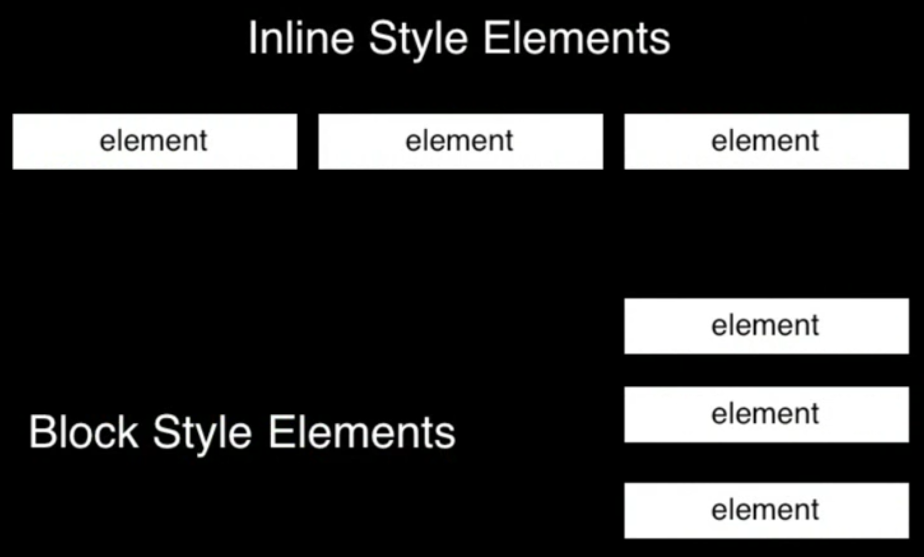
Notes:
Take a look at this diagram
This should help you see the fundamental difference between inline elements and block style elements
The biggest difference is that inline element flow horizontally
And when they reach the border of their parent element they do a soft line break to wrap to the next horizontal line
The block elements stack vertically on top of each other
There are some things that can change this such as setting their float to left or right
So right now we’re interested in the CSS properties for block elements
(next slide)

Slide 5
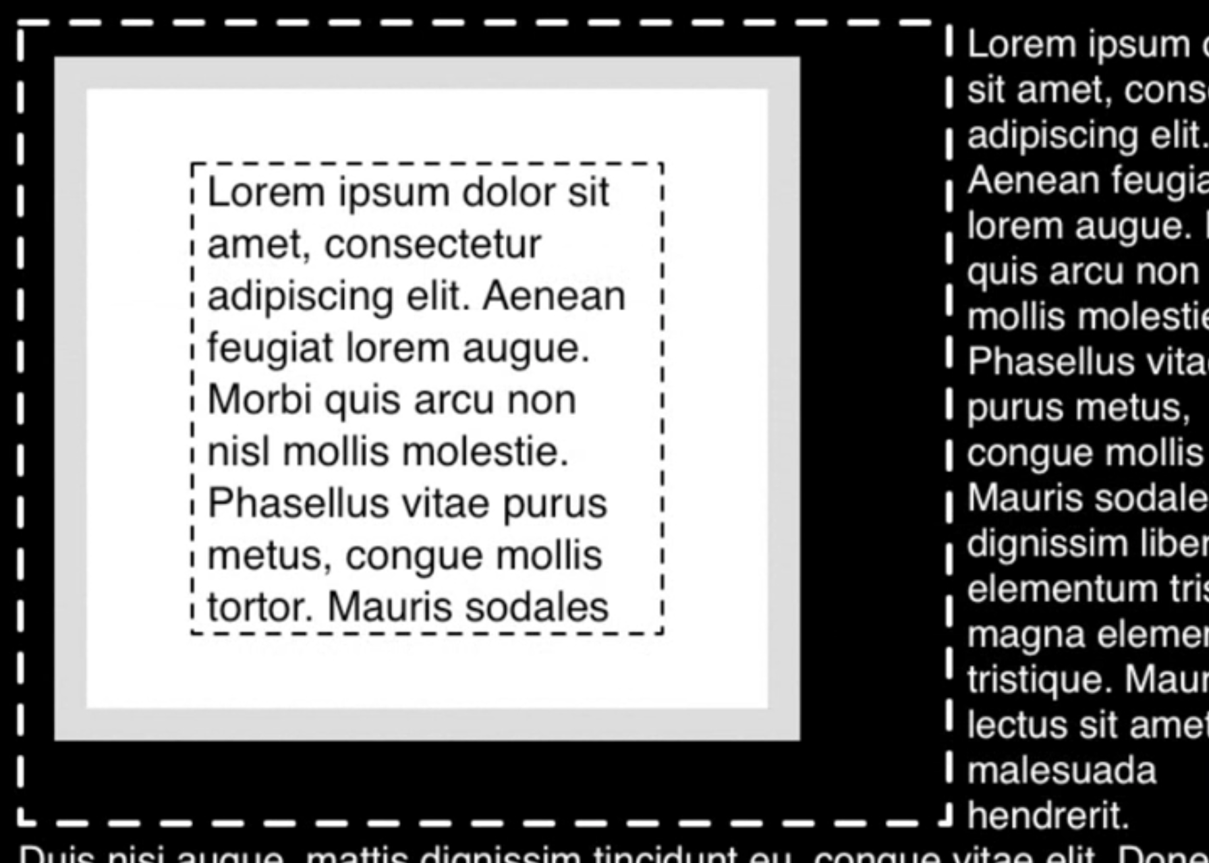
Notes:
So let’s go over the different parts of the box or block element
First of all, in the inner-most section is the content area itself
Contains the text, images, or whatever you’re placing inside this box
It has a width and a height
Outside of that is a padding
Behind all of that is a background
In this case it is set to white
Then it has a border
And it takes up a certain amount of space as well
And then there’s a margin
(Do exercise with class)

Slide 6
CSS3 Media Queries
Claim Academy

Slide 7
CSS3 @media Rule
Definition: The @media rule is used to define different style rules for different media types/devices.
In CSS2 this was called media types, while in CSS3 it is called media queries.
Media queries look at the capability of the device, and can be used to check many things, such as:
width and height of the viewport
width and height of the device
orientation (is the tablet/phone in landscape or portrait mode?)
resolution
and much more
http://www.w3schools.com/cssref/css3_pr_mediaquery.asp
Notes:
Show example on w3schools
Make template project responsive using media queries

