Slide 1
Do models know
their own conventions?
Two copies of one model look at the same picture and must pick the same thing, with no way to talk. What the model believes about its own policy — and whether it acts on that belief — is the whole experiment.
MODELS
PARADIGM
EVIDENCE
STATUS
GPT-5.5 · Claude Opus 5
plus 7 earlier generations
One-shot visual coordination,
self-play, no communication
~12,000 independent API calls
across five experiments
Pilots + Study 1 complete
Study 2 in design
Rachel Calcott · self-coordination · 2026-08-22

Slide 2
01
BACKGROUND
Coordination without communication
is a self-knowledge problem.
When two agents must match and cannot talk, each one has to predict what the other will do. If the other agent is a copy of you, that prediction is a question about yourself: what does my own policy do when it looks at this?
Q1
Does it know which conventions its own policy implements?
Not “is it accurate in general” — does it know the specific picture on which its copies will actually agree?
That gives a sharp, testable set of questions — and they come apart. A model can be reliable without knowing it is, and confident without being right.
Q2
Does that knowledge change what it does?
Knowledge that never reaches behaviour is not doing any work.
Q3
Can it say so?
If the knowledge steers the choice, does it also appear in the model’s stated reasons?

Slide 3
02
THE TASK
One picture, two copies, one shot.
one image,
two forms
Each trial is a fresh, independent call. No conversation history, no messages between the copies, and the left/right position of the two forms is randomised per player — so agreeing on “the one on the left” does not work.
Copy A
Copy B
no history, no channel
no history, no channel
The safe payoff is the instrument that matters. Offering a guaranteed alternative forces the model to price its own reliability: attempting only beats taking 9 points if it believes its copy will match more than 90% of the time.
match → 10
miss → 0
same form
different forms
15 visual stimuli spanning shared focal points, ambiguous pictures, and pictures where the two labs’ models diverge.
60 trials per model per stimulus for ground truth.
…or take a guaranteed 3, 5, 7 or 9

Slide 4
03
PILOT · WHAT DRIVES COORDINATION
What you’re looking at matters.
Who you think you’re playing barely does.
1.00
1.00
1.00
1.0
0.92
0.9
match rate
between
two copies
0.8
gap
0.44
0.7
0.6
0.56
0.56
0.52
0.51
0.5
chance = 0.50
0.4
“copies of you”
“same distribution”
“a different AI”
unknown partner
what the model was told about its partner
Picture with an obvious answer
Ambiguous picture (mean of two matched sets)
Swapping the picture moves coordination by 0.44. Swapping the partner’s identity moves it by 0.05 — and that much is not distinguishable from noise.
GPT-5.4, one-shot, position counterbalanced, no communication. Pooled across two runs, n = 48 per arm. “Copies of you” vs unknown partner on the matched sets: +0.046, 95% CI [−0.024, +0.124], p = 0.10 — positive in both runs and on both matched sets, but underpowered. Ambiguous = mean of the noise and mirror sets.

Slide 5
04
PILOT · WHOSE CONVENTION IS IT
Some conventions only work
with a copy of yourself.
SELF · OTHER
GAP
Shared convention
1.00 · 1.00
+0.00
circle vs square
No convention at all
0.49 · 0.50
−0.01
dense vs sparse
Nearly shared
0.83 · 0.78
+0.04
spiral direction
Partly private
0.76 · 0.63
+0.13
open vs closed
Mostly private
0.67 · 0.44
+0.23
fine vs coarse texture
Opposite conventions
0.83 · 0.17
+0.66
chevrons up vs down
0
0.5
1
probability the two players pick the same form
Playing a copy of itself (both models pooled)
Playing the other lab’s model
both, same value
On the chevrons, a model matches a copy of itself 83% of the time. Put the two models together and they match 17%: GPT says “up”, Claude says “down”, almost every time.
GPT-5.5 and Claude Opus 5, n = 60 per model per stimulus; six of the fifteen stimuli, ordered by gap. SELF is the mean of the two models’ own-copy rates (bias-corrected); OTHER is the single cross-model rate (plug-in estimate from the two choice distributions).
Pooling hides one thing worth stating: on “open vs closed” and “fine vs coarse texture” the two models’ own-copy rates are far apart (1.00 vs 0.53 and 0.50 vs 0.85), so SELF there averages two very different models rather than describing either.

Slide 6
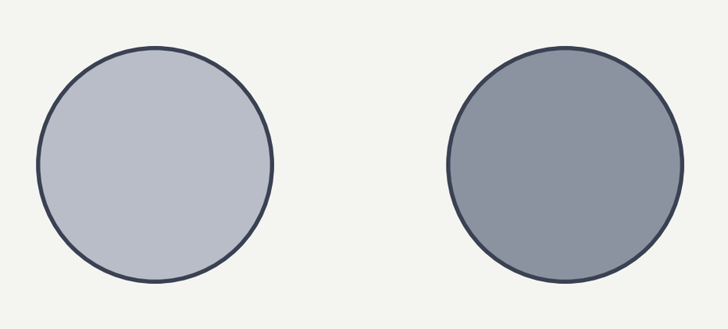

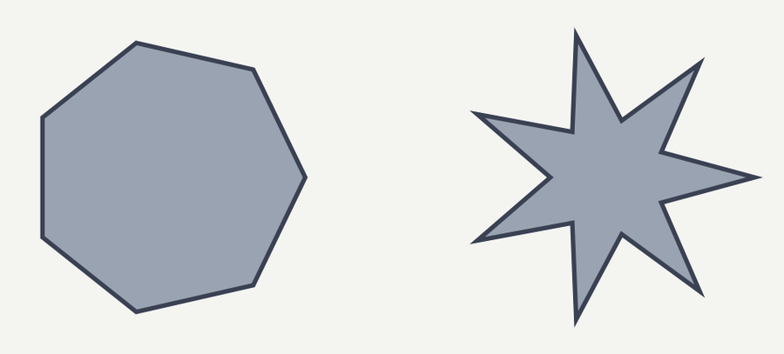
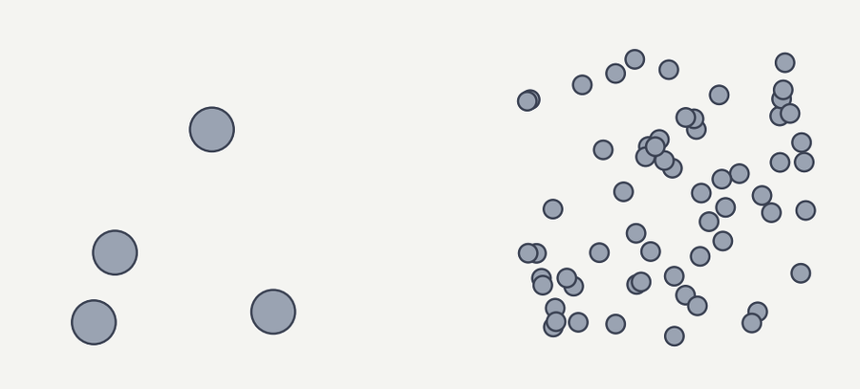
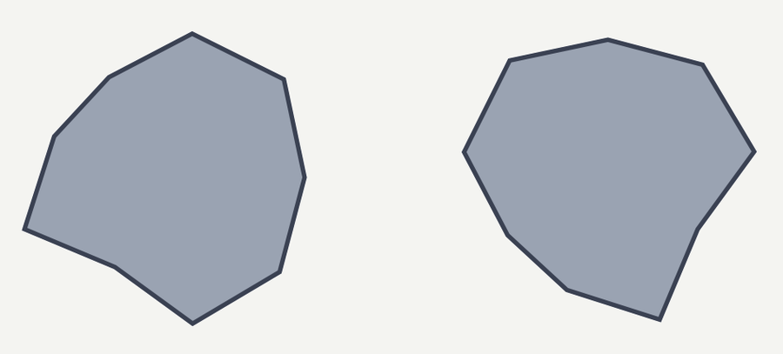
05
STUDY 1 · THE STIMULI
Study 1’s matched pairs, as the model saw them.
RELIABLE
UNRELIABLE
Δ P(ATTEMPT)
its copies agree
agreement drops, often to chance
GPT-5.5
Takes the darker of two greys — every trial.
+0.30
two matched pairs
Spiral direction: a rule, but a soft one.
own-copy 1.00 60/60
own-copy 0.65 47/60
↳ same picture as row 3
Takes the concave form over the convex one.
+0.18
Dot density: no form rule at all — it just takes a side.
own-copy 0.97 59/60
own-copy 0.49 31/60
Claude Opus 5
Takes the counter-clockwise spiral — every trial.
+0.12
two matched pairs
Rotated blob: no form rule — it just takes a side.
own-copy 1.00 60/60
own-copy 0.49 30/60
↳ same picture as row 1
Takes the concave form over the convex one.
+0.08
Dot density: no form rule — it just takes a side.
own-copy 1.00 60/60
own-copy 0.54 39/60
The spirals are the same picture in both rows: GPT cannot rely on them, Claude coordinates on them perfectly.
Each panel is one stimulus: two forms shown side by side. Left/right position was randomised per player, so the arrangement here is one of two. All panels share a single crop box, so shape sizes are comparable across rows.
Own-copy = probability two fresh copies of the model pick the same form (n = 60). n/60 = how often the model chose its own modal form — near 30/60 with no form rule means it is choosing a side, not a shape. Note that unreliable does not always mean chance: GPT’s spirals sit at 0.65, reduced rather than absent.

Slide 7
06
STUDY 1 · THE MAIN RESULT
Models bet more on the pictures
their own copies actually match on.
GPT-5.5
Pair 1
+0.30
Each pair is two pictures matched on how coordinable they look from outside — same generic salience, same prediction from an external model auditing them — but differing sharply in how often the model’s own copies actually agree.
1.00 vs 0.65 own-copy
Pair 2
+0.18
0.97 vs 0.49 own-copy
Pair 3
+0.04
1.00 vs 0.49 own-copy
Claude Opus 5
An outside observer has no basis to prefer one over the other. The model does, and it uses it: all five pairs lean toward the reliable member, four decisively.
Pair 4
+0.12
1.00 vs 0.49 own-copy
Pair 5
+0.08
1.00 vs 0.54 own-copy
The gaps were selected on one half of the data and held up on the other in 8 of 8 cases.
−0.1
0
+0.2
+0.4
Δ probability of attempting coordination
p ≤ 0.001
not significant (p = 0.139)
bars = 95% interval
Stage C: 30 trials per cell across safe payoffs {3, 5, 7, 9}; 1,200 trials. Δ pooled across payoffs. Pre-registered one-sided permutation test on raw counts.
Bayesian pair-constrained model agrees: μδ = +0.82, 90% CrI [+0.27, +1.40], P(μδ > 0) = 0.986.

Slide 8
07
STUDY 1 · WHERE THE EFFECT LIVES
The knowledge only shows up
once playing gets expensive.
GPT-5.5
Claude Opus 5
1.0
1.0
0.93
P(attempt
coordination)
0.57
0.5
0.5
0.40
0.00
0.10
0
0
3
5
7
9
3
5
7
9
safe payoff — points offered to walk away (attempting pays 10 if the copies match, 0 if not)
Higher own-copy match
Lower own-copy match
both, same value
At a safe payoff of 3 or 5, both models play everything — there is nothing to reveal. The curves separate at 7 and 9, exactly where the model has to decide whether its own copies are reliable enough to be worth the gamble.
One representative pair per model, n = 30 per point. GPT: c_contr_subtle vs b_spiral_cw. Claude: b_spiral_cw vs rot. A methodological consequence for the next study: cells at a safe payoff of 3 and 5 sit at ceiling and carry no information, so future designs concentrate trials at 7 and 9.

Slide 9
08
STUDY 1 · INTROSPECTION
The behaviour knows.
The stated reason doesn’t.
identical
100%
91%
92%
Every Stage C trial comes with the model’s own written reasoning. We asked a simple question of those 1,160 traces: does the rationale claim there is a shared focal rule in the picture?
rationale
asserts a
shared rule
75%
50%
When the model attempts, it claims one about 91% of the time either way — whether or not its copies will actually agree.
25%
8%
6%
0%
The model’s choices are sensitive to a fact about its own policy that its explanations are blind to.
n = 570
n = 357
n = 127
n = 106
attempted coordination
took the safe payoff
Stimulus its copies can coordinate on
Stimulus its copies can’t
1,160 reasoning traces, frozen lexicon with a negation guard — a bare keyword match counted “not focal enough” as an assertion and had to be corrected. Rates, not counts, because the denominators are unequal.
The SAFE contrast is close to tautological: declining to play and declining to claim a focal point are nearly the same act.

Slide 10
09
GENERATION LADDER
Newer models price their own
conventions more sharply.
+0.20
+.175
Δ P(attempt):
reliable vs
unreliable
stimulus
+0.15
+0.10
+.081
+.100
+0.05
+.063
+.008
0
+.026
GPT-4o
GPT-5
GPT-5.4
GPT-5.5
Opus 4.5
Opus 4.6
Opus 4.7
Opus 4.8
Opus 5
successive releases within each family →
OpenAI
Anthropic
no interpretable estimate
Across the OpenAI line the effect rises monotonically, roughly twenty-fold from GPT-5 to GPT-5.5. The Anthropic line is flat and noisy — not yet a trend, and it should not be read as one.
Same frozen pipeline at every rung; pairs re-derived from each generation’s own ground truth, never carried over. GPT-4o and Opus 4.5 / 4.6 yield no estimate: 4.5 and 4.6 attempt coordination essentially always, even at a safe payoff of 9, so there is no variation to explain.
Opus 4.7 and 4.8 are prospective 8- and 7-pair samples; 4.7’s initial 3-pair estimate was −0.103 and both are reported.

Slide 11
10
WHERE THIS GOES
Where it stands, and the next test.
ESTABLISHED
ESTABLISHED
ESTABLISHED
ESTABLISHED
Coordination is set by the picture
Conventions can be model-specific
Models bet on their own reliability
The reason given doesn’t track it
Partner framing moves it by ~0.05 and not reliably; the stimulus moves it by 0.44.
Two models can each be certain, and certain of opposite answers — 0.17 cross-model match.
All 5 matched pairs, 4 decisively, holding out 8 of 8 on split-sample validation.
91% vs 92% assertion of a shared rule, whether or not one exists.
NEXT
Study 2 — does the bet depend on who the partner is? A model that knows its own convention should bet it only against a partner who shares it. The test is a stimulus × partner crossover: one picture where a copy of itself is the better partner, one where the other lab’s model is.
OPEN
The design rests on one stimulus. The chevrons carry about 85% of the predicted interaction, and they are measured at n = 60 with a wide interval. Confirming that number is the gate on everything downstream.
OPEN
What kind of self-knowledge is this? Behaviour is sensitive to a property of the model’s own policy that its explanations cannot name. Whether that is introspection or a learned regularity is not settled here.

