Slide 1
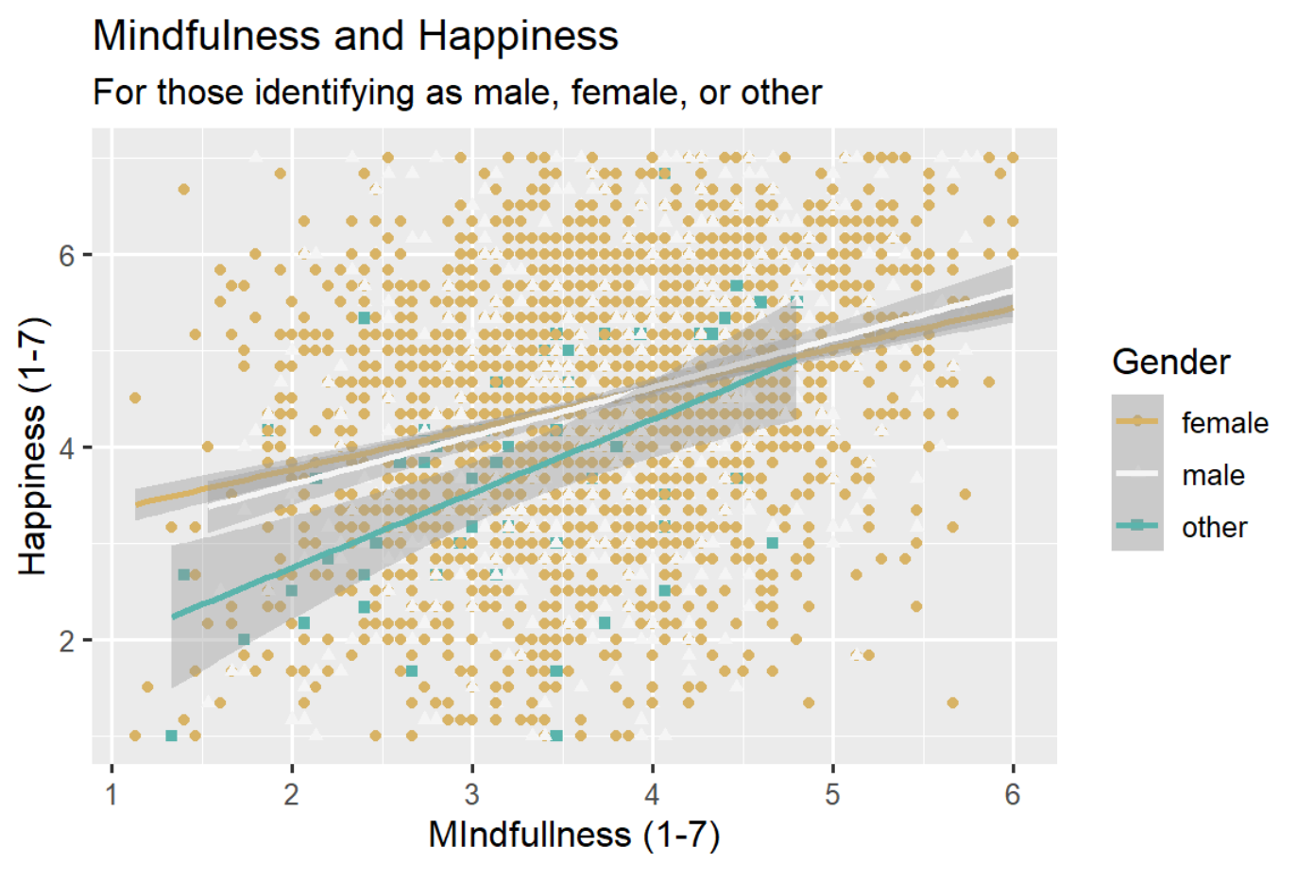
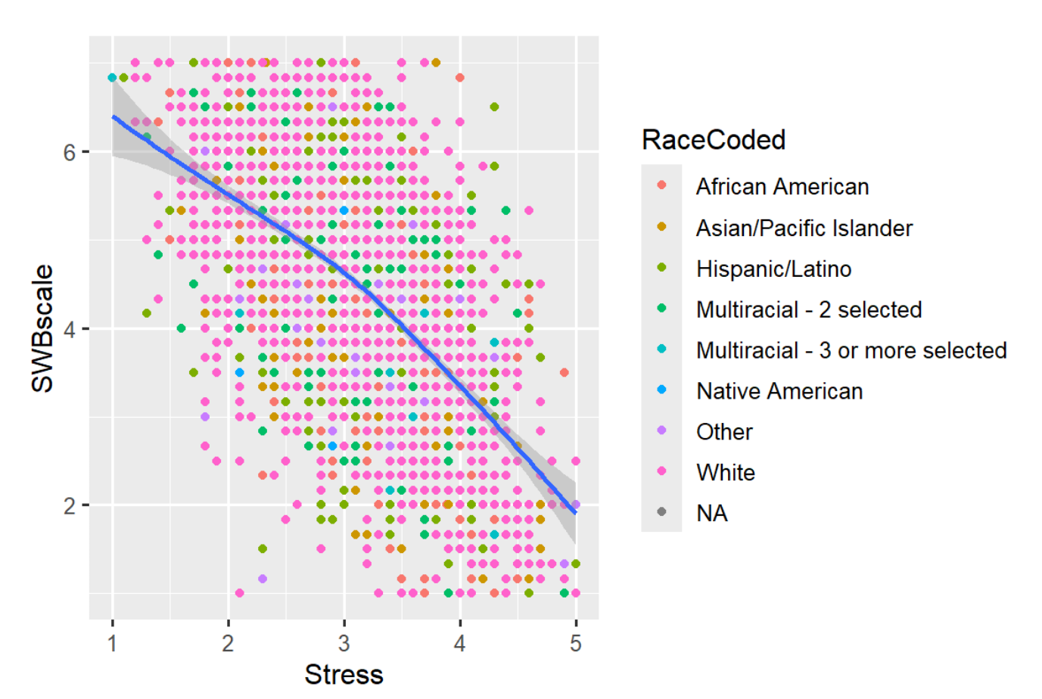
Title
Name
Introduction
Results
Any needed background information
State your question(s)
State your predictions
Use bullet points; avoid long blocks of text
Stress and Happiness
(broken down by ethnic identity)
Method
Data source
Tools used
Approach
Discussion
Data source
Tools used
Approach
Conclusion 1
Conclusion 2

