Slide 1
Machine Learning for Cyber
Unit 1: Introduction

Slide 2
Learning Outcomes
Upon completion of this unit:
Students will have a better understanding of machine learning approaches.
Students will have a better understanding of features.
Students will have a better understanding of data sets.
Students will have a better understanding of the need for machine learning to solve cyber security problems.
Students will have a better understanding of the difference between deep learning and machine learning.
Students will have a better understanding of big data and how it relates to machine learning and cyber security.

Slide 3
Terms
Machine learning
Cyber security
Big data
Deep learning
Notes:
This sets up the problem we’ll use to demonstrate various control and data structures of scripts.
This is a common security need, and various commercial tools such as tripwire and tiger do this. They are not scripts, but they work very much like what is here.
You might mention that, in practice, one would put the files we will create in places other than where this exercise puts them. Normally the files would go in a protected area, but here I opt for simplicity.

Slide 4
Tools
WEKA
Python
Numpy
Pandas
Sklearn
Tensorflow
Hadoop
Spark
AWS
GPUs, CPUs, TPUs, cognitive processors
Notes:
There are other attributes, such as i-node number, device number, time of last access, and time of last change to i-node (as opposed to time of last change to the file). Getting these requires some fancy commands and formatting (basically, call stat(1) and collapse the output into a line), and it seemed easier not to do this in this unit.
All of these can be obtained from the widely used “ls” command.

Slide 5
What is machine learning?
Methods for predicting, detecting , or grouping data samples based on a model
The model must be learned with data
Methods can be geometrical (or not) and the model is based on distance metrics or linear boundaries
Notes:
In practice, we would take special care of the file holding the attributes and names (keep them on write-once media, etc.).

Slide 6
Why machine learning for cyber?
Too much data
Building models by hand is labor intensive
Machine learning can also learn models

Slide 7
What is big data?
Lots of data
Terabytes
So much data that a single computer with 8 RAM and latest CPU cannot do the work
Instead, need more powerful computer
Better yet, several computers working in parallell
Two main approaches:
Parallel CPUs
GPUs (1 or several also in parallel)

Slide 8
Machine learning Terms - 1
Supervised
Classifiers
Classifier
Y_test
Train Data
Train Model
Evaluation
dividing
Data
X_test
Test Data

Slide 9
Machine learning Terms - 2
Unsupervised
Clustering
Clustering
Data
Clustered Data
Evaluation

Slide 10
Machine learning Terms - 3
Features
Data sets
Data pre-processing
Performance metrics

Slide 11
Machine learning algorithms
Naïve Bayes
Decision trees
Random forest
KNN
Linear regression
Logistic regression
Neural networks
Support Vector Machines

Slide 12
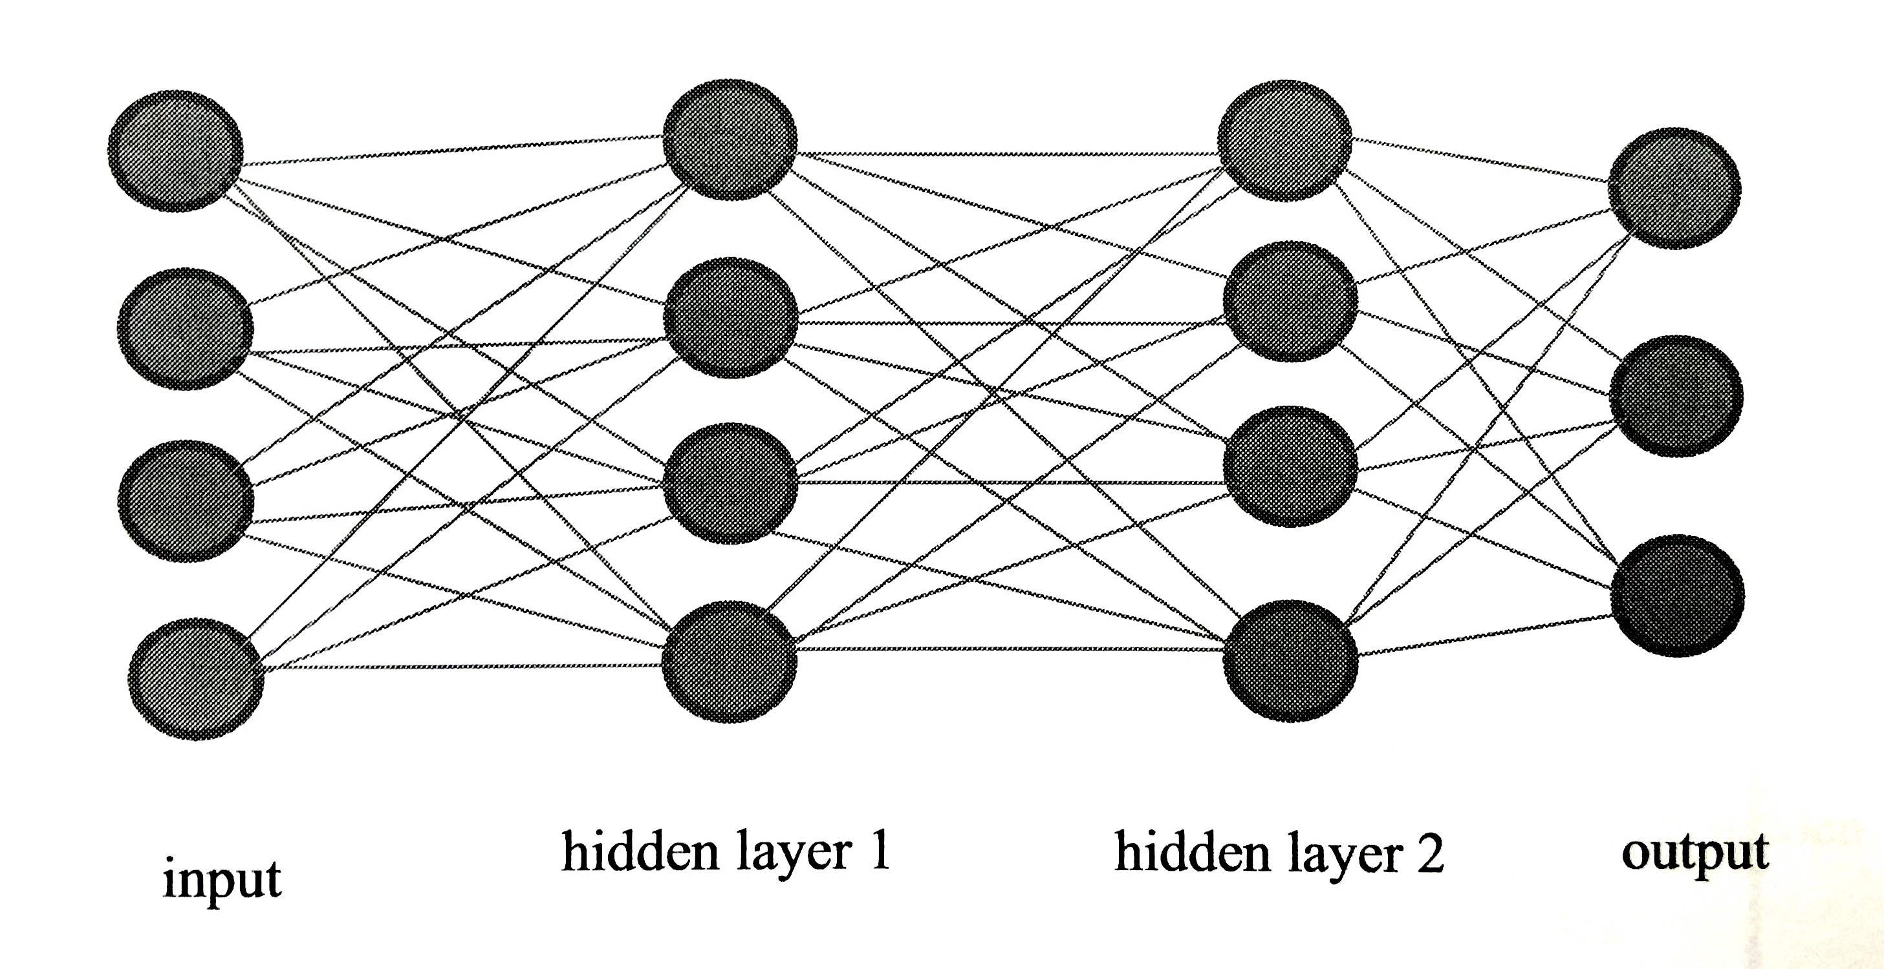
What is deep learning?
Neural networks with more layers between the input and output layers
Batch processing for big data
Matrix multiplication operation takes advantage of GPUs
Have outperformed all others since around 2012

Slide 13
Machine learning pipeline
Pre-processing
(formatting, featured…)
Data
Vector Space Model
Evaluation
Machine Learning Algorithms

Slide 14
Dataset formats
.csv
0,tcp,http,SF,162,4528,0,0,0,1, … ,normal.
.libsvm
[label] [index 1]:[value 1] [index 2]:[value 2] …
.arff
The format of Weka storage data
@duration numeric
@protocol_type {tcp,udp,icmp}
…
@data
0,tcp,http,SF,162,4528,0,0,0,1, … ,normal
etc …

Slide 15
What is a sample?
Defining your sample is critical
Examples:
A single item: text (Bag-of-Words)
Data science is popular.
An image: fingerprint.bmp
Elements or averages within a time window:

Slide 16
Data sets
NSL-KDD network intrusion
Unsw big data networking
Iris
Phishing
Honeypot unsupervised
Denial of service
Malware
Ransomware
Biometrics

Slide 17



Companies using Machine learning
Tesla
Facebook
Google
Amazon (Alexa for instance)
Apple 
Microsoft

Slide 18


Companies using machine learning for Cyber
Northrop Grumman
BluVector
Banks
Etc.

Slide 19
Sample Code
Additionally, all the code used in this book can be obtained from GitHub at Prof. Calix's Github and any other complimentary materials

Slide 20
Environment
Virtual Machine
You can use the latest version of Linux to run your code.
Ubuntu 14.04 to 16.04 (64 bit) and Mac
Tensorflow from (Tensorflow Website )
Sklearn from (Scikit-learn Website )
AWS

Slide 21
If you want to build a physical box
A GPU GeForce gtx980 or better (or 1070 or Titan)
A CPU such as the AMD 8 CORE
Power supply EVGA SuperNOVA 1200 P2 220
Motherboard for GPU and CPU
32 MB of RAM (DDR3)
SSD hard drive 1 TB
A case
The total cost for 1 device with just 1 CPU and 1 GPU may be between $1,500 and $2,000.

Slide 22
Summary
Intro to data science
Intro tools for data science
Intro machine learning and deep learning
Intro cyber security datasets for the course
Intro environment for the course

