Slide 1
Machine Learning for Cyber
Unit 3: Performance Metrics

Slide 2
Learning Outcomes
Upon completion of this unit:
Students will have a better understanding of machine learning approaches.
Students will have a better understanding of features.

Slide 3
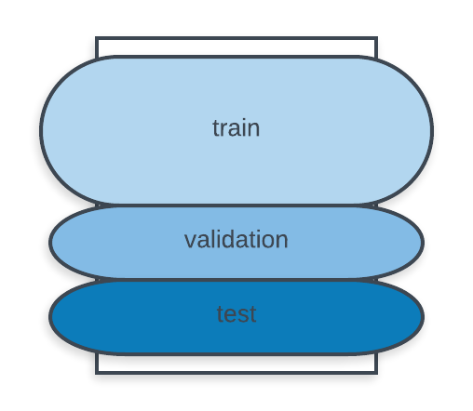
What are performance metrics?
Determine how well a model performs on the data
Data is divided
train
validation
test
60%
20%
20%
Notes:
This sets up the problem we’ll use to demonstrate various control and data structures of scripts.
This is a common security need, and various commercial tools such as tripwire and tiger do this. They are not scripts, but they work very much like what is here.
You might mention that, in practice, one would put the files we will create in places other than where this exercise puts them. Normally the files would go in a protected area, but here I opt for simplicity.

Slide 4
Splitting the data
80%/20%
10-fold cross validation
Notes:
There are other attributes, such as i-node number, device number, time of last access, and time of last change to i-node (as opposed to time of last change to the file). Getting these requires some fancy commands and formatting (basically, call stat(1) and collapse the output into a line), and it seemed easier not to do this in this unit.
All of these can be obtained from the widely used “ls” command.

Slide 5
Metrics
Accuracy
Precision
Recall
F-measure
Confusion matrix
ROC curve

Slide 6
Performance classifiers evaluation
We will use the sklearn.metrics module for performance evaluation of the classifiers.
I will show that this module can be used with SKlearn classifiers and with Tensorflow classifiers.
Again, this will help to more easily understand deep learning since we don’t have to use the more complex and very verbose Tensorflow functions.

Slide 7
Metrics
accuracy_score
recall_score
f1_score
precision_score
confusion_matrix

Slide 8
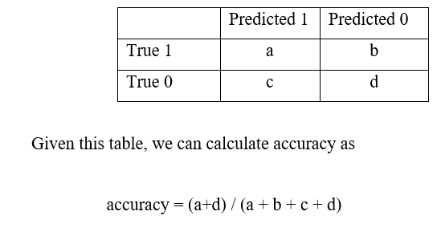
Accuracy

Slide 9
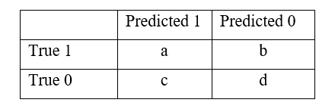
Precision
precision = a / (a + c)

Slide 10
Recall
recall = a / (a + b)

Slide 11
F-measure
F = (2 * (precision*recall)) / (precision + recall)

Slide 12
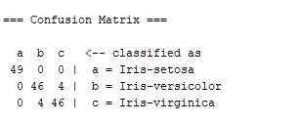
Confusion Matrix

Slide 13
Round 2: An example …
Would you believe someone who claimed to create a model to identify terrorists trying to board flights with greater than 99% accuracy?
Well, here is the model: simply label every single person flying from a US airport as not a terrorist.
Given the 800 million average passengers on US flights per year
and
the 19 (confirmed) terrorists who boarded US flights from 2000–2017
this model achieves an astounding accuracy of 99.9999999%!
That might sound impressive, but the US Department of Homeland Security may not be calling anytime soon to buy this model.
While this solution has nearly-perfect accuracy, this problem is one in which accuracy is clearly not an adequate metric!

Slide 14
Example
The terrorist detection task is an imbalanced classification problem: we have two classes we need to identify
terrorists
not terrorists
with one category representing the overwhelming majority of the data points.
Another imbalanced classification problem occurs in disease detection when the rate of the disease in the public is very low.
In both these cases the positive class — disease or terrorist — is greatly outnumbered by the negative class.
These types of problems are examples of the fairly common case in data science when accuracy is not a good measure for assessing model performance.

Slide 15
Example
Intuitively, we know that finding all negative data points in the terrorist detection problem is not helpful and, instead, we should focus on identifying the positive cases.
The metric our intuition tells us we should maximize is known in statistics as recall,
or the ability of a model to find all the relevant cases within a dataset.

Slide 16
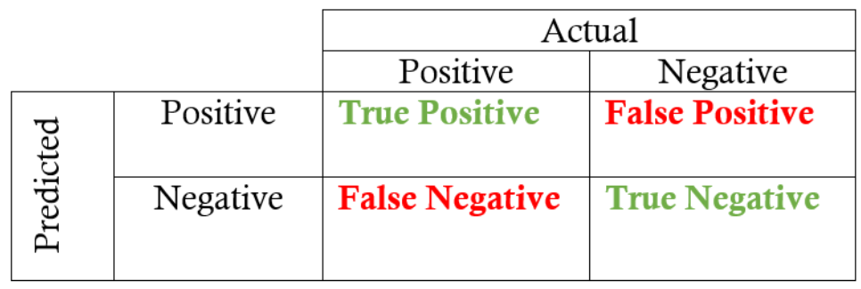
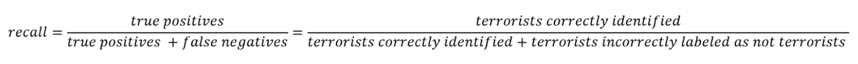
Recall
The precise definition of recall is the number of true positives divided by the number of true positives plus the number of false negatives.
True positives are data point classified as positive by the model that actually are positive (meaning they are correct), and false negatives are data points the model identifies as negative that actually are positive.
In the terrorism case, true positives are correctly identified terrorists, and false negatives would be individuals the model labels as not terrorists that actually were terrorists.
Recall can be thought of as a model’s ability to find all the data points of interest in a dataset.

Slide 17
Recall
all
none
How can we find all terrorists?
In this case, let us predict everyone as a terrorist and problem solved. Recall will be high, right?
Problem: In the case of recall, when we increase the recall, we decrease the precision.
Again, we intuitively know that a model that labels 100% of passengers as terrorists is probably not useful because we would then have to ban every single person from flying.
This approach would suffer from low precision, or the ability of a classification model to identify only the relevant data points

Slide 18
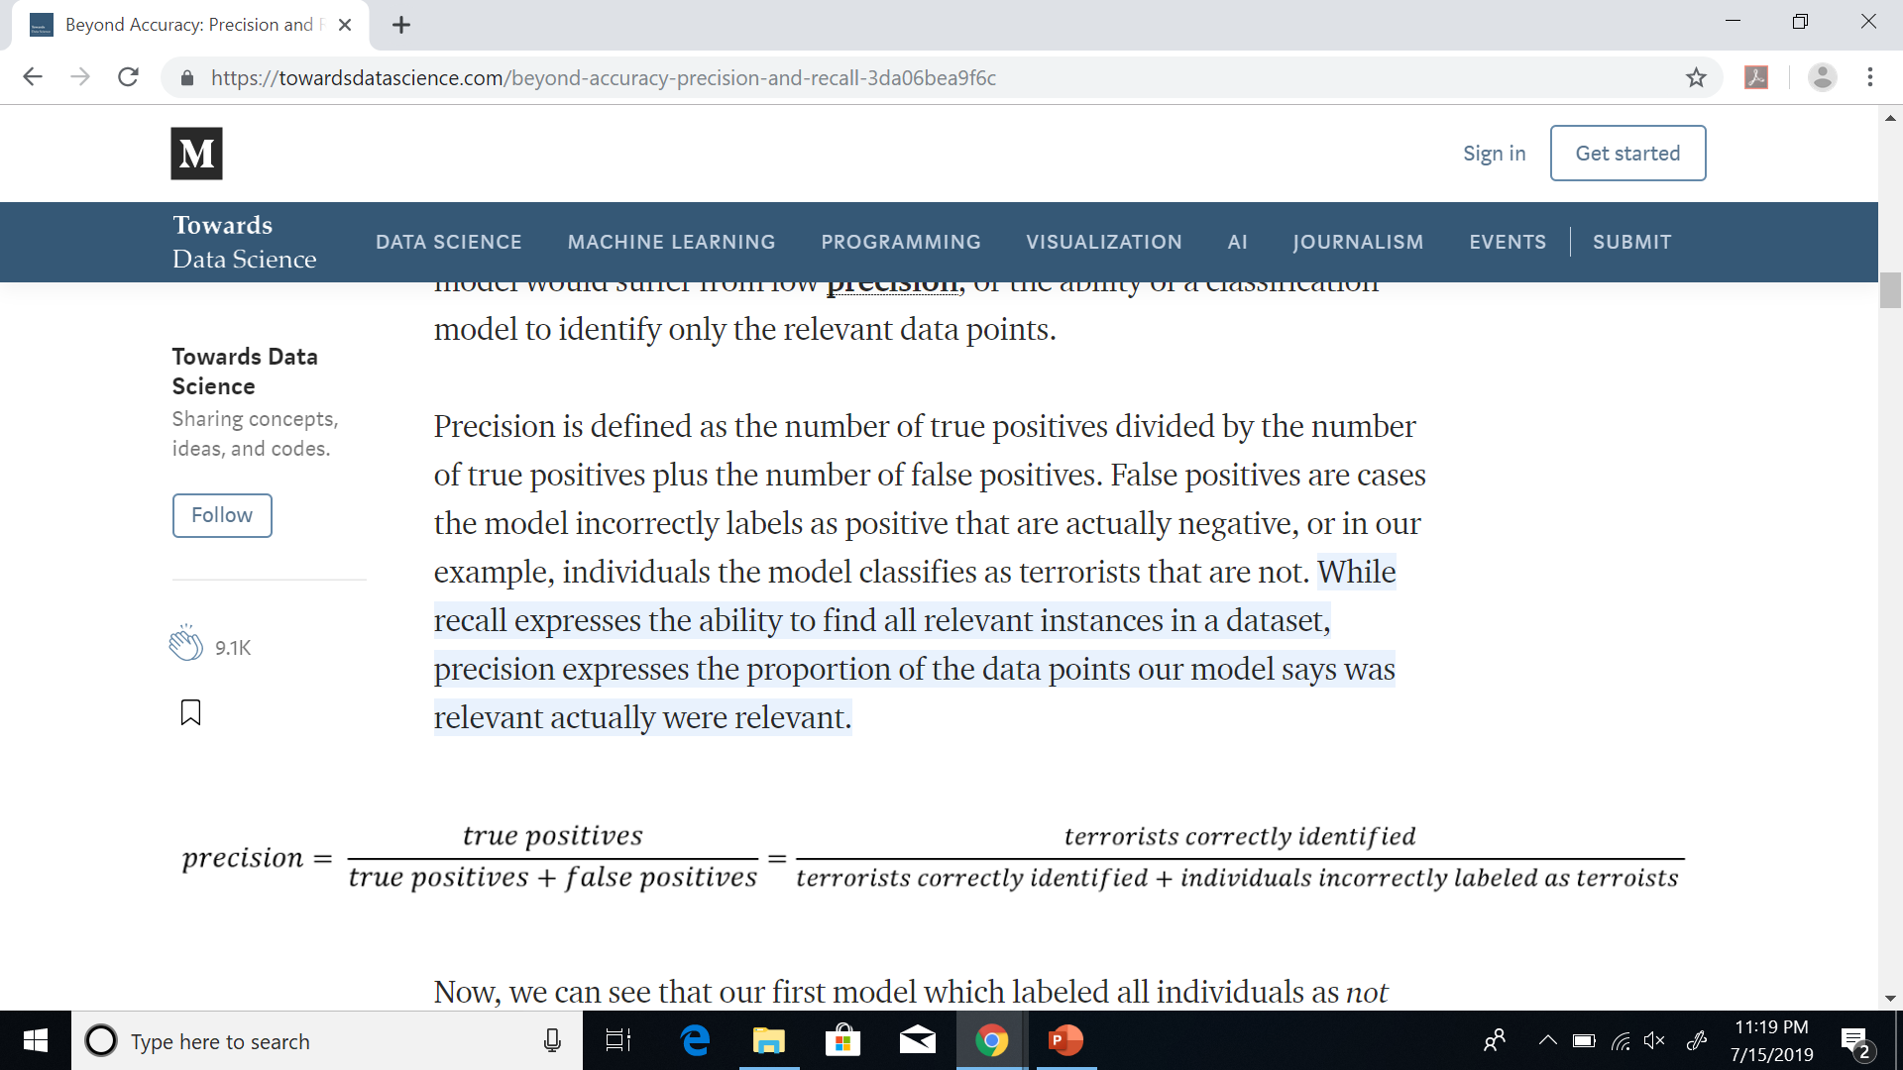
Precision
Precision is defined as the number of true positives divided by the number of true positives plus the number of false positives.
False positives are cases the model incorrectly labels as positive that are actually negative, or in our example, individuals the model classifies as terrorists that are not.
precision expresses the proportion of the data points our model says were relevant and actually were relevant.

Slide 19
Now, we can see that our first model which labeled all individuals as not terrorists wasn’t very useful. - Accuracy
Although it had near-perfect accuracy, it had 0 precision and 0 recall because there were no true positives
Say we modify the model slightly, and identify a single individual correctly as a terrorist.
Now, our precision will be 1.0 (no false positives) but our recall will be very low because we will still have many false negatives.
If we go to the other extreme and classify all passengers as terrorists, we will have a recall of 1.0 (false negative = 0)— we’ll catch every terrorist — but our precision will be very low and we’ll detain many innocent individuals.
In other words, as we increase precision we decrease recall and vice-versa.

Slide 20
Combining precision and recall
In some situations, we might know that we want to maximize either recall or precision at the expense of the other metric.
For example, in preliminary cancer screening of patients for follow-up examinations, we would probably want a recall near 1.0 — we want to find all patients who actually have cancer— and we can accept a low precision if the cost of the follow-up examination is not significant.
However, in cases where we want to find an optimal blend of precision and recall we can combine the two metrics using what is called the F1 score.

Slide 21
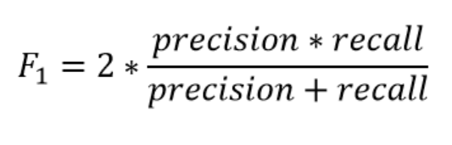
F1
The F1 score is the harmonic mean of precision and recall taking both metrics into account in the following equation:

Slide 22
F1
We use the harmonic mean instead of a simple average because it punishes extreme values.
A classifier with a precision of 1.0 and a recall of 0.0 has a simple average of 0.5 but an F1 score of 0.
The F1 score gives equal weight to both measures
There are other metrics for combining precision and recall, such as the Geometric Mean of precision and recall, but the F1 score is the most commonly used. Weights could also be adjusted to favor one or the other.
If we want to create a balanced classification model with the optimal balance of recall and precision, then we try to maximize the F1 score.

Slide 23
Performance Evaluation
Evaluation of the performance of your classifiers is extremely important.
The SKlearn kit provides very good modules to address this issue.
In particular, evaluation often involves measuring accuracy, precision, recall, and f-measure.
The best way to understand these metrics is to think of a confusion matrix.
Confusion matrices show how many elements from a class are correctly and incorrectly classified.

Slide 24
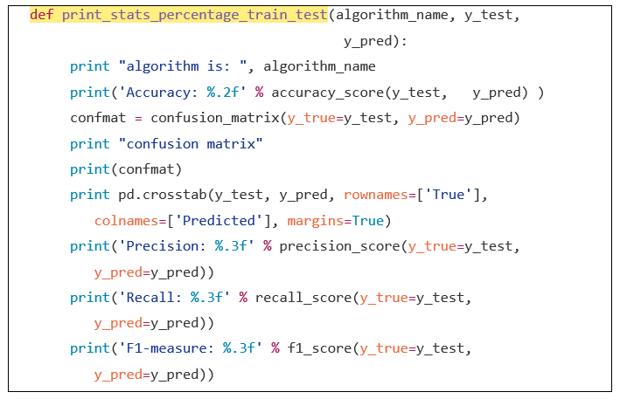
The sample code to obtain the metrics
Notes:
def print_stats_percentage_train_test(algorithm_name, y_test,
y_pred):
print "algorithm is: ", algorithm_name
print('Accuracy: %.2f' % accuracy_score(y_test, y_pred) )
confmat = confusion_matrix(y_true=y_test, y_pred=y_pred)
print "confusion matrix"
print(confmat)
print pd.crosstab(y_test, y_pred, rownames=['True'],
colnames=['Predicted'], margins=True)
print('Precision: %.3f' % precision_score(y_true=y_test,
y_pred=y_pred))
print('Recall: %.3f' % recall_score(y_true=y_test,
y_pred=y_pred))
print('F1-measure: %.3f' % f1_score(y_true=y_test,
y_pred=y_pred))

Slide 25
Code explanation
The code above shows a function to print the performance metric statistics.
Two sets are provided which are y_pred and y_test.
The y_test data set contains the original annotated labels.
The y_pred data set contains the labels predicted by your classifier.
Each of the metric functions such as f1_score and recall_score uses these 2 data sets to calculate the respective metric.

Slide 26
Summary
Performance metrics

