Slide 1
Machine Learning
Unit 4: WEKA

Slide 2
Learning Outcomes
Upon completion of this unit:
Students can explain the basics of WEKA.
Students will be able to demonstrate methods in WEKA.

Slide 3
What is WEKA?
WEKA in a java-based program for machine learning
Easy to use
GUI based
For quick prototyping
Not really for big data
Notes:
This sets up the problem we’ll use to demonstrate various control and data structures of scripts.
This is a common security need, and various commercial tools such as tripwire and tiger do this. They are not scripts, but they work very much like what is here.
You might mention that, in practice, one would put the files we will create in places other than where this exercise puts them. Normally the files would go in a protected area, but here I opt for simplicity.

Slide 4
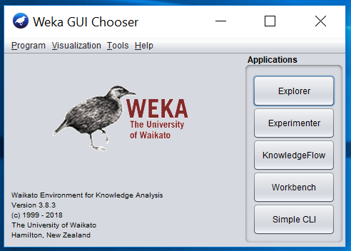
Basic Menu

Slide 5
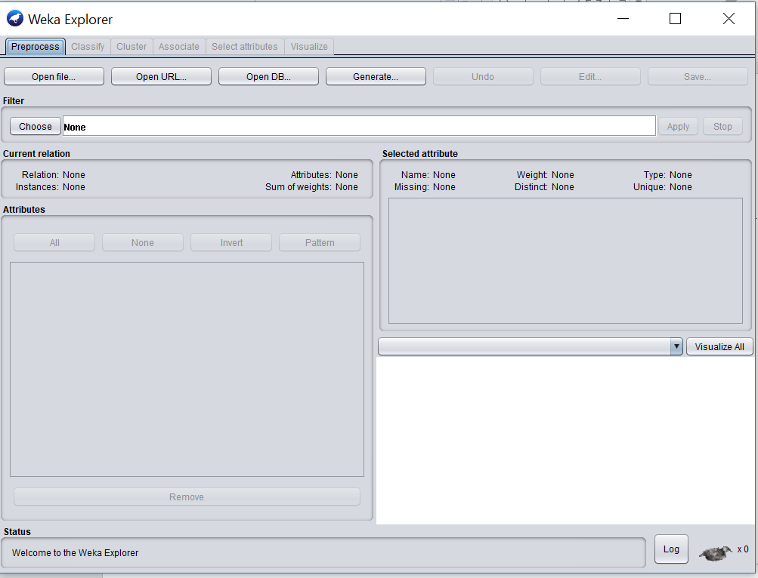
The explorer

Slide 6
ARFF format

Slide 7
Features or Class
Numeric
Nominal
Data types in Weka

Slide 8
Classifiers
j48 – decision tree

Slide 9
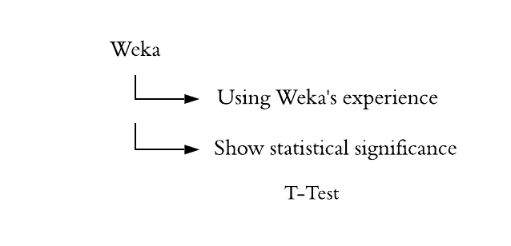
Statistical significance

Slide 10
Feature ranking
Features tab
Features tab
Info gain /Chi-Squre
And it ranks the feature

Slide 11
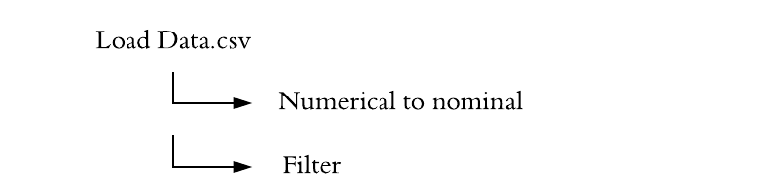
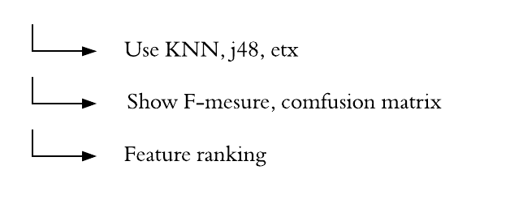
WEKA for cyber security

Slide 12
Summary

