Slide 1
Machine Learning for Cyber
Unit : Linear Regression in TensorFlow

Slide 2
Learning Outcomes
Upon completion of this unit:
Students will have a better understanding of linear regression in TensorFlow
Basic theory of linear regression algorithm
TensorFlow
mechanics

Slide 3

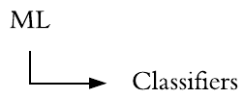
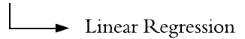
Linear regression
0
1
2
200,000
300,000

Slide 4
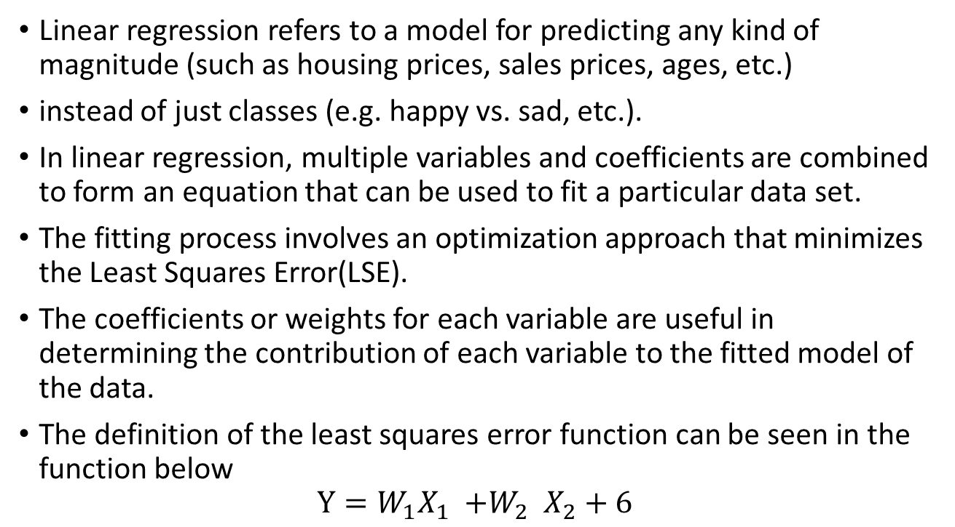
Linear regression
Linear regression refers to a model for predicting any kind of magnitude (such as housing prices, sales prices, ages, etc.)
instead of just classes (e.g. happy vs. sad, etc.).
In linear regression, multiple variables and coefficients are combined to form an equation that can be used to fit a particular data set.
The fitting process involves an optimization approach that minimizes the Least Squares Error(LSE).
The coefficients or weights for each variable are useful in determining the contribution of each variable to the fitted model of the data.
The definition of the least squares error function can be seen in the function below
$$Y=W_{1}X_{1} {+W}_{2} X_{2}+6$$

Slide 5
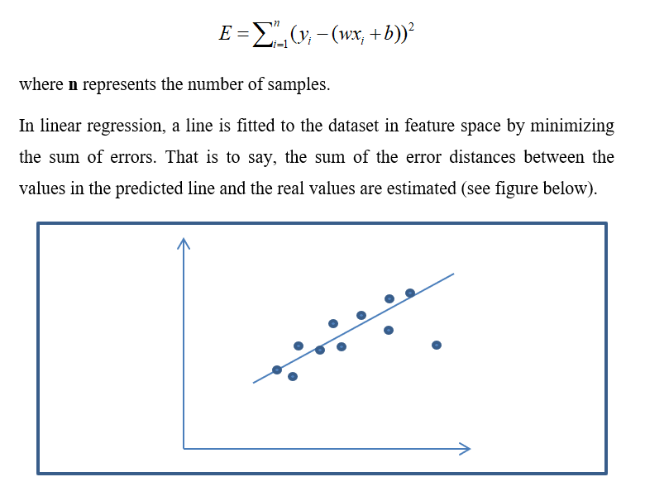
LSE

Slide 6


linear regression equation
This simple equation defines the linear regression and the parameters that must be learned given the training data.
With this theoretical framework I will now proceed to describe how to code this with TensorFlow.
The linear regression model is implemented in the code below.
The purpose of the code below is to be simple and to show how a linear regression algorithm can be implemented in python using TensorFlow.
$$\hat{y}=mx+b$$
$$\hat{y}=wx+b$$
M

Slide 7
Linear regression
For our example, we are going to assume a very simple regression problem for housing prices.
We are going to have 1 input (1 feature x₁) in our samples (the size of the house) and we will predict 1 output value y (the cost of the house).
IRIS
y Housing Prices
class
F1
F2
F3
F4
Mag
F1
0
200,000
1000
0
250,000
2000
1
400,000
4000
0
2

Slide 8
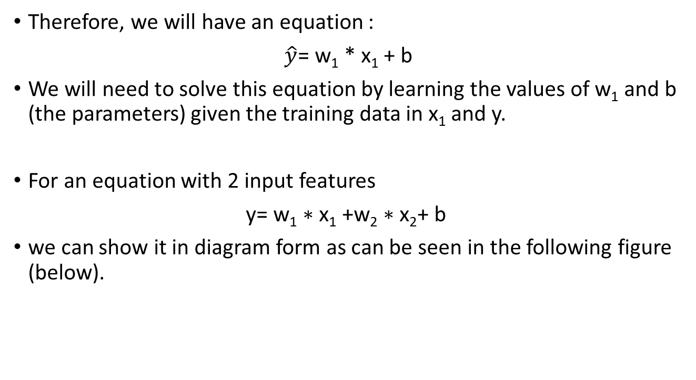
Linear regression cont'd
Therefore, we will have an equation :
$\hat{y}\text{= }\text{w}\text{1}\text{ ∗ }\text{x}\text{1}\text{ + }\text{b}$
We will need to solve this equation by learning the values of w₁ and b (the parameters) given the training data in x₁ and y.
For an equation with 2 input features
y$\text{= }\text{w}\text{1}\text{ ∗ }\text{x}\text{1} \text{+}\text{w}\text{2}\text{ ∗ }\text{x}\text{2}\text{+ }\text{b}$
we can show it in diagram form as can be seen in the following figure (below).

Slide 9
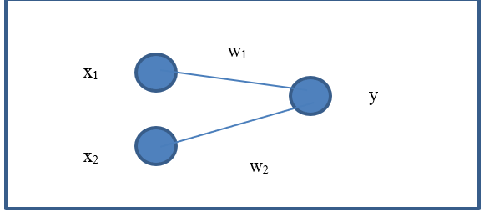
Linear regression
neural networks
TensorFlow
linear regression
TensorFlow

Slide 10
linear regression equation
As shown in the previous equation, a linear regression is an equation made up of 3 main elements: x, w, and b.
The x value holds the training data (features), w represents the weights per feature, and b is the offset value (bias) learned by the model.
These values are directly coded into our algorithm using TensorFlow. In the code below, after the library declarations, 4 variables have been declared. They are:
D -- x
D -- y_
M -- W
M -- b
Matrix

Slide 11
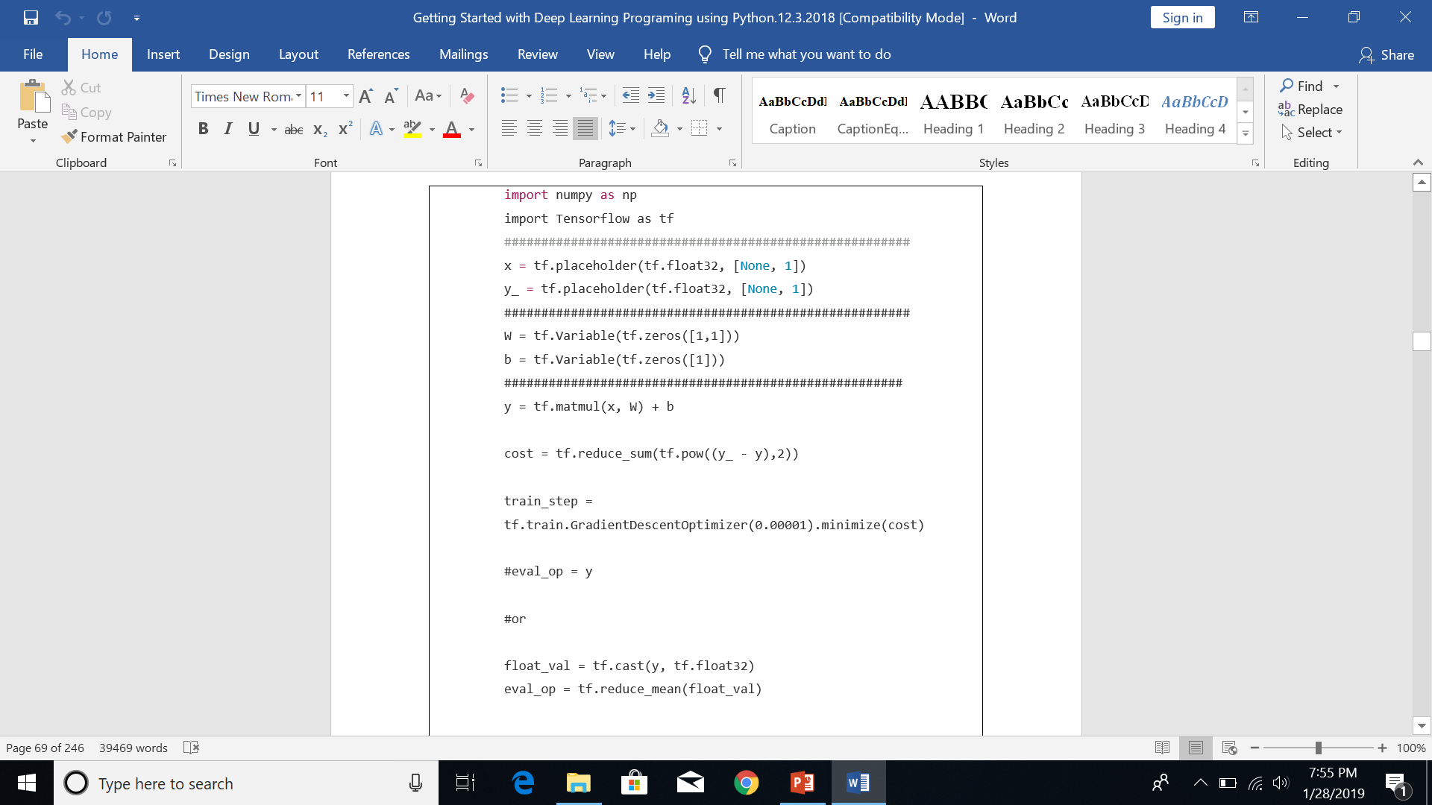


Code
$$y_={(y−\hat{y})}^{2}$$
$$\hat{y}=wx+b$$
1
2
3
4

Slide 12
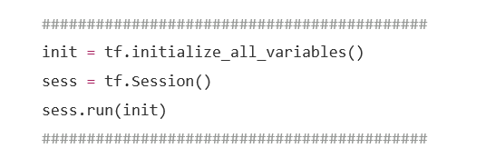
Session

Slide 13
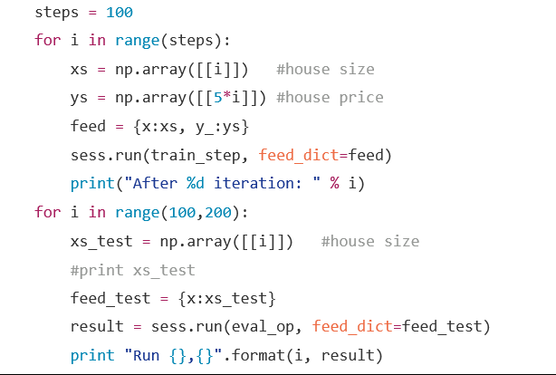
Code example

Slide 14
Place holders
The variables x and y_ are defined with Tensorflow placeholders.
These are used to store our data whether training or testing.
So, the data you read from your .csv or other source files goes here.
The syntax to declare a variable to hold the data is as follows:
x = tf.placeholder(tf.float32, [None, 1]).

Slide 15
Dimensions
Notice that you declare the data type (tf.float32), and you define the dimensions of the x variable.
In this case, “None” and 1 are the dimensions of the feature data for our toy linear regression model.
The number 1 means that this data has only 1 feature or column (x₁).
The “None” parameter indicates that the number of rows can vary.
For this example, x is the feature data and y_ holds the labels for each sample in x.

Slide 16
Variables
The other 2 variables, W and b, are variables that define the prediction equation.
They are the parameters to be learned.
W and b are matrices (tensors) whose dimensions need to be defined.
This is where we start to define the architecture of our models. In this case, the dimensions are [1,1] for W and just [1] for b.
Notice that we initialize these matrices with the Tensorflow construct tf.zeros().
In the case of W the dimension is [1, 1] because it is for a model with 1 feature (x₁) and 1 output value (the predicted housing price y).
Think of W as a matrix that connects one layer to the next. In this case, we are connecting the inputs to the outputs.

Slide 17
eval_op
In the previous code, the statement
eval_op = tf.reduce_mean(float_val)
is used because there is only one value in the tensor.
For example [[996.23]] and the function tf.reduce_mean() returns just the value 996.23 (i.e. without the square brackets).
The function tf.reduce_mean() is a built in Tensorflow function that takes as input a tensor and computes the mean of the elements across the dimensions of a given tensor.
So, it returns a reduced tensor.

Slide 18
tf.reduce_mean()
For example, given:
x = tf.constant( [[1, 1] , [2, 2]] )
we can get the following:
all = tf.reduce_mean(x) => # 1.5
all = tf.reduce_mean(x, 0) => # [1.5, 1.5]
all = tf.reduce_mean(x, 1) => # [1, 2]
To see the results, we can run:
print sess.run(all)

Slide 19
Core Functions
Okay, so now that we have defined the variables, the next step is to define the equation and define the cost function to learn the parameters (e.g. the weights).
To do that, we use the following section of code.
This is one of the most important parts of deep learning programming.
I also want to emphasize that the code in the segment below is the section that will vary the most for the different models.
That is, this is where we define the specifics of the linear regression model, or the logistic regression model, or the neural network model, or the deep neural network model.
In essence, this is the heart or core of it all or is it the brains?

Slide 20

Core Functions

Slide 21
tf.matmul( , )
So, defining the specifics of the code means defining the regression equation and the cost function.
Here we use the following statements to accomplish this.
These 2 lines of code do all the heavy lifting.
y = tf.matmul(x, W) + b
cost = tf.reduce_sum(tf.pow((y_ - y),2))

Slide 22
tf.matmul()
The first statement y = tf.matmul(x, W) + b defines the regression equation.
We use tf.matmul(x, W) to perform the matrix multiplication and we add b to the result.
The dimensions of the b vector need to match the dimension of the j index of the weights vector (weights=[i, j]).
As a side note, I will point out here that Tensorflow is designed to be used with GPUs, and GPUs are very good at matrix multiplications.
The function tf.matmul() will perform these multiplications. This is the power of Tensorflow.

Slide 23
Cost
The line cost = tf.reduce_sum(tf.pow((y_ - y),2)) defines the cost function.
This is the standard least squares cost function in linear regression.
Notice that the tf.pow() function raises the difference between vector y_ and vector y to the power of 2.
This result is passed through the tf.reduce_sum() function and assigned to cost.
The function tf.reduce_sum() computes the sum of the elements across dimensions of a tensor.

Slide 24
tf.reduce_sum()
>>>x = tf.constant( [[1, 1, 1], [1, 1, 1]])
>>>y = tf.reduce_sum(x) #6
>>>y = tf.reduce_sum(x, 0) #[2, 2, 2]
>>>y = tf.reduce_sum(x, 1) #[3, 3]

Slide 25
Gradient Descent
Whenever we want to reference the cost function or the regression equation, we can just do so by the variable names we defined for them which are y and cost, in this case.
Once the cost function is defined, we need to tell the model what optimization to use. In this case, the line:
train_step=tf.train.GradientDescentOptimizer(0.00001).minimize (cost)
indicates that we should use a gradient descent optimizer with a step size of 0.00001.

Slide 26
train_step
This object, train_step, is now the optimizer which references the cost function via cost.
And cost itself is linked to the regression equation via y.
The final part of this code segment just takes the predicted y value and performs typecasting and reducing operations (e.g. if you have a vector of values, average all of them and return 1 averaged value).

Slide 27
Graph
Train_step
Gradient_ descent
cost
reduce
pol
-
y_
2
y
+
b
Matmul
eval_op
X
w

Slide 28
Init
Once the inner workings of the model are defined, the next step is to move to the session definition and the main loop.
In the code segment below, we can see that this process involves defining the variables init and sess.
The init variable will call:
tf.initialize_all_variables()
which initializes all the variables and placeholders (the tensors) in the graph once you run the session.

Slide 29
sess.run()
Consider that at this point all we have done is define the graph structure without actually running anything in Tensorflow.
To run things in Tensorflow we use sess.run() with the variable we want to run it with.
In this case, we want to initialize the variables so we run sess.run(init).

Slide 30
Session
init = tf.initialize_all_variables()
sess = tf.Session()
sess.run(init)

Slide 31
Main Loop
Finally, the last part in our linear regression code is to run the main loop to actually train and test the model.
In this case, I have broken up the main loop into 2 separate loops for better visualization.
The first loop is for training and the second loop is for testing. The first training loop is very simple.
The training data, in this case, is not read from a file but instead is created automatically.
The feature vector is stored in xs and contains only one feature (x₁) which is the “i” index.
This feature represents the size of the house.
The corresponding housing price for each xs sample is stored in ys.

Slide 32
housing price example
For this scenario, each housing price value is 5 times its corresponding house size.
Therefore, our model after training should be equivalent to:
y = 5 * x₁ + b.
In this case, the training phase would optimize the weight vector to be equal to 5 (W₁=5).
Notice that the process is repeated 100 times.
Once xs and ys are defined, these values are assigned to the feed dictionary.
This is an internal mechanism of Tensorflow that is very useful f
or passing the data from the python code to the Tensorflow graph. In this case, xs is assigned to x and ys is assigned to y_.
These variables are the same ones that we have already defined in the code.

Slide 33
sess.run(train_step)
The last part is to run the graph. Finally, this is where your Tensorflow code will run.
Before now, the code had not executed but after sess.run(train_step), the code finally executes.
In this case we run train_step and everything that is linked to train_step.
So we run the gradient descent optimizer, the cost function for least squares estimation, and the linear regression equation.

Slide 34
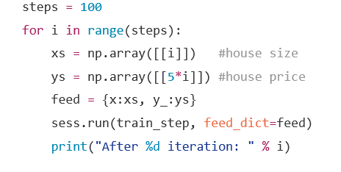
Train Loop

Slide 35
The second loop
The second loop (below) is very similar to the first one except that it is focused on the testing phase.
Here we use the model from the training phase to predict the housing prices given the house sizes for the range of values from 100 to 200.
Remember that the data is created automatically, for this example. Notice that sess.run() now calls eval_op.
The variable eval_op is linked to y which is basically the linear regression model.

Slide 36
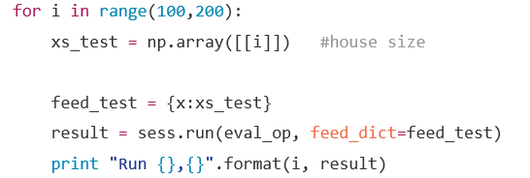
Test Loop

Slide 37
xs_test
So, here we used the trained model but with a new dataset xs_test.
The result is stored in the variable result and printed out on the screen.
The result of the classification should be that the regression model predicts housing prices that are 5 times the input house size.
This outcome can be seen in the output below.

Slide 38

Results

Slide 39
Modular Approach
The previous code for linear regression can be re-written in a more modular form using function calls.
This approach will be very helpful later on as most implementations can be written in the same way and the only thing that changes is the internal definition of the functions.
This new modular approach can be seen next.

Slide 40
Code

Slide 41
Code example

Slide 42
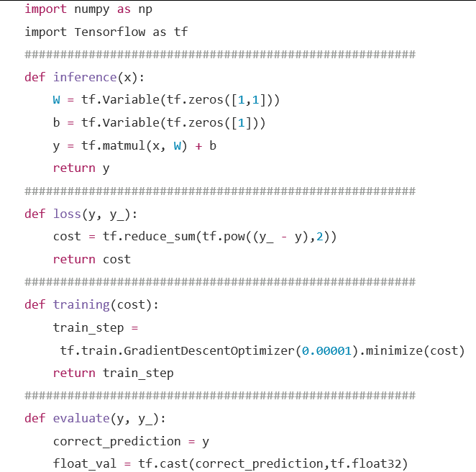
Linear Regression Code(Modular)

Slide 43
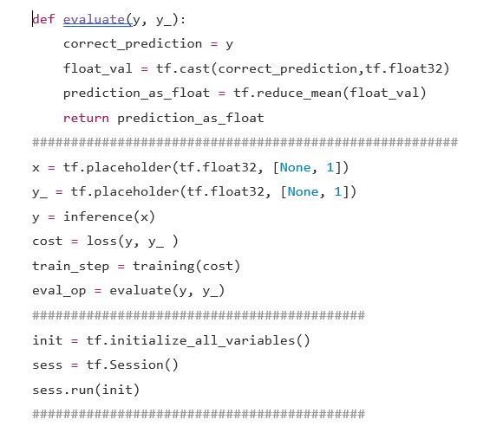
Evaluate()

Slide 44
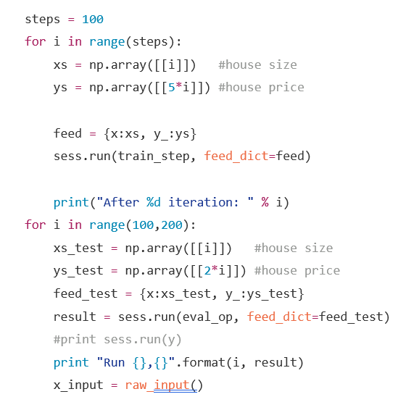
steps

Slide 45
Wrap up
As can be seen from the previous code example, not much had to change in the code to make it more readable, modular, and easier to modify.
The new aspects are that we now have 4 functions that can be used to define the model.
They are:
inference() for the equation
loss( ) for the cost function
training() for the optimization
evaluate() for the performance estimation

Slide 46
Summary
We discussed linear regression in TensorFlow
TensorFlow
code
Linear Regression
theory
TensorFlow
Graph <=code
Modular approach
Lin R
Log R
NN
DNN

