Slide 1
Machine Learning For Cyber
Unit 12: Logistic Regression in TensorFlow

Slide 2








Learning Outcomes
Upon completion of this unit:
Students will have a better understanding logistic regression.
Theory logistic Regression
Not the math intuition
$$X_{1}$$
$$W_{1}$$
$$Y_{1}$$
$$W_{2}$$
TensorFlow
$$W_{3}$$
$$X_{2}$$
$$Y_{2}$$
Code → Network
$$W_{4}$$

Slide 3
Terms
Logistic regression
TensorFlow
Notes:
This sets up the problem we’ll use to demonstrate various control and data structures of scripts.
This is a common security need, and various commercial tools such as tripwire and tiger do this. They are not scripts, but they work very much like what is here.
You might mention that, in practice, one would put the files we will create in places other than where this exercise puts them. Normally the files would go in a protected area, but here I opt for simplicity.

Slide 4
Neural Nets
Before we look at the deep neural nets, it is a good idea to look at logistic regression.
Logistic regression is still a linear classifier but deep neural nets can build on the ideas of logistic regression.
So, basically here we will use all the code we have developed so far.
The only difference is that now we will re-define the code for the functions:
inference()
loss()
As we can see in the next code segment, inference is mainly different from the linear regression approach because we now run our equation
tf.matmul(x_tf, W) + b

Slide 5
Softmax Function
through a softmax function.
Additionally, instead of predicting a real valued number with just one output neuron, we now have several output neurons which represent each possible class (3 in the case of IRIS, or 10in the case of MNIST).
Intuitively think of it this way.

Slide 6
Housing Price
For the linear regression problem we were predicting housing prices given square footage as such:
housing_price = w1 * square_footage + b
or
y = w1*x1 + b
This formula with values could look like this:
$250,500 = 50 * 5000 + 500

Slide 7
Model
The model learned the parameters 50 and 500, and with an input of 5000 square feet can predict a housing price.
If you remember, this is a network of 1 input neuron and one output neuron.
But the question is, how can we represent a model of several classes?
Such as a model for the IRIS data set which has 3 classes?
150,500 → low
5000
250,500 → med
350,500 → high

Slide 8
Activation functions
Well, we know in linear regression we can learn to predict real valued numbers given inputs.
From maths we also know that we can run real valued numbers through certain functions to obtain scaled versions of those numbers.
In this case a function such as the sigmoid (or the softmax) can do the following:
new_y = S(y)
where
y = w * x + b

Slide 9
Sigmoid()
Softmax()
This function will take any value and convert it into a value in the range from 0-1
For example:
$250,500 = 50 * 5000 + 500
new_y = S($250,500)
new_y = 0.80

Slide 10
Softmax function
So, this allows us to learn functions that predict values between 0 and 1.
This is good because these values can also be interpreted as probabilities or strengths of my prediction.
As in, I have a 0.80 confidence that the house price is $250,500.
But what if I had 3 possible housing prices: $150,700, $250,500, and $350,400.
How can I represent this in the previous equation?

Slide 11









Softmax function
Well, if we built one equation for $250,000.
Then we can definitely learn equations for the other 2 prices as such:
$150,700 = 30 * 5000 + 700
$250,500 = 50 * 5000 + 500
$350,400 = 70 * 5000 + 400
$$W_{1}$$
$$X$$
$$Y_{1}$$
$$W_{2}$$
$$X$$
$$Y_{2}$$
$$W_{3}$$
$$X$$
$$Y_{3}$$

Slide 12
Softmax function
So now if you notice, we have created a system of 3 equations
y₁ = w₁ * x + b₁
y₂ = w₂ * x + b₂
y₃ = w₃ * x + b₃
If you look at this as a network, we can see that it has 3 output neurons and 1 input neuron and, in fact, the network will look like this:

Slide 13
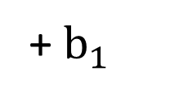





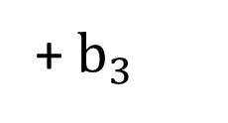

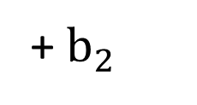
3 housing price equations architecture.
$$Y_{1}$$
+ $b_{1}$
$$W_{1}$$
X
$$W_{2}$$
$$Y_{2}$$
+ $b_{2}$
$$W_{3}$$
$$Y_{3}$$
+ $b_{3}$
Input
Output

Slide 14
Sigmoid function
If we apply our sigmoid function:
new_y = S(y)
to each equation then we can get:
o1 = S( y₁ ) = w₁ * x + b₁
o2 = S( y₂ ) = w₂ * x + b₂
o3 = S( y₃ ) = w₃ * x + b₃

Slide 15
Sigmoid function
a new set of outputs which are now scaled to be from 0..1. So are formulas, that looked like this
$150,700 = 30 * 5000 + 700
$250,500 = 50 * 5000 + 500
$350,400 = 70 * 5000 + 400

Slide 16
Sigmoid function
Can now look like this
0.20 = S(30 * 5000 + 700)
0.70 = S(50 * 5000 + 500)
0.10 = S(70 * 5000 + 400)

Slide 17
Sigmoid function
So, this intuition hopefully shows you how you can train models to predict confidence of a specific output neuron such as confidence that, given a square footage of 5000, the housing price is more likely to be $250,000 (based on the 0.70 confidence).
Finally, to train this model you do not need to give it the housing prices but just the output neuron associated with the inputs.
In this case our X matrix would consist of 1 sample (5000) associated with on output neuron ([0, 1, 0]).
X
[5000] [250,500] [med] [010]
[2000] [150,700] [ low] [100]

Slide 18
Softmax()
Formally, a softmax function is a way of mapping a vector of real valued numbers in any range into a vector of real valued numbers in the range of zero to 1 (0-1.0) where all the values add up to 1.0.
The result of the softmax therefore gives a probability distribution over several classes.

Slide 19


Softmax()
The softmax function can be written as follows:
This function takes the y values as inputs (called logit scores) and produes a new y vector where all values add up to 1.
For example, it can take
[2.0 , 1.0, 0.1] and maps it to => [0.7, 0.2, 0.1]
$$S\left(y_{i}\right)=\frac{e^{y_{i}^{}}}{\sum{e^{y_{j}}}}$$
$$\frac{e^{y_{2}^{}}}{e^{y_{1}^{}}+e^{y_{2}^{}}+e^{y_{3}^{}}}$$

Slide 20
Python (Softmax)
>>> logits = [2.0, 1.0, 0.1 ]
>>>import numpy as np
>>>exps = [ np.exp(i) for i in logits]
>>>sum_of_exps = sum(exp)
>>>softmax = [ j/sum_of_exps for j in exps ]
>>> print sum(softmax)
1

Slide 21
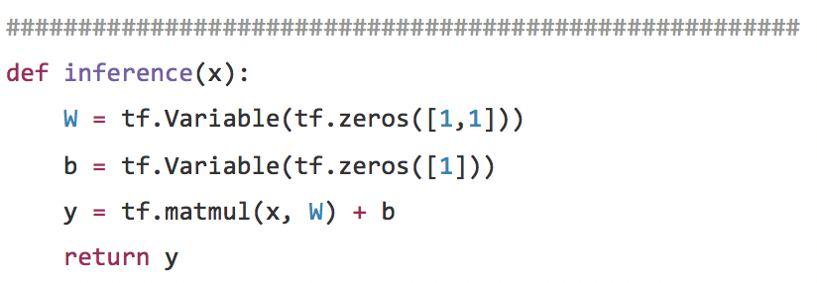
simple linear regression defines the network architecture
Notes:
defines the network architecture
#simple logistic regression
def inference(x_tf, A, B):
init = tf.constant_initializer(value=0)
#W = tf.Variable(tf.zeros([A,B]))
W = tf.get_variable("W", [A,B],initializer=init)
#b = tf.Variable(tf.zeros([B]))
b = tf.get_variable("b", [B], initializer=init)
output = tf.nn.softmax(tf.matmul(x_tf, W) + b)
return output

Slide 22
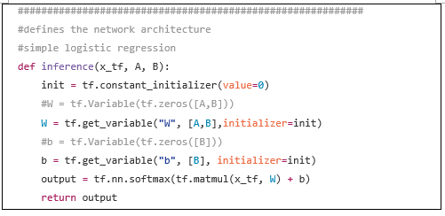
simple logistic regression defines the network architecture
X_tf
w
“w”
matmul
y
b
“b”
Notes:
defines the network architecture
#simple logistic regression
def inference(x_tf, A, B):
init = tf.constant_initializer(value=0)
#W = tf.Variable(tf.zeros([A,B]))
W = tf.get_variable("W", [A,B],initializer=init)
#b = tf.Variable(tf.zeros([B]))
b = tf.get_variable("b", [B], initializer=init)
output = tf.nn.softmax(tf.matmul(x_tf, W) + b)
return output

Slide 23
tf.get_variable()
Notice that we can use tf.get_variable() instead of tf.Variable() here to declare W and b. The values A and B represent, as previously defined, the number of features and the number of classes.
The difference between tf.Variable() and tf.get_variable() have to do with re-using the same variable.
Basically, tf.Variable() is older and tf.get_variable() is newer and more efficient.
The current Tensorflow world suggestion on this issue is to forget about tf.Variable() and always use tf.get_variable() instead.

Slide 24
iris dataset
So, assuming we are working with the iris dataset, A would be equal to 4 and B would be equal to 3.
The drawing below shows the architecture for a logistic regression model.
If you look closely, you can conclude that a logistic regression model is like a neural network with no hidden layers.
There are only 2 layers: the input layer and the output layer. A hidden layer would be a layer in between input and output that connects these 2 layers.

Slide 25





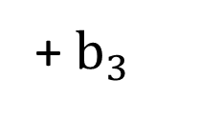

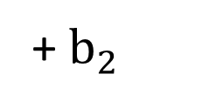

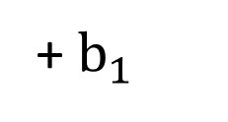
Logistic Regression Architecture for the Iris dataset
12 weights
$$X_{1}$$
$$Y_{1}$$
+ $b_{1}$
$$X_{2}$$
$$Y_{2}$$
+ $b_{2}$
$$X_{3}$$
$$Y_{3}$$
+ $b_{3}$
$$X_{4}$$

Slide 26
Code explanation
So for the previous code segment, in W we can see that we create a matrix that is [A,B] in size or for Iris [4,3].
The b vector (bias) has dimension B equal to 3 (for the 3 output neurons).
That is, there is now a bias for every neuron in the output layer.
Additionally, notice that the variable init in init = tf.constant_initializer(value=0) helps to initialize Tensorflow variables.

Slide 27
Init: normal distribution
There are several available options in Tensorflow to do this.
Similarly, the loss function is also changed from the linear regression version.
In the linear regression version we used a Least Squares Error loss function.
In this case we now use a logistic regression cost function as shown below.

Slide 28
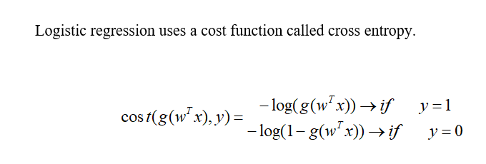
Cost Function

Slide 29
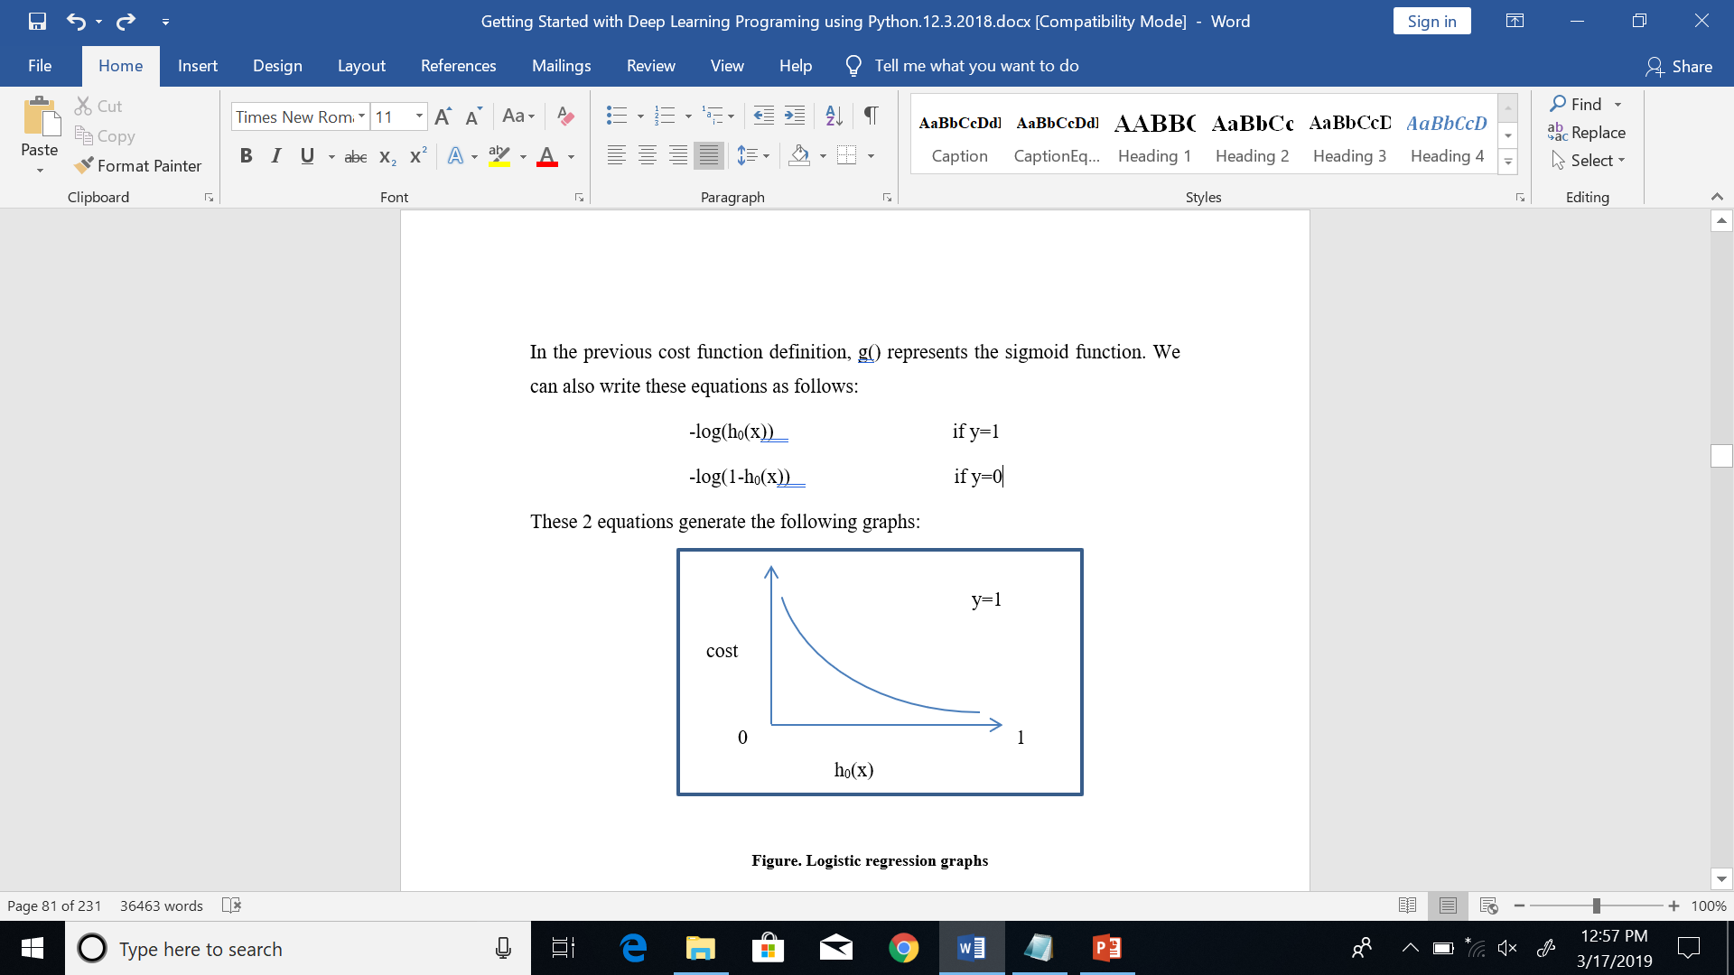
Sigmoid function

Slide 30
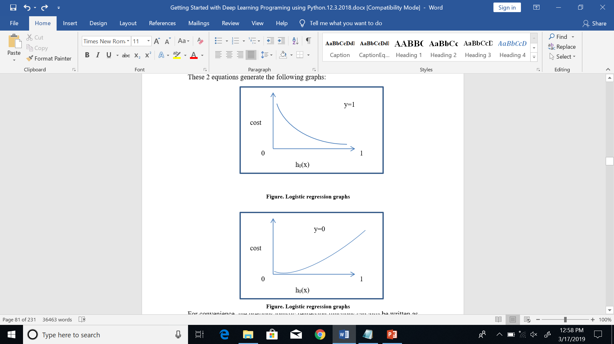
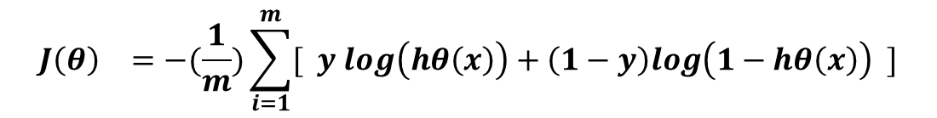
logistic regression graph
Figure. Logistic regression graphs
.
$$J{\left(θ\right)}^{}=−(\frac{1}{m})\sum_{i=1}^{m}{[ y log\left(hθ\left(x\right)\right)+\left(1−y\right)log\left(1−hθ\left(x\right)\right) ]}$$

Slide 31

logistic regression function (binary)

Slide 32
Code
The following code shows the implementation of the loss function for logistic regression as if we were writing out the equations.
One important thing to mention is that I have noticed that this model does not always converge.
To correct this, I have added the following line of code
output2 = tf.clip_by_value (output,1e-10,1.0)

Slide 33
Clip
This line of code helps because some values in the process become NaN (Not a number) and the clipping in the function addresses the problem.
This approach of writing out the cost function or equations is not always the most optimal but I have shown it here for contrast between linear regression and logistic regression.
A better approach is to use Tensorflow built-in cost functions for cross entropy calculations.
Future code for deep neural networks will abstract this by using the built-in functions.

Slide 34
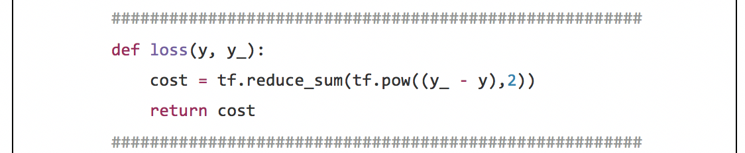
Loss function for linear regression

Slide 35
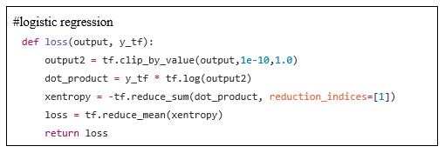
Loss function for logistic regression

Slide 36
tf.reduce_sum() function
tf.reduce_sum()
The function tf.reduce_sum() computes the sum of the elements across dimensions of a tensor. For example:
>>>x = tf.constant( [[1, 1, 1], [1, 1, 1]])
>>>y = tf.reduce_sum(x) #6
>>>y = tf.reduce_sum(x, 0) #[2, 2, 2]
>>>y = tf.reduce_sum(x, 1) #[3, 3]

Slide 37
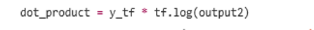
Cross Entropy
There are actually 2 types of cross entropy. They are:
The binary form of the cross-entropy
And the multi-class form (think one-hot encoded vectors)

Slide 38
We actually used the multiclass cross entropy

Slide 39
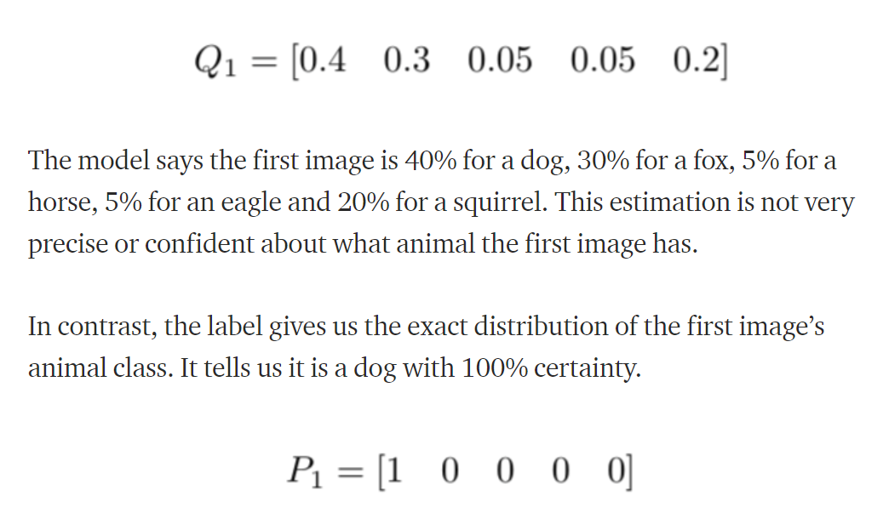
Example

Slide 40
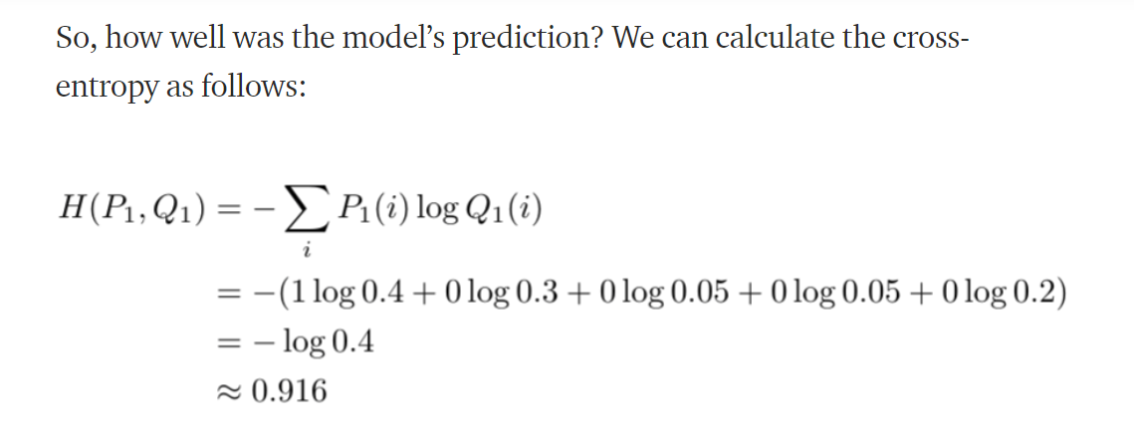
Example

Slide 41
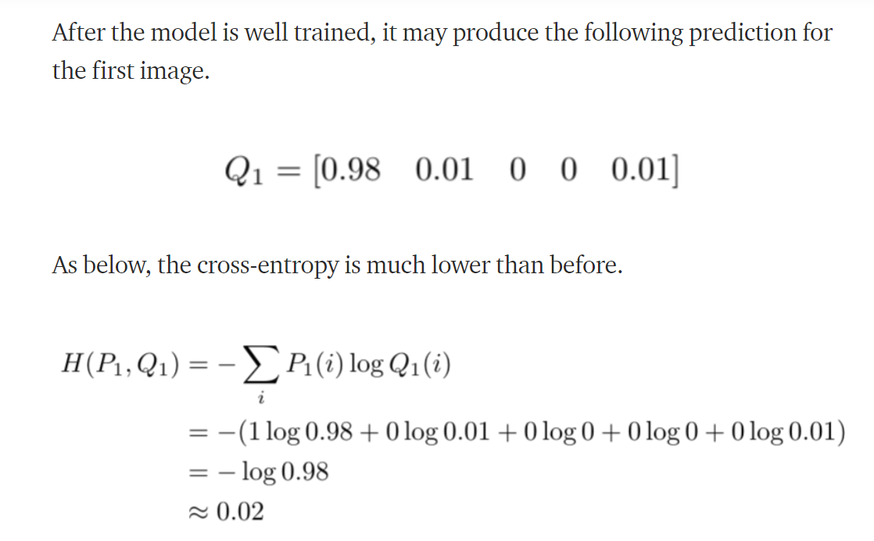
Example

Slide 42
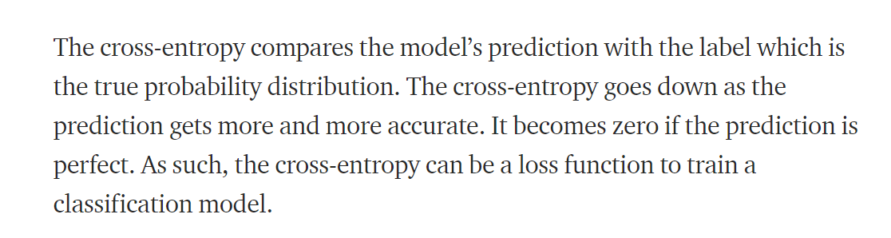
Example conclusion

Slide 43
So, which Cross Entropy should I use?
The binary form of the cross-entropy
The multi-class form

Slide 44
Answer: Neither
Instead use:
tf.nn.softmax_cross_entropy_with_logits(output, y_tf)
Which is the built in TensorFlow cross entropy
When can I use my own loss functions:
When you are really sure of what you are doing with loss functions
When you understand the numerical methods’ implications of your own loss
When you use your own regularization parameters
After extensive research
When you want to understand intuition for academic growth

Slide 45
Summary
Theory logistic
Linear regression
Logistic regression
Log regression
inference()
loss()

