Slide 1
Machine Learning for Cyber
Unit : K Nearest Neighbor(KNN)

Slide 2
Learning Objectives
The student will learn about KNN
KNN is a traditional ML algorithm
Simple algorithm/ mechanism

Slide 3
KNN
Not optimal for big data
Quickly prototype your dataset
KNN
Neural Network
traditional
Naïve Bayes
Big Data
weak
Deep Learning
Decision Trees
8-Gig RAM
GB
10,000 rows
10,000 cols
1,000,000 rows
10,000 cols

Slide 4
KNN
Z (F₃)
X (F₁)
Y (F₂)
Vector space model

Slide 5
KNN
IDS = Intrusion Detection System
0101
0101
DDos attack
Malware
Spoofed
(bad ware)
Email (crypto)
web
YouTube
(good ware)

Slide 6
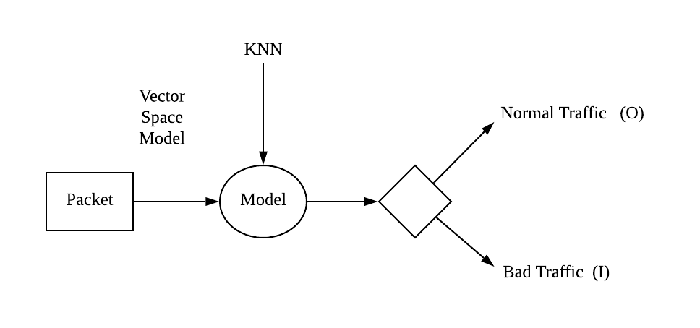
IDS

Slide 7
Packets
F1 F2 F3
S1
S2
S3
0
1
1
1
0
X
Y
✓ ✓
✘
✘
Eth
IP
TCP
Payload

Slide 8
Graph
F1 F2 F3
F₂
S1
S2
S3
0
1
1
1
0
F₁
F₃
X
Y
F₁
F₂

Slide 9
KNN
Destination port (F₃)
Source port (F₂)
Protocol (F₁)

Slide 10
KNN
Converts data to vector space model
Calculate distance between your X test sample and all other points or sample
Sort distance in ascending order
Select the 5 closest sample KNN(5) and pick the majority class

Slide 11
In the next lesson:
Use KNN in WEKA to analyze and classify our data

Slide 12
Summary
KNN
Traditional machine learning algorithm
Easy to implement
Vector space model and how to represent packets with this model
We learned the mechanism of the KNN algorithm

