Slide 1
Machine Learning for Cyber
Unit : Data for TensorFlow

Slide 2
Learning Outcomes
Upon completion of this unit:
Students will have a better understanding of Data for Tensorflow.

Slide 3
Data issues
To most practitioners, data collection is the most important issue in machine learning.
getting the data
cleaning data
pre-processing data
building a corpus and annotating it
performing inter-annotator agreement
Notes:
This sets up the problem we’ll use to demonstrate various control and data structures of scripts.
This is a common security need, and various commercial tools such as tripwire and tiger do this. They are not scripts, but they work very much like what is here.
You might mention that, in practice, one would put the files we will create in places other than where this exercise puts them. Normally the files would go in a protected area, but here I opt for simplicity.

Slide 4
Data sets
Data can be obtained from the web such as text from twitter or web pages.
Specific data sets can also be obtained from the machine learning libraries.
Sklearn has a “dataset” module.
This dataset module can be used to obtain certain data sets such as the iris dataset

Slide 5
Getting Data
Here, the first index in the data matrix represents the rows and the second index represents the columns.
iris = datasets.load_iris()
X = iris.data[:, [1,2,3]]
y = iris.target

Slide 6
CSV format data set
1.0,6.1,2.8,4.7,1.2
0.0,5.7,3.8,1.7,0.3
2.0,7.7,2.6,6.9,2.3
1.0,6.0,2.9,4.5,1.5
1.0,6.8,2.8,4.8,1.4
0.0,5.4,3.4,1.5,0.4

Slide 7
Numpy
Once the data is in Matrix_data, it can be processed as a numpy array matrix.
This means that it is no longer just an array
but instead it is more a vector or matrix as in linear algebra.
Many operations are now simplified like
extracting certain columns or rows.
This is usually referred to as slicing.

Slide 8
code
f_numpy = open("data/12559_Training_Dataset.csv",'r’)
Matrix_data = numpy.loadtxt(f_numpy, delimiter=",", skiprows=1)
A = len(Matrix_data[0,:])
print "num features,", A
#X=Matrix_data[:, [1,2,3,4,5,6]]
X = Matrix_data[:,:18] #[:,:149]
y = Matrix_data[:, 19]

Slide 9
In the previous code we can see that we can calculate the dimensions of the matrix as in A = len(Matrix_data[0,:]) which gives you the number of columns or the number of features plus the class.
The following code example shows how data can be read with np.loadtxt() and sliced from the matrix Test_data into 2 matrices X_test and y_test.
Notice that X_test has all rows from Test_data and columns from 0 to 18.
Whereas, the y_test matrix has the same number of rows but only 1 column (19).

Slide 10
we can calculate the dimensions of the matrix as in
A = len(Matrix_data[0,:])
which gives you the number of columns or the number of features plus the class.

Slide 11
The following code example shows how data can be read with np.loadtxt() and sliced from the matrix Test_data into 2 matrices X_test and y_test. Notice that X_test has all rows from Test_data and columns from 0 to 18. Whereas, the y_test matrix has the same number of rows but only 1 column (19).
f_test = open("data/rc_3156_Test_19_features.csv",'r’)
Test_data = np.loadtxt(f_test, delimiter=",", skiprows=1)
X_test = Test_data[:,:18]
y_test = Test_data[:, 19]

Slide 12
Feature scaling is very important to achieving good results in classification tasks.
For example, in Principal Component Analysis (PCA) which is a feature reduction technique, feature scaling is very important.
The purpose of PCA is to project data to a vector that captures the most variability in the data.
If the features are not scaled properly, one feature could dominate over the others and therefore be considered as the most variable feature.

Slide 13
Feature Scaling
With feature scaling, features with real valued numbers from any range can be mapped to other ranges
such as from -1.0 to 1.0.
This is performed for all features so that no one feature will dominate in the model.
Other classifiers and Deep learning models are also susceptible to feature scaling.

Slide 14
sc = StandardScaler()
sc.fit(X_train)
X_train_normalized = sc.transform(X_train)
X_test_normalized = sc.transform(X_test)

Slide 15

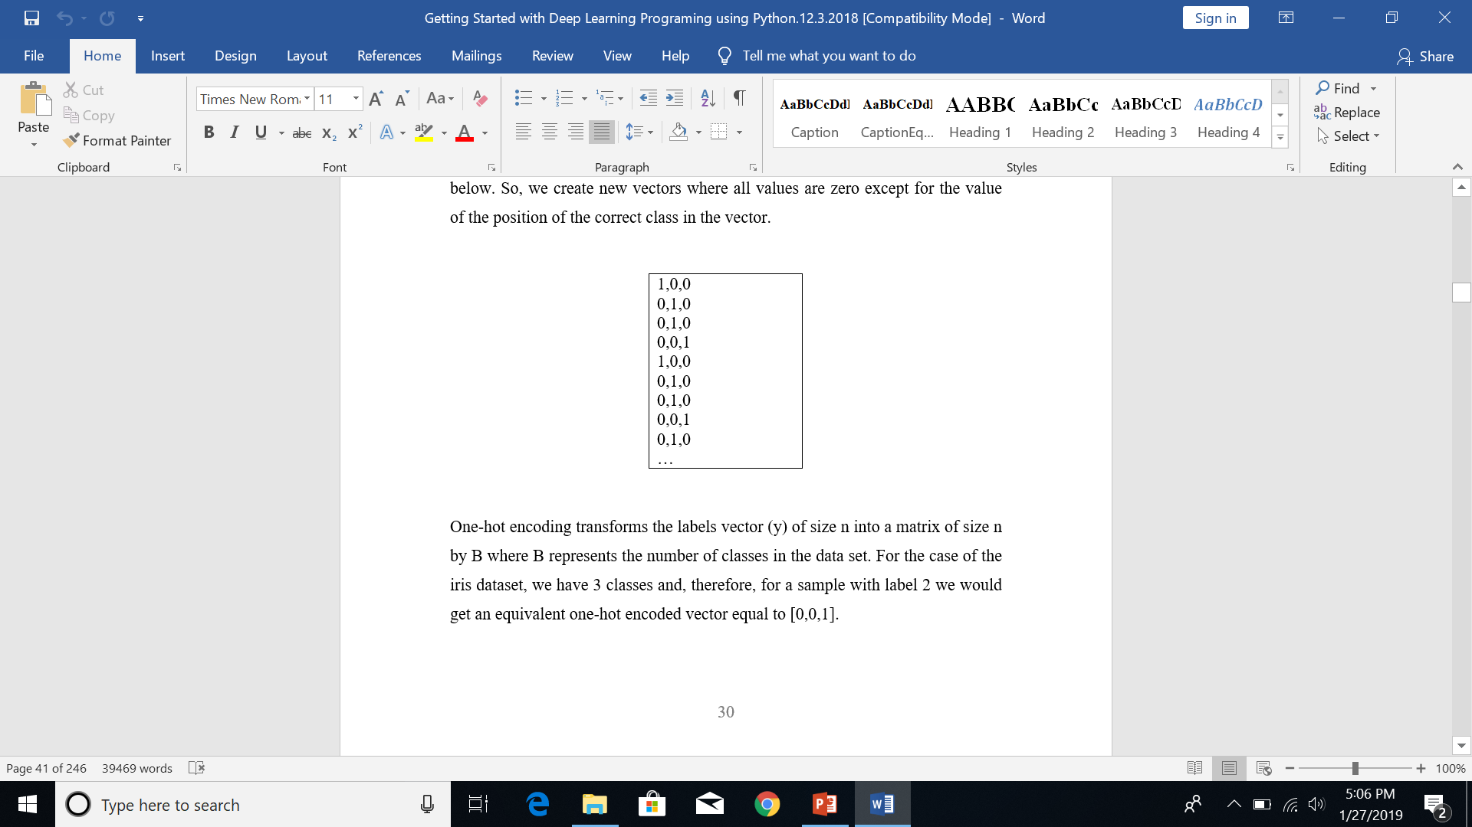
One-Hot encoding

Slide 16
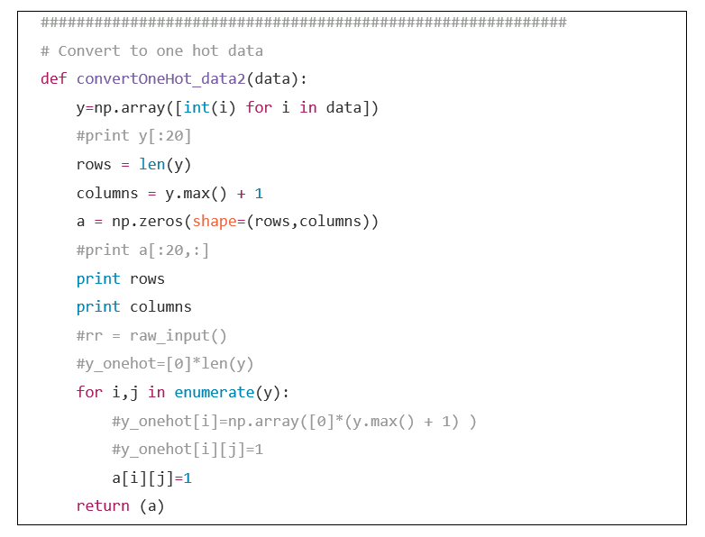
One-Hot encoding function

Slide 17
Features
A supervised machine learning algorithm is only as good as the features that are provided to it.
This statement used to be very true and many people made careers of just developing features for problems in different domains.
For instance, in NLP, many people would spend a lot of time developing parsers and other techniques to find and create features from a text based problem.

Slide 18
Features
in image processing, researchers developed many techniques to filter data out of images to perform efficient image classification.
Today, deep learning has somewhat changed this.
It has managed to introduce approaches to decrease the amount of human involvement in the feature extraction process.

Slide 19
Features
Basically, deep learning methods, in some cases, have the ability to extract features from data using only un-supervised or semi-supervised techniques.
In some way, you can say that deep learning algorithms can extract the features themselves without human involvement.
This ability has had a very strong impact in the performance of the algorithms implemented in industry and in the work performed by machine learning specialists.
These abilities for enhanced feature extraction are available in the main mediums of text processing and image processing.

Slide 20
Corpus
A supervised machine learning algorithm is only as good as the data that is provided to it.
Learning models learn how human annotators assign the labels to a sample and a system can only be expected to be as good as the human annotator.
Some tasks are more subjective than others for human annotators and this is usually reflected in the classifier performance.
Therefore, many practitioners recommend that before measuring classifier performance, and analysis of the subjectivity of the human annotation should be performed.
This is usually referred to as inter annotator agreement.
When annotating a new resource, the quality of the annotation process must be measured in some way

Slide 21
Important metrics used to evaluate inter-annotator agreement (Artstein and Poesio 2008) include:
average observed agreement
Pi
Alpha
S
Kappa

Slide 22
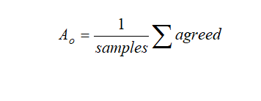
Average Observed Agreement (A_{o})
Averaged observed agreement is the easiest metric to compute. It is the percentage of annotations that two annotators agreed upon.
The metric is formulated as follows where the variable “samples” represents the total number of annotation samples and “agreed” is the amount of samples for which both annotators agreed.

Slide 23
#interannotator agreement
import nltk
toy_data = [
['1', 5723, 'ORG'],
['2', 5723, 'ORG'],
['1', 55829, 'LOC'],
['2', 55829, 'LOC'],
['1', 259742, 'PER'],
['2', 259742, 'LOC'],
['1', 269340, 'PER'],
['2', 269340, 'LOC']
]
task = nltk.metrics.agreement.AnnotationTask(data=toy_data)
print 'kappa', task.kappa()
print 'alpha', task.alpha()
print 'average Agreement', task.avg_Ao()
print 'pi', task.pi()
print 's', task.S()
print '######################################'
print '######################################'
toy1 = ['ORG','LOC','PER','PER']
toy2 = ['ORG','LOC','LOC','LOC']
cm = nltk.metrics.ConfusionMatrix(toy1,toy2)
print cm

Slide 24
Summary
In this module we looked at data for deep learning

