Slide 1
Machine Learning for Cyber
Unit : Deep Learning Intro

Slide 2
Learning Outcomes
Upon completion of this unit:
Students will have a better understanding of deep learning approaches.

Slide 3
For this module, we will use Linux, Python, Sklearn, and the TensorFlow framework
You can install the TensorFlow framework following the instructions in the main TensorFlow website (https://www.tensorflow.org/ ).

Slide 4
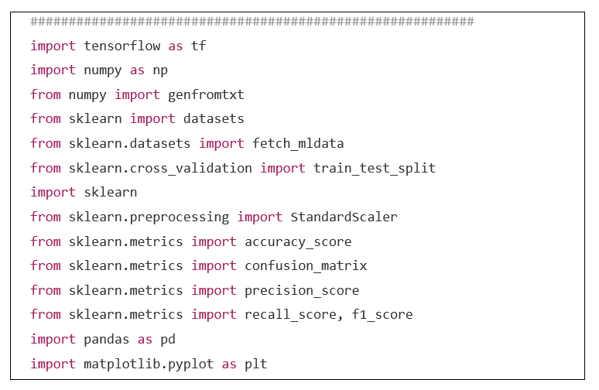
Libraries

Slide 5
Deep learning
Deep learning algorithms are iterative in the sense that they load samples in batches to avoid running out of memory.
This is very important as it allows you to load millions of data samples in subsets called batches.
Therefore, we can set up the parameters for batch processing.
In the code below, we can see that we want to load batches of 100 samples each.
For a training set of 1,000 samples, we would divide the set into 10 bins of 100 samples each and therefore run 10 batches.

Slide 6
N_epochs
The n_epochs parameter represents the number of times that we will run our main “for” loop.
This is the loop that we will run to provide data to our algorithms for training and testing.
At this point, an optimization begins to occur which helps the supervised learning algorithm to learn from the samples.

Slide 7
learning_rate
The learning_rate value (in this case 0.01) is a very important parameter in the learning algorithm.
Simply speaking, it represents the step that is taken in a gradient descent algorithm to find an optimal solution.
Think of this like a giant walking over a mountainous region with many peaks and valleys.
He is trying to find an optimal location; if the step is too big, the giant could go from peak to peak and skip a valley altogether.
On the other hand, if the step is to small the giant may take too long to move in or out of a valley.
In terms of Tensorflow, the learning rate can affect convergence.
Convergence is the term that means that the iterative algorithm is starting to tend to the optimal solution.

Slide 8
The learning_rate can also be assigned a function instead of just a value.
## a smarter learning rate for a gradient descent optimizer
learningRate = tf.train.exponential_decay(learning_rate=0.0008,
global_step=1,
decay_steps=trainX.shape[0],
decay_rate=0.95,
staircase=True)

Slide 9
parameters
learning_rate = 0.01
n_epochs = 27000 #1000
batch_size = 100

Slide 10
Deep learning algorithms in Tensorflow consist of a basic structure.
Simply put, they have:
the main loop
the initialization section
the declaration of the main variables or placeholders
definition of the classifier to use.

Slide 11
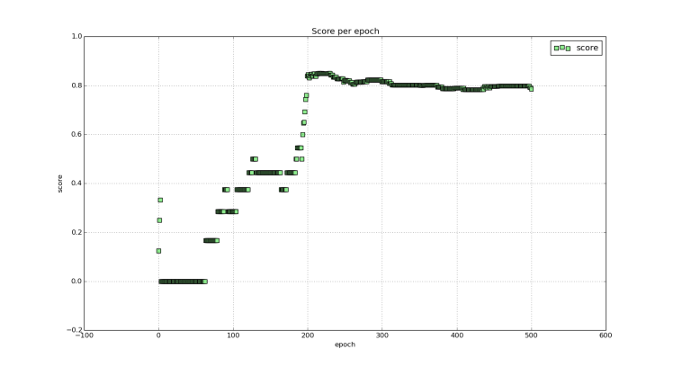
Accuracy per epoch

Slide 12
In this example on the figure, a deep net takes a few epochs to learn how to detect and classify the samples.
After about 200 epochs, a deep net of say 2 hidden layers stabilizes and is able to maintain a consistent accuracy score.

Slide 13
So what’s it all about?
Again, my focus here is not to discuss deep learning from the equations point of view or talk about the derivatives.
Those are all very important concepts but can be overwhelming when starting.
Instead, I want to help the reader write deep learning code with Tensorflow.
Then, the reader will, no doubt, have many questions where the theory and fundamentals will help him or her to better understand and use the algorithms.

Slide 14
The figures below present some of the challenges that must be addressed when dealing with real data.
Real data such as language data from Twitter is highly noisy and un-balanced.
An imbalance in the data means, for example, that 80% of the samples belong to 1 class and the remaining 20% belong to the other class.
Therefore, training a classifier to, say, perform emotion classification (where data is highly imbalanced) can be a difficult task.
In the figure below, a sample of Twitter data is represented.
Each sample in the dataset had multiple features but was compressed into a two dimensional vector for visualization purposes.

Slide 15
As can be seen, the data in the figures has a high overlap in the classes and the data is difficult to separate.
A linear classifier (the line seen on the graph) can only separate a small portion of the samples and the majority are not easy to separate in this space.
The graph below is available on-line in color.

Slide 16
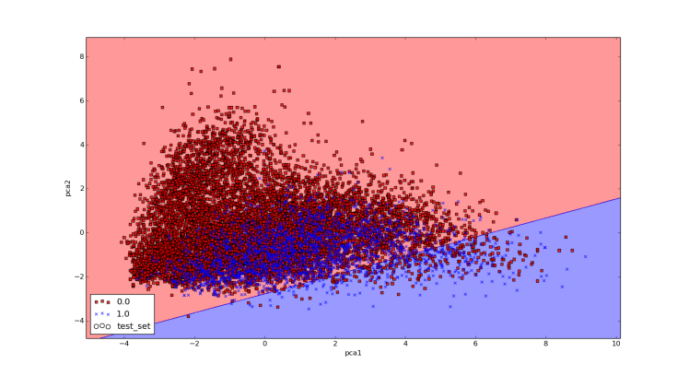

Slide 17
So how can we get more of the samples of one class without getting too many of the samples of the other class?
Well, the answer is that we could use another type of line for the separation.
For instance, instead of using a straight line we could use a curved line.
This is why some algorithms are called linear and others are called non-linear.
Non-linear algorithms can sometimes create better separations in the data and therefore obtain fewer errors. In the next Figure, an example of this is shown using Support Vector Machines (SVM).
SVM methods can sometimes build better non-linear classifiers because of their ability to project data to higher dimensional spaces.
Deep neural networks can be used to learn non-linear models as well.
This property of non-linear models can help to obtain better classification accuracy scores. This figure is available on-line in color.

Slide 18
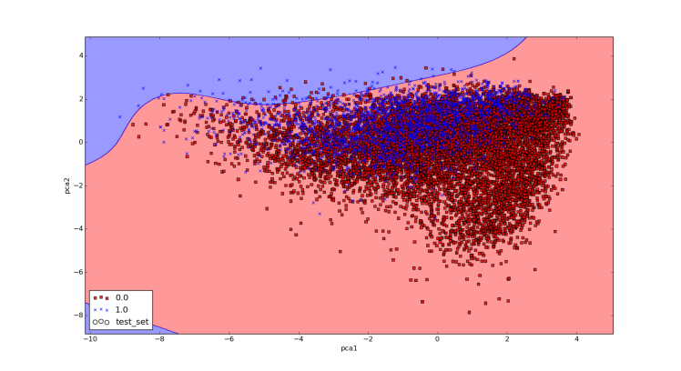

Slide 19
The figure above shows an SVM classifier building a non-linear separation line (the curved line in the graph) on the data.
It could be expected that a deep neural network could build even better separation boundaries and that different architectures could give different results.
This takes us to the very important aspect of deep learning architecture.
Deep learning architecture is where we define the parameters such as layers and neurons that define a deep neural network.
You could think of this as the way that you construct the line that you want to build and use.
We will discuss this in the next sections but it is important to know that you can define many deep learning architectures.

Slide 20
Deep Leaning Definition
Deep learning systems are neural networks with many layers.
As such, the more layers they have the deeper they are considered to be.
In the next sections, I will begin to discuss neural networks.
I will focus mostly on intuition when talking about neural networks.
I will use linear regression and logistic regression constructs to define them.
We can also think of deep neural nets as functions and this will become very useful as we start to program our code.

Slide 21
Deep learning architecture
Deep learning architecture is where we define the parameters such as layers and neurons that define a deep neural network.
You could think of this as the way that you construct the line that you want to build and use.
it is important to know that you can define many deep learning architectures.

Slide 22
Deep learning
Deep learning systems are neural networks with many layers.
As such, the more layers they have the deeper they are considered to be.
We can also think of deep neural nets as functions and this will become very useful as we start to program our code.

Slide 23
TensorFlow basics
The main idea with Tensorflow is that you need to define a graph and run your code through this graph on the CPU (s) or GPU (s).
Tensorflow is object oriented
Tensors are multidimensional arrays
Tensorflow variables are memory buffers that contain these tensors
We call elements from Tensorflow by referencing the object tf as such: tf.placeholder

Slide 24
In Tensorflow you need to define a graph and then run it.
Nothing runs until you call the graph with an object called a session
Tensorflow get its name from the fact that data is stored as tensors and flows through a graph

Slide 25
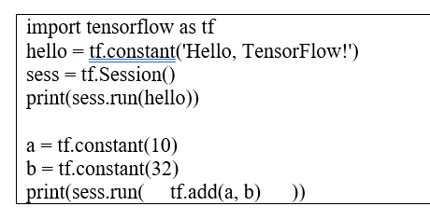

Slide 26
In this code we initialize 2 variables a and b and add them together.
Additionally, we initialize the session object with sess = tf.Session().
What is important to note here is that whenever you reference an object in Tensorflow with tf, such as initializing the variable a, you are actually adding elements or nodes to a graph.
This graph does not get executed until the command sess.run() is called.

Slide 27
In this code we initialize 2 variables a and b and add them together.
Additionally, we initialize the session object with sess = tf.Session().
What is important to note here is that whenever you reference an object in Tensorflow with tf, such as initializing the variable a, you are actually adding elements or nodes to a graph.
This graph does not get executed until the command sess.run() is called.
The graph can be seen in the following figure.

Slide 28
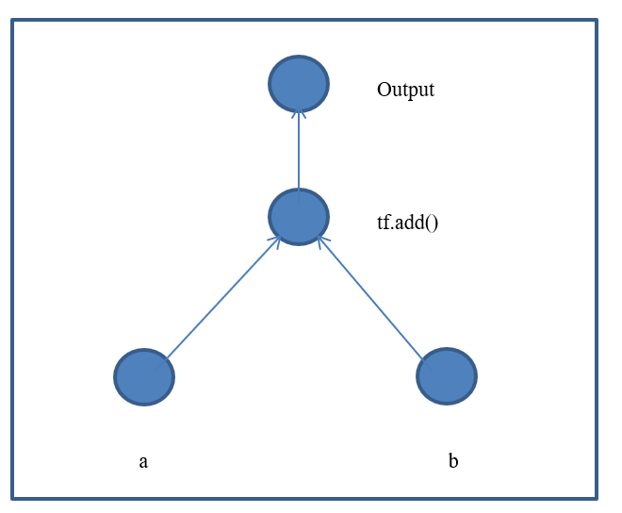
TensorFlow graph

Slide 29
Loading your Data into your Tensorflow code
Loading the data can actually be somewhat complicated in Tensorflow.
One of the issues is that you need to convert the data, say from something like the below example, to another format using one-hot encoding for the labels.
This can sometimes be complicated and can cause you problems when writing your algorithms.

Slide 30
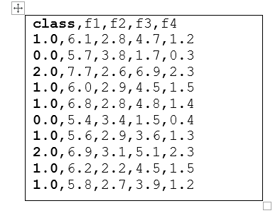

Slide 31
IRIS
The IRIS dataset has 3 classes (0, 1, and 2).
The other 4 columns represent the features per each sample.
the data is contained in the file iris.csv
We can use the numpy loadtxt() function to obtain the data and to load it into a numpy matrix.
Notice that the file has a header for the class and the 4 features.
We can easily remove the header by using the parameter skiprows=1 in the numpy.loadtxt() function.

Slide 32
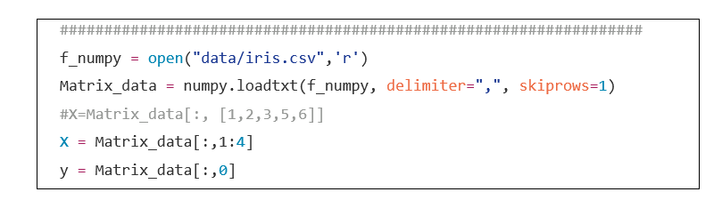

Slide 33
In the previous code we can slice the class column into the y variable and the rest of the columns into the X variable
When slicing a 2-D matrix (matrix[i, j] ) we specify the number of rows with “i” and the number of columns with “j”.
We can also specify ranges by doing the following:
matrix[2:5, :].
The “:” on the “j” index indicates select all columns.
If we wanted to select from a list of column indices we could do the following:
X=Matrix_data[:, [1,2,3,5,6]]

Slide 34
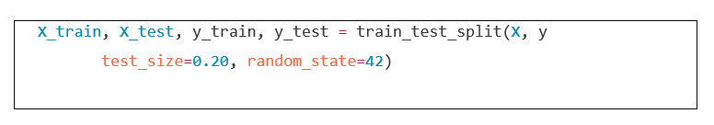
Splitting data

Slide 35
we can now split the data from X and y to obtain the train and test sets:
X_train, X_test, y_train, y_test.
Only the labels need to be one-hot encoded.

Slide 36
y_train_onehot = convertOneHot_data2(y_train)
y_test_onehot = convertOneHot_data2(y_test)

Slide 37
In the code above we take the labels in y_train and y_test and pass them through our one-hot encoding function to produce the new variables y_train_onehot and y_test_onehot.
You can visualize the new one-hot encoded vectors by running
print y_train_onehot[:20,:].
Tensorflow does provide a function for one-hot encoding which is:
tf.one_hot()
This function takes a y vector and converts it to the one-hot encoded version

Slide 38
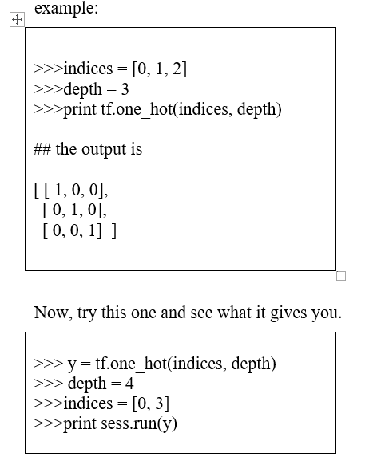

Slide 39
The next step in the process is to scale the X data.
I suggest running your data with scaling and without to compare the performance of your classifier.
Convergence of your deep learning algorithm and classification results can be better with scaled data.
In this case we can use SKlearn’s scaling module
StandardScaler() to perform this task.

Slide 40
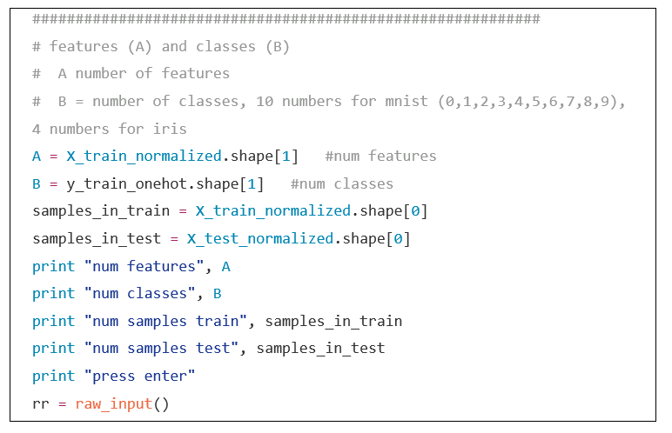
code

Slide 41
At this point, we have completed most of the pre-processing steps and we are ready to define the learning algorithms.
This is where we define
neural network architecture,
the cost functions to be used,
and the functions to predict results for given test samples.

Slide 42
Summary
We discussed various aspects of deep learning

