Slide 1
Machine Learning
Lecture: Layers of the Deep Neural Network in TensorFlow

Slide 2
Learning Outcomes
Upon completion of this unit:
Students will have a better understanding of neural networks.
Students will be able to convert their logictic regression algorithms
in a nerual net and then a deep neural net.
Tensorflow code.
Architecture.

Slide 3
Terms
w
P1
P2
As we saw in the previous discussions, a logistic regression model is similar to a linear regression model.
As you might imagine, a neural network is similar to the logistic regression model.
In particular, the neural network now has more layers and the more layers it has, the deeper it becomes.
Layers in between the input and output layers are called hidden layers and help to represent non-linearity and to better discover new features from the input features.
For example, in an image processing problem, a neuron in a hidden layer might take as inputs 2 features or input neurons that detect circles.
Notes:
This sets up the problem we’ll use to demonstrate various control and data structures of scripts.
This is a common security need, and various commercial tools such as tripwire and tiger do this. They are not scripts, but they work very much like what is here.
You might mention that, in practice, one would put the files we will create in places other than where this exercise puts them. Normally the files would go in a protected area, but here I opt for simplicity.

Slide 4
Face Detection
1
28
28
16
I
Logistic Regression, Feature Eng
28
Filter Edge
Filter Shadow
28
1
784
F
28
28
1
784
28
F
1
1568
28

Slide 5
Logistic Regression, Feature Eng
28
Filter Edge
Filter Shadow
28
1
784
F
28
28
1
784
28
F
1
1568
28
Logistic Regression
Filters
Face Detect
ML
Edge
Shadow
1568
1568

Slide 6
DNN
28
Filter Edge
Filter Shadow
28
1
784
F
28
28
1
784
28
F
1
1568
28
1
F
F
789
1568

Slide 7
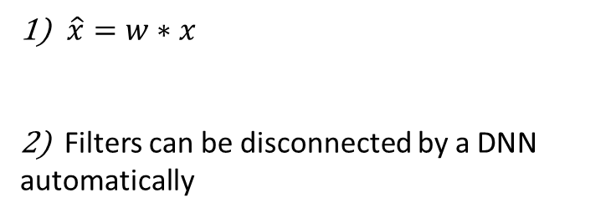

Face Detect continue
28
Filter Edge
Filter Shadow
28
1
784
F
28
28
1
784
28
F
1
1568
1
28
F
F
789
1568
$\hat{x}=w∗x$
2) Filters can be disconnected by a DNN automatically
F
shadow
=
$$x ∗ \vec{v} = \hat{x}$$

Slide 8

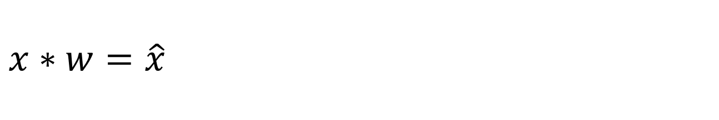


$$x∗w=\hat{x}$$
28
Filter Edge
Filter Shadow
28
1
784
F
28
28
1
784
28
F
1
1568
28
W1(F)
W2(F)
$$x∗w=\hat{x}$$
x
F
$$\hat{x}$$
x
$$\hat{x}$$
784
784

Slide 9
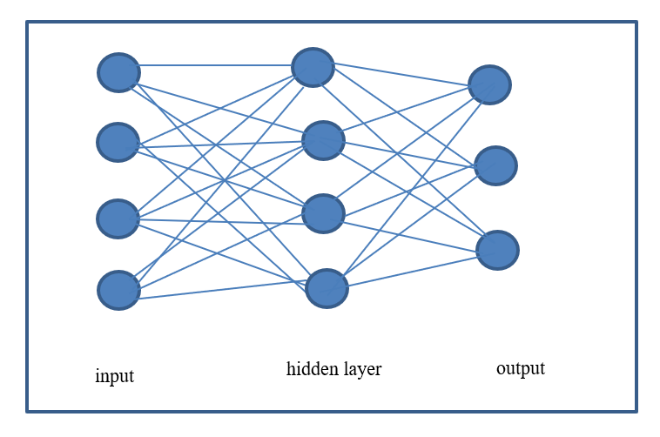
A one-layer neural network architecture

Slide 10
Deep Nets
Layers in between the input and output layers are called hidden layers and help to represent non-linearity and to better discover new features from the input features.
For example, in an image processing problem, a neuron in a hidden layer might take as inputs 2 features or input neurons that detect circles.
H
X
X
hidden
circular
eyes
Notes:
This sets up the problem we’ll use to demonstrate various control and data structures of scripts.
This is a common security need, and various commercial tools such as tripwire and tiger do this. They are not scripts, but they work very much like what is here.
You might mention that, in practice, one would put the files we will create in places other than where this exercise puts them. Normally the files would go in a protected area, but here I opt for simplicity.

Slide 11
“eyes” in DNN
If these two circles are detected by the 2 input neurons, then the neuron in the next hidden layer which is connected to them might infer that a pair of eyes has been discovered.
Therefore, this neuron in the hidden layer becomes a face detection or “pair of eyes” detection neuron.
Given enough data, the model may discover this intuition and many others.
A 1-layer neural network can look like the previous figure and a 2-layer neural network can look like the network in figure below.

Slide 12
Architecture
As can be seen, we can continue to add layers, and this is part of defining the architecture of a deep neural network.
In theory, more layers can potentially give a model more power to learn from the data and be a better classifier.
Notice, however, that this also means that many more parameters need to be estimated (e.g. more weights).
Therefore, up until recently, this was very expensive to achieve.
With the advent of high-performance hardware and GPUs, this is now more feasible.

Slide 13
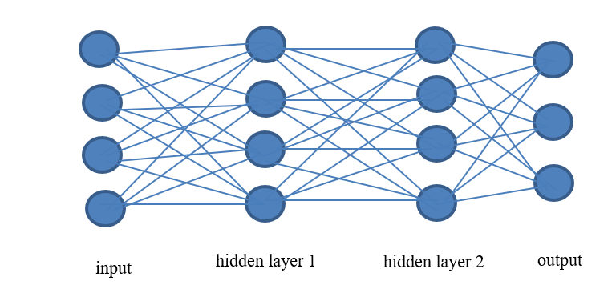
A two-layer neural network architecture

Slide 14
Layer()
In our code, we need an efficient way of creating layers that is straightforward.
For this, we will use a modular approach and simply define a function called layer().
If you look at the network figures, each layer has neurons connected to other layers.
In fact, the lines that connect the neurons are the weights, so each neuron in say hidden layer 1 is equal to the sum of the neurons in the previous layer times their respective weights which are learned by the model.
Therefore, we can define the function layer() as can be seen below.

Slide 15
layer() example code
def layer(input, weight_shape, bias_shape):
weight_stddev = (2.0/weight_shape[0])**0.5
w_init =
tf.random_normal_initializer(stddev=weight_stddev)
bias_init = tf.constant_initializer(value=0)
W = tf.get_variable("W", weight_shape, initializer=w_init)
b = tf.get_variable("b", bias_shape,
initializer=bias_init)
return tf.nn.relu(tf.matmul(input, W) + b)

Slide 16
Code explanation
In the previous code, we continue to use the equation
tf.matmul(input, W) + b
and this time pass it through the neural network function
tf.nn.relu()
The relu (Hahnloser et al. 2000) function stands for rectified linear unit.
It is an optimal neuron for neural networks, and it serves as the activation function.
Notice also, that in the code, a few init variables were defined to initialize the variables and improve the optimization performance.

Slide 17
“Going Deep”: An N layer Neural Network in Tensorflow
We have defined so much of the code already that there really isn’t much left except to define the architecture and cost (or loss) function.
For the cost function in a deep neural network, similarly to the least square error function in linear regression or cross entropy in logistic regression, we can define the equation or more conveniently use the built-in Tensorflow cost functions.
In this case, we use tf.nn.softmax_cross_entropy_with_logits(). This is defined in the code segment below for the loss_deep() function.

Slide 18
Optimization
def loss_deep(output, y_tf):
xentropy = tf.nn.softmax_cross_entropy_with_logits(output, y_tf)
loss = tf.reduce_mean(xentropy)
return loss

Slide 19
Inference()
Finally, the last part in our code is to define the architecture of the deep neural network.
The following examples show how we could define the architectures using multiple layers.
The important aspect to notice is that we are treating each layer as a function layer().
The output of one function becomes the input of the next function.

Slide 20
x_tf
So, for a network of 2 layers we can define the code as shown in the code segment below.
The input to the first layer in hidden scope 1 is x_tf which is our data matrix that we defined in previous sections.
The result of this equation would be passed to the variable hidden_1.
Then, for the next layer, hidden_1 becomes the input to the layer in hidden scope 2, and finally hidden_2 becomes the input to the final layer in scope output which is the connection of hidden layer 2 to the output layer.

Slide 21
IRIS
#defines network architecture
#deep neural network with 2 hidden layers
def inference_deep(x_tf, A, B):
with tf.variable_scope("hidden_1"):
hidden_1 = layer(x_tf, [A, 4],[4])
with tf.variable_scope("hidden_2"):
hidden_2 = layer(hidden_1, [4, 4],[4])
with tf.variable_scope("output"):
output = layer(hidden_2, [4, B], [B])
return output

Slide 22
IRIS data set
Using the iris data set, the following definition
hidden_1 = layer(x_tf, [A, 4],[4])
means that 1 input vector from the iris data set is connected to the first hidden layer of the model.
Therefore, the neurons in the input layer are the 4 features per plant in the iris dataset.
In contrast, for the hidden layer, the neurons represent abstract entities that are sums of the input features times their respective weights.

Slide 23
IRIS data set continued
The final part
output = layer(hidden_2, [4, B], [B])
in the function defines a mapping of 4 abstract neurons (from hidden 2) to the 3 neurons in the output layer which represent the 3 classes of setosa, virginica, and versicolor.

Slide 24
output
Here, hidden_2 is defined as a mapping from hidden_1 (which has 4 neurons) to hidden_2 which also has 4 neurons.
The number of neurons can be defined by the architect of the network.
Similarly, a deep neural network of 3 hidden layers can be defined as follows.
Notice that the following statement helps to define the third hidden layer
output = layer(hidden_3, [10, B], [B])
and that each hidden layer now consists of 10 neurons as can be seen in the code below.

Slide 25
inference() architecture
1
#defines network architecture
#deep neural network with 3 hidden layers
def inference_deep_3layers(x_tf, A, B):
with tf.variable_scope("hidden_1"):
hidden_1 = layer(x_tf, [A, 10],[10])
with tf.variable_scope("hidden_2"):
hidden_2 = layer(hidden_1, [10, 10],[10])
with tf.variable_scope("hidden_3"):
hidden_3 = layer(hidden_2, [10, 10],[10])
with tf.variable_scope("output"):
output = layer(hidden_3, [10, B], [B])
return output
4
789
10
10
10
I
h1
h2
h3
O

Slide 26
inference() architecture continued
Finally, as a last example, a 4-layer deep neural network can be defined with the following TensorFlow code.
Here, the lines
hidden_4 = layer(hidden_3, [21, 21],[21])
output = layer(hidden_4, [21, B], [B])
have been added to the architecture and each hidden layer consists of 21 neurons.
The number of neurons to define the layer is sometimes considered more of an art than a science so some experimentation will be required.
However, some practitioners recommend that the number of neurons in the hidden layers should not exceed the number of neurons in the input layer (i.e. the features per sample).

Slide 27
variable_scope()
A common approach by the Tensorflow community is to use tf.variable_scope to better define the scope of the variables in each layer.
This provides efficiencies in the internal workings of the Tensorflow code.
h1\var1
h2\var2

Slide 28
Example of 4-layer architecture
#defines network architecture
#deep neural network with 4 hidden layers
def inference_deep_4layers(x_tf, A, B):
with tf.variable_scope("hidden_1"):
hidden_1 = layer(x_tf, [A, 21],[21])
with tf.variable_scope("hidden_2"):
hidden_2 = layer(hidden_1, [21, 21],[21])
with tf.variable_scope("hidden_3"):
hidden_3 = layer(hidden_2, [21, 21],[21])
with tf.variable_scope("hidden_4"):
hidden_4 = layer(hidden_3, [21, 21],[21])
with tf.variable_scope("output"):
output = layer(hidden_4, [21, B], [B])
return output
100
21
21
21
21
x_tf
h1
h2
h3
h3
O

Slide 29
Machine Learning for Cyber Security
Performance evaluation in Tensorflow

Slide 30
Learning Objectives
Learn to apply performance metrics such as precision, recall, f-measure
Apply 10-Fold cross validation for your tensorflow algorithm
List comprehension

Slide 31

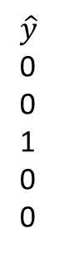
Evaluating your Deep Neural Network in Tensorflow
Now that we have defined our entire deep neural network models, we can focus on some issues with performance evaluation.
The previously defined print_stats_metrics() function can be used to estimate the performance of the deep neural network.
The function takes in the predicted labels (y_pred) and the annotated labels (y_test) and compares performance.
Really, the only issue is to make sure that both inputs to the function are in the correct format.
y
0
0
1
1
0
$$\hat{y}$$
0
0
1
0
0
y_tf
$\hat{y}$_tf
1 0
1 0
0 1
0 1
1 0
1 0
1 0
0 1
1 0
1 0
80%

Slide 32
Quiz solution

Slide 33
scores_list
The lists precision_scores_list = [] and accuracy_scores_list = [] are used for printing the performance plots with the plotting function described earlier.

Slide 34
Print stats code
## print stats
precision_scores_list = []
accuracy_scores_list = []
def print_stats_metrics(y_test, y_pred):
print('Accuracy: %.2f' % accuracy_score(y_test, y_pred) )
accuracy_scores_list.append(accuracy_score(y_test, y_pred) )
confmat = confusion_matrix(y_true=y_test, y_pred=y_pred)
print "confusion matrix"
print(confmat)
print pd.crosstab(y_test, y_pred, rownames=['True'], colnames=['Predicted'], margins=True)
precision_scores_list.append(precision_score(y_true=y_test, y_pred=y_pred))
print('Precision: %.3f' % precision_score(y_true=y_test, y_pred=y_pred))
print('Recall: %.3f' % recall_score(y_true=y_test, y_pred=y_pred))
print('F1-measure: %.3f' % f1_score(y_true=y_test, y_pred=y_pred))

Slide 35
10-fold cross validation
The final part I want to discuss is how 10-fold cross validation works and can be implemented for our deep neural networks.
In this case, I have provided a simplistic way of looking at 10-fold cross validation for the sake of ease of understanding.
Quite simply, cross validation means dividing the data sets into bins (for instance 10) and then iterating through them while using some for training and some for testing.
Usually, 9 are used for training and 1 is held out for testing.
The following function select_fold_to_use_rc(X, y, k) defines the process.

Slide 36
select_fold_to_use_rc(X, y, k)
Using an input parameter k (the fold) we can select the indices that will be used for training and testing.
Every fold, these indices will change.
So, for each fold, the function select_fold_to_use_rc(X, y, k) returns the samples to use for training and the values to use for testing based on the selected indices.

Slide 37
manual 10 fold crossvalidation get sets
## manual 10 fold crossvalidation get sets
def select_fold_to_use_rc(X, y, k):
K = 10
num_samples = len(X[:,0])
training_indices = [i for i, x in enumerate(X) if i % K != k]
testing_indices = [i for i, x in enumerate(X) if i % K == k]
X_train = X[training_indices]
y_train = y[training_indices]
X_test = X[testing_indices]
y_test = y[testing_indices]
return X_train, X_test, y_train, y_test

Slide 38
perform the analysis
Once we have the sets, we can simply perform the analysis with the selected sets.
This of course can be done in a loop but here I have hard-coded each call to a different fold for illustration purposes. Tensorflow has its own built-in ways of performing cross validation.

Slide 39
manual 10 fold cross validation
## manual 10 fold cross validation
#select each fold
X_train, X_test, y_train, y_test = select_fold_to_use_rc(X_train_10fold, y_train_10fold, 1)
X_train, X_test, y_train, y_test = select_fold_to_use_rc(X_train_10fold, y_train_10fold, 2)
X_train, X_test, y_train, y_test = select_fold_to_use_rc(X_train_10fold, y_train_10fold, 3)
X_train, X_test, y_train, y_test = select_fold_to_use_rc(X_train_10fold, y_train_10fold, 4)
X_train, X_test, y_train, y_test = select_fold_to_use_rc(X_train_10fold, y_train_10fold, 5)
X_train, X_test, y_train, y_test = select_fold_to_use_rc(X_train_10fold, y_train_10fold, 6)
X_train, X_test, y_train, y_test = select_fold_to_use_rc(X_train_10fold, y_train_10fold, 7)
X_train, X_test, y_train, y_test = select_fold_to_use_rc(X_train_10fold, y_train_10fold, 8)
X_train, X_test, y_train, y_test = select_fold_to_use_rc(X_train_10fold, y_train_10fold, 9)
X_train, X_test, y_train, y_test = select_fold_to_use_rc(X_train_10fold, y_train_10fold, 0)

Slide 40
Summary
In this chapter, the main topic of deep learning was introduced.
The chapter addressed the Tensorflow environment and code definitions as well as theoretical frameworks for deep learning.
Issues about neural network architecture and performance evaluation were also presented.
Finally, several coding examples using python, Sklearn, and Tensorflow were provided in an incremental fashion for the algorithms of linear regression, logistic regression, 1-layer neural networks, and n-layer neural networks.
The next chapter will further look at other methods that can be implemented with Tensorflow and, in particular, their relationship with semantic vector spaces.

