Slide 1
Machine Learning For Cyber
Unit : Deep Reinforcement Learning

Slide 2
Learning Outcomes
Upon completion of this unit:
Students will have a better understanding the topic of Reinforcement Learning.
Theory
Q-Learning using a Table
Q-Learning using a Neural Network
Q-Learning using a Neural Network and Randomness

Slide 3
Introduction
Reinforcement Learning : an area of machine learning between supervised learning and unsupervised learning
Applied to recommender systems and AI-based games
Main advantage of applying reinforcement learning to games is that games are governed by rules

Slide 4
reinforcement learning techniques
Q-learning Several additional optimization

Slide 5
Frozen Lake game(cybersecurity version)
firewall | pass | Break through | firewall
pass | pass | firewall | pass
firewall | pass | pass | firewall
pass | firewall | pass | start

Slide 6
Q maping
The key to predicting these rewards is to know the associated reward given a current state and action to take. This is called a Q maping
Q (state, action) = reward

Slide 7
An example of the table
 | Up | Down | Left | right
State1 | Q=0.6 | Q=0.8 | Q=0.1 | Q=0.0
State2
State3
State4 | 0 |  | 0.1
State5
State6 |  |  | 0
State7 |  | 0.6 |  | 0
State8 |  |  | 1
State9 | 0
State10 |  | 0 |  | 1
State11 |  |  | 1
State12 | 0.02
State13 |  |  | 0.4
State14 |  | 0.6
State15 |  | 0.3 | 0
State16 |  | 1 |  | 0
Figure. Q-Learn Table

Slide 8
The Bellman equation
Q(state, action) = reward + weight * max [ Q(future_state, future_action )]

Slide 9
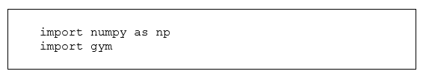

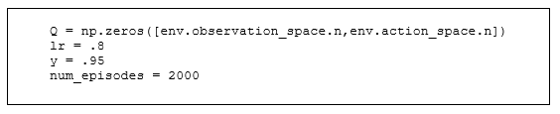
code to implement Q-Learning using a table

Slide 10

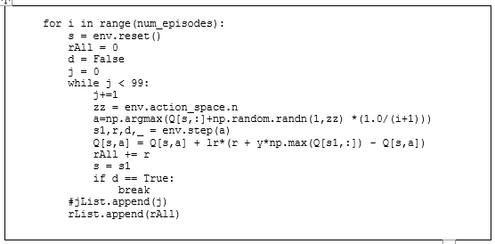
code to implement Q-Learning using a table

Slide 11
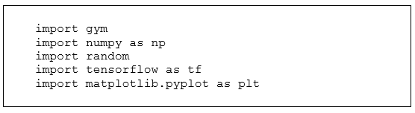

Q-Learning using a Neural Network

Slide 12
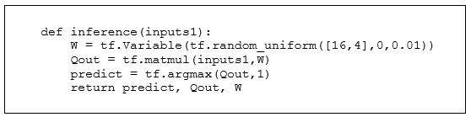
inference function

Slide 13
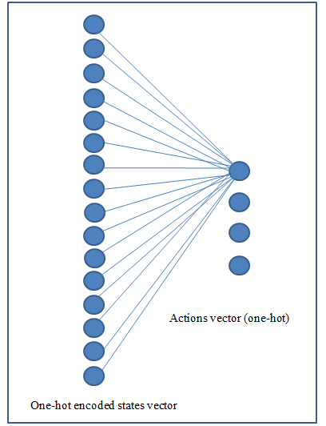
Q-Learning network

Slide 14
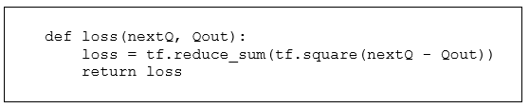
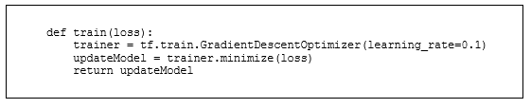
Train and loss function

Slide 15

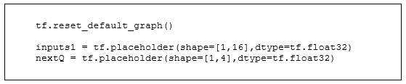
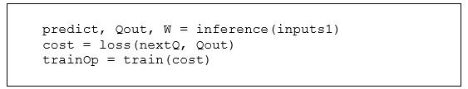
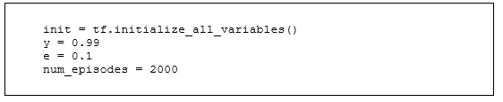
Function continued

Slide 16
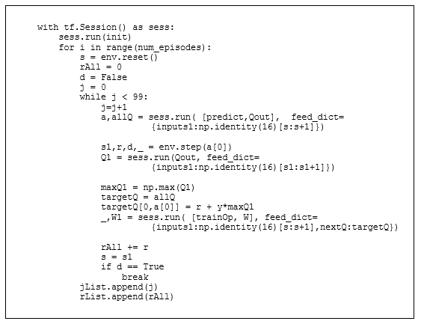
main loop

Slide 17
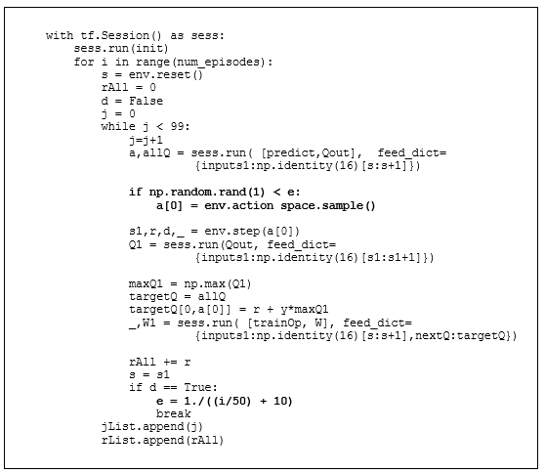
Q-Learning using a Neural Network and Randomness

Slide 18
Summary
we have discussed the Q learning algorithm as part of the larger topic of Reinforcement Learning using tables and neural networks

