Slide 1
Machine Learning for Cyber
Unit : Data Sets and Features

Slide 2
Learning Outcomes
Upon completion of this unit:
Students will have a better understanding of features for machine learning.
Students will have a better understanding of how to extract features.

Slide 3
Data sets
Data sets are central to machine learning
The algorithms are data hungry
What is better have?
The most powerful machine learning algorithm and small amounts of poor data
Or
Lots of good data even if our algorithm is not the best
Data is king!
Why have companies like Facebook, google, etc. do so well?
Because all of you that have social media feed them new data all the time and you even annotate it for them by labeling it with likes, etc.

Slide 4
Difference
What is the difference between a regular data science class and a data science class for cyber security
The data
Everything else is the same. The machine learning algorithms do not really change
What Changes is the how the data is represented or converted to features, samples, classes, etc.
In this, module we will explore data sets.

Slide 5
Characteristics of data sets
When thinking of a data set, think in terms of a matrix
Rows => samples
Columns => features
Matrix_data = np.loadtxt(dataset, delimiter= “ , ” , skiprows=1)
X = Matrix_data[ : , : 4]
y = Matrix_data[ : , 4]

Slide 6
Iris
Iris dataset is a collection of multiple variable analysis dataset. It contains totally 150 data. There are 3 labels in this dataset which are Setosa, Versicolour, and Virginica. Each class contains 4 features to do prediction.
X1 X2 X3 X4 y
[[5.1 3.5 1.4 0.2 0. ]
[4.9 3. 1.4 0.2 0. ]
…
[5.9 3. 5.1 1.8 2. ]]

Slide 7
Text Data set
Phishing Websites Data Set:
Phishing Dataset

Slide 8
Images data set

Slide 9
Speech

Slide 10
NSL-KDD
Network intrusion

Slide 11
UNSW big data
Network

Slide 12
Phishing

Slide 13
Honeypot unsupervised

Slide 14
Malware

Slide 15
Fraud Detection

Slide 16
Biometrics

Slide 17
What are features?
Ways to represent a sample
Vector space model
Notes:
This sets up the problem we’ll use to demonstrate various control and data structures of scripts.
This is a common security need, and various commercial tools such as tripwire and tiger do this. They are not scripts, but they work very much like what is here.
You might mention that, in practice, one would put the files we will create in places other than where this exercise puts them. Normally the files would go in a protected area, but here I opt for simplicity.

Slide 18
Types of features
Binary
Continuous

Slide 19
Dimensionality
Number of features determines dimensionality

Slide 20
Machine Learning (ML) is essential for automated systems to make decisions and to infer new knowledge about the world.
Machine learning approaches can be divided into
supervised learning (such as Support Vector Machines)
unsupervised learning (such as K-means clustering).

Slide 21
Within supervised approaches
Within supervised approaches, the learning methodologies can be divided based on whether they
predict a class (into classifiers )
or a magnitude (and regression models)

Slide 22
An additional categorization for these methods depends on whether they use
sequential
or non-sequential data.

Slide 23
Technique | Definition | Pros | Cons
Support Vector Machines | Supervised learning approach that optimizes the margin that separates data. | SLT Confidence characteristic (expected risk) | class imbalance issues
Decision Trees | This method performs classification by constructing trees where branches are separated by decision points. | Easy to understand | Not flexible
Neural Networks | Model represents the structure of the human brain with neurons and links to the neurons. | Versatile | Can obscure the underlying structure of the model
K-means clustering | Unsupervised method that forms k-means clusters to minimize distance between centroids and members of cluster. | Unsupervised – so no training needed | Needs clearly defined separations in the data in order to be effective
Linear Discriminant Analysis (LDA) | Creates linear function of features to classify data | Simple yet robust classification method | Normality assumptions of the classes
Naïve Bayes | Probabilistic Learning to calculate the probability of seeing a certain condition in the world by selecting the most probable class given the feature vector | Fast, easy to understand the model | Bayes assumptions of independence
Maximum Likelihood Estimation (MLE) | Calculates the likelihood that an object will be seen based on its proportion in the sample data | Simple | Too simplistic for some applications
Hidden Markov Models (HMM) | A Markov Chain is a weighted automaton consisting of nodes and arcs where the nodes represent states and the arcs represent the probability of going from one state to another. | Probabilistic. Good for sequence mining | Combinatorial complexity/ needs prior knowledge

Slide 24
A few ML algorithms
Classifiers are machine learning approaches that produce as an output a specific class given some input features.
Important classifiers include:
Support Vector Machines (Burges 1998) commonly implemented using LibSVM (Chang and Lin, 2001)
Naïve Bayes
artificial neural networks
deep learning based neural networks
decision trees
random forests
k-nearest neighbor classifier

Slide 25
deep learning
deep learning based methods are simply neural nets with more layers.
Deep learning methods have made a big impact in the field of machine learning in recent years.
given enough computational power, they can automatically learn the optimal features to be used in a classification problem.

Slide 26
Feature Engineering
In the past, learning what features to use required using humans to engineer the features.
This issue has now been alleviated somewhat by deep learning.
Revolutionized the industry

Slide 27
Additionally, artificial neural networks are classifiers that can handle non-linearly separable data.
In theory, this capability allows them to model data that may be more difficult to classify.

Slide 28
Libraries
import numpy as np
from sklearn import datasets
from sklearn.cross_validation import train_test_split
from sklearn.preprocessing import StandardScaler
from sklearn.metrics import accuracy_score
from matplotlib.colors import ListedColormap
import matplotlib.pyplot as plt
from sklearn.metrics import confusion_matrix
from sklearn.metrics import precision_score
from sklearn.metrics import recall_score, f1_score
import pandas as pd
from sklearn.preprocessing import LabelEncoder
from sklearn import decomposition

Slide 29
SKlearn library
SKlearn library is the main library which contains most of the traditional machine learning tools we will
The numpy library is essential for efficient matrix and linear algebra operations.
For those with experience with MatLab, I can say that numpy is a way of performing linear algebra operations in python similar to how they are done in MatLab.
This makes the code more efficient in its implementation and faster as well.
The datasets library helps to obtain standard corpora. You can use it to obtain annotated data like Fisher’s iris data set, for instance.

Slide 30
sklearn.cross_validation we can import train_test_split which is used to create splits in a data matrix such as 70% for training purposes and 30% for testing purposes.
From sklearn.preprocessing we can import the StandardScaler module which helps to scale feature data.
We will use functions such as these to scale our data for the Tensorflow based classifiers.
Deep learning algorithms can improve significantly when data is properly scaled. So, it is recommended to do this.

Slide 31
Two more very important libraries are matplotlib.pyplot and pandas.
The matplotlib.pyplot library is very useful for visualization of data and results and the pandas library is very useful for pre-processing.
The pandas library can be very useful to pre-process large data sets in very fast and very efficient ways.
There are some parameters that are sometimes useful to set in your code.
The code sample below shows the use of np.set_printoptions.
The function is used to print all values in a numpy array.
This can be useful when trying to visualize the contents of a large data set.

Slide 32
## set parameters
np.set_printoptions(threshold=np.inf) ## print all values in numpy array

Slide 33
Splitting the data
Let us assume that our data is stored in the matrix X.
The code segment below uses the function train_test_split.
This function is used to split a data set (in this case X) into 4 sets which are X_train, X_test, y_train, y_test.
These are the 4 sets that will be used by the traditional classifiers or the deep learning classifiers.
The sets that start with X hold the data (feature vectors) and the sets that start with y hold the labels per sample (e.g. y₁ for the first feature vector, y₂ for the second feature vector, and so on).

Slide 34
Split size
The values test_size=0.01and random_state=42 in the function are parameters that define the split.
The value 0.01 makes a train set that has 99% of all samples while the test set has 1% of all samples.
In contrast test_size=0.20 would mean that there is a 80% and 20% split.
The random_state=42 allows you to always get the same random data since the seed is defined as 42.

Slide 35
#X_train, X_test, y_train, y_test = train_test_split(X, y, test_size=0.30, random_state=48)
## k-folds cross validation all goes in train sets (hence 0.01)
X_train, X_test, y_train, y_test = train_test_split(X, y, test_size=0.01, random_state=42)

Slide 36
To call all the functions or classifiers you can employ the following approach.
Here we have defined 5 common classifiers.
Notice that each one gets the 4 data sets obtained from the percentage split.
Notice also that the data files have a _normalized added to their name.
This is a good standard approach used by programmers to indicate that this data has been scaled.
The next chapter addresses scaling. Here you run X_train through a scaler function to obtain X_train_normalized.
The labels (y) are not scaled.

Slide 37
#######################################
## ML_MAIN()
#logistic_regression_rc(X_train_normalized, y_train, X_test_normalized, y_test)
#svm_rc(X_train_normalized, y_train, X_test_normalized, y_test)
#random_forest_rc(X_train, y_train, X_test, y_test)
#knn_rc(X_train_normalized, y_train, X_test_normalized, y_test)
multilayer_perceptron_rc(X_train_normalized, y_train, X_test_normalized, y_test)

Slide 38
Optimization
Before we begin to discuss some of the machine learning algorithms, I should say something about optimization.
Optimization is a key process in machine learning.
Basically, any supervised learning algorithm needs to learn a prediction equation given a set of annotated data.
This prediction function usually has a set of parameters that must be learned.
However, the question is “how do you learn these parameters?”
The answer is that you do so through optimization.

Slide 39
In its simplest form, optimization consists of trying a set of parameters with your model and seeing what result they give you.
If the result is not good, the optimization algorithm needs to decide if you should decrease the values of the parameters or increase the values of the parameters.
In general, you do this in a loop (increasing and decreasing) until you find an optimal set of parameters.
But one of the questions to answer here is: do the values go up or down?
Well, as it turns out, there are methodologies based on calculus that help you to make this decision.

Slide 40
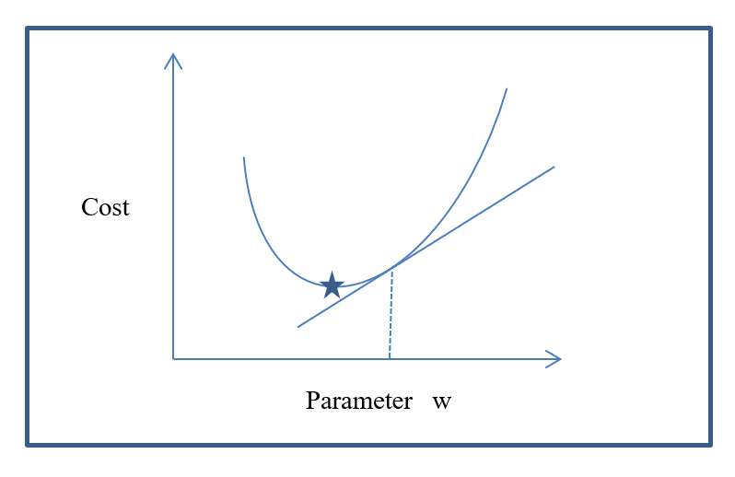
Optimization graph

Slide 41
The above graph represents an optimization problem.
The y axis represents the cost (or penalty) of using a given parameter.
The x axis represents the value of the parameter (w) being used at the given iteration.
The curve represents the behavior that the function being used to minime the cost will follow for every value of parameter w.

Slide 42
As shown in the graph, the optimal value for the curve is found where the star is located (i.e where the value of cost is at a minimum).
So, somehow the optimization algorithm needs to travel through the function and arrive at the position indicated by the star.
At that point, the value of “w” reduces the cost and finds the best solution.
Instead of trying all values of “w” at random, the algorithm can make educated guesses about which direction to follow (up or down).
To do this, we can use calculus to calculate the derivative of the function at a given point.
This will allow us to determine the slope at that point.

Slide 43
In the case of the graph, this represents the tangent line to the curve if we calculate the derivative at point w.
If we calculate the slope at the position of the star symbol, then the slope is zero because the tangent at that point is parallel to the x axis.
The slope at the point “w” will be positive.
Based on this result, we can tell the direction we want to take for parameter w (decrease or increase).
This type of optimization is called gradient descent and is very important in machine learning and deep learning.
There are several approaches to implement gradient descent and this is just the simplest explanation for conceptual purposes.

Slide 44
old_x = 0
new_x = 4
step_size = 0.01
precision = 0.00001
def function_derivative(x):
return 3*x ** 2 – 6*x
while absolute_value(new_x – old_x) > precision:
old_x= new_x
new_x = old_x – step_size * function_derivative(old_x)
print “result is: ”, new_x

Slide 45
In the previous code example we assume a function of
f() = x³ – 3x² + 7
that needs to be optimized for parameter x. We will need the value of the derivative for each point x. The derivative for f() is:
f ´() = 3x² – 6x
So, the parameter x can be calculated in a loop using the derivative function which will determine the direction to follow when increasing or decreasing the parameter x.

Slide 46
Summary
Data sets and features

