Slide 1
Machine Learning for Cyber
Unit : SKlearn

Slide 2
Learning Outcomes
Upon completion of this unit:
Students will have a better understanding of SKlearn.

Slide 3
What is SKlearn?
A python-based library for machine learning
I machine learning, it is better to code. Python has many machine learning libraries.
TensorFlow is like SKlearn but for deep neural networks
You can get Sklearn from: http://scikit-learn.org/
Notes:
This sets up the problem we’ll use to demonstrate various control and data structures of scripts.
This is a common security need, and various commercial tools such as tripwire and tiger do this. They are not scripts, but they work very much like what is here.
You might mention that, in practice, one would put the files we will create in places other than where this exercise puts them. Normally the files would go in a protected area, but here I opt for simplicity.

Slide 4
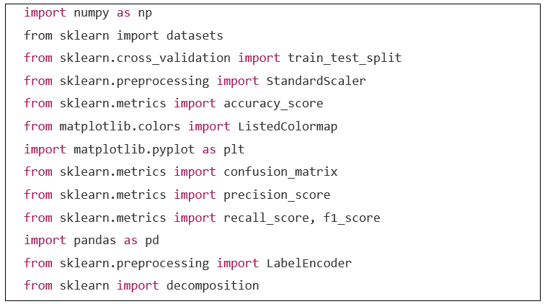
Libraries

Slide 5
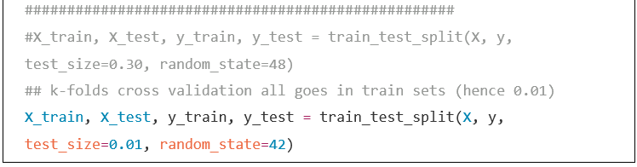
Train Test Split

Slide 6
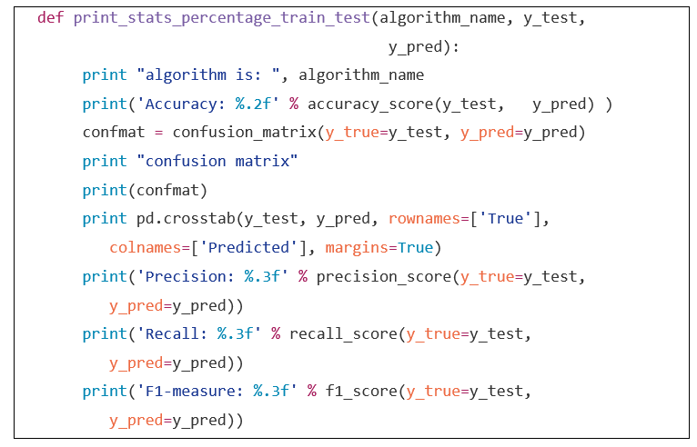
Performance metrics

Slide 7
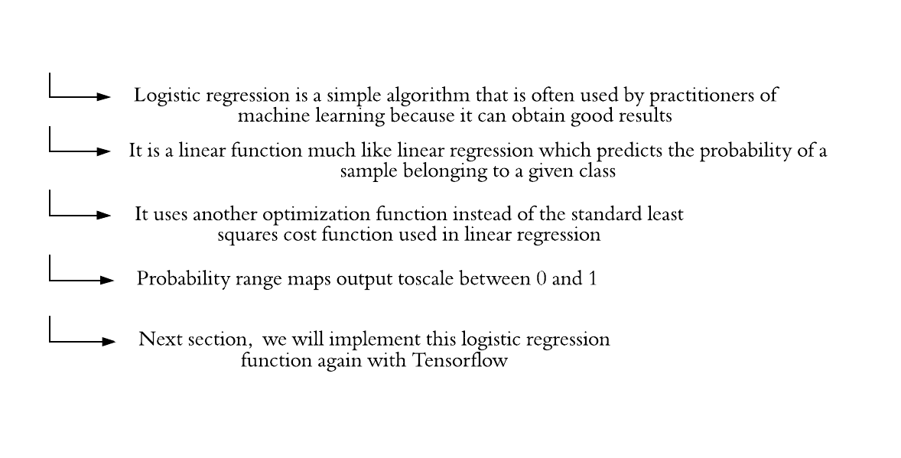
Logistic Regression
Notes:
Logistic regression is a simple algorithm that is often used by practitioners of machine learning because it can obtain good results.
Logistic regression is a linear function much like linear regression which predicts the probability of a sample belonging to a given class.
Logistic regression uses another optimization function instead of the standard least squares cost function used in linear regression.
The predicted values from a standard regression approach are now passed through a sigmoid function that basically maps the output to a probability range scale between 0 and 1.
The code below provides an example of how to use the logistic regression function with SKlearn.
Later, we will implement this logistic regression function again with Tensorflow.

Slide 8
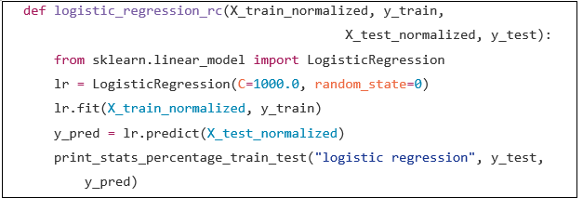
Logistic Regression demonstration
input
output
Figure. Logistic Regression Architecture for the Iris dataset

Slide 9
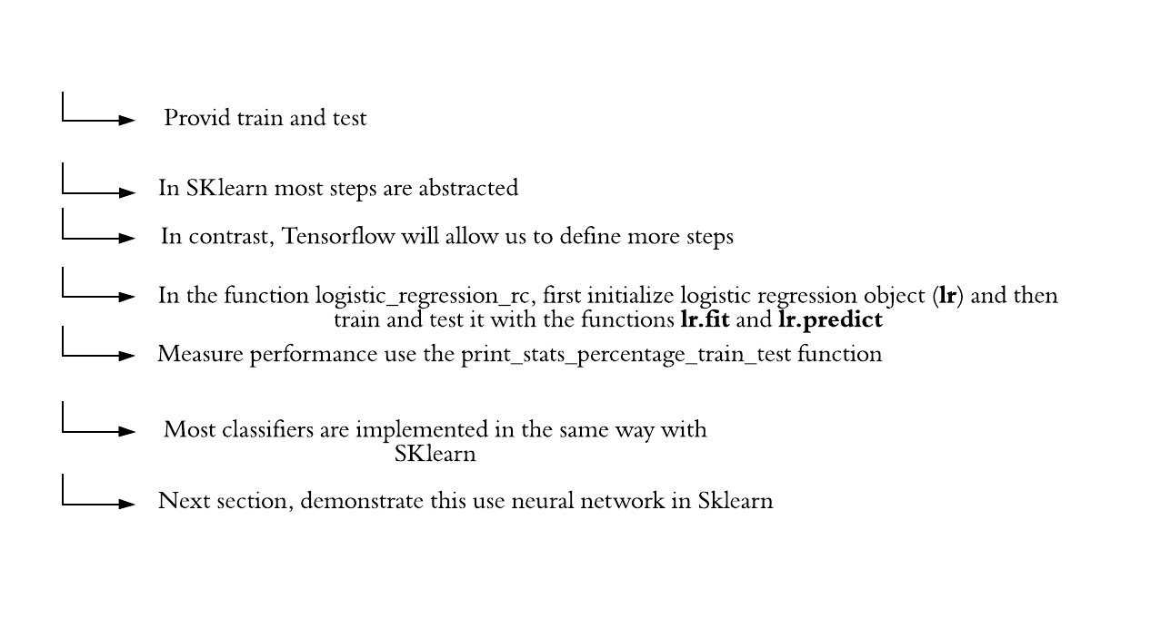
Logistic Regression mechanism
Notes:
In the previous function, the train and test sets are provided for the model to be trained and tested.
In SKlearn most steps are abstracted.
In contrast, Tensorflow will allow us to define more steps such as the cost function, optimization, and inference equation and other aspects.
In the function logistic_regression_rc, first you initialized a logistic regression object (lr) and then you train and test it with the functions lr.fit and lr.predict.
The final step is to measure performance using the previously described function print_stats_percentage_train_test.
Most classifiers are implemented in the same way with SKlearn.
In the next section, I will demonstrate how this is done for a neural network in Sklearn.

Slide 10
Logistic Regression mechanism
In the previous function, the train and test sets are provided for the model to be trained and tested.
In SKlearn most steps are abstracted.
In contrast, Tensorflow will allow us to define more steps such as the cost function, optimization, and inference equation and other aspects.
In the function logistic_regression_rc, first you initialized a logistic regression object (lr) and then you train and test it with the functions lr.fit and lr.predict.
The final step is to measure performance using the previously described function print_stats_percentage_train_test.
Most classifiers are implemented in the same way with SKlearn.
In the next section, I will demonstrate how this is done for a neural network in Sklearn.
Notes:
In the previous function, the train and test sets are provided for the model to be trained and tested.
In SKlearn most steps are abstracted.
In contrast, Tensorflow will allow us to define more steps such as the cost function, optimization, and inference equation and other aspects.
In the function logistic_regression_rc, first you initialized a logistic regression object (lr) and then you train and test it with the functions lr.fit and lr.predict.
The final step is to measure performance using the previously described function print_stats_percentage_train_test.
Most classifiers are implemented in the same way with SKlearn.
In the next section, I will demonstrate how this is done for a neural network in Sklearn.

Slide 11
Neural Networks
Neural networks are very complex systems that take a long time to train.
Therefore, the use of them in SKlearn may not be recommended except for the smallest of data sets.
The code is shown here for contrast purposes with later implementations of neural networks in Tensorflow.
In the next chapters, we will focus on how to do this in Tensorflow and how to create networks of multiple layers.

Slide 12
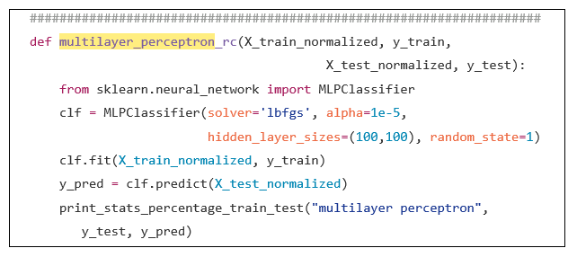
Neural Networks Code Example
everything is very similar to the previous logistic regression implementation.
The new changes appear in the definition of the clf multilayer object.
The parameter hidden_layer_sizes=(100,100) means that the architecture of the network consists of 2 hidden layers with 100 neurons each.
A parameter such as (200, ) means that the network has 1 hidden layer with 200 neurons.

Slide 13
KNN
The k-nearest neighbor (KNN) classifier is a popular algorithm that I always like to use.
It requires very little parameter tuning and can be easily implemented.
Here, the Sklearn based code is similar to all previous approaches.
The new aspects relate to the KNN parameters such as the value k.
The n_neighbors parameter is the k.
In this case, the five closest samples are selected.

Slide 14
def knn_rc(X_train_normalized, y_train, X_test_normalized, y_test):
from sklearn.neighbors import KNeighborsClassifier
knn = KNeighborsClassifier(n_neighbors=5, p=2,
metric='minkowski')
knn.fit(X_train_normalized, y_train)
y_pred = knn.predict(X_test_normalized)
print_stats_percentage_train_test("knn", y_test, y_pred)

Slide 15
Support Vector Machines (SVM)
Before Deep Neural Networks, SVM was one of the big boys in the block.
SVM is an example of a theoretically well founded machine learning algorithm.
And for this reason it has always been very well respected by machine learning practitioners.
This is in contrast to neural networks which haven’t always been considered as very strong on their theoretical framework.
As an example, in the rest of this chapter I will discuss SVM’s framework and then provide example code to implement an SVM with SKlearn.

Slide 16
Support Vector Machines
Support Vector Machines is a binary classification method based on statistical learning theory which maximizes the margin that separates samples from two classes (Burges 1998; Cortes 1995).
This supervised learning machine provides the option of evaluating the data under different spaces through Kernels that range from simple linear to Radial Basis Functions [RBF] (Chang and Lin 2001; Burges 1998; Cortes 1995).
Additionally, its wide use in the field of machine learning research and ability to handle large feature spaces makes it an attractive tool for many applications.

Slide 17
def svm_rc(X_train_normalized, y_train, X_test_normalized, y_test):
from sklearn.svm import SVC
#svm = SVC(kernel='linear', C=1.0, random_state=0)
svm = SVC(kernel='rbf', random_state=0, gamma=0.0010, C=32)
svm.fit(X_train_normalized, y_train)
y_pred = svm.predict(X_test_normalized)
print_stats_percentage_train_test("svm (rbf)", y_test, y_pred)

Slide 18
Sklearn for cyber security

Slide 19
Cyber security for sklearn

Slide 20
Summary
overview of some of the main traditional topics of supervised machine learning was provided.
In particular, the following machine learning algorithms were presented: logistic regression, KNN, Support Vector Machines, and neural networks.
Code examples of their implementation using the SKlearn kit were presented and discussed.
Additionally, issues related to classifier performance were also addressed.
The next chapter will focus on issues related to data and data pre-processing that apply to both traditional machine learning as well as deep learning.

