Slide 1
Thesis
Wireless Requirements
Architectural Modeling
Testbed Development
Data Collection and Organization
Machine Learning
Future Research

Slide 2
Wireless Requirements
Architectural Modeling
Data Collection and Organization
Machine Learning
Future Research
Investigation of online learning for RF situational awareness
Understanding the radio environment within the factory inclusive of the industrial workcell
Functional Decomposition of network and physical system
Indication of physical and network constraints
Integrate ML with industrial control systems
Extension of model to larger systems and inclusion into standards
Instrumentation of testbed with network and physical systems probes
Big data problem of the organization/cleaning/curation of data for analysis
Application of graph database for organization, query, and visualization
Interference level estimation using machine learning regression
Analysis of various regression techniques for industrial application
Study of the industrial wireless work cell in smart manufacturing control
Identification of interfaces
Identification of sources of information flows relevant to assessment of cyberphysical systems performance
Indication of applicable wireless technologies to use cases identified
Identification of the pertinent wireless use cases found in the factory

Slide 3
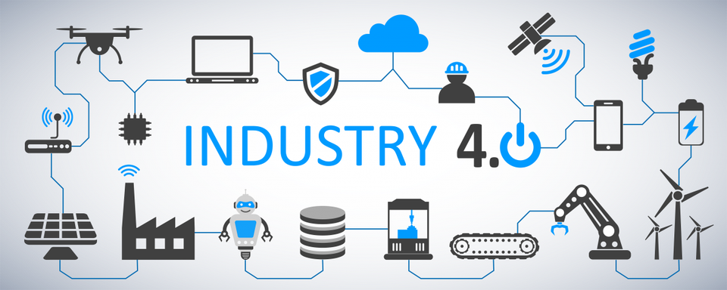
Cloud
Efficiency
Analytics
Security
AI
Wireless
Edge Computing
Data
3D printing
Autonomy
Cobots

