Slide 1




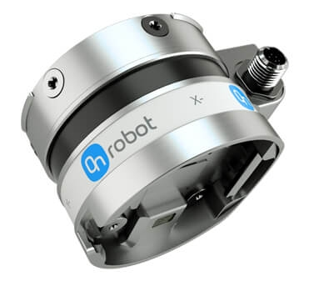
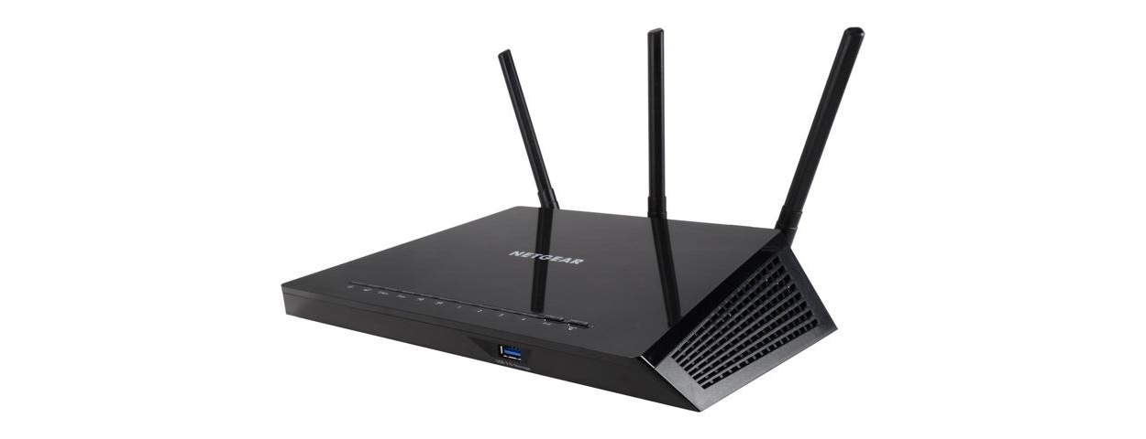
Measurement Setup (Nov. 2019)
Inspector
Supervisor
NUC
INS_FT
INS_RC
TAP
Eth->Wi-fi
PLC
Two PTP capable switches
(22 ports combined)
Wi-Fi Router
Non-PTP Switch
TAP
AP
Robot Controller(RC)
Force-Torque(FT) Sensor
Operator
TAP
TAP
CNC_1
Non-PTP Switch
Eth->Wi-fi
Traffic Generator
Sniffer
Traffic Sink
TAP
CNC_2
TAP
CNC_3
OPT_FT
OPT_RC
TAP
CNC_4
Notes:
Identify Flows
Tesyt Case Baseline

