Slide 1
RSA and Shor’s Algorithm
Public-key cryptography, and how a quantum computer breaks it
Roberto Cappuccio
Istituto Nazionale di Fisica Nucleare - Pisa
Quantum Computing course 2026-27 · Laurea Magistrale in Fisica
Companion material: rsa_shor_lesson.pdf · 16_Shor_Period_Finding_to_RSA.ipynb (IBM Aer simulator / IQM Garnet & Emerald)
Notes:
Lecture for the Quantum Computing course (MSc Physics). Companion to lesson/rsa_shor_lesson.pdf and the 16_Shor_Period_Finding_to_RSA.ipynb notebooks (IBM Aer / IQM).

Slide 2
Roadmap
1
Public-key cryptography
the key-distribution problem, trapdoor one-way functions
2
Number-theory toolbox
Bézout & modular inverses, Euler’s φ, Fermat/Euler theorems, CRT
3
RSA
key generation, why decryption works, a worked example, security = factoring
4
Shor’s algorithm
factoring → order finding, QPE, continued fractions, demo on a simulator and on IQM hardware
Notes:
Four blocks, ~90 minutes. The number theory is the toolbox; RSA is the construction; Shor is the demolition. The last block is hands-on with the notebook.

Slide 3
Symmetric vs. asymmetric cryptography
Symmetric (AES, ChaCha20, …)
One secret key k encrypts and decrypts:
$$c=E_{k}(m), m=D_{k}(c)$$
Fast (GB/s), used for the bulk of every TLS connection
Key-distribution problem: Alice and Bob must already share k over a secure channel
n parties → n(n−1)/2 shared keys
Asymmetric / public-key (Diffie–Hellman 1976, RSA 1977)
Each party publishes pk and keeps sk:
$$c=E_{pk}(m), m=D_{sk}(c)$$
Anyone can encrypt to Bob with his public key
Only Bob, holder of the private key, can decrypt
n parties → n key pairs, no secure channel needed
1 000 users: 499 500 symmetric keys vs 1 000 public/private pairs. In practice: public-key crypto exchanges a symmetric session key, which then does the heavy lifting.
Notes:
Symmetric ciphers are fast but need a shared secret: n parties need n(n-1)/2 keys. Public-key cryptography (Diffie-Hellman 1976, RSA 1977) removes the problem: encrypt with the public key, decrypt with the private key.

Slide 4
Trapdoor one-way functions
Definition
A function f is one-way if y = f(x) is easy to compute but x = f⁻¹(y) is computationally infeasible. It is a trapdoor one-way function if some extra secret information (the trapdoor) makes inverting f easy again.
multiply: easy, O(n²)
two primes
p , q
modulus
N = p·q
factor: hard (classically)
For RSA the trapdoor is the factorisation of the modulus: whoever knows p and q can compute the private key; whoever only knows N (everybody) cannot — as far as classical computers go.
Shor’s algorithm (1994) destroys this asymmetry on a quantum computer.
Notes:
RSA's trapdoor is the factorisation of the modulus. Multiplying is easy, factoring is believed hard classically. Shor's algorithm removes the asymmetry: that is the whole story of this lecture.

Slide 5
Modular arithmetic, Bézout and inverses
Notation: a ≡ b (mod n) means n | (a − b). The residues Z/nZ = {0, 1, …, n−1} form a commutative ring under + and × modulo n.
Theorem (Bézout’s identity)
For integers a, b not both zero there exist integers x, y with
$$ax+by=gcd(a,b)$$
x, y are computed in O(log min(a, b)) steps by the extended Euclidean algorithm.
Proof idea
Let d = ax₀ + by₀ be the least positive element of S = {ax + by}. Divide a by d: a = qd + r with 0 ≤ r < d. Then r = a(1 − qx₀) − b(qy₀) ∈ S ∪ {0}, so minimality forces r = 0: d | a, and likewise d | b. Hence d | gcd(a, b); conversely gcd(a, b) divides every ax + by. So d = gcd(a, b). ∎
Corollary (modular inverses)
a ∈ Z/nZ has an inverse a⁻¹ (with a·a⁻¹ ≡ 1 mod n) iff gcd(a, n) = 1. The inverse is the coefficient x in ax + ny = 1, reduced mod n.
This is how RSA turns the public exponent into the private one: d ≡ e⁻¹ (mod φ(N)).
Notes:
Everything in RSA lives in Z/NZ. Bézout gives the modular inverse, computed by the extended Euclidean algorithm in O(log) steps. This is exactly how the public exponent e becomes the private exponent d.

Slide 6
Units and Euler’s totient function
Definition (group of units)
The invertible residues
$$(ℤ/nℤ)^{*}=\{a:1≤a≤n, gcd(a,n)=1\}$$
form an abelian group under multiplication modulo n.
Definition (Euler’s totient)
$$φ(n)=\left|{\left(ℤ/nℤ\right)}^{*}\right|$$
= the number of integers in {1, …, n} coprime to n.
φ(p) = p − 1 for a prime p; φ is multiplicative: φ(mn) = φ(m)φ(n) when gcd(m, n) = 1.
Proposition — the case RSA needs
If p ≠ q are primes then
$$φ(pq)=(p−1)(q−1)$$
Proof sketch. Among {1, …, pq} the numbers not coprime to pq are the q multiples of p and the p multiples of q, with pq counted twice: φ(pq) = pq − p − q + 1 = (p − 1)(q − 1). ∎
Examples
φ(55) = 4 · 10 = 40
φ(3233) = 60 · 52 = 3120
φ(15) = 2 · 4 = 8
φ(561) = 2·10·16 = 320 (561 = 3·11·17)
Notes:
The units form a group of order phi(n). For a product of two distinct primes phi(pq) = (p-1)(q-1): inclusion-exclusion on the multiples of p and q.

Slide 7
Fermat’s little theorem and Euler’s theorem
Theorem (Fermat’s little theorem, 1640)
If p is prime and p ∤ a, then
$$a^{p−1}≡1 \left(mod p\right)$$
Equivalently aᵖ ≡ a (mod p) for every integer a.
Theorem (Euler, 1763)
If gcd(a, n) = 1, then
$$a^{φ(n)}≡1 \left(mod n\right)$$
Fermat is the special case n = p, φ(p) = p − 1.
Proof (one line of group theory)
Work in the finite abelian group (Z/nZ)* of order φ(n). By Lagrange’s theorem the order of any element divides the order of the group, so a^φ(n) = 1 in (Z/nZ)*, i.e. a^φ(n) ≡ 1 (mod n). ∎
Euler’s theorem is the engine of RSA: raising to the power φ(N) acts as the identity on units, so exponents can be reduced modulo φ(N).
Try it
n = 15, φ(15) = 8, a = 7:
7¹=7, 7²=49≡4, 7³≡28≡13, 7⁴≡91≡1
so 7⁸ ≡ 1 as Euler promises — and in fact already 7⁴ ≡ 1: the order of 7 is 4, a divisor of 8.
Keep r = 4 in mind: Shor will measure it.
Notes:
Lagrange: the order of an element divides the order of the group. That is the whole proof of Euler's theorem; Fermat is the special case n = p. This is the engine of RSA: exponents can be reduced modulo phi(N).

Slide 8
The Chinese Remainder Theorem
Theorem (CRT)
If gcd(m, n) = 1, the system x ≡ a (mod m), x ≡ b (mod n) has a unique solution modulo mn. Equivalently the map
$$ℤ/mnℤ⟶ℤ/mℤ×ℤ/nℤ, x⟼(x mod m, x mod n)$$
is a ring isomorphism (and hence a bijection of unit groups: this is why φ is multiplicative).
Why we need it
To prove RSA correct: we show m^ed ≡ m modulo p and modulo q separately, then CRT glues the two into a congruence modulo N = pq.
To speed RSA up: decrypting modulo p and q separately (two exponentiations with half-size numbers) is ≈ 4× faster than modulo N. Every real implementation does it.
Example (used later to decrypt by hand)
Solve x ≡ 2 (mod 5), x ≡ 7 (mod 11).
Candidates ≡ 7 mod 11: 7, 18, 29, 40, 51 …
7 ≡ 2 (mod 5) already → x = 7 (unique mod 55).
Textbook formula: x = a·n·(n⁻¹ mod m) + b·m·(m⁻¹ mod n) mod mn.
Notes:
CRT is used twice: to prove RSA correct (combine the mod p and mod q congruences) and to speed up real RSA decryption by about 4x.

Slide 9
RSA — key generation (Recipe R1)
1
Choose two large distinct primes p, q
e.g. 1024 bits each for a 2048-bit key
Encrypt / decrypt
message m with 0 ≤ m < N
$$c=m^{e} mod N$$
$$m=c^{d} mod N$$
Both are one modular exponentiation: square-and-multiply, O((log N)³) bit operations.
2
Compute N = p·q and φ(N) = (p − 1)(q − 1)
N is public, φ(N) is secret
3
Choose a public exponent e with 1 < e < φ(N), gcd(e, φ(N)) = 1
commonly e = 65537 — next slide
4
Compute d ≡ e⁻¹ (mod φ(N))
extended Euclidean algorithm (Bézout)
5
Public key pk = (N, e) Private key sk = (N, d)
discard or guard p, q, φ(N): knowing any of them breaks the scheme
Signatures run the same trapdoor backwards: σ = m^d mod N is produced with the private key and verified by anyone via σ^e ≡ m (mod N).
Notes:
Five steps. The security-relevant secrets are p, q and phi(N); knowing any one of them breaks the scheme. Note the role of each theorem: Bezout gives d, Euler/CRT will prove correctness.

Slide 10
Why is the public exponent usually e = 65537?
$$65537=2^{16}+1=F_{4}=100000000000000001_{2}$$
the fourth (and largest known) Fermat prime — a 17-bit number with only two 1-bits
1 · Fast
Square-and-multiply follows the bits of e: only two 1-bits →
16 squarings + 1 multiplication
Encryption and signature verification (the operations done by every client) are almost free; the cost sits in d, which is ~2048 random bits anyway.
2 · Always invertible
Recipe R1 needs gcd(e, φ(N)) = 1.
e prime ⇒ fails only if 65537 | φ(N)
i.e. only if p ≡ 1 or q ≡ 1 (mod 65537): probability ≈ 2/65537 — then just pick another prime.
3 · Large enough to be safe
Tiny e (e = 3) is even faster but exposes textbook RSA to low-exponent attacks:
if m³ < N the cipher-text is m³ exactly — take a cube root
Håstad broadcast / Coppersmith: same m sent to e recipients
65537 leaves no such room and costs only 17 operations.
e | 1-bits | squarings + multiplications | remarks
3 | 2 | 1 + 1 | fastest; unsafe without proper padding
17 | 2 | 4 + 1 | used in small textbook examples (N = 3233)
65537 | 2 | 16 + 1 | the standard choice (PKCS #1, FIPS 186, every TLS certificate)
random 2048-bit | ≈1024 | 2047 + ≈1023 | no benefit: security does not depend on e being random
Notes:
65537 = 2^16 + 1 is the fourth Fermat prime F4. Its binary expansion has only two 1 bits, so square-and-multiply costs 16 squarings and one multiplication. Being prime, gcd(e, phi(N)) = 1 unless 65537 divides phi(N). It is large enough to avoid the low-exponent attacks that bite e = 3, and it is the value fixed by the standards, so every library agrees.

Slide 11
Why decryption works — RSA correctness
Theorem (RSA correctness)
With the parameters of Recipe R1, for every integer m with 0 ≤ m < N:
$${\left(m^{e}\right)}^{d}≡m \left(mod N\right)$$
Step 0 — unpack d
By construction ed ≡ 1 (mod φ(N)), so
$$ed=1+kφ(N)=1+k(p−1)(q−1)$$
for some integer k ≥ 0.
Step 1 — modulo p
If p | m: m^ed ≡ 0 ≡ m (mod p). Otherwise gcd(m, p) = 1 and Fermat gives m^(p−1) ≡ 1, so
$$m^{ed}=m·{\left(m^{p−1}\right)}^{k(q−1)}≡m \left(mod p\right)$$
Step 2 — modulo q: identical argument.
Step 3 — CRT
m^ed − m is divisible by both p and q, which are coprime, hence by N = pq:
$$m^{ed}≡m \left(mod N\right) ∎$$
Everything used: Bézout (d exists), Fermat (the exponent collapses), CRT (glue).
Notes:
ed = 1 + k phi(N). Modulo p: either p | m (trivial) or Fermat gives m^(p-1) = 1 and (p-1) divides phi(N). Same modulo q. CRT combines. Note that the proof covers m not coprime to N as well.

Slide 12
RSA by hand: p = 5, q = 11
Key generation
N = 5 · 11 = 55
φ(N) = 4 · 10 = 40
e = 3 (gcd(3, 40) = 1)
d: 3d ≡ 1 (mod 40). Since 3·27 = 81 = 2·40 + 1, d = 27
pk = (55, 3)
sk = (55, 27)
Encrypt m = 7
$$c=7^{3} mod 55=343 mod 55=13$$
343 = 6·55 + 13
Decrypt c = 13 (with CRT)
mod 5: 13 ≡ 3, 3²⁷ ≡ 3^(27 mod 4) = 3³ = 27 ≡ 2
mod 11: 13 ≡ 2, 2²⁷ ≡ 2^(27 mod 10) = 2⁷ = 128 ≡ 7
CRT: x ≡ 2 (mod 5), x ≡ 7 (mod 11) ⇒ x = 7 ✓
The textbook ‘big’ example
(13_RSA.ipynb in the course repo)
p = 61, q = 53 → N = 3233
φ(N) = 60 · 52 = 3120
e = 17, d = 2753 (17 · 2753 = 46801 = 15·3120 + 1)
m = 65 → c = 65¹⁷ mod 3233 = 2790
2790²⁷⁵³ mod 3233 = 65 ✓
Real keys: N has ~617 decimal digits.
Notes:
Small enough to do live on the board. Decryption uses CRT and Fermat to keep the numbers tiny: 3^27 mod 5 reduces the exponent mod 4, 2^27 mod 11 reduces it mod 10.

Slide 13
Security: what an attacker must do
Proposition — knowing φ(N) is as hard as factoring
Given N = pq, recovering φ(N) is computationally equivalent to factoring N.
Proof. From φ(N) = N − (p + q) + 1 we get s := p + q = N − φ(N) + 1; then p, q are the roots of
$$t^{2}−st+N=0, p,q=\frac{s±\sqrt{s^{2}−4N}}{2} ∎$$
Best classical attack
General Number Field Sieve — sub-exponential but super-polynomial:
$$exp\left(O\left({\left(logN)^{1/3}(loglogN\right)}^{2/3}\right)\right)$$
Record: RSA-250 (829 bits), 2020, ≈ 2 700 core-years. RSA-2048 is far out of reach.
Textbook RSA vs real RSA
Textbook RSA as above is deterministic, hence insecure in practice: equal messages give equal cipher-texts; a small m with e = 3 may satisfy m³ < N so c = m³ exactly; chosen-cipher-text tricks exploit multiplicativity (c₁c₂ = (m₁m₂)^e).
Real deployments add randomised padding — RSA-OAEP for encryption, RSA-PSS for signatures — and use e = 65537. None of this changes the number theory: the security still reduces to the integer-factorisation problem.
Notes:
Knowing phi(N) is equivalent to factoring: p+q = N - phi(N) + 1 and p, q are the roots of a quadratic. So everything rests on factoring. The best classical algorithm, GNFS, is sub-exponential; the record is RSA-250 (829 bits, 2020, ~2700 core-years).

Slide 14
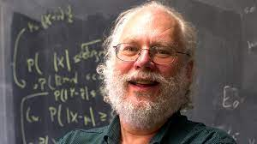
Shor’s algorithm (1994)
Factors N in time polynomial in log N on a quantum computer — breaking RSA asymptotically.
Its heart is a purely classical reduction wrapped around one quantum subroutine:
Classical
pick a random a,
check gcd(a, N)
Quantum
find the order r of a:
a^r ≡ 1 (mod N)
(phase estimation + continued fractions)
Classical
if r even and a^(r/2) ≢ −1:
factors = gcd(a^(r/2) ± 1, N)
Peter Shor, 1994
Cost: Õ((log N)²) quantum gates and O(log N) qubits per run, plus O((log N)³) classical post-processing — polynomial in the input size.
It is probabilistic: each run succeeds with constant probability; failures are detected cheaply and the run is repeated.
Same machinery solves discrete logarithms — so Diffie–Hellman and elliptic-curve cryptography fall too.
Notes:
Structure first: a classical reduction (factoring to order finding) wrapping a single quantum subroutine (order finding by phase estimation). Polynomial in log N, versus sub-exponential for GNFS.

Slide 15
Step 1 — reduce factoring to order finding
Definition (multiplicative order)
For a with gcd(a, N) = 1, the order r = ord_N(a) is the smallest positive integer with
$$a^{r}≡1 \left(mod N\right)$$
Theorem (order finding yields factors)
Let N be odd and composite, a coprime to N with order r. If (i) r is even and (ii) a^(r/2) ≢ −1 (mod N), then
$$gcd\left(a^{r/2}−1,N\right) and gcd\left(a^{r/2}+1,N\right)$$
are non-trivial factors of N.
Proof
Set x = a^(r/2) mod N. Then x² = a^r ≡ 1, so
$$N∣x^{2}−1=(x−1)(x+1)$$
If N divided x − 1 we would have x ≡ 1, contradicting the minimality of r (since r/2 < r). If N divided x + 1 we would have x ≡ −1, excluded by (ii). Hence N divides the product but neither factor: its prime factors are split between x − 1 and x + 1, and gcd(x − 1, N) is a proper divisor > 1 of N (and so is gcd(x + 1, N)). ∎
Why (i) and (ii) matter
r odd → a^(r/2) is not an integer power: no square root of 1 to exploit.
a^(r/2) ≡ −1 → the trivial square root of 1: both gcds are N and 1.
Either failure → pick another a.
Notes:
The whole quantum part is only needed to find r. The theorem is elementary: N divides (x-1)(x+1) but neither factor, so its primes split between the two gcds.

Slide 16
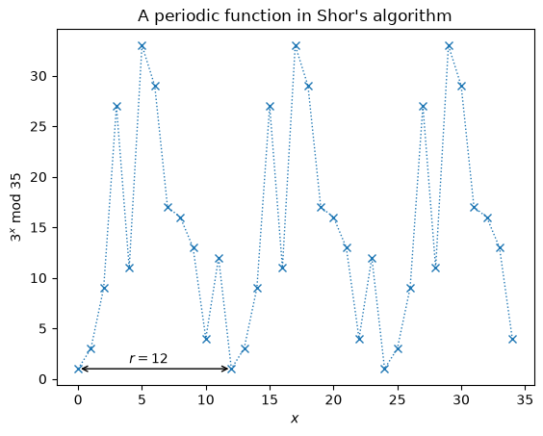
The gamble usually pays off
Lemma
If N has k distinct odd prime factors and a is drawn uniformly from (Z/NZ)*, then conditions (i)–(ii) both hold with probability at least
$$1−2^{−k} ≥ \frac{1}{2}$$
So two or three random choices of a suffice on average; if a fails, pick another. (Idea of proof: by CRT the order of a mod N combines the orders modulo each prime, and the ‘bad’ cases need all their 2-adic parts to line up.)
Example: N = 35, a = 3
Powers of 3 mod 35: 3, 9, 27, 11, 33, 29, 17, 16, 13, 4, 12, 1 → r = 12 (even ✓)
$$3^{6}=729≡29≢−1 \left(mod 35\right) ✓$$
$$gcd(29−1,35)=7, gcd(29+1,35)=5$$
The function x ↦ aˣ mod N is periodic with period r: finding r is a period-finding problem — exactly what the quantum Fourier transform is good at.
Notes:
With k distinct odd prime factors the two conditions hold with probability at least 1 - 2^(-k) >= 1/2 for a random a. Example on the board: a = 3, N = 35, r = 12. The plot is the periodic function 3^x mod 35 from the notebook.

Slide 17
Step 2 — the operator U and its eigenstates
Classically, finding r is as hard as factoring. Quantumly it is easy — via Quantum Phase Estimation of the modular-multiplication operator
$$U|y⟩=|ay mod N⟩, y∈\{0,1,…,N−1\} (a permutation of the residues ⇒ unitary)$$
Proposition (eigenstructure of U)
For each s ∈ {0, 1, …, r − 1} the state
$$|u_{s}⟩=\frac{1}{\sqrt{r}}\sum_{k=0}^{r−1}{e^{−2πisk/r}}|a^{k} mod N⟩$$
is an eigenvector of U with eigenvalue e^{2πi s/r}. Moreover
$$U|u_{s}⟩=e^{2πis/r}|u_{s}⟩, \frac{1}{\sqrt{r}}\sum_{s=0}^{r−1}{|u_{s}⟩}=|1⟩$$
Proof idea
U shifts a^k ↦ a^(k+1) inside the sum; re-indexing k ↦ k − 1 pulls out exactly the factor e^{2πi s/r}.
Summing |u_s⟩ over s, the phases Σ_s e^{−2πi sk/r} cancel for k ≢ 0 and reinforce for k = 0, leaving |a⁰⟩ = |1⟩.
Two facts that make this usable
The eigenphase φ_s = s/r contains the order. We cannot prepare one |u_s⟩ (we don’t know r) — but |1⟩ = r^(−1/2) Σ_s |u_s⟩ is trivial to prepare.
QPE on U with input |1⟩ therefore measures a phase φ ≈ s/r for a uniformly random s ∈ {0, …, r − 1}.
Notes:
U is a permutation of the residues, hence unitary. Its eigenphases are s/r: the order sits in the spectrum. We cannot prepare a single eigenstate, but |1> is their uniform superposition, and that is all QPE needs.

Slide 18
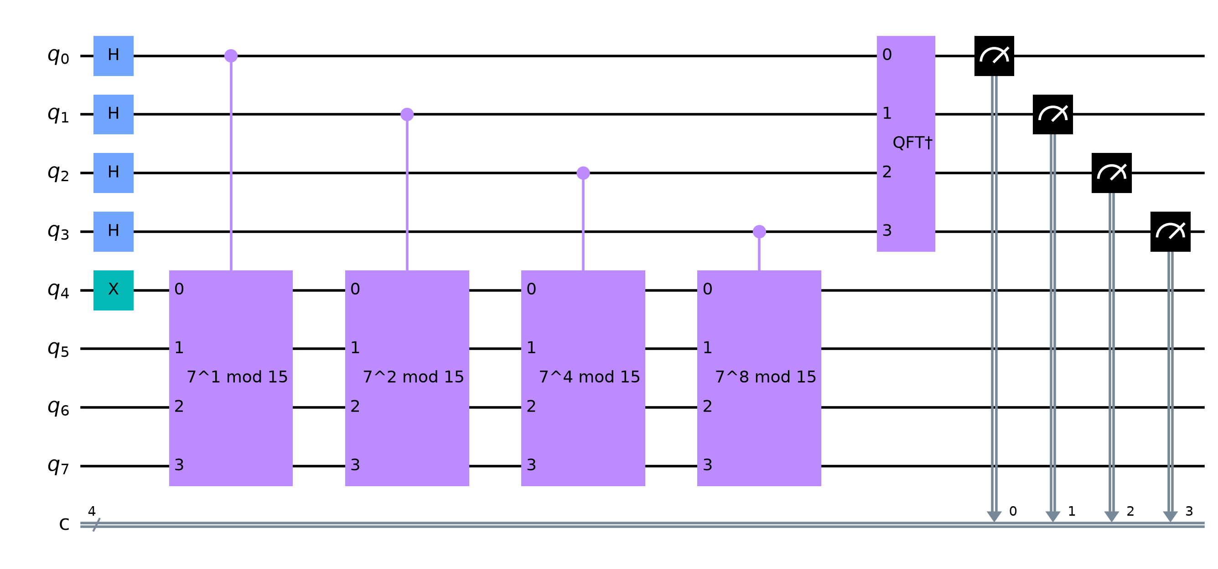
Step 2 — the quantum phase estimation circuit
Reading the circuit
t counting qubits → |+⟩^⊗t (Hadamards); work register → |1⟩ (one X)
controlled U^(2⁰), U^(2¹), …, U^(2^(t−1)): qubit j picks up the phase e^{2πi s·2^j/r}
inverse QFT turns the phases into a binary number
measure y ∈ {0, …, 2^t − 1}:
$$ϕ≈\frac{y}{2^{t}}≈\frac{s}{r}$$
t ≈ 2 log₂N + 1 counting qubits make φ sharp enough for the next step.
16_Shor_Period_Finding_to_RSA.ipynb: build_order_finding_circuit(a=7, n_count=4) for N = 15 — counting register on top, 4-qubit work register below
Qubit budget: t + ⌈log₂N⌉ qubits here (8 + 4 = 12 for N = 15 in the notebook). Beauregard’s construction needs 2n + 3 qubits for an n-bit N.
Where the gates go: the controlled modular multiplications dominate — see ‘the bottleneck’ later.
Notes:
t counting qubits in |+>, work register in |1>, controlled U^(2^j), inverse QFT, measure. The read-out y/2^t approximates s/r. With t ~ 2 log2 N + 1 the estimate is sharp enough for continued fractions. The circuit shown is the notebook's for N = 15, a = 7 with t = 4.

Slide 19
Step 3 — recover r by continued fractions
Theorem (continued-fraction recovery)
If a rational s/r with 0 ≤ s < r ≤ N is approximated by φ to within
$$\left|ϕ−\frac{s}{r}\right|≤\frac{1}{2r^{2}}$$
then s/r is one of the convergents of the continued-fraction expansion of φ, found in O(log N) steps.
In code: one line
Fraction(phi).limit_denominator(N)
returns the best rational approximation to φ with denominator ≤ N — exactly the convergent above. Its denominator is the candidate r.
Example: Fraction(0.75).limit_denominator(15) = 3/4 → r = 4
Why the algorithm is probabilistic — and why that is fine
s = 0: φ = 0 carries no information.
gcd(s, r) > 1: we recover a divisor of r, not r itself (e.g. s/r = 2/4 → r′ = 2).
r odd, or a^(r/2) ≡ −1: the theorem of Step 1 does not apply.
Each failure is detected cheaply (test a^r ≡ 1? and the gcds) and we simply repeat with a new run or a new a. A constant number of repetitions gives any desired success probability.
Notes:
QPE returns a binary fraction close to s/r. The continued-fraction theorem says s/r is a convergent of phi provided the error is below 1/(2 r^2). In Python it is one call: Fraction(phi).limit_denominator(N). Three failure modes, all cheaply detected.

Slide 20
The complete recipe (S1)
1
Classical shortcuts
If N is even output 2. If N = cᵇ is a perfect power (checkable classically) output c.
Legend
■ classical
■ quantum
Only step 3 runs on the QPU. Everything else is a few lines of Python.
Notebook: shor_factor(N)
2
Pick a random a ∈ {2, …, N − 1}
Compute g = gcd(a, N). If g > 1 output g — a lucky factor, no quantum computer needed.
3
Quantum order finding
QPE on U|y⟩ = |ay mod N⟩ with input |1⟩; measure φ ≈ s/r.
4
Continued fractions
r = denominator of limit_denominator(φ, N). Verify aʳ ≡ 1 (mod N); if not, go to 2.
5
Extract the factors
If r is even and a^(r/2) ≢ −1 (mod N), output gcd(a^(r/2) ± 1, N). Otherwise go to 2.
Notes:
This is shor_factor(N) in the notebook, line by line. Steps 1, 2, 4, 5 are classical; only step 3 is quantum.

Slide 21
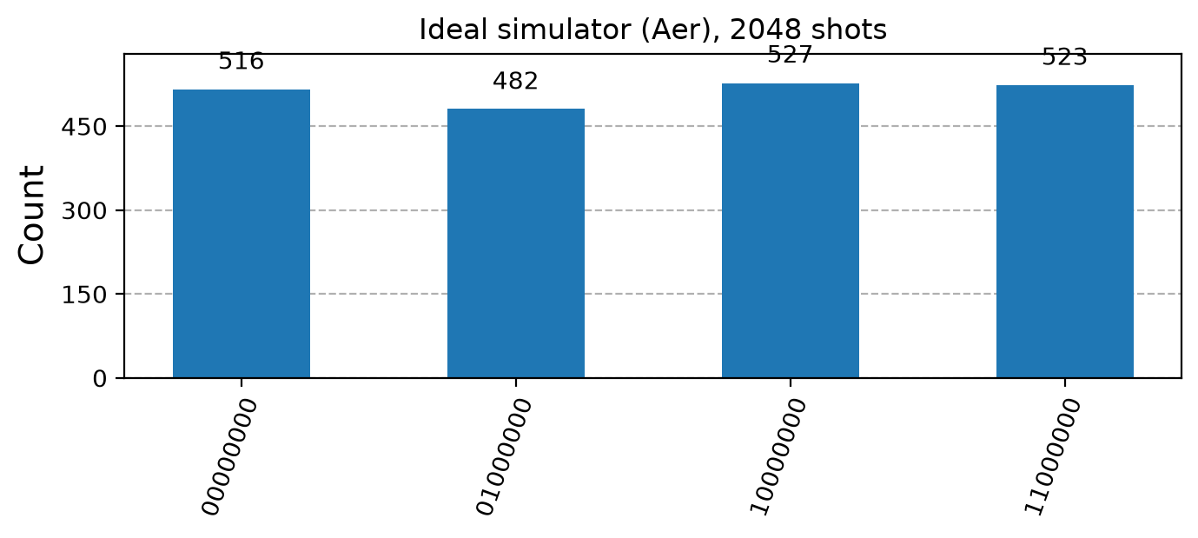
Example: factoring N = 15 with a = 7 on a simulator
Reading the histogram
r = 4 (7¹=7, 7²≡4, 7³≡13, 7⁴≡1), so QPE returns φ ∈ {0, ¼, ½, ¾} with equal probability: register values {0, 64, 128, 192} out of 256.
φ = ¾: limit_denominator(15) → 3/4, r = 4 ✓
φ = ¼: → 1/4, r = 4 ✓
φ = ½: → 1/2, r = 2: but 7² ≢ 1 — rejected, retry
φ = 0: no information — retry
IBM/16_Shor_Period_Finding_to_RSA.ipynb on the Aer simulator — 8 counting qubits, 2048 shots
Then the classical finish
$$a^{r/2}=7^{2}=49≡4 \left(mod 15\right), gcd(4−1,15)=3, gcd(4+1,15)=5 ⟹ 15=3×5$$
Notes:
Ideal Aer simulation of the notebook circuit with 8 counting qubits: four equally likely outcomes 0, 64, 128, 192 i.e. phases 0, 1/4, 1/2, 3/4. Two of the four outcomes succeed. The histogram is exactly what the notebook shows.

Slide 22
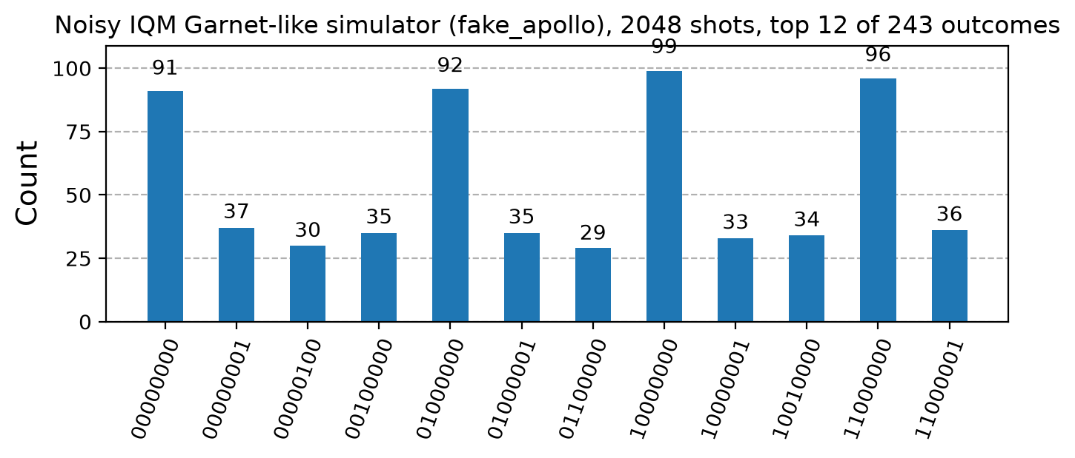
The same circuit on a noisy 20-qubit device model
What the hardware sees
Transpiled to the native gate set (PRX + CZ) on a square lattice:
12 qubits · ≈ 600 native instructions · depth ≈ 350
The four ideal peaks are still the four tallest bars, but most of the 2048 shots are scattered by gate errors and decoherence (T₁, T₂).
shor_factor(15) still succeeds — after a few more retries (continued fractions + the aʳ ≡ 1 check reject the bad samples).
IQM/16_Shor_Period_Finding_to_RSA.ipynb on fake_apollo — IQM’s noisy model of a 20-qubit Garnet-class chip
Run it yourself
One line selects the backend in IQM/16_Shor_Period_Finding_to_RSA.ipynb: TARGET = "fake_apollo" (local noisy simulator) → "garnet" / "emerald" (real 20- / 54-qubit QPUs on IQM Resonance).
The ‘:mock’ targets only test the cloud pipeline (they return random bitstrings); verify logic on fake_apollo, then spend QPU credits.
Notes:
Transpiled to IQM's native PRX + CZ gate set with Garnet's square-lattice connectivity: 12 qubits, about 600 native instructions, depth about 350. The four peaks survive but most shots land elsewhere. shor_factor still succeeds after a few retries. The user can run this on IQM Emerald via the TARGET line.

Slide 23
Breaking a toy RSA key — and N = 21
The attack (16_Shor_Period_Finding_to_RSA.ipynb, last section)
The attacker sees only the public key (N, e) = (55, 3) and the cipher-text c = 13.
1. Run Recipe S1 on N = 55 → p = 5, q = 11
2. φ(N) = 4 · 10 = 40
3. d ≡ 3⁻¹ ≡ 27 (mod 40) — the private key
4. m = c^d mod N = 13²⁷ mod 55 = 7 — the message
public data → factor N → φ(N) → d → m
The private key and the message are recovered purely from public data: the trapdoor is gone.
Second example: N = 21, a = 2
Powers of 2 mod 21: 2, 4, 8, 16, 11, 1 → r = 6 (even)
$$a^{r/2}=2^{3}=8$$
$$gcd(8−1,21)=7$$
$$gcd(8+1,21)=3$$
$$21=3×7$$
Exercise: which measured phases y/2⁸ fail for N = 21, and why?
Notes:
End to end: from public data only, Shor recovers p and q, then phi, then d, then the message. This is the last section of 16_Shor_Period_Finding_to_RSA.ipynb. N = 21 with a = 2 is the second worked example of the lesson.

Slide 24
The bottleneck: modular exponentiation
The controlled-U^(2^j) gates dominate the cost. We never build U^(2^j) by repeating U 2^j times (that is exponential): a^(2^j) mod N is precomputed classically by repeated squaring in O(j) multiplications, and the circuit performs one controlled modular multiplication by that number.
Measured in the course notebook (N = 15, t = 8)
Naive: repeat U 2^j times → 69 914 native instructions
Classical pre-computation → 650 native instructions, depth 372
(IQM transpiler, PRX + CZ gate set; IQM Resonance refuses jobs above 10 000 instructions — the naive circuit cannot even be submitted.)
Theorem (complexity of Shor’s algorithm)
Order finding, hence factoring N, succeeds with constant probability using
$$O(logN) qubits$$
$$\overset{\sim }{O}\left({\left(logN\right)}^{2}\right) quantum gates per run$$
plus O((log N)³) classical post-processing — polynomial in the input size log N.
How the multiplier is built
Reversible modular multiplication = QFT-based adders (Draper) + controlled modular additions: Beauregard (2003) factors an n-bit N with 2n + 3 qubits and O(n³) gates.
For N = 15 the notebook cheats pedagogically: multiplication by 2, 4, 7, 8, 11, 13 is a permutation of 4 wires (swaps + X gates) — that is c_amod15.
Notes:
Never build U^(2^j) by repeating U: a^(2^j) mod N is computed classically by repeated squaring and the circuit does one multiplication. Our own notebook measured the difference: 69 914 vs 650 native instructions on the IQM transpiler. Beauregard: 2n+3 qubits, O(n^3) gates.

Slide 25
Reality check: how far are we from RSA-2048?
20 000 000
noisy physical qubits · 8 hours
Gidney & Ekerå (2019), RSA-2048
< 1 000 000
noisy physical qubits · < 1 week
Gidney (2025), RSA-2048, improved codes
20 / 54
qubits on IQM Garnet / Emerald
the machines behind IQM/16_Shor_Period_Finding_to_RSA.ipynb
≈ 10³
physical qubits on the largest chips
no fault-tolerant logical qubits at scale yet
Polynomial, but the constants are enormous: every logical qubit of the factoring circuit needs hundreds to thousands of physical qubits of error correction, and the modular-exponentiation circuit has ~10⁹ Toffoli gates.
Hence the gap: our notebooks factor 15 and 21 with 12 qubits — several orders of magnitude from 2048-bit keys. No RSA key has ever been broken by a quantum computer.
Why worry now? ‘Harvest now, decrypt later’: encrypted traffic recorded today can be decrypted once a large machine exists. Long-lived secrets need protection today.
Notes:
Gidney & Ekera 2019: 20 million noisy physical qubits, 8 hours. Gidney 2025 lowered the estimate to under a million noisy qubits running for less than a week. Today's chips: IQM Garnet 20, Emerald 54, the largest superconducting processors around a thousand physical qubits, with error rates that still need heavy error correction. Hence the notebooks factor 15 and 21.

Slide 26
Post-quantum cryptography
Shor breaks everything whose security reduces to factoring or discrete logarithms — RSA, Diffie–Hellman, DSA, elliptic curves. The answer is not ‘more bits’: it is a different hard problem.
FIPS 203 — ML-KEM (Kyber)
key encapsulation
Module lattices: Learning With Errors. Replaces RSA / ECDH key exchange in TLS 1.3 (hybrid X25519 + ML-KEM is already deployed by major browsers and CDNs).
FIPS 204 — ML-DSA (Dilithium)
digital signatures
Also lattice-based (Fiat–Shamir with aborts). Replaces RSA-PSS / ECDSA signatures in certificates and code signing.
FIPS 205 — SLH-DSA (SPHINCS+)
hash-based signatures
Security rests only on hash functions; larger signatures, but a conservative backup if lattices fall.
What survives, what doesn’t
Symmetric crypto and hashes: Grover gives only a quadratic speed-up → double the key length (AES-256, SHA-384) and you are fine.
Public-key crypto based on periodicity (RSA, DH, ECC): broken in polynomial time → must be replaced, standards finalised by NIST in 2024.
Notes:
NIST finalised FIPS 203/204/205 in August 2024. ML-KEM and ML-DSA are lattice-based: their security does not reduce to factoring or discrete logs, i.e. to period finding, which is what Shor exploits. Migration is under way in TLS and SSH.

Slide 27
From the lesson to the notebook
Lecture | 16_Shor_Period_Finding_to_RSA.ipynb
Order → factors (Step 1) | factors_from_order(a, r, N)
Operator U and QPE circuit (Step 2) | c_amod15, qft_dagger, build_order_finding_circuit
Continued fractions (Step 3) | best_rational / Fraction.limit_denominator
Recipe S1 — the full loop | shor_factor(N)
RSA key, encryption, attack | rsa_keygen, rsa_encrypt, ‘breaking RSA’ cell
Demo Shor (IBM Aer)
Demo Shor (IQM)
How to run
IBM/16_Shor_Period_Finding_to_RSA.ipynb: pip install qiskit qiskit-aer matplotlib pandas — runs entirely on the Aer simulator.
IQM/16_Shor_Period_Finding_to_RSA.ipynb: same notebook; the helper iqm_backend.py transpiles to PRX + CZ and runs on fake_apollo (offline) or, with an IQM Resonance token, on Garnet / Emerald. One TARGET line.
Notes:
Demo time. Each piece of the lecture is a named function in 16_Shor_Period_Finding_to_RSA.ipynb. Run on the Aer simulator first; the IQM copy switches to Garnet/Emerald with the TARGET line.

Slide 28
Exercises
1
Compute φ(561) and verify that 561 = 3·11·17 is a Carmichael number: a⁵⁶⁰ ≡ 1 (mod 561) for all a coprime to 561, yet 561 is composite. (Why does this not contradict Euler?)
2
For p = 7, q = 13 build an RSA key with e = 5; find d and encrypt/decrypt m = 9 by hand, using CRT for the decryption.
3
Prove that if gcd(e, φ(N)) ≠ 1 then d need not exist, and explain why Recipe R1 step 3 forbids it. What happens if you try e = 65537 with p = 65537·2 + 1?
4
In the N = 15, a = 7 example, which measured phases φ fail to produce a factor, and why? Relate your answer to the three failure modes of Step 3. Check with the notebook histogram.
5
Factor N = 35 by hand using a = 3 (r = 12): show gcd(3⁶ ± 1, 35) = {5, 7}. Then modify shor_factor to handle N = 35 (hint: you need a different modular multiplier).
Notes:
Exercises from the lesson; 4 and 5 are meant to be done with the notebook.

Slide 29
References
R. Rivest, A. Shamir, L. Adleman — A Method for Obtaining Digital Signatures and Public-Key Cryptosystems. Comm. ACM 21 (1978) 120–126
P. W. Shor — Polynomial-Time Algorithms for Prime Factorization and Discrete Logarithms on a Quantum Computer. SIAM J. Comput. 26 (1997) 1484 — arXiv:quant-ph/9508027
M. A. Nielsen, I. L. Chuang — Quantum Computation and Quantum Information. Cambridge University Press (2000), Chapter 5
S. Beauregard — Circuit for Shor’s algorithm using 2n+3 qubits. arXiv:quant-ph/0205095
C. Gidney, M. Ekerå — How to factor 2048 bit RSA integers in 8 hours using 20 million noisy qubits. Quantum 5 (2021) 433 — arXiv:1905.09749
C. Gidney — How to factor 2048 bit RSA integers with less than a million noisy qubits. arXiv:2505.15917 (2025)
NIST — FIPS 203 (ML-KEM), FIPS 204 (ML-DSA), FIPS 205 (SLH-DSA). Post-Quantum Cryptography Standards, August 2024

Slide 30

Questions & Answers
Thanks for your attention! · rsa_shor_lesson.pdf · IBM/16_Shor_Period_Finding_to_RSA.ipynb · IQM/16_Shor_Period_Finding_to_RSA.ipynb

