Slide 2




App Modernization with Microsoft Azure
Riccardo Cappello
Senior Consultant @
Microsoft Azure MVP | Intel Software Innovator | rcappello@outlook.com

Slide 3
App attualmente esistenti on-prem
App
on-prem
Notes:
Using an existing .Net application

Slide 4
Valore per Ottimizzare e Modernizzare
Agilità
Time to market
Costo totale della proprietà
IT simplification
Continuous delivery
Containers
Scalabilità e HA
Insights e Analytics
Costo infrastruttura
Manutenzione in corso
Standardizzazione
Semplificazione
Notes:
Slide 7

Slide 5
Lift and Shift
App
on-prem
Lift and Shift
Lift & Shift
Cambiamenti di codice minimi
Notes:
Impellente necessità di spostarsi nel cloud

Slide 6








Lift and Shift Migrazione delle your app on-prem su Azure con IaaS
Pro
Existing Apps
Web apps (on-prem.)
Lift & Shift
Web apps (Cloud)
Nessuna ri-architettura o nuovo codice
Minor effort per una migrazione rapida
Supportato al minimo comune denominatore
On-Premises
IaaS Cloud (VMs)
Contro
Hai un valore minimo offerto dal Cloud
Patching manuale, gestione manuale degli aggiornamenti
Nessun meccanismo automatico di scaling e di alta affidabilità
Monolithic architecture
Monolithic architecture

Slide 7
Cloud optimized
App
on-prem
Lift and Shift
Cloud optimized
Optimization
Cambiamenti minimi di codice
Notes:
Using an existing .Net application

Slide 8



Cloud Optimized Ottieni maggiori benefici dal Cloud “containerizzando” la tua app
Lift & Shift
Web apps (Cloud)
Pro
Existing apps
Web apps (on-prem.)
Orchestration and Managed Services
Nessuna ri-architettura o nuovo codice
Maggiore densità e minori costi di implementazione
Maggiore produttività e agilità DevOps
Portabilità di app e dipendenze
Alta disponibilità con orchestratori
On-Premises
Contro
Containerizzare è un’attività addizionale
Monolithic architecture
Notes:
Spostamento nel cloud causando il minimo impatto. Quindi cambiare la connection String

Slide 9
App Modernize
App
on-prem
Lift and Shift
Cloud optimized
App modernized
Architected for the cloud
modernized/refactor/rewrite
Notes:
Using an existing .Net application

Slide 10




App Modernized Amplia le tue app con nuovi servizi nativi cloud tra cui serverless, microservizi e PaaS.
Cloud-optimized full PaaS
Pro
Existing apps
Web apps (on-prem.)
Ottimizzato per l'agilità a lungo termine
Ottimizzato per dimensioni e alta disponibilità
Architettura moderna con microservizi
On-Premises
Contro
Richiede un significativo refactoring o riscrittura del codice
Monolithic architecture
Microservice architecture

Slide 11

Lo scenario
Contoso, Ltd. Fornisce una gamma completa di prodotti assicurativi a lungo termine.
Stanno cercando di far fronte al sovraccarico del loro prodotto a causa di una crescita più rapida del previsto.
Notes:
Contoso Ltd. is a new company in a very old business. Founded in Auckland, New Zealand, in 2005, by senior life insurance executives, the ambitious new company provides a full range of long-term insurance services to help people who are underinsured.
Almost from the start, the company grew far faster than anticipated. An avalanche of business meant that the original processes created to manage policy documentation became overloaded. Employees struggled to cope, even as the headcount rose from five to 110 during the first year.

Slide 12

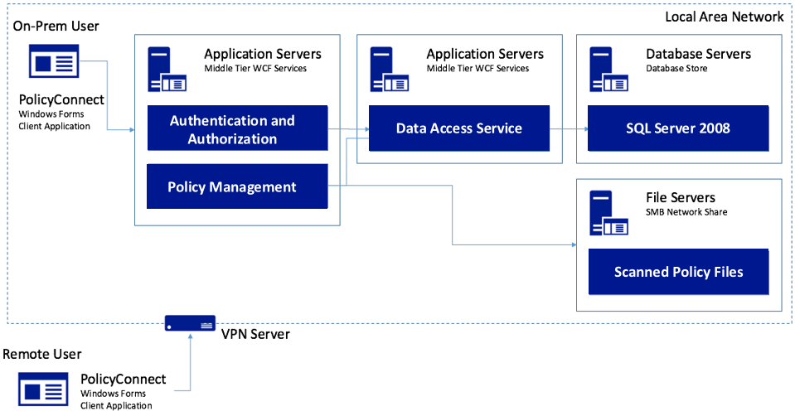
Lo scenario
Contoso, Ltd. ha sviluppato un’app Windows Forms, chiamata PolicyConnect, per consentire ai propri dipendenti di gestire le informazioni sui titolari delle pratiche.
I dati sono memorizzati in un DB SQL Server 2008 e hanno un file server nella loro rete locale.
Notes:
Contoso Ltd. implemented PolicyConnect, a custom Windows Forms application used by their staff to input key metadata that includes policy holder information such as insured amount, beneficiary, policy type, and any deductible and out of pocket requirements.
Contoso employees access this application which ultimately stores its data in a SQL Server 2008 database, and a file server on their local area network.

Slide 13



Lo scenario
I dipendenti fanno affidamento sull'e-mail come motore del flusso di lavoro per le attività di gestione dei documenti.
Vorrebbero acquisire informazioni senza la necessità di sviluppo personalizzato ulteriore.
Vorrebbero rendere disponibile il sistema di titolari di polizze tramite applicazioni web e mobile senza l’ausilio di una VPN.
Notes:
Contoso employees rely on email as a workflow engine relative to the document management tasks. They are using Office 365.
Executive leadership have frequent challenges in gauging productivity and throughput given the manual workflow—they feel that are blocked in quickly getting to the insights they need because each new question seems to need more custom development.
Wants to make their policy holder system available to its employees and brokers via web and mobile applications without requiring VPN, and store policies in cloud storage for retrieval via the new apps.
They would like to migrate their SQL Server based database to SQL Database

Slide 14




Lo scenario
Vorremmo assicurarci che il nostro database non sia sovraccaricato, mostrare una dashboard con le statistiche degli utenti, consentire ai non sviluppatori di altri reparti di creare app mobili e migliorare la sicurezza proteggendo i segreti delle applicazioni.
Puoi aiutarci a fare questo?
Notes:
Want to ensure they employ best practices for mitigating the impact of repeated querying of the database
Looking to implement a scoreboard of sorts that tracks the most active users in a 24-hour period, as well as approximate the number of operations that user performed with the system in perpetuity
Want to make sure they have a streamlined way for internal departments to quickly build their own apps to automate time saving micro-processes without having to involve the PolicyConnect development team or ideally, even developers
Improve security by externalizing secrets such as connection strings from the web apps and APIs, and storing them in an encrypted location accessible only to authorized services
Contoso has multiple development teams and is concerned about duplication of effort and change management as they move more business logic to APIs. They also are considering opening a subset of APIs to a network of affiliated partners.

Slide 15






I desiderati
Modernizzare l’architettura
Go mobile
Permettere ai dipendenti non-dev di creare app
Migliorare la gestione dei secret delle app
Aggiungere una ricerca che sfrutti meccanismi di AI
Usare una tecnologia serverless per le API
Migrare il SQL Database su un servizio totalmente gestito
Aggiungere un meccanismo di caching

Slide 16
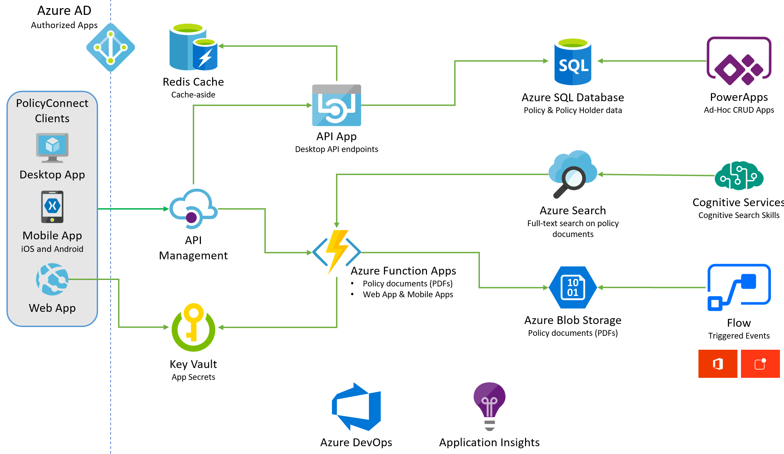
Lo soluzione proposta – app modernization
Flow / Power Automate
Notes:
The solution begins with migrating Contoso's SQL Server 2008 R2 database to Azure SQL Database using the Azure Database Migration Service. After performing an assessment using the Data Migration Assistant, Contoso was able to determine that there were no compatibility issues or unsupported features to prevent them from migrating into a fully-managed SQL database service in Azure. Next, the web and API apps are migrated into Azure App Services. In addition, mobile apps, built for Android and iOS using Xamarin, are created to provide access to PolicyConnect. The website, hosted in a Web App, provides the user interface for browser-based clients, whereas the Xamarin Forms-based apps provide the UI to mobile devices. Both the mobile app and website rely on web services hosted in an a Function App, which sits behind API Management. An API App is also deployed to host APIs for the legacy Windows Forms desktop application. Light-weight, serverless APIs are provided by Azure Functions and Azure Functions Proxies to provide access to the database and policy documents stored in Blob Storage. Azure API Management is used to create an API Store for development teams and affiliated partners. Sensitive configuration data, like connection strings, are stored in Key Vault and accessed from the APIs or Web App on demand so that these settings never live in their file system. The API App uses the Azure Redis Cache to implement the cache aside pattern, caching data as it is retrieved from SQL Database. A full-text cognitive search pipeline is used to index policy documents in Blob Storage. Cognitive Services are used to enable search index enrichment using cognitive skills in Azure Search. PowerApps enable authorized business users to build mobile and web create, read, update, delete (CRUD) applications that interact with SQL Database and Azure Storage, while Microsoft Flow enables them to orchestrations between services such as Office 365 email and services for sending mobile notifications. These orchestrations can be used independently of PowerApps or invoked by PowerApps to provide additional logic. The solution uses user and application identities maintained in Azure AD.

Slide 17
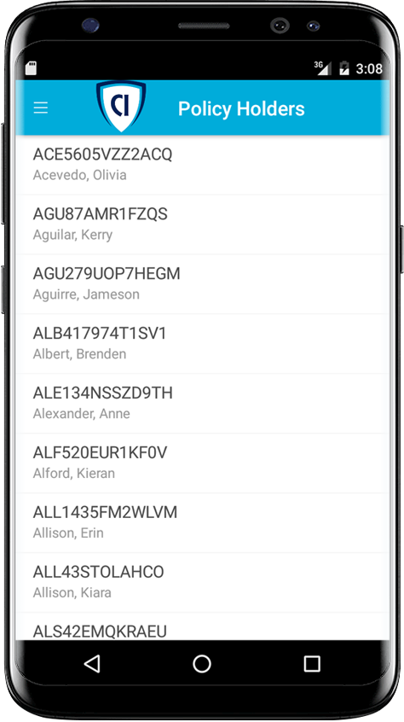



Lo soluzione proposta
Mobile e Web Applications
App mobile con Xamarin
API App per il back-end
Web App per il front-end
Utilizzo di Azure Functions Proxies
Notes:
How should Contoso implement the PolicyConnect mobile app?
- Utilize Xamarin within Visual Studio
What Azure service would host the services supporting the mobile app backend? Would you suggest a Mobile App or an API App? Why?
- In this scenario, either one would work because API Apps and Mobile Apps expose the same functionality that Contoso needs to support the Web App and the APIs that are behind the Web App and the Xamarin mobile application.
What Azure service would host the web site?
- A Web App
What Azure service would provide a light weight, serverless API solution for retrieving policy documents from Azure blob storage?
- Azure Functions Proxies provide an easy way to create serverless APIs, providing a way to break large APIs into multiple function apps (as in a microservices architecture), while still presenting a single API surface for clients.

Slide 18
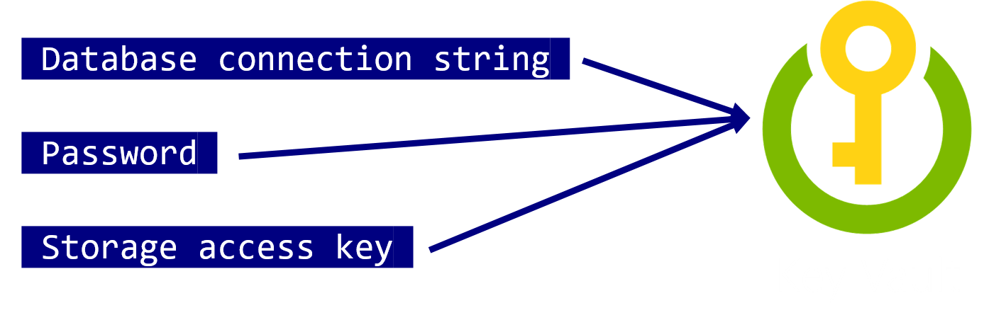
Lo soluzione proposta
Mobile e Web Applications
Utilizzo di Azure Key Vault per memorizzare I secret come la connection string per il database, password, storage account key.
Notes:
How would you secure sensitive information used by the web site and APIs?
- Rather than storing sensitive application secrets like credentials and database connection strings in the web.config of the Web and API Apps, Contoso should use Key Vault to store these secrets

Slide 19
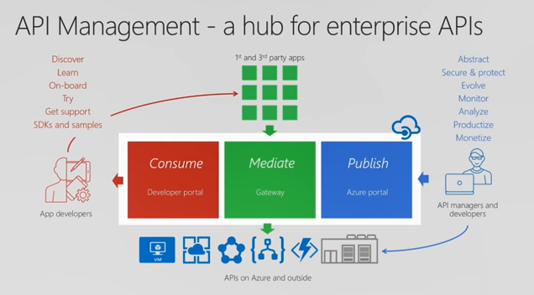

Lo soluzione proposta
API Management
Contoso dovrà utilizzare Azure API Management per aggregare i vari backend ed avere un entrypoint unico
Azure API Management
Notes:
What recommendations can you make to help Contoso manage its API inventory as it grows in the future? Are there services in Azure that can provide a proof of concept *API Store* experience now and serve as path to development in the future?- Azure API Management has features to help Contoso quickly build and scale an API ecosystem and grow into the future. APIs can be organized into Product groups to provide organization and AAD integration comes out of the box. It will be relatively easy to develop new customer channels for affiliated partners and provide controlled discoverability and lifecycle management to development teams.

Slide 20
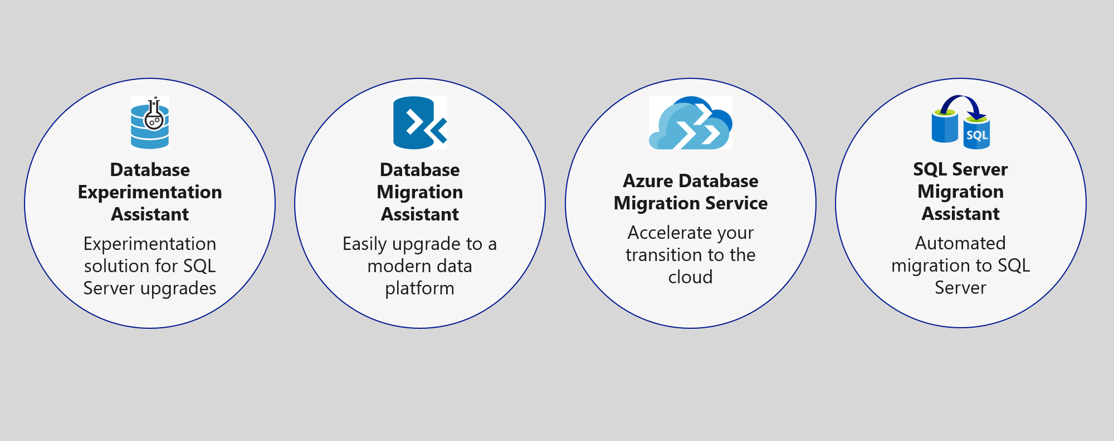
Lo soluzione proposta
Data Management
Migrazione del DB su SQL Azure usando Database Migration Service

Slide 21
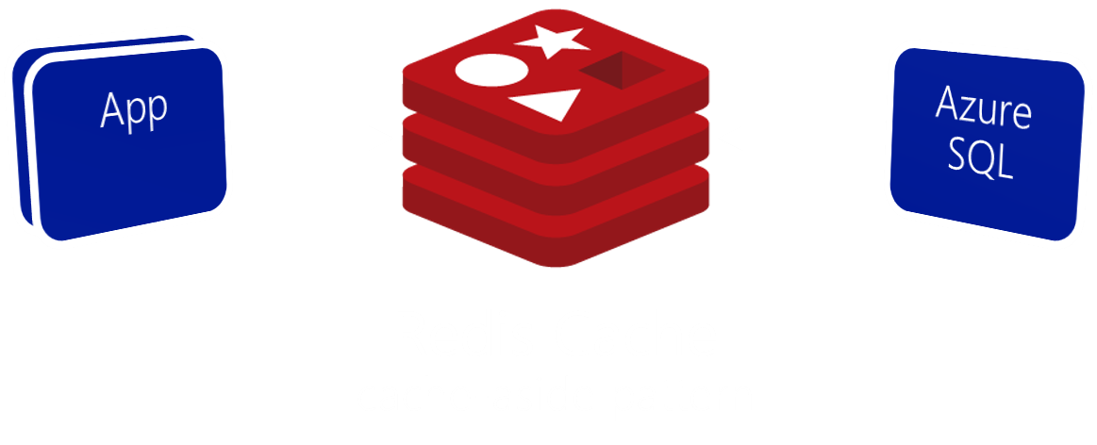
Lo soluzione proposta
Data Management
Utilizzare Azure Redis Cache per ridurre il carico sul database e per implementare la scoreboards.
Redis HyperLogLog
username | count
custserv89 | 9834793
alrickman | 9453452
sandrabrown | 8350927
vishwashn | 8277314
Scoreboard using HyperLogLog
Notes:
What patterns and services would you use to reduce load on the database? Implement the scoreboards?
- Use Azure Redis Cache and the cache-aside pattern.
- Check Azure Redis Cache is first on data requests. Return cached copy if exists, fetch from SQL Database if not, then save to Redis Cache.
- Scoreboards can also be implemented with Azure Redis Cache due to support for fast atomic incrementing of the values for any given string key (e.g., the key would be the username, the value the count). To reduce memory requirements for very large counts, use Redis’ HyperLogLog to store the counted value for each user key.
----------------------------------------------------------------------------------------
- In this approach, as data items are requested, the Azure Redis Cache is first checked to see if it exists there (if it is, then the cached copy is returned). Failing that, the application makes a request directly against SQL Database, but while returning the result to the client it also adds the data item into the Redis Cache.
- Scoreboards can be implemented effectively using Azure Redis Cache because of its support for fast atomic incrementing of the values for any given string key (e.g., the key would be the username, the value the count). To reduce memory requirements for very large counts (such as is possible collecting transaction counts per user in perpetuity), they could use Redis’ HyperLogLog to store the counted value for each user key. The HyperLogLog approximates the cardinality of a set the approximates the count of the number of unique items added (with an error rate less than 1%), and uses a fixed size of 12KB.

Slide 22
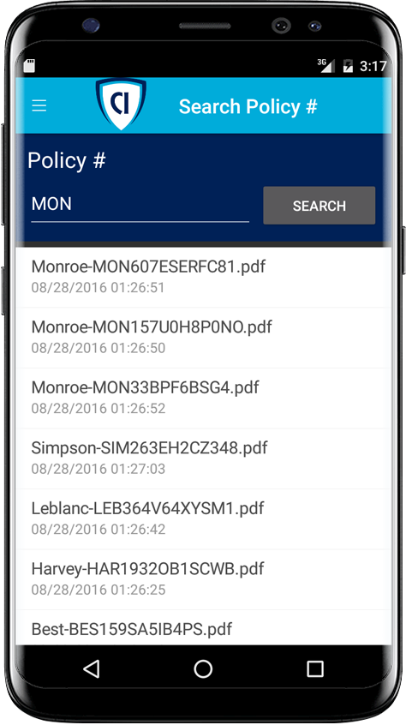

Lo soluzione proposta
Ricerca
Abilitare la ricercar full-text sui documenti delle polizze via Azure Search.
Azure Search + Indexer su Azure Storage blobs
Notes:
Given their requirements, how would you enable full text search on the stored policy documents?
- Use Azure Search and the Indexer for Azure Storage blobs.
- For files stored in Azure Storage Blobs, this indexer will full-text index PDFs, Microsoft Office Documents (DOCX, DOC, XLSX, XLS, PPTX, PPT and MSG), HTML, XML, ZIP, EML, JSON, and plain text files. They could then use the Azure Search .NET SDK from the API App to kick off searches.

Slide 23
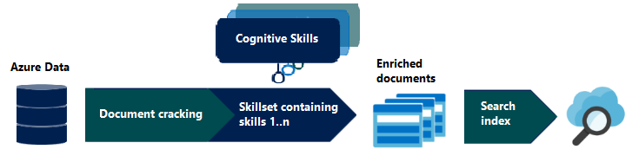

Lo soluzione proposta
Azure Cognitive Search Deep Dive
Giovedì 5 ore 10:30
Sala Verde – Marco Minerva
Ricerca
Arricchire l’indice di ricerca con Azure Cognitive Search
Custom cognitive skills
Azure Search + Functions

Slide 24

Lo soluzione proposta
Estensibilità
Consentire agli utenti aziendali di creare le proprie app mobile per uso interno usando PowerApps.
Utilizzare Microsoft Flow per creare processi automatizzati ad-hoc.
Power Automate
Flow
Notes:
How would you enable their business users to create their own internal mobile apps that help them streamline their processes without the time and resource investment required for full scale mobile apps?
- PowerApps would enable business users at Contoso to create their own web and mobile apps that support CRUD functionality against data in SQL DB and Azure Storage Blobs.
- Microsoft Flow, which integrates with PowerApps but can also be used stand-alone, would enable them to create automated processes in ad-hoc fashion. Business users could create these for their own use or share them back with the rest of the organization.

Slide 25

Lo soluzione proposta
Estensibilità
Gli utenti aziendali possono creare un workflow di email automatizzandolo con Microsoft Flow / Power Automate in 3 semplice passaggi:
Creare un nuovo flusso che inizia con Office 365, ad ogni nuova email con flag Alta priorità.
Inviare una notifica push utilizzando l’oggetto e il mittente dell’ email.
L’utente installa l’app Microsoft Flow / Power Automate per ricevere la notifica.
Power Automate
Flow
Notes:
This could be implemented with Microsoft Flow.
The business user would login to Microsoft Flow and create a new flow. It would begin with Office 365, on new email, where the priority flag is set to High.
Then a Push notification – send a push notification action would follow that can use the subject and sender of the email in the subject of the notification.
The user would save this flow. To receive notifications, the user would need to install the Microsoft Flow app on her mobile device.

Slide 26



Le obiezioni che potrebbero farci
Come possiamo automatizzare i nostri processi??
Microsoft Flow sostituirà Logic Apps?
Esiste davvero un modo per archiviare in modo sicuro i secret nel cloud?
Come possiamo rimanere al top gestendo un ecosistema API sempre in crescita?
Non avremo tutte le funzionalità SQL disponibili nel Cloud.
Quale framework .NET dovremmo scegliere?
Notes:
* Microsoft Flow allows business users to automate their processes.
* Flow will not replace Logic Apps. Logic Apps represent an “advanced” version of Microsoft Flow, providing support for more developer centric tasks, such as integrating API Apps as custom actions, whereas Flow only provides pre-built actions.
* Azure Key Vault provides a mechanism to store secrets encrypted and securely stored within the confines of specialized hardware called Hardware Security Modules (HSM). * A proof of concept that demonstrates the capabilities of Azure API Management can be put together quickly and can easily be scaled up to create the API Store experience Contoso is looking for.
* It is likely that a feature that was previously built into SQL Server and used from applications directly now runs external to Azure SQL Database in the form of a separate Azure service. Examples include:
Linked servers- are not supported by SQL Server, but cross database read-only querying is possible using elastic database query.
Database Mail- which was used to send email directly from SQL Server is not supported, but there are multiple alternatives (such as using Office 365 and SendGrid) that applications can use to send emails.
SQL Server Agent Jobs- these background processes can usually be migrated to a Web Job (running within an App Service), Azure Functions, or to Cloud Service Worker Role.
Service Broker- numerous alternative messaging options exist in Azure, including Azure Storage Queues and Azure Service Bus Brokered Messaging.

Slide 27
App Modernization
Flow / Power Automate
Notes:
The solution begins with migrating Contoso's SQL Server 2008 R2 database to Azure SQL Database using the Azure Database Migration Service. After performing an assessment using the Data Migration Assistant, Contoso was able to determine that there were no compatibility issues or unsupported features to prevent them from migrating into a fully-managed SQL database service in Azure. Next, the web and API apps are migrated into Azure App Services. In addition, mobile apps, built for Android and iOS using Xamarin, are created to provide access to PolicyConnect. The website, hosted in a Web App, provides the user interface for browser-based clients, whereas the Xamarin Forms-based apps provide the UI to mobile devices. Both the mobile app and website rely on web services hosted in an a Function App, which sits behind API Management. An API App is also deployed to host APIs for the legacy Windows Forms desktop application. Light-weight, serverless APIs are provided by Azure Functions and Azure Functions Proxies to provide access to the database and policy documents stored in Blob Storage. Azure API Management is used to create an API Store for development teams and affiliated partners. Sensitive configuration data, like connection strings, are stored in Key Vault and accessed from the APIs or Web App on demand so that these settings never live in their file system. The API App uses the Azure Redis Cache to implement the cache aside pattern, caching data as it is retrieved from SQL Database. A full-text cognitive search pipeline is used to index policy documents in Blob Storage. Cognitive Services are used to enable search index enrichment using cognitive skills in Azure Search. PowerApps enable authorized business users to build mobile and web create, read, update, delete (CRUD) applications that interact with SQL Database and Azure Storage, while Microsoft Flow enables them to orchestrations between services such as Office 365 email and services for sending mobile notifications. These orchestrations can be used independently of PowerApps or invoked by PowerApps to provide additional logic. The solution uses user and application identities maintained in Azure AD.

Slide 28


Q&A
Aggiungimi su LinkedIn
Riccardo Cappello
Senior Consultant @
Microsoft Azure MVP | Intel Software Innovator | rcappello@outlook.com

Slide 29







Contatti
OverNet Education
Info@OverNetEducation.it
www.OverNetEducation.it
Rozzano (MI) +39 02 365738
Bologna +39 051 269911
www.wpc-overneteducation.it
#wpc19it

