Slide 1













Team 22
Housing price prediction using neural networks
UE21CS343BB2
Topics in deep learning
PES2UG21CS126 Burugupalli Yogitha
PES2UG21CS132 C Rahul
PES2UG21CS157 Deepak P J
PES2UG21CS174 Ganesha Gosikere Matta

Slide 2
Table of Contents
1.
Technologies used
2.
Model used
3.
Output Snapshots
4.
Results

Slide 3
Technologies used
Python
Keras
Tensorflow
Flask
Scikit
Numpy
Pandas

Slide 4
Model Used
The model architecture consists of a Sequential neural network comprising several dense layers.
The input layer has 500 neurons with ReLU activation function, which helps introduce non-linearity to the model and extract complex features from the input data.
Two hidden layers follow, each containing 250 and 125 neurons, respectively, also with ReLU activation functions. These hidden layers enable the model to learn hierarchical representations of the data, capturing both low-level and high-level features.
Finally, the output layer consists of a single neuron with linear activation, making it suitable for regression tasks, such as predicting house prices.

Slide 5
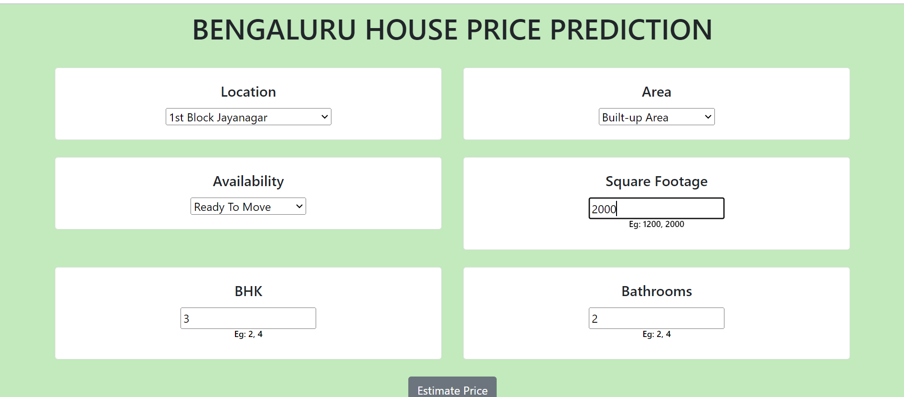
Output Snapshots

Slide 6

Output Snapshots

Slide 7
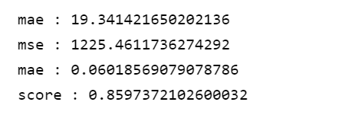
Results
The results for the used model :
The accuracy score by using this neural network model is better than other pre-trained models llike Logistic Regression and Random Forest

Slide 8

Thank you very much!

