Slide 1
Influence of Weather Conditions on Energy Consumption in Lisbon: An Analysis of Domestic and Industrial Use
Nuno Gomes E-mail: A18364@alunos.isel.ipl.pt
Ricardo Ramos E-mail: A46638@alunos.isel.ipl.pt
Rafael Carvalho E-mail: A47663@alunos.isel.ipl.pt
MEIC- Mineração de Dados em Larga Escala Instituto Superior Engenharia de Lisboa Lisboa, Portugal

Slide 2
Introduction
1. Understanding the Data Mining and Contextualisation Problem
The main objective of the paper is to demonstrate a clear understanding of the data mining problem, from the definition of the specific problem to its contextualisation in the general area of data mining. What is the data mining problem in question?
2. Dataset Characterisation and Preprocessing
The paper also characterises in detail the data set used, explaining the criteria followed for its construction. It also discusses the problems encountered during data pre-processing and the solutions adopted to resolve these problems, ensuring the quality of the data for the development of the learning model.

Slide 3
Introduction
3. Question Formulation and Data Preprocessing
The first part of the work involves formulating possible questions and answers from a data set, as well as pre-processing this data. The aim is to make it possible to correctly classify municipalities as industrial or residential on the basis of energy consumption and to predict energy consumption in Lisbon taking meteorological conditions into account.
4. Application of Models and Performance Assessment
The second part of the paper focuses on the application of machine learning models for classification and regression, using performance metrics to evaluate the results. The influence of sampling techniques, such as oversampling, on the results is also explored. The best results obtained for both oversampled classifiers and the regressor without sampling are presented.

Slide 4
Question Formulation and Data Preprocessing - Methodology
Model

Slide 5
Question Formulation and Data Preprocessing - Implementation
Implementation Details

Slide 6
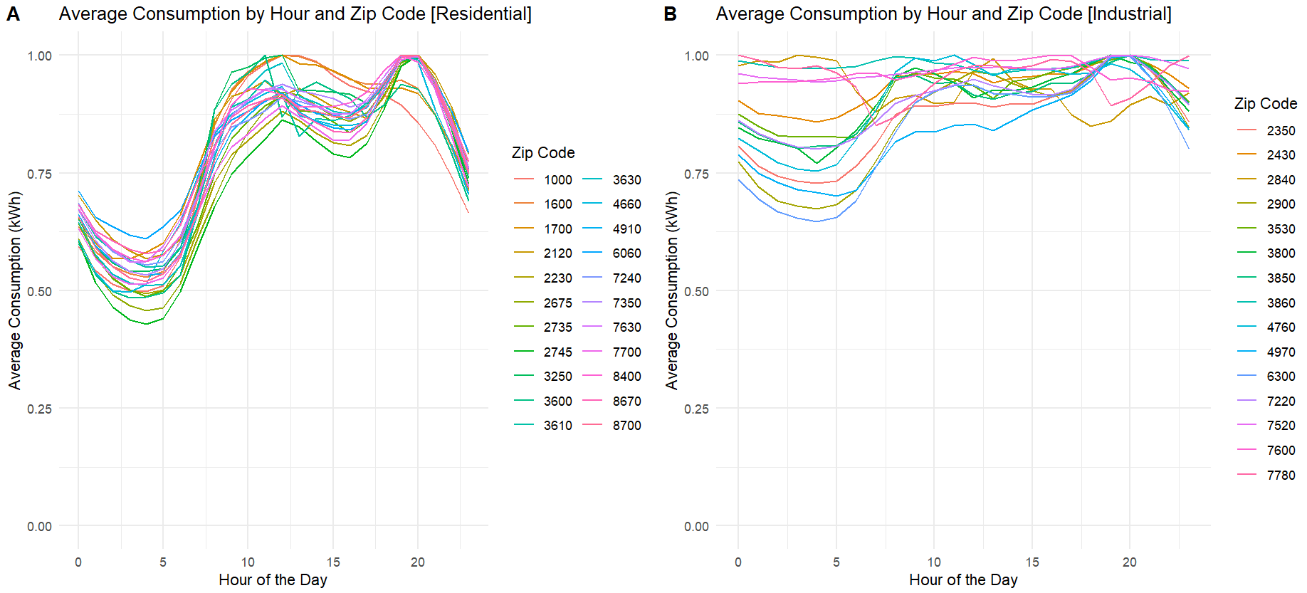
Application of Models and Performance Assessment Evaluation

Slide 7
Dataset Characterization and Preprocessing Methodology and Implementation
Based on the data in the attached graphs, we can draw some conclusions and make comparisons between the two:
1. Hourly Consumption Pattern
Both graphs show a similar pattern of electricity consumption throughout the day.
There is a significant increase in consumption from 5-6 a.m., peaking during midday until early afternoon.
Consumption gradually decreases until it reaches a low point at night.

Slide 8
Dataset Characterization and Preprocessing Methodology and Implementation
2. Differences between residential and industrial areas
Graph A (Residential):
It has a more pronounced peak in the early hours of the morning.
Consumption is lower at night.
Graph B (Industrial):
It shows a higher and sustained level of consumption during working hours.
Even at night, industrial consumption remains relatively high compared to residential areas.
These observations can be relevant for energy planning and management, as they provide insights into the dailypatterns of electricity demand in different zones categorised by postcodes.

Slide 9
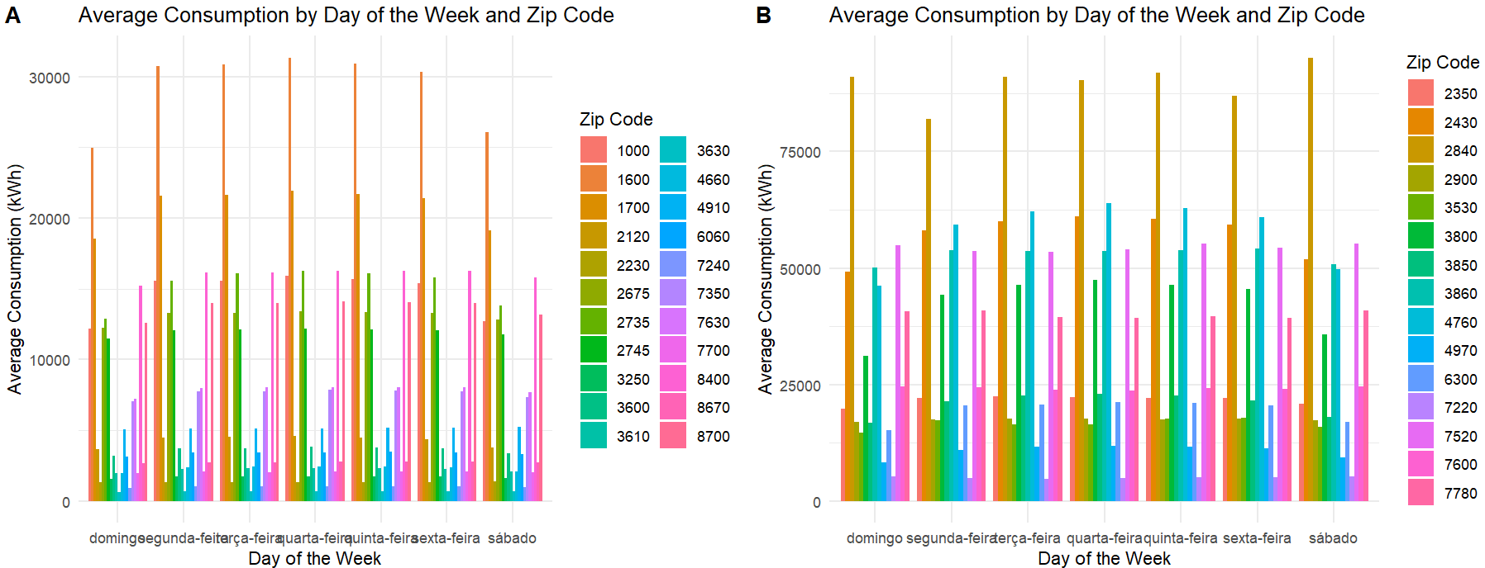
Application of Models and Performance Assessment - Results

Slide 10
Data
Differences between residential and industrial areas:
Graph A (Residential):
It has a more pronounced peak in the early hours of the morning.
Consumption is lower at night.
Graph B (Industrial):
It shows a higher and sustained level of consumption during working hours.
Even at night, industrial consumption remains relatively high compared to residential areas.

Slide 11
Data
To obtain specific information on electricity consumption in municipalities and sectors of activity in Portugal, we consulted the data provided by the Directorate-General for Energy and Geology (DGEG) [1]. This data provides details on consumption broken down by municipality and economic sector, as well as aggregations by region. In addition, Pordata also provides information on electricity consumption per capita in Portugal, making it possible to compare the average use of electricity between different municipalities and types of consumption [2] [3] [4].

Slide 12
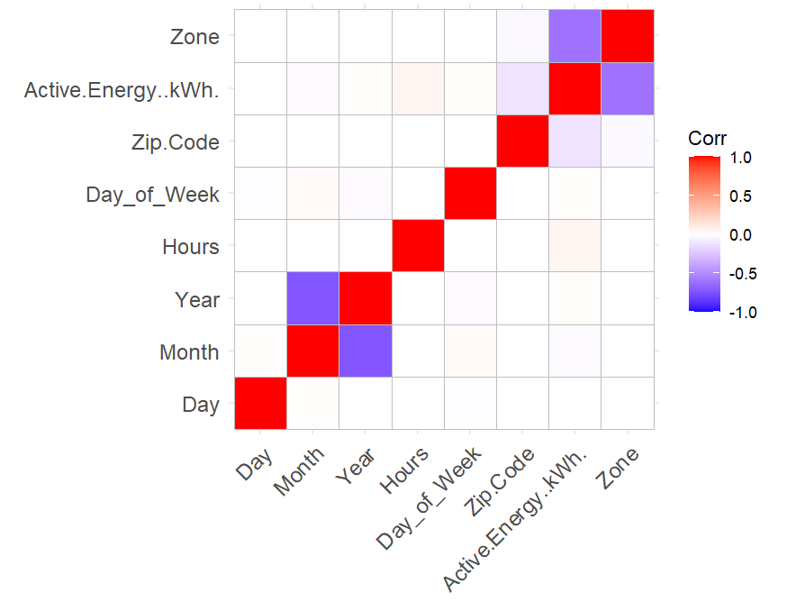
Conclusion and Future Direction

Slide 13
Correlation Matrix
1. Positive and Negative Correlations
The cells in shades of red indicate positive correlations, i.e. when one variable increases, the other also tends to increase.
The cells in shades of blue indicate negative correlations, i.e. when one variable increases, the other tends to decrease.
2. Specific comments
The "Active.Energy" variable has a strong positive correlation with the "Hours" variable, which suggests that energy consumption increases as time passes.
The variable "Day of Week" does not seem to have a strong correlation with other variables, which indicatesthat the day of the week does not significantly affect energy consumption.

Slide 14
Correlation Matrix
3. General Interpretation
This correlation matrix can be useful for identifying which variables are most closely related to each other. For example, if we are interested in predicting energy consumption based on the time of day, the correlation between "Active.Energy" and "Hours" may be relevant.
Note: just because two variables are correlated does not necessarily mean that one causes the other. It is important to consider other factors and carry out more detailed analyses in order to draw definitive conclusions.

Slide 15
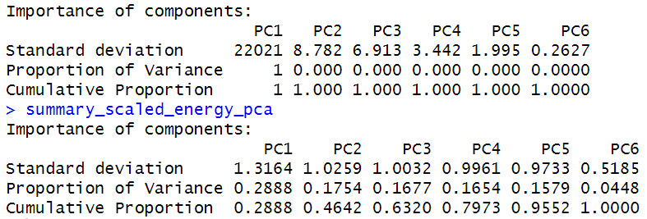

Slide 16
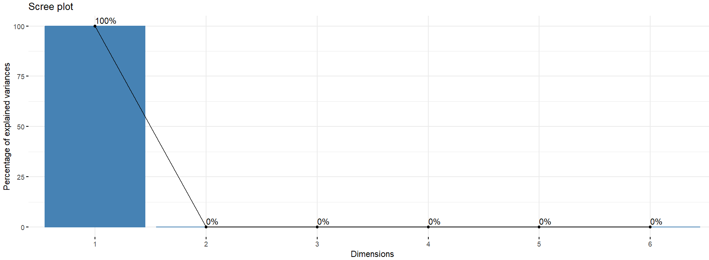

Slide 17
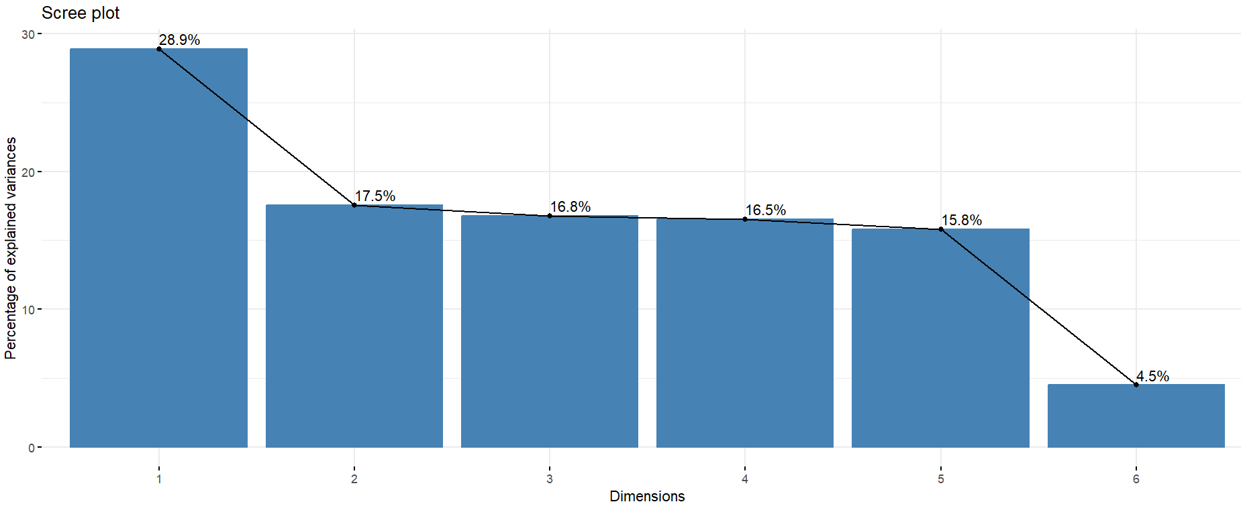

Slide 18
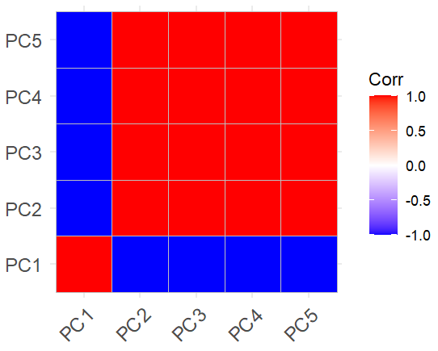

Slide 19
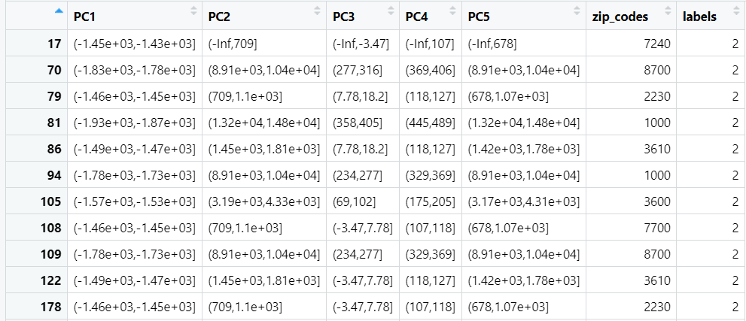

Slide 20
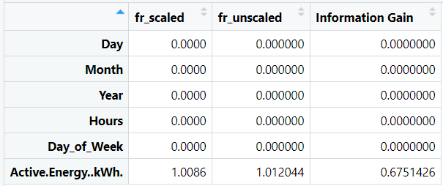

Slide 21
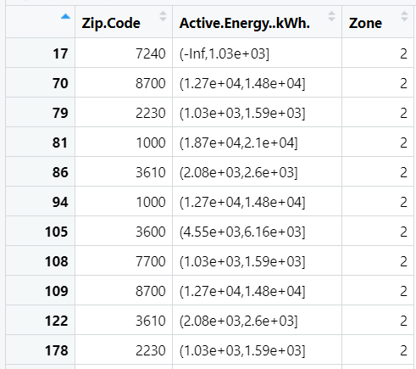

Slide 22
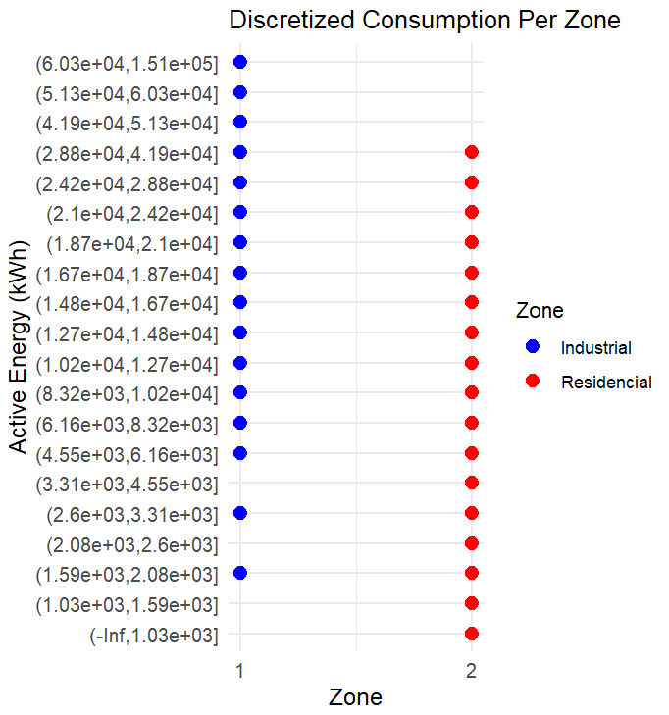

Slide 23
Summary

Slide 24
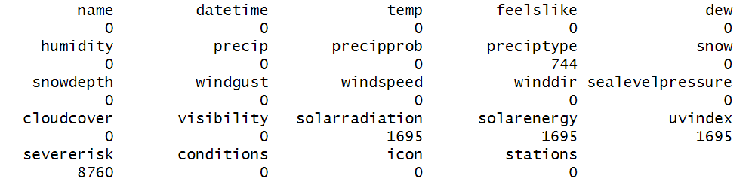
Weather Analysis

Slide 25
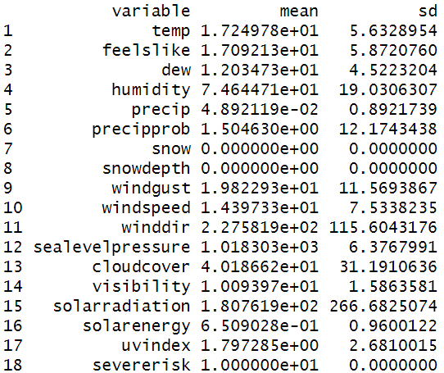

Slide 26
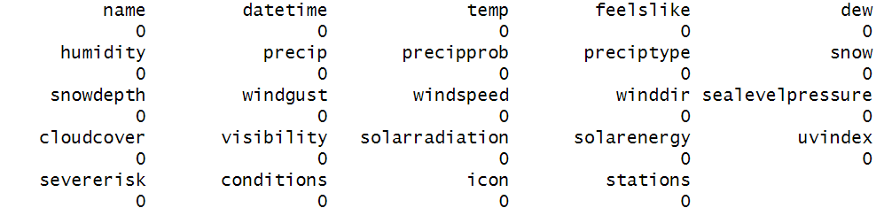

Slide 27
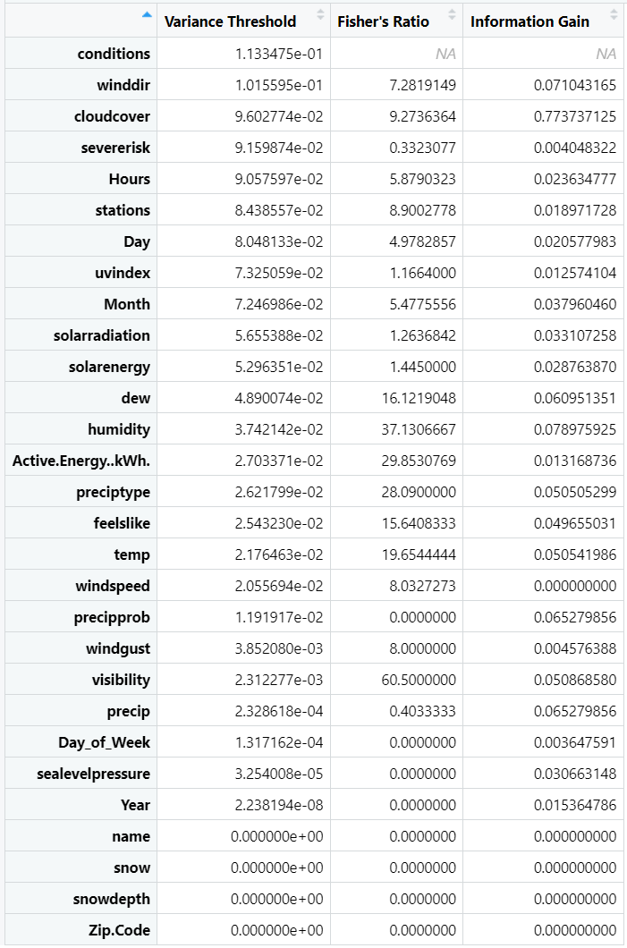

Slide 28
Characteristics with High Variability and Informativeness
humidity: High variance (0.037), very high Fisher's ratio (37.13) and moderate information gain (0.079). This suggests that humidity is a very informative characteristic and varies greatly between classes.
Dew: Moderate variance (0.049), high Fisher's ratio (16.12) and moderate information gain (0.061). Dew point is also an important characteristic.
Active.Energy..kWh.: Moderate variance (0.027), very high Fisher's ratio (29.85) and low information gain (0.013). This indicates that active energy consumption is relevant, especially in the Fisher ratio.

Slide 29
Characteristics with High Variability but Lower Informativeness
cloudcover: Moderate variance (0.096), high Fisher's ratio (9.27) and high information gain (0.774). Cloud cover is important both in terms of variance and information gain.
winddir: Moderate variance (0.101), moderate Fisher's ratio (7.28) and low information gain (0.071). Wind direction is relevant, but less informative compared to other characteristics.

Slide 30
Characteristics with Low Variability and Informativeness
windgust: Very low variance (0.0038), low Fisher's ratio (8.00) and very low information gain (0.0046). Wind gusts have low variability and informativeness.
sealevelpressure: Very low variance (0.000032), zero Fisher's ratio (0.00) and low information gain (0.031). Sea level pressure does not vary and has little information.

Slide 31
Non-lInformative or Constant Characteristics
precip, Day of Week, Year, name, snow, snowdepth, Zip.Code:
All these characteristics have zero variance and zero Fisher's ratio, indicating that they are not useful for analysis and classification. The information gain for these characteristics is also zero or very low.

Slide 32
Characteristics with Moderate Variance and Moderate Informativeness
feelslike, temp
Both characteristics have moderate variance and relatively high Fisher's ratios (*15-19), with moderate information gain (*0.05).
Temperature and thermal sensation are important, but not the most critical.

Slide 33
Characteristics with Inconsistent Values
Severerisk
Moderate variance (0.092), but very low Fisher's ratio (0.33) and very low information gain (0.004).
This may indicate that the "severerisk' variable is not well distributed or is not relevant to the classification.

Slide 34
Summary for Feature Selection
Main features (important to maintain): humidity, dew, Active.Energy..kWh., cloudcover, winddir.
Less Informative Features (possibly removable): windgust, sealevelpressure, severerisk.
Non-Informative Features (removable): precip, Day of Week, Year, name, snow, snowdepth, Zip.Code.

Slide 35
Next steps
keeping the main characteristics: keeping the characteristics that show high variability and high informativeness according to Fisher's ratio and information gain.
Remove Uninformative Features: Remove features with zero variance and low information gain, as they do not contribute to the modelling.
Evaluate Moderate Characteristics: For characteristics with moderate variability and informativeness, assess whether they are necessary for the model based on correlation analysis and importance during modelling.

Slide 36
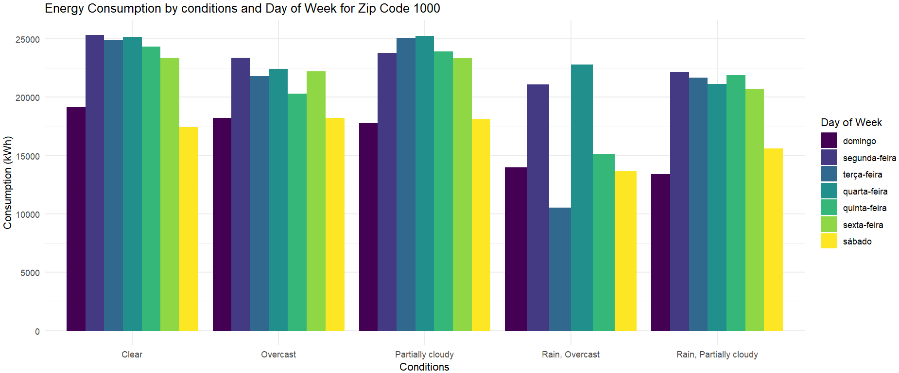
Weather Weekly

Slide 37
Weather Weekly
Variation in Energy Consumption by Day of the Week
The graph shows energy consumption in kilowatt-hours (kWh) for different weather conditions (Clear, Overcast, Partially cloudy, Rain) on each day of the week.
The bars represent the average energy consumption for each weather condition on a specific day.
Specific comments:
On some days, such as Monday and Friday, energy consumption is higher under "Rain, Overcast“ conditions compared to "Clear".
On the other hand, on Wednesday and Saturday, "Clear" conditions seem to have higher energy consumption than "Rainy" or "Overcast" conditions.
This suggests a correlation between climatic conditions and energy use.

Slide 38
Weather Weekly
Additional Considerations:
It's important to remember that correlation does not imply causality. In other words, just because two variables are correlated does not necessarily mean that one causes the other.
For more detailed analyses, it would be useful to consider other factors, such as temperature, seasonality and specific activities on each day of the week.

