Slide 1

Influence of Weather Conditions on Energy Consumption in Lisbon: An Analysis of Domestic and Industrial Use
Nuno Gomes E-mail: A18364@alunos.isel.ipl.pt
Ricardo Ramos E-mail: A46638@alunos.isel.ipl.pt
Rafael Carvalho E-mail: A47663@alunos.isel.ipl.pt
MEIC- Mineração de Dados em Larga Escala Instituto Superior Engenharia de Lisboa Lisboa, Portugal

Slide 2
Introduction
Questions and answers were crafted from a dataset, then preprocessed to allow responses. This led to defining the main goal: accurately classifying a municipality as industrial or residential based on energy usage and predicting Lisbon's energy consumption using weather conditions.
2

Slide 3
Data Analysis
To obtain specific information on electricity consumption in municipalities and sectors of activity in Portugal:
Direção-Geral de Energia e Geologia (DGEG) [1].
Pordata [2] [3] [4].

Slide 4
Data Analysis - Energy
In summary, exploratory analyses, dimensionality reduction (PCA), feature selection, and data discretization are performed on an energy consumption dataset, aiming to prepare the data for supervised machine learning model training.

Slide 5
Data Analysis - Weather
In summary, energy consumption and meteorological data are combined, missing data are handled, feature selection is conducted using various metrics (Fisher's Ratio, Information Gain, and Variance Threshold), numerical features are discretized, and datasets with the most relevant features are created.

Slide 6
Metholagy for Model processing (Energy)
Different models were trained: Random Forest, Logistic Regression, and Decision Tree.
Predictions were made on test data using these models, and confusion matrices and the area under the ROC curve (AUC) were calculated.
Undersampling & Oversampling
(residential) is undersampled to match the size of the minority class (industrial).
(industrial) is oversampled to match the size of the majority class (residential).
Performance metrics, such as confusion matrices and AUC, are calculated for each model and sampling technique.

Slide 7
Metholagy for Model processing (Weather)
Four different models are trained: Random Forest, Linear Regression, Decision Tree, and Gradient Boosted Trees.
Error metrics are calculated using `ml_regression_evaluations`.
Oversampling & Undersampling
The majority classes are undersampled to match the size of the minority class. The models are retrained with the undersampled data, and predictions and error metrics are calculated.
Error metrics, such as RMSE and R^2, are calculated for each model and sampling technique.

Slide 8
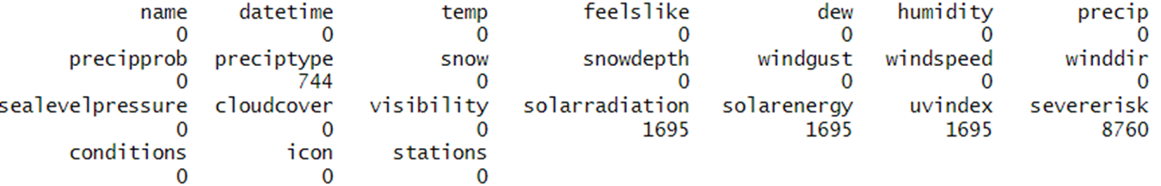
Data Interpretation – Weather
Weather characteristics in Lisbon in a two-year period
9504 instances with 24 features
Imputation based on median, mean, or zero, given standard deviation of original values

Slide 9
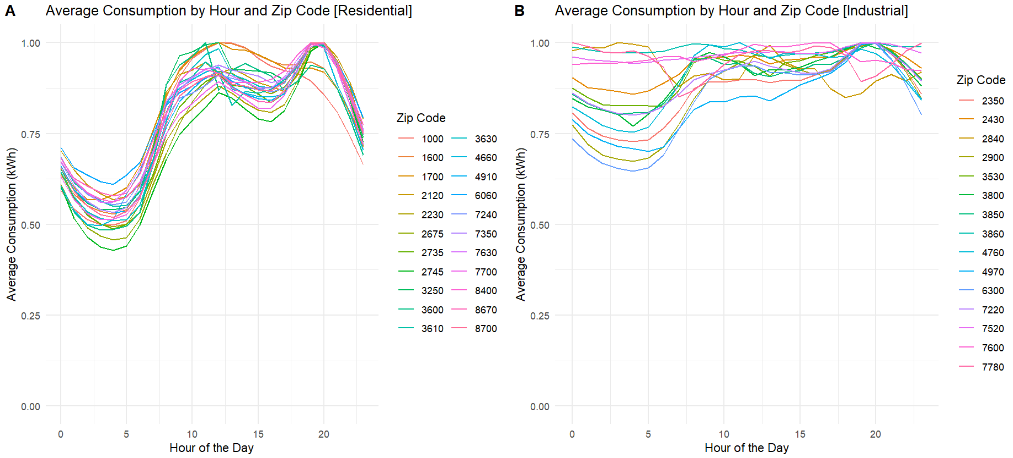
Data Interpretation – Energy
Displays a higher and sustained level of consumption during working hours. Even during the night, industrial consumption remains relatively high compared to residential areas.
Exhibits a more pronounced peak in the early morning hours. Consumption is lower during the night.
~3.7M instances with 5 features

Slide 10
Data Analysis - Question formulation
Is it possible to infer whether a municipality is predominantly industrial or residential based on the evolution of energy consumption throughout the day?
Can we predict energy consumption by taking into account the forecast weather conditions for a certain date?"

Slide 11
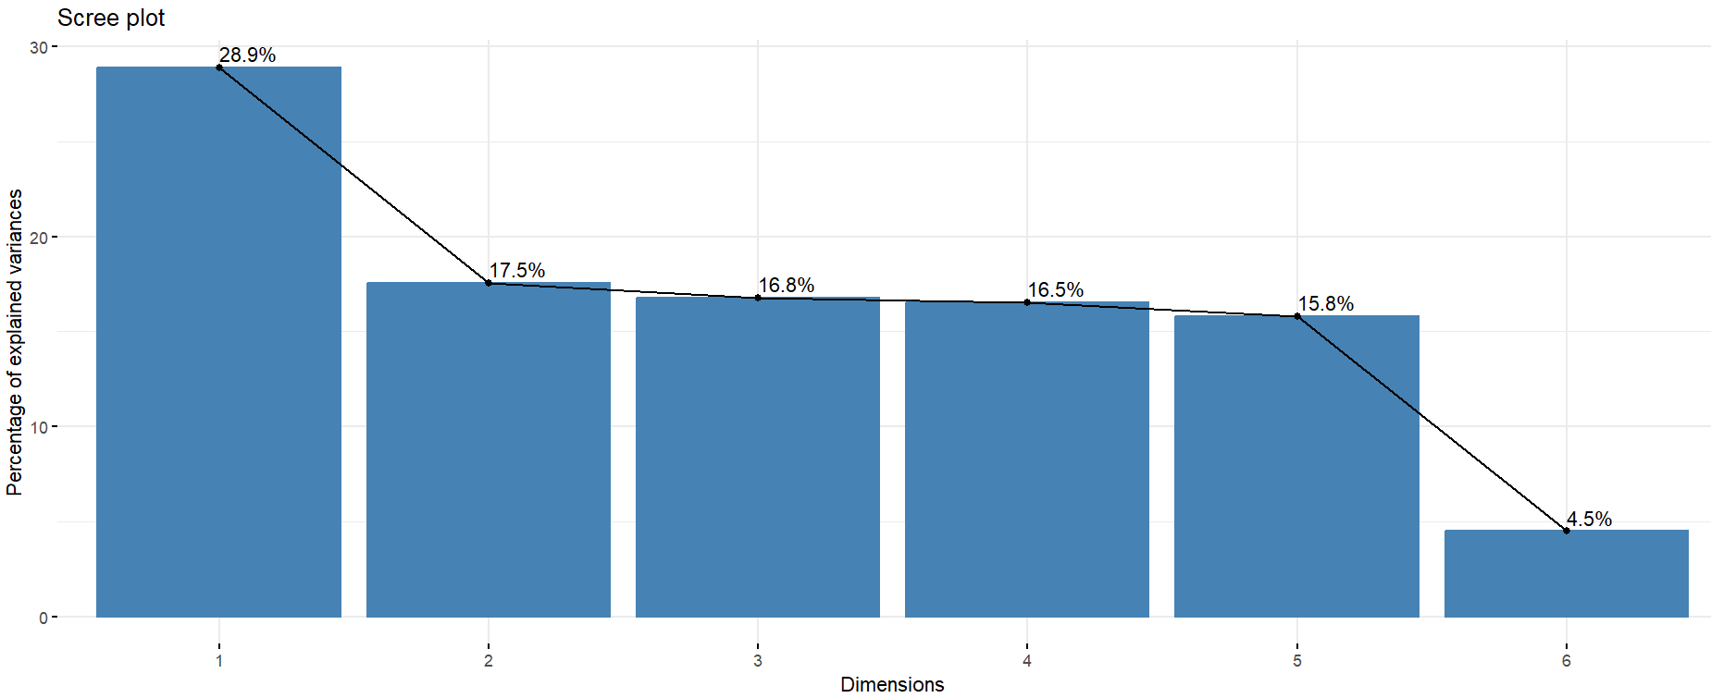
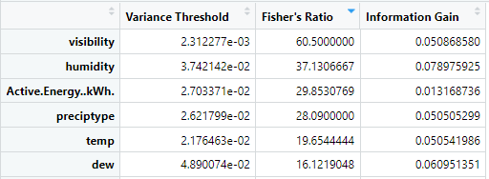
Data Analysis - Pre-processing
Feature Selection / Feature Reduction with 95% variance of original data
Principal Component Analysis

Slide 12
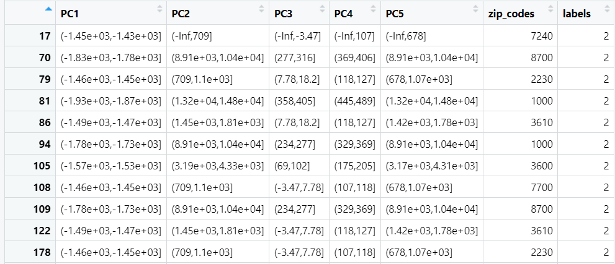
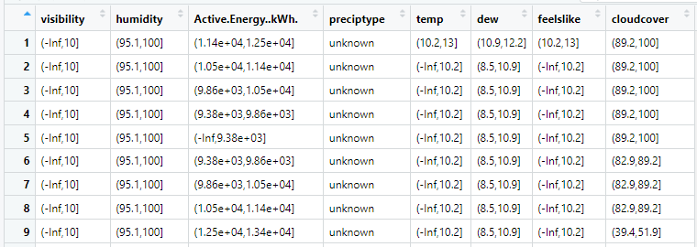
Data Analysis Discretization with Equal Frequency Binning

Slide 13

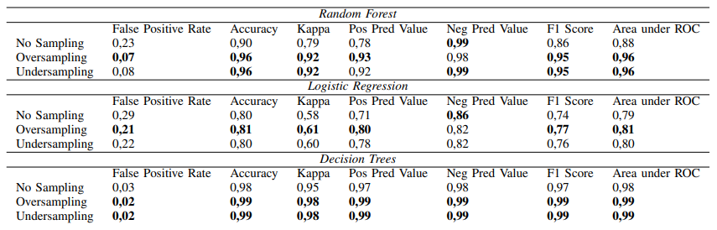
Answer to Question 1 Classifying a Zip Code as Industrial or Residential
Best results for Decision Trees, performance to be investigated
Logistic Regression displays worst performance overall
Oversampling gets the best results
Random seed influences Random Forest and Logistic Regression

Slide 14
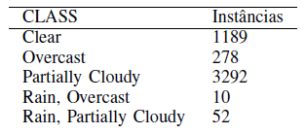
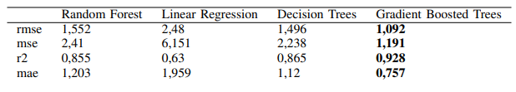
Answer to Question 2 Predicting energetic consumption in Lisbon
Best results for Gradient Boosted Trees
Simplest model (Linear Regression) is the worst
Oversampling and undersampling distort the dataset

Slide 15
Conclusions and Areas for Improvement
Any questions?

