Slide 1







Stack overflow developer survey
Rosabell Castañeda
20.05.2024

Slide 2



OUTLINE
Executive Summary
Introduction
Methodology
Results
Visualization – Charts
Dashboard
Discussion
Findings & Implications
Conclusion
Appendix

Slide 3

EXECUTIVE SUMMARY
About the dataset and analysis goal
Methodoology description
Data gathering
Data analysis
Data visualizations
Results in form of graphs and trends
Discussion of findings
Conclusions of the research

Slide 4

INTRODUCTION
Stack Overflow Developer Survey is one of the largest questionnaire for people who code around the globe
Respodents answers multiple questions about programming, tools they are using and which ones they want to learn
Nearly 90,000 developers took the survey
Findings and implications:
Trends to predict which technology will be most desired within developers for 2020
Characterization of developers around the world

Slide 5

METHODOLOGY
Collecting data
Web scraping
API
Requests library
Data Wrangling
Exploratory data analysis
Data distribution
Outliers
Correlations
Data visualization
Seaborn library
Dashboards
Cognos Analytics IBM

Slide 6

RESULTS

Slide 7
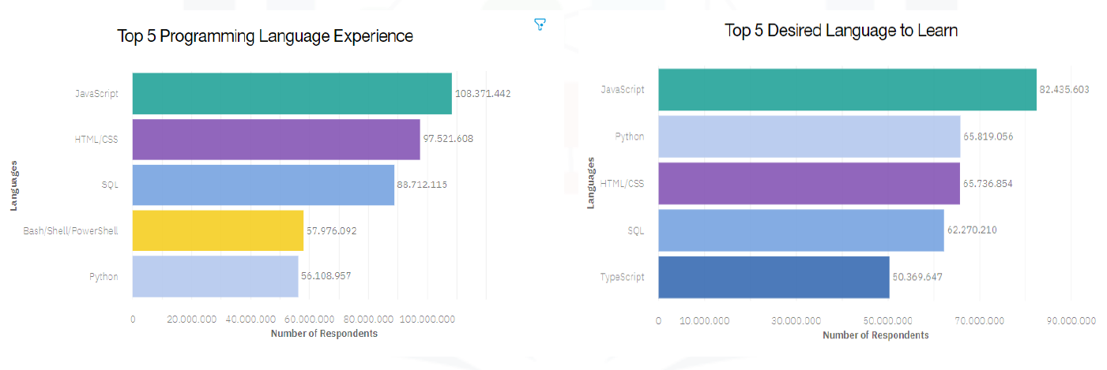
PROGRAMMING LANGUAGE TRENDS
Current Year from the top 5 instead top 10
Current Year from the top 5 instead top 10

Slide 8
PROGRAMMING LANGUAGE TRENDS - FINDINGS & IMPLICATIONS
Findings
JavaScrip remains as the 1st place
Python is the fastest growing language of them all
Increased interest in TypeScript for the upcoming year
PHP is no longer in top 5 languages
Implications
TypeScript will possibly poach JavaScript users.
Decreased interest in PHP in young developers

Slide 9
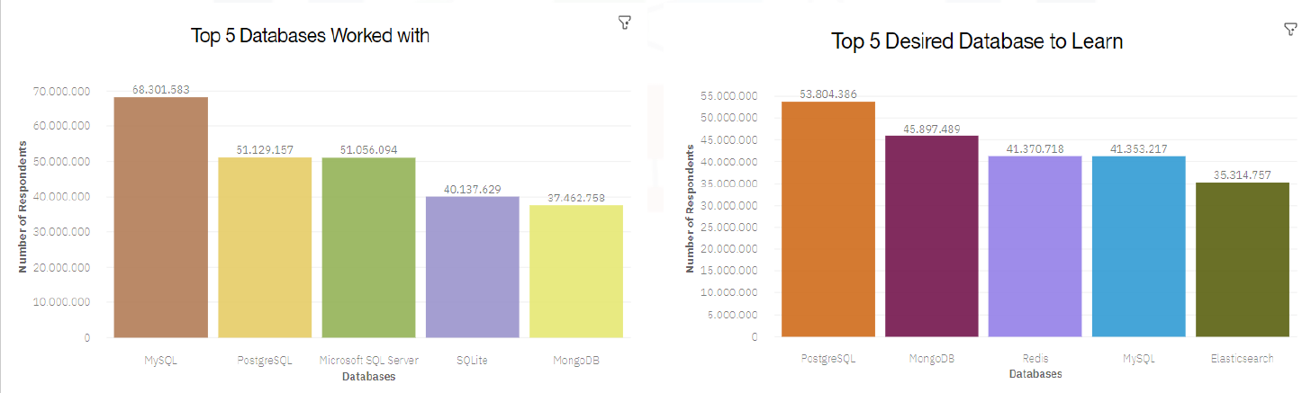
DATABASE TRENDS
Current Year from the top 5 instead top 10
Current Year from the top 5 instead top 10

Slide 10
DATABASE TRENDS - FINDINGS & IMPLICATIONS
Findings
Top databases are relational databases
MongoDB as the most used non-relational database
Implications
Respondents see opportunity in non-relational databases in upcoming year
MySQL and Microsoft SQL server losing market

Slide 11
DASHBOARD

Slide 12
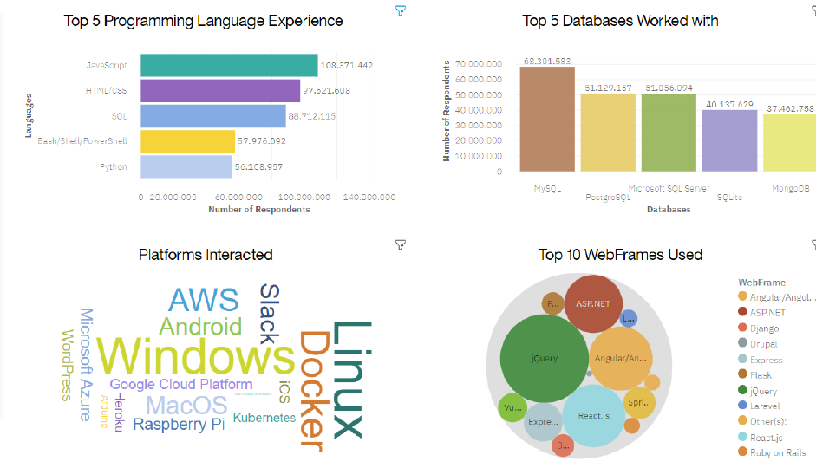
Current Technology Usage

Slide 13
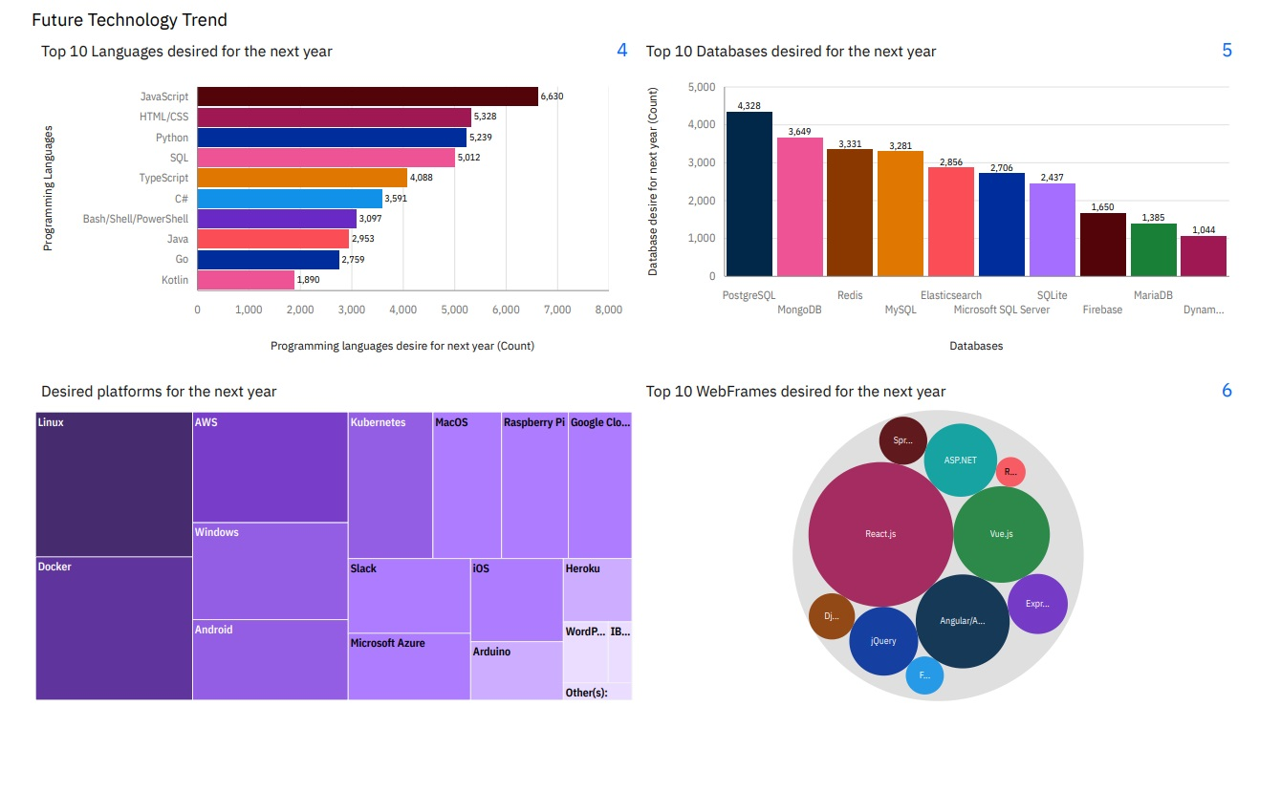
DASHBOARD TAB 2

Slide 14
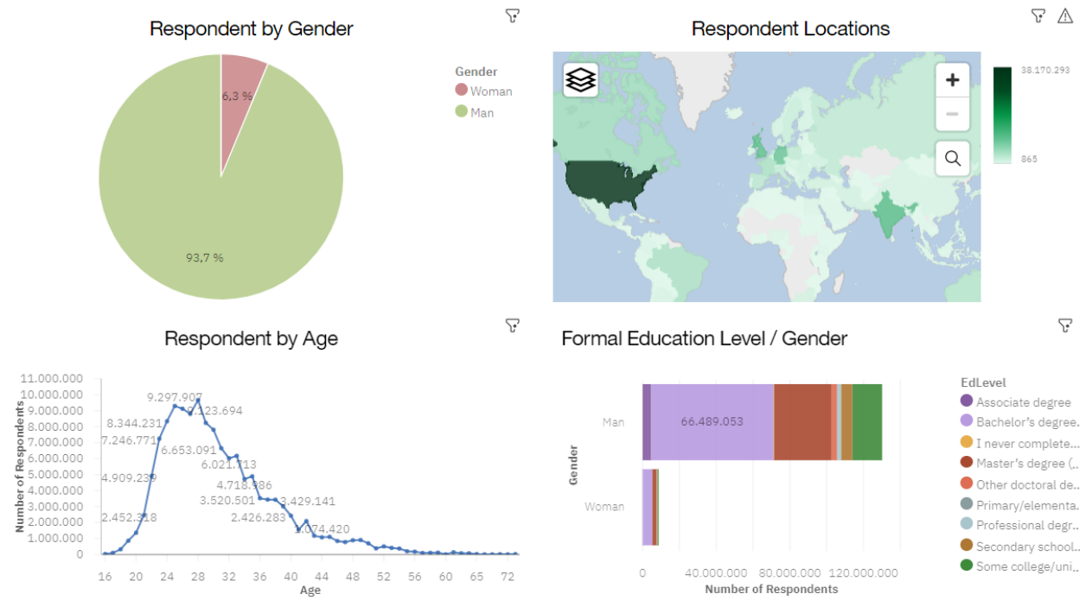
Popular Program Languages

Slide 15
DISCUSSION

Slide 16
OVERALL FINDINGS & IMPLICATIONS
Findings
Javascript as the most used programming language and MySQL as the most used database within respondents
Developers lean towards non-relational databases and python for upcoming year
Most of the developers are young male in developed countries
Implications
Javascript holds strong position in the market
Data science gaining more interest year by year as developers leaning towards non-relational databases and python
Low awareness of IT field in low developed countries

Slide 17

CONCLUSION
Respodents popularity of programming languages and databases can shape the current state of the market
Data science sector gains more interest in young developers
Strong shift in the Webframes trends in upcoming year
Low developed countries face issue with accessibility to IT market

Slide 18

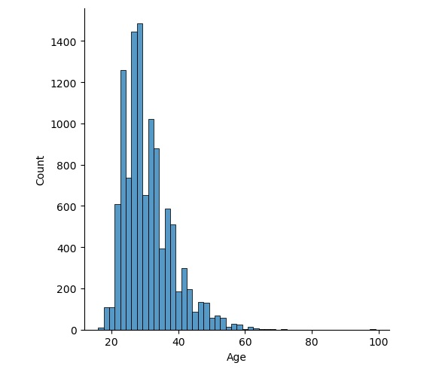
APPENDIX
Age distribution

Slide 19
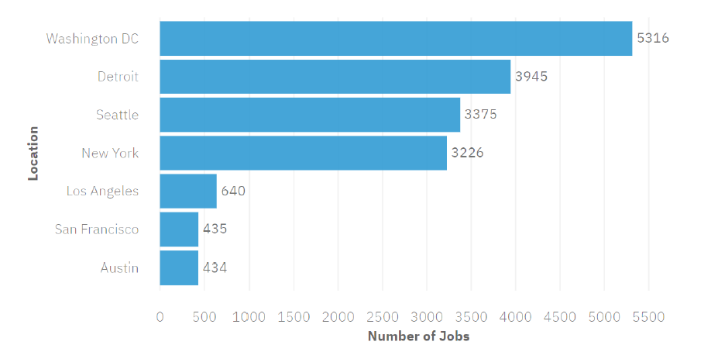
JOB POSTINGS

Slide 20
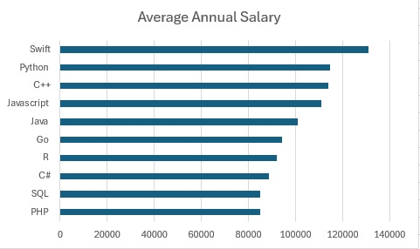
POPULAR LANGUAGES

