Slide 1
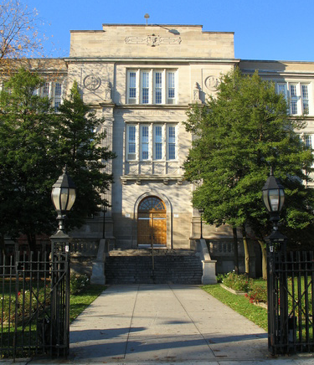
Career & Technical Education
Computer Programing & Web Design
Bayside High School

Slide 2
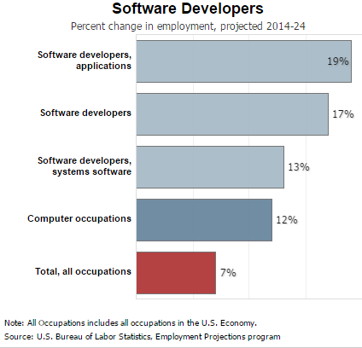
According the Bureau of Labor Statistics,
With advancements in technology there is an exploding increase in the need for developers.

Slide 3
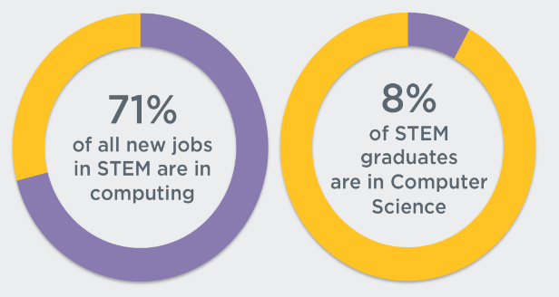
Not enough students are going into computer science
related fields. Skills gap will widen unless we change.
Presented by Code.org

Slide 4
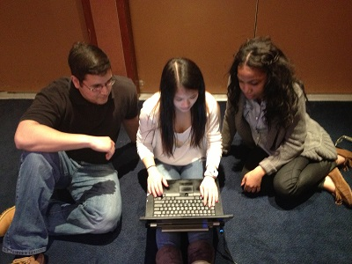
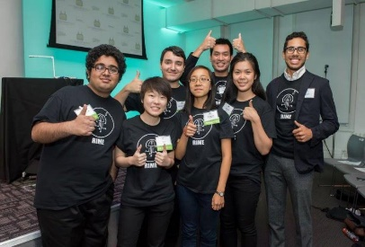
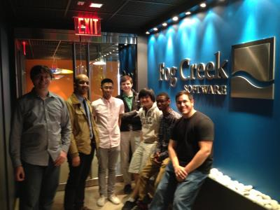
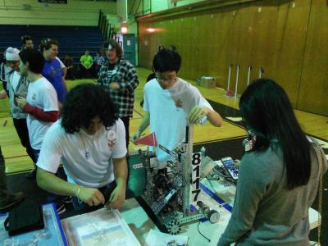
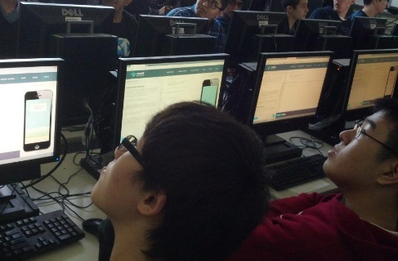
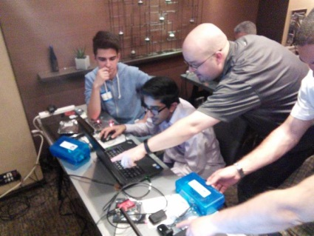
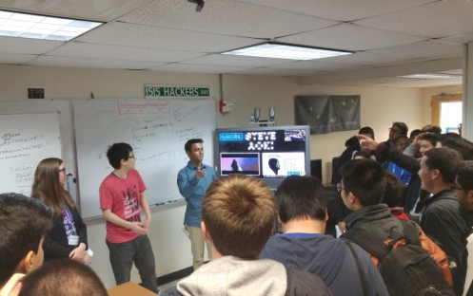
Computer Programming & Web Design Career & Technical Education
For over 10 years, Bayside High School has offered
a comprehensive sequence of study in computer science that prepared students for careers and post-secondary education in STEM fields.
For the past 5 years with the integration of industry and post-secondary partners, Bayside High School has transformed the sequence into a Career & Technical Education (CTE) program in Computer Programming.

Slide 5

What is Career & Technical Education (CTE)?
CTE programs prepare students for careers and post secondary education in a career field by addressing 3 areas,
Career Aligned Academics
Work Based Experiences
Career Preparation
In 2010, Bayside High School started transforming its existing computer science program into a CTE program in Computer Programming.
In 2016, NYS approved the program allowing us to graduate students with state endorsed CTE diplomas.
Career Aligned Academics
Career Preparation
Work Based Experience

Slide 6
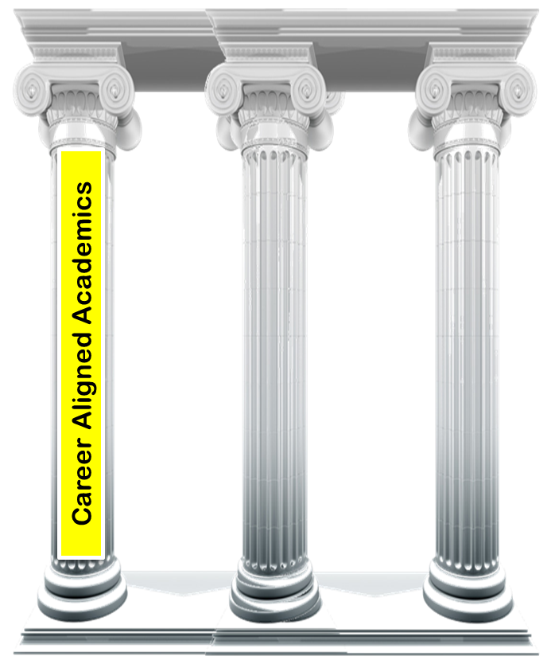
What is Career & Technical Education (CTE)?
Career Aligned Academics
With input from industry and post secondary partners, courses are aligned to prepare students for careers in computer programming and provide college credit through articulation agreements.
All students must take 7 elective credits to graduate. CTE programs focus these electives into career aligned courses.
In the Computer Programming & Web Design CTE students will take,
9th - Programming Technologies (2cr / optional)
10th - Introduction to Computer Programming (2cr)
11th - Introduction to Computer Science (2 cr)
12th - CS Career Development (2 cr)
Career & Financial Management (1cr)
Notes:
As part of the CTE program in Computer Programming students must meet standard high school graduation requirements in addition to passing the courses listed below.
Overview of Courses
9th Programming Technologies – Students are exposed to computer science as a natural extension of our language and logic thinking. Students learn basic programming concepts while developing projects in arts, video games, Internet of Things and Robotics using Python. Focus of the course is to inspire and gain an appreciation of what can be accomplished with programming.
Technology: Python, Raspberry Pi with Dexter Industries add-ons
10th Introduction to Computer Programming - Students further their knowledge of fundamental programming concepts. Students explore web development in conjunction with application development. Equal part to programming knowledge is the development of problem solving and analytic skills. Large portion of the course is spent working with data from external sources. Students appreciate the power of combining various technologies through programming.
Technology: HTML, CSS, JavaScript, Bootstrap, API, Data Processing, Firebase, MongoDB, Full Stack Development (overview)
11th Introduction to Computer Science – Students delve deeper into programming concepts previously learned with a greater focus on the “why” and not just the “how”. Students explore advance topics in object oriented programming such as inheritance and polymorphism as well as cover concepts in recursion, sorting and searching algorithms. Juniors are fortunate of being able to receive college credits through one of two routes: 1) Articulation agreement with SUNY Farmingdale or St John’s University 2) Successful grade on the AP CS exam.
Technology: Java, Android
12th CS Career Development – Course is centered around the students selecting an area where there is a need, proposing a product, developing a solution and presenting their product. Students are challenged to develop within a previously learned programming domain or explore a new programming domain. More emphasizes is place on entrepreneurial and project management skills, rather than just coding. Select advance topics are covered in the course such as databases.
Technology: Project Management, Students programming domain of choice

Slide 7
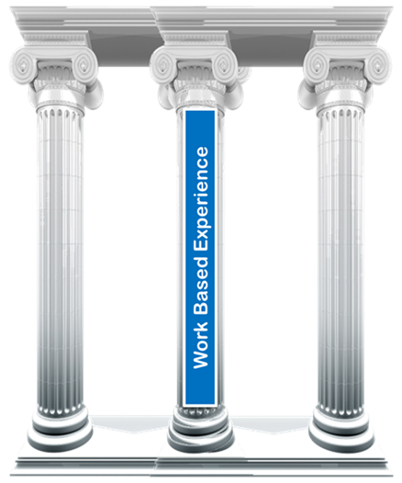
What is Career & Technical Education (CTE)?
Work Based Experience
At the core of CTE is the understanding that students must see, experience and apply what they are learning in the classrooms.
In the Computer Programming & Web Design CTE students participate in various work based and post secondary education experiences such as,
Guest Speakers
Career Fairs
Mentorships
Internships
Career Readiness Events
Competitions / Hackathons
Career Focused Trips
University Trips
Industry Interactive Projects

Slide 8
What is Career & Technical Education (CTE)?
Career Preparation
To validate a student’s Career & Technical Education, every student must pass a industry based certification, complete a culminating capstone project and take the Career and Financial Management course.
In the Computer Programming & Web Design CTE students,
Pass the NOCTI Computer Programming Exam (4023).
As part of their capstone project, research a need, propose a product, develop and pitch their solution.
Develop resume, job searching and interviewing skills
Practice workforce skills such as collaboration, communication and presentation.
Career Preparation

Slide 9
What is Career & Technical Education (CTE)?
Overview
Career Aligned Academics
Work Based Experience
Introduction to Computer Programming
Introduction to Computer Science
CS Career Development
Career & Financial Management
Guest Speakers
Career Fairs
Mentorships
Internships
Career Readiness Events
Competitions / Hackathons
Career Focused Trips
University Trips
Industry Interactive Projects
Career Preparation
NOCTI Computer Programming Exam (4023)
Capstone Project
Essential workforce skills

Slide 10
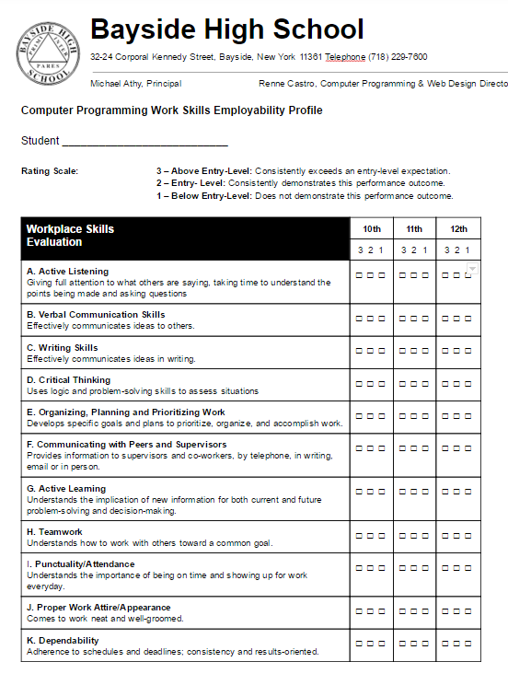
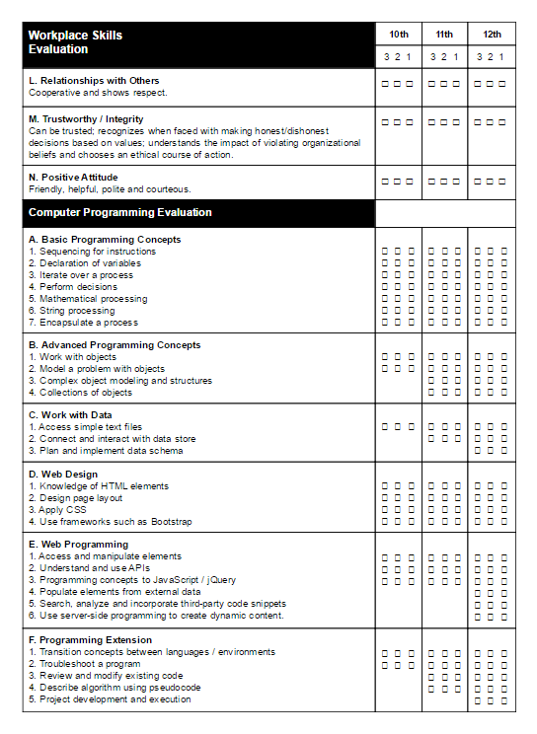
Work Skills Employability Profile
Work Skills Employability Profile (WSEP) is one of the essential documents used to connect the academics, work based experiences and the industry preparation. WSEP lists workforce and technical skills required for entry level positions in Web and Software Development.
Skills are aligned by course
Scaffolding skills to build depth of knowledge
Students enhance their skills through work based experiences
Experiences serve to motivate, build and reinforce workforce and technical skills
Students monitor their skills through out
Used during internship opportunities
Career Aligned Academics
Work Based Experience
Career Preparation

Slide 11
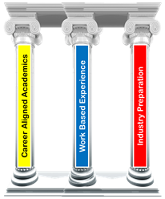
Collaboration & Communication
Career Aligned Academics, Work Based Experiences and Career Preparation are only possible through constant communication and collaboration. High school faculty along with industry and post secondary partners continuously work together to maintain and improve the career and technical education offered to students.
Work
Site
Visits
Advisory Board Meetings
School Visits
Email
Skype
Phone
PD

Slide 12
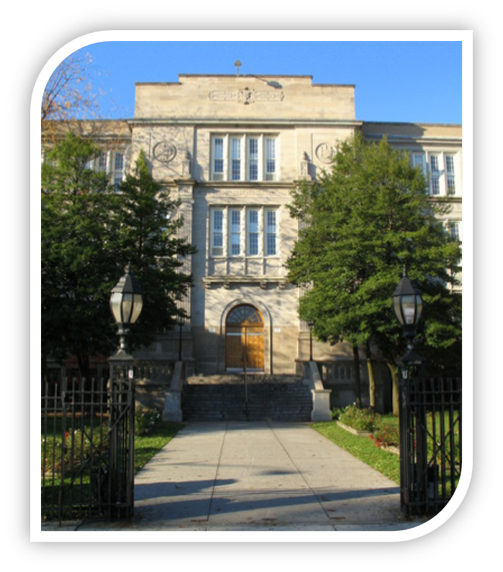
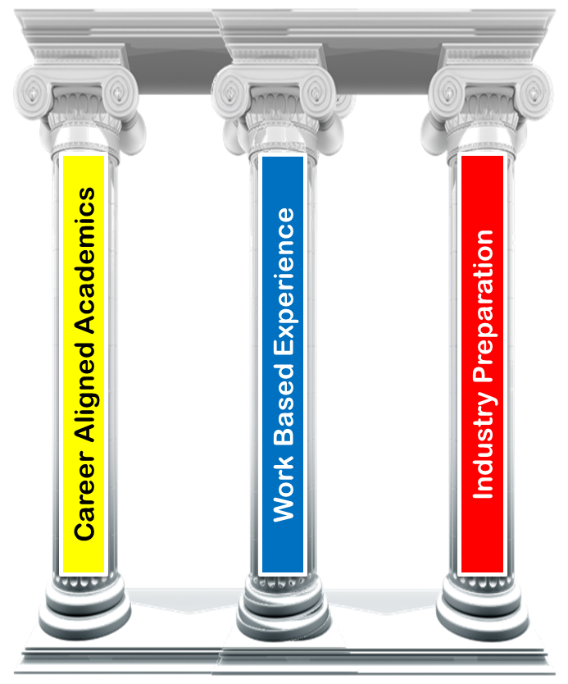

End State
Through successful completion of the Career and Technical Education program in Computer Programming and Web Design students,
Receive college and career focused education
Opportunity to earn college credit through high school courses
Gain experience and build resumes by participating in internships, mentorships, competitions, career fairs and various other industry collaborated opportunities
+ =

