Slide 1
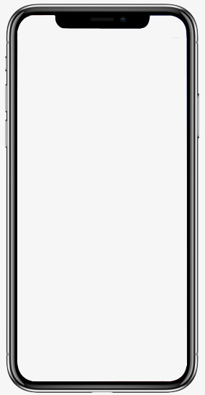
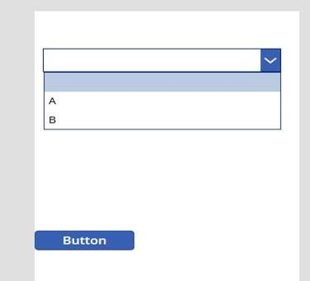

COMPUTER
LANGUAGE
CONVERTER
HELLO!
Calcu
How to
About us
What converter do you need?
Binary to Decimal
Binary to Decimal
Binary to Octal
Binary to Hexadecimal
Decimal to Binary
Decimal to Octal
Others…

Slide 2
Binary to Decimal
Insert Binary Numbers:
110011101
Convert
Reset
Decimal Number:
413
Solution:
110011101 = (1 × 2⁸) + (1 × 2⁷) + (0 × 2⁶) + (0 × 2⁵) + (1 × 2⁴) + (1 × 2³) + (1 × 2²) + (0 × 2¹) + (1 × 2⁰) = 413
HOME

Slide 3
COMPUTER
LANGUAGE
CONVERTER
HELLO!
Calcu
How to
About us
What do you want to learn?
Binary to Decimal
Binary to Decimal
Binary to Octal
Binary to Hexadecimal
Decimal to Binary
Decimal to Octal
Others…

Slide 4
Binary to Decimal
For binary number with n digits:
d_{n-1} ... d₃ d₂ d₁ d₀
The decimal number is equal to the sum of binary digits (d_{n}) times their power of 2 (2^{n}):
decimal = d₀×2⁰ + d₁×2¹ + d₂×2² + ...
Ex:
111001₂ = 1⋅2⁵+1⋅2⁴+1⋅2³+0⋅2²+0⋅2¹+1⋅2⁰ = 57₁₀
HOME

Slide 5
COMPUTER
LANGUAGE
CONVERTER
HELLO!
Calcu
How to
About us
ABOUT US
Contact no.: 09123456789
Email: math@edu.ph
We created this app for…..

