Slide 1
Are you Happy ?
Click to continue

Slide 2
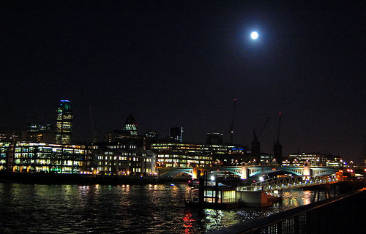
On a certain occasion, during an elegant welcoming reception
for the new Director of Marketing of an
important London company, some of the wives
of the other directors, who wanted to get acquainted with the
new spouse, asked her with some hesitation:
Does your spouse make you happy, truly happy?

Slide 3
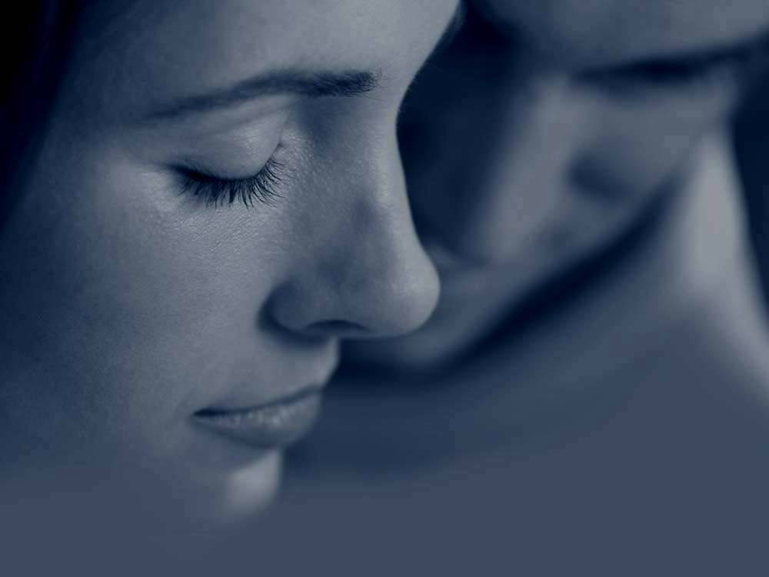
The husband, who at the moment was not at her side, but was sufficiently near to hear the question, paid attention to the conversation, sitting up slightly, feeling secure, even filling his chest lightly in pride, knowing that his spouse would answer affirmatively, since she had always been there for him during their marriage.
Nevertheless, to both his and the others’ surprise, she replied simply
“No, no he doesn’t make me happy...

Slide 4

The room became uncomfortably silent, as if everyone were listening to the spouse’s response.
The husband was petrified.
He couldn’t believe what his wife was saying,
especially at such an important occasion for him.
To the amazement of her husband and of everyone, she simply placed enigmatically on her head an elegant black silk scarf and continued:
“No, he doesn’t make me happy …I AM HAPPY.”
The fact that I am happy or not,
doesn’t depend on him, but on me.

Slide 5

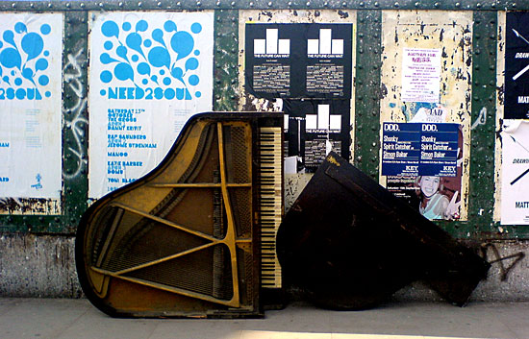
“I am the only person upon which my happiness depends.
I make the choice to be happy in each situation and in each moment of my life.
If my happiness were to depend on other people, on other things or circumstances on the face of this earth, I would be in serious trouble!
“Everything that exists in this life changes continually:
humans, wealth, my body, the climate, pleasures, etc.
I could enumerate an infinite list…

Slide 6
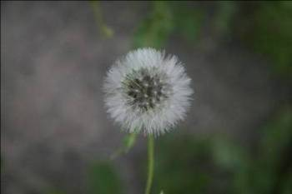
“Over my life I have learned a couple of things:
I decide to be happy and the rest is a matter of
"experiences or circumstances;”
like helping, and understanding,
accepting, listening, consoling;
and with my spouse,
I have lived and practiced this
many times….
Happiness will always be found in
forgiveness and in loving yourself and others.
- …It’s not the responsibility of my spouse to make me happy... He also has his “experiences or circumstances.” I love him and he loves me, often inspite of his circumstances and of mine.

Slide 7

“He changes, I change, the environment changes, everything changes;
Having forgiveness and true love, and observing these changes,
that can be, big or little, but always happen,
we must face them with the love that exists in each one of us.
If the two of us love and forgive each other,
the changes will only be “experiences or circumstances”
that enrich us and give us strength.
Otherwise we would only be “living together.”

Slide 8
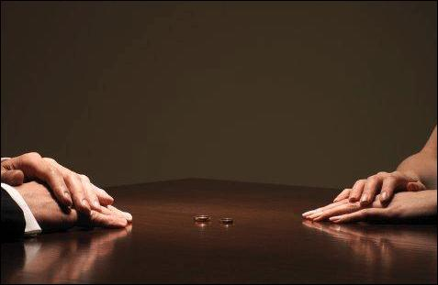
For some, divorce is the only solution;
(…in reality it is the easiest…)
To truly love, is difficult,
It is to forgive unconditionally, to live,
To take the “experiences or circumstances” as they are,
Facing them together and being happy with conviction.

Slide 9
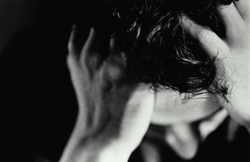
There are those who say:
“I cannot be happy because I am sick, because I have no money,
Because it’s too cold, because they insulted me,
Because someone stopped loving me,
Because someone didn’t appreciate me!”

Slide 10
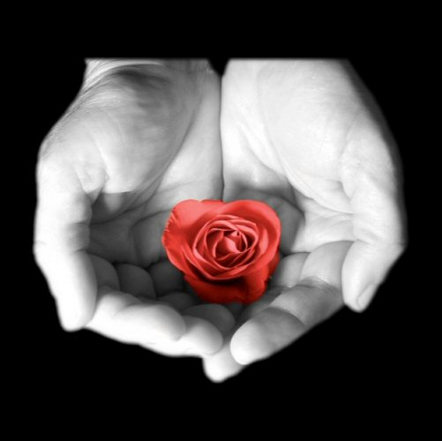
But what you don’t know is that you can be happy even though you are sick,
whether it is too hot, whether you have money or not,
Whether someone has insulted you,
Or someone didn’t love you, or hasn’t valued you.
BEING HAPPY
is an attitude about life and each one of us must decide !
BEING HAPPY,
depends on you !

Slide 11
F I N
Diseño original y galería de fotos de libre acceso en internet
Cortesía de Carlos Rangel
Santiago de Querétaro, Mex. Dic. 2007
Carlitosrangel@hotmail.com
Translated into English by
Paul Cushman
gocush@comcast.net

