Slide 1
Intro to D3
Kazutaka Takahashi
RCC

Slide 2
What is D3?
D3 = Data-Driven Documents
D3.js is a JavaScript library for manipulating documents/objects based on data
Creating data visualization
Uses HTML, CSS, and SVG
(Relatively) easy to use API
Viewable on browsers

Slide 3
Examples
Hawai’i topographic map example
Zoomable US Map

Slide 4
Advanced Examples
1) Basic Force-Directed Graph (Network Visualization)
2) Interactive Network Visualization : How-to (with lots of great explanations)
3) 3D Network Visualization
4) Interactive Collapsible Reingold-Tilford Tree
5) Interactive Chord Diagram : “International Trade Flows”

Slide 5
What is DOM?
The Document Object Model (DOM) is an application programming interface (API) for valid HTML and well-formed XML documents. It defines the logical structure of documents and the way a document is accessed and manipulated. In the DOM specification, the term "document" is used in the broad sense - increasingly, XML is being used as a way of representing many different kinds of information that may be stored in diverse systems, and much of this would traditionally be seen as data rather than as documents. Nevertheless, XML presents this data as documents, and the DOM may be used to manage this data.

Slide 6
What is SVG?
SVG stands for Scalable Vector Graphics.
SVG is used to define vector-based graphics for the Web.
SVG defines the graphics in XML format.
Every element and every attribute in SVG files can be animated.
SVG is a W3C recommendation.
SVG integrates with other W3C standards such as the DOM and XSL.

Slide 7
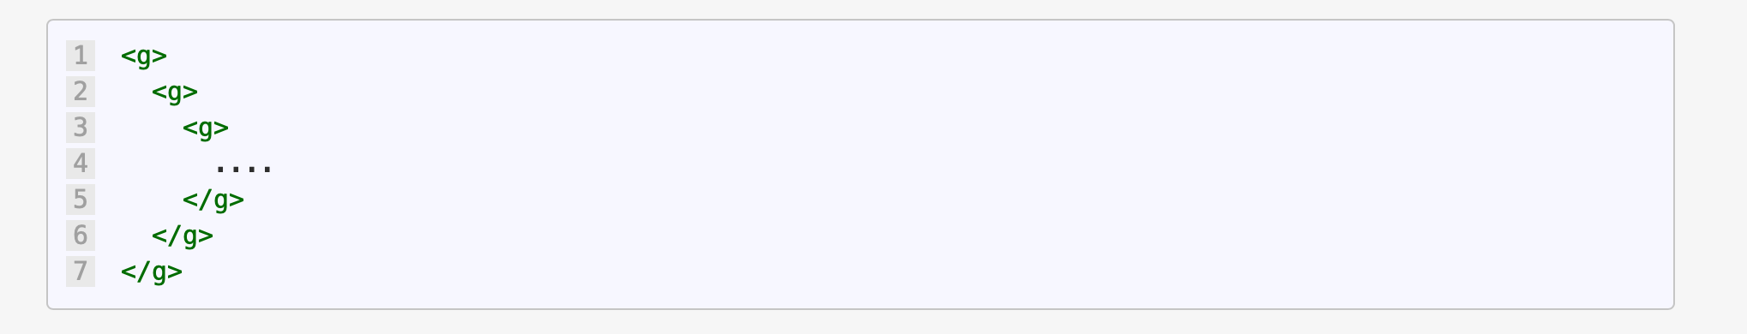
SVG Group Element
The SVG Group Element is used to group SVG elements together.
The SVG Group Element is a container that contains all child SVG elements defined inside of it.
The SVG Group Element is defined by <g> and </g>.
The SVG Group Element can be nested inside of other SVG Group Elements:
Any transformation applied to the SVG Group Element is applied to all of the child elements contained inside.

Slide 8
We will cover two major uses of the SVG Group Element:
Grouping - To group a set of SVG elements that share the same attribute
Transforming - To define a new coordinate system for a set of SVG elements by applying a transformation to each coordinate specified in this set of SVG elements

Slide 9
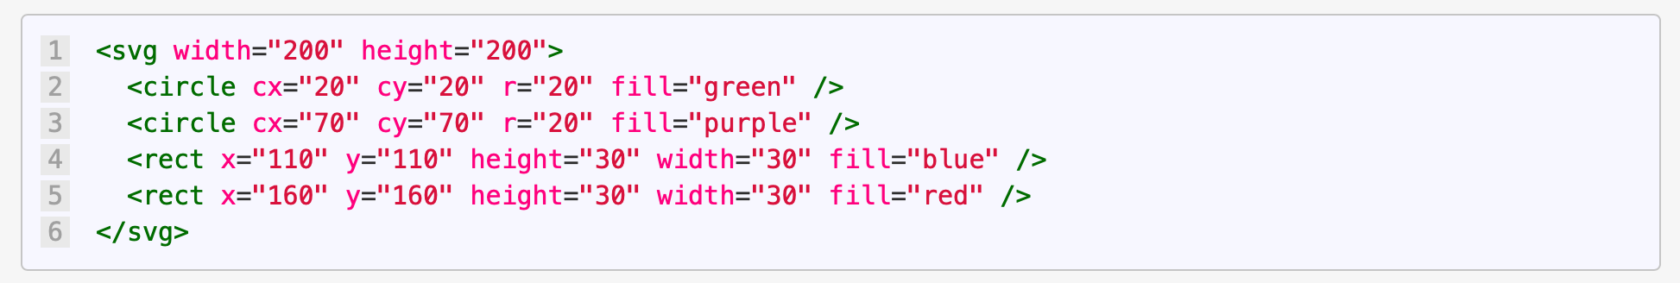
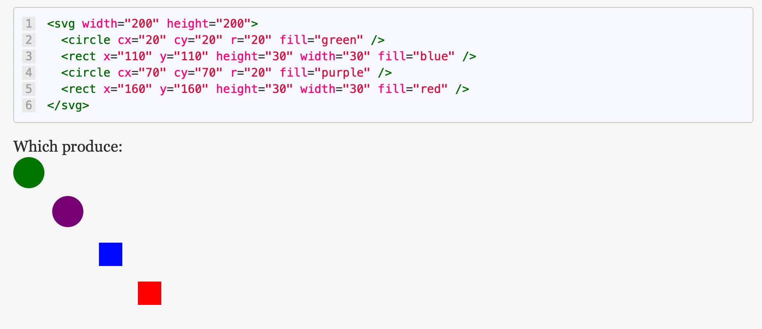
Grouping SVG Elements Together We start with 4 SVG Basic Shape Elements (2 circles and 2 rectangles):
Notes:
However, if we had the 500 circles and 370 rectangles, it would still be confusing.
Luckily we have the SVG Group element.
With the SVG Group element, we can organize all of the circles together and all of the rectangles together.
This makes our SVG visualization more organized (which is a win) as well as easier to read:

Slide 10
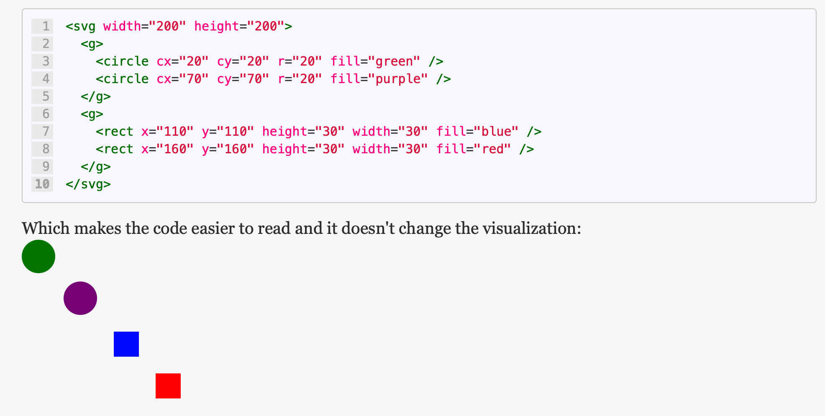
Notes:
Which is one of the goals of using the SVG Group Element - to group a set of SVG elements that share the same attribute.
In this example - grouping all the circles together and all the rectangles together.

Slide 11
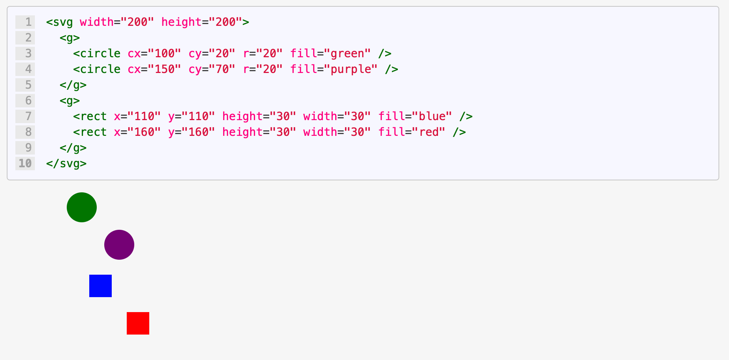
Transforming SVG Elements Together
What if we decided we wanted to move the circle elements 80 units to the right?
We could add 80 units to the cx attribute of each of our circles:
Notes:
However, what if we had the 500 circles and 370 rectangles?
Disaster!
Who would want to manually add 80 units to the cx of every circle?!
Luckily we have the SVG Group element.
With the SVG Group element, we can transform all of the circles together and move them to the right 80 units.

Slide 12
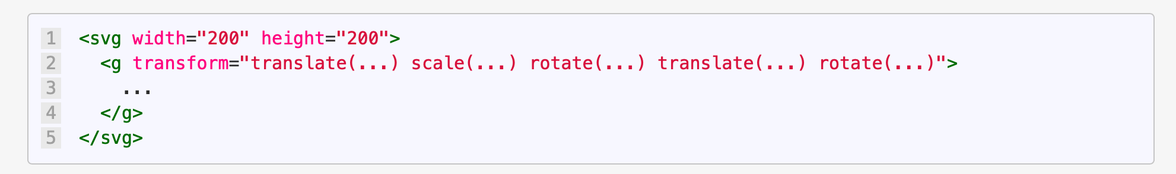
SVG Transform Attribute
The SVG Transform Attribute applies a list of transformations to an element and it's children.
Notes:
Each transform definition is separated by white space and or commas.
The transformations are applied from right to left.
They are applied right to left because they are treated as nested transforms.

Slide 13
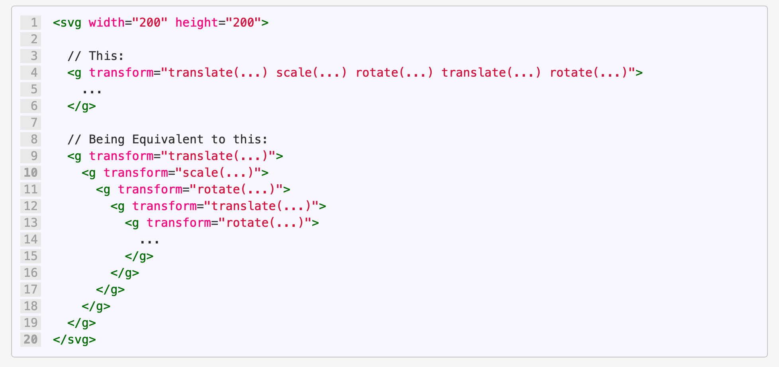
Equivalent Expressions

Slide 14
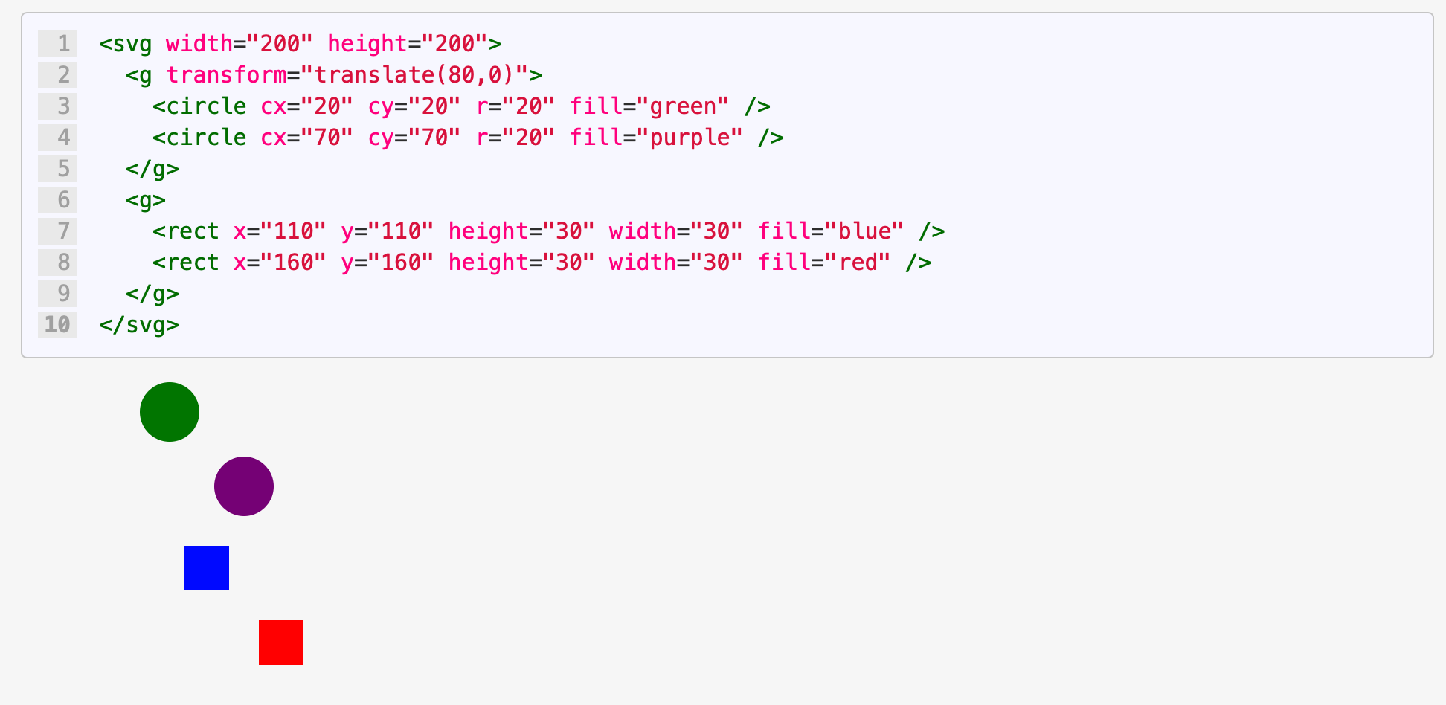
Transforming SVG Elements Together
Now with the group –
Notes:
Only for the circle group is moved by 80 from right to left, not left to right!

Slide 15
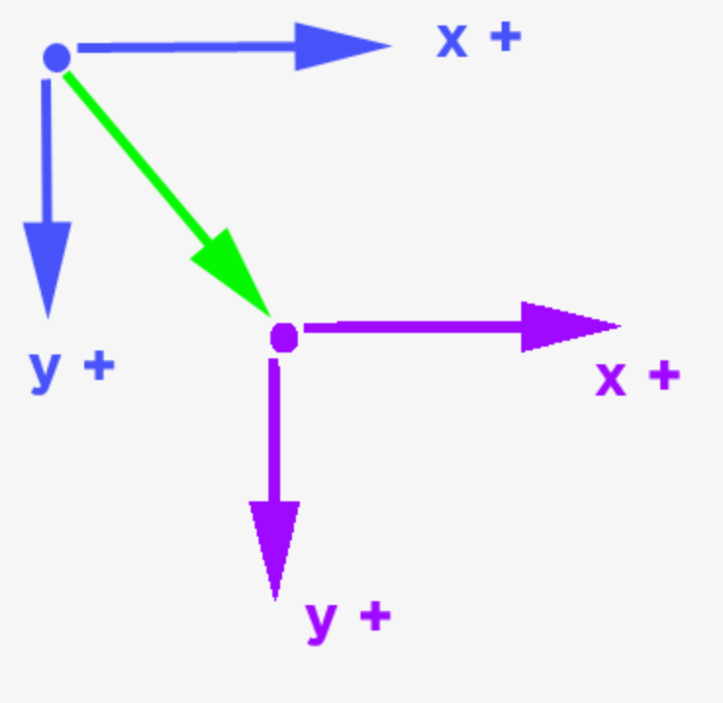
SVG Transform as a Coordinate Space Transformation
The SVG Transform is actually transforming the coordinate space!
If you've studied Linear Algebra, the SVG Transform is a transformation matrix.
Translate functionality can be thought of as moving the (0,0) point of the blue coordinate system to a (0,0) point in the purple coordinate system.
Notes:
This means that we are moving the (0,0) point 80 units to the right just for the elements inside of the SVG Group Element!

