Slide 1
We are going to use Google’s Colab for this workshop
Google’s Colab is basically Google Docs for interactive, runnable Jupyter Notebooks, and it is a fantastic resource for playing around with machine learning models. It comes with great sharing and collaboration features and even a free GPU runtime!
If you have never used Colab, please follow the instruction below; otherwise, you can skip it:

Slide 2
Sign up for Colab
Anyone with a Google Drive account can sign up for Colab by heading to colab.research.google.com and following the listed instructions.
Create a new notebook
File -> New Notebook. Either Python 2 or 3 will work, but I would recommend Python 3 (that’s what the rest of this tutorial will be using)
Set up the GPU runtime
Runtime -> Change runtime type -> Hardware Accelerator -> GPU. Free GPU cycles!

Slide 3
Let’s start with: linear regression
It has long been known that crickets (an insect species) chirp more frequently on hotter days than on cooler days. For decades, professional and amateur scientists have cataloged data on chirps-per-minute and temperature.
Now you are asked to learn a model to predict this relationship. Using this data, you want to explore this relationship.
First, examine your data by plotting it.

Slide 4
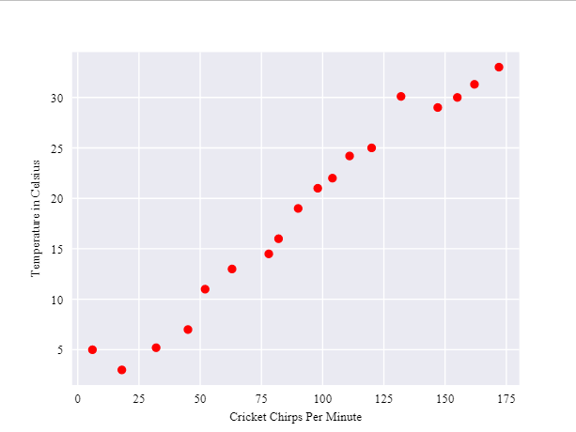
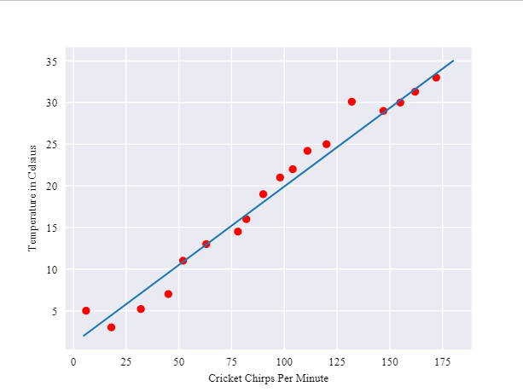
As expected, the plot shows the temperature rising with the number of chirps. Is this relationship between chirps and temperature linear?
Yes, you could draw a single straight line like the above to approximate this relationship.

Slide 5
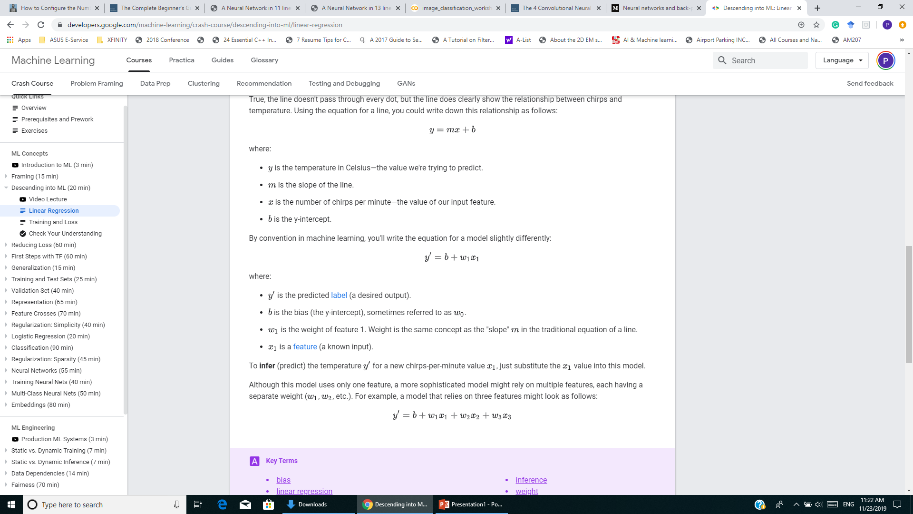
Although the line doesn't pass through every dot, it does clearly show the relationship between chirps and temperature. Using the equation for a line, you could write down this relationship as follows:
By convention in machine learning, you'll write the equation for a model slightly differently:
Although this model uses only one feature, a more sophisticated model might rely on multiple features, each having a separate weight (w1, w2, etc.).
For instance, a model that relies on three features might look as follows:

Slide 6
Training and Loss
Training a model simply means learning (determining) good values for all the weights and the bias from labeled examples.
In supervised learning, a machine learning algorithm builds a model by examining many examples and attempting to find a model that minimizes loss.
Loss is the penalty for a bad prediction. That is, loss is a number indicating how bad the model's prediction was on a single example. If the model's prediction is perfect, the loss is zero; otherwise, the loss is greater. The goal of training a model is to find a set of weights and biases that have low loss, on average, across all examples.

Slide 7
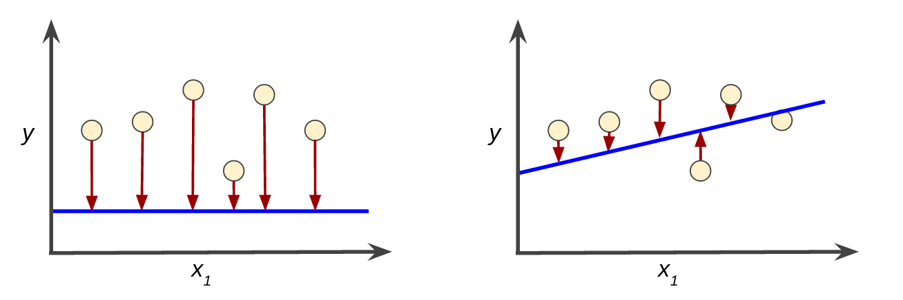
For example, the figure below shows a high loss model on the left and a low loss model on the right.
The arrows represent loss.
The blue lines represent predictions.
Notice that the arrows in the left plot are much longer than their counterparts in the right plot.
→ the line in the right plot is a much better predictive model than the line in the left plot.
You may create a mathematical function—a loss function—that would aggregate the individual losses in a meaningful fashion.

Slide 8
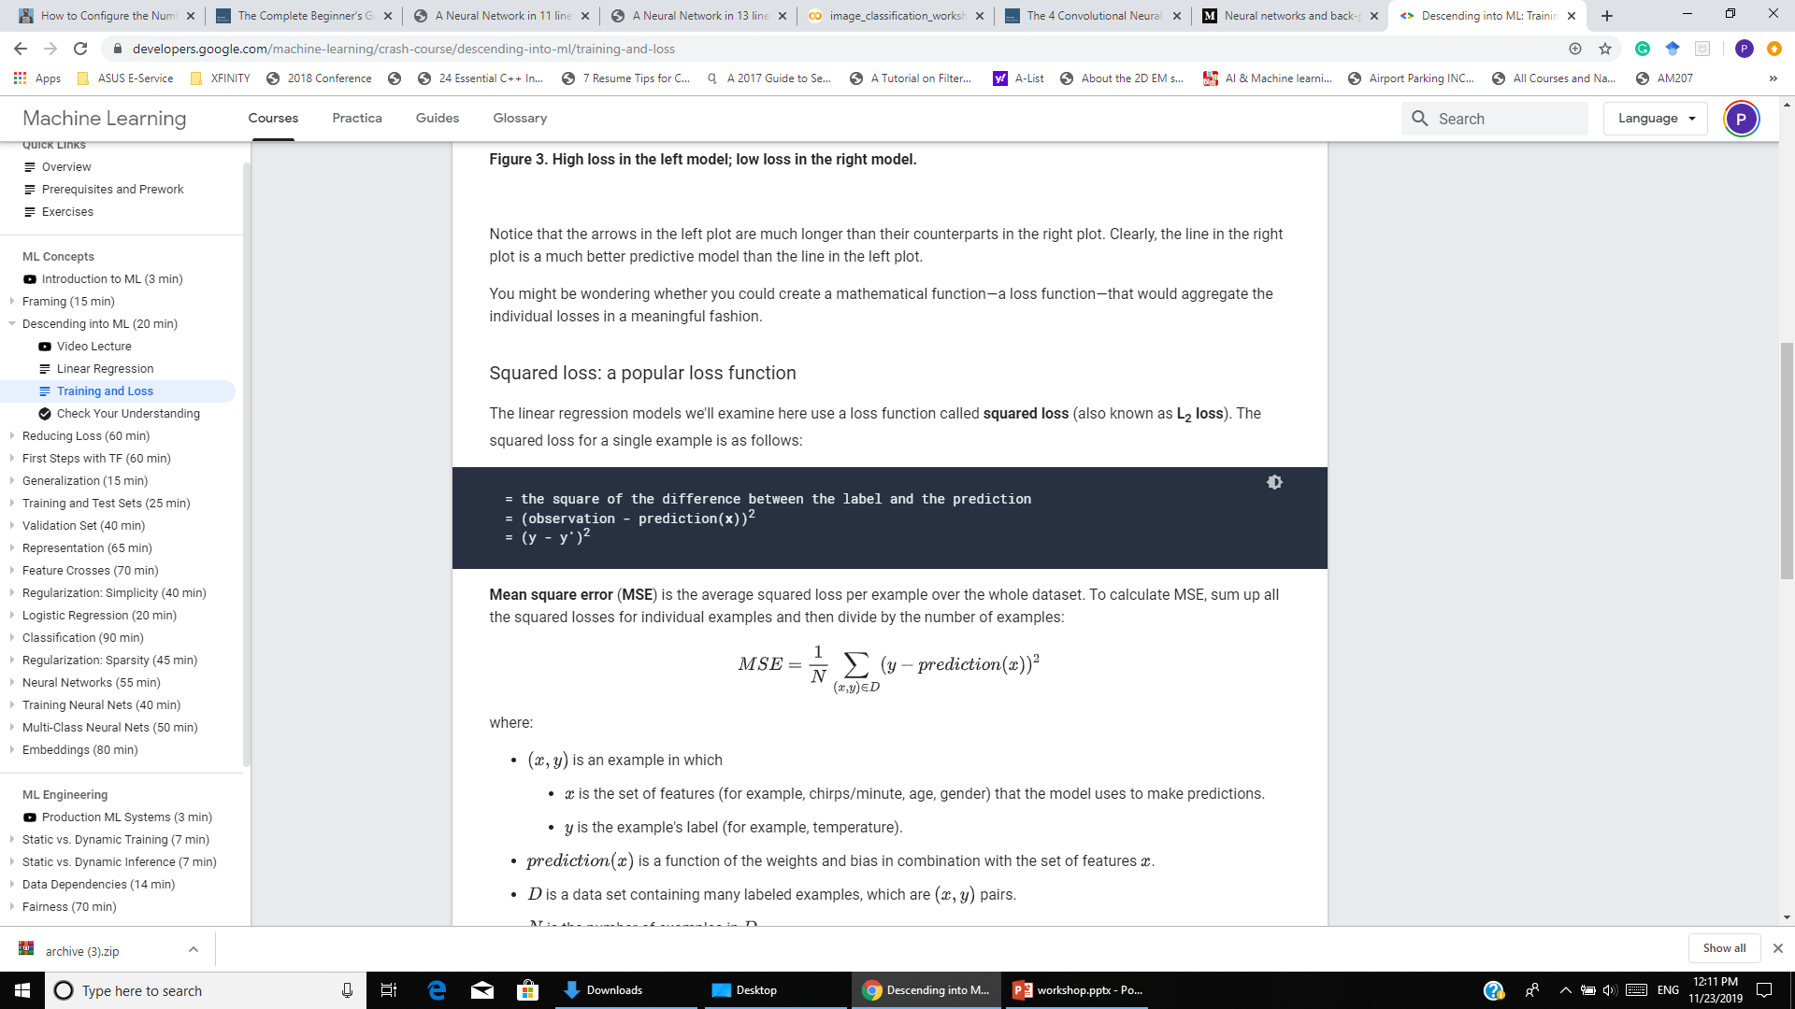
Squared loss: a popular loss function
The linear regression models we examine here use a loss function called squared loss (also known as L₂ loss).
The squared loss for a single example is as follows:
Mean square error (MSE) is the average squared loss per example over the whole dataset.
To calculate MSE, sum up all the squared losses for individual examples and then divide by the number of examples:
How to minimize the loss (in the case here, to minimize the MSE)?

Slide 9
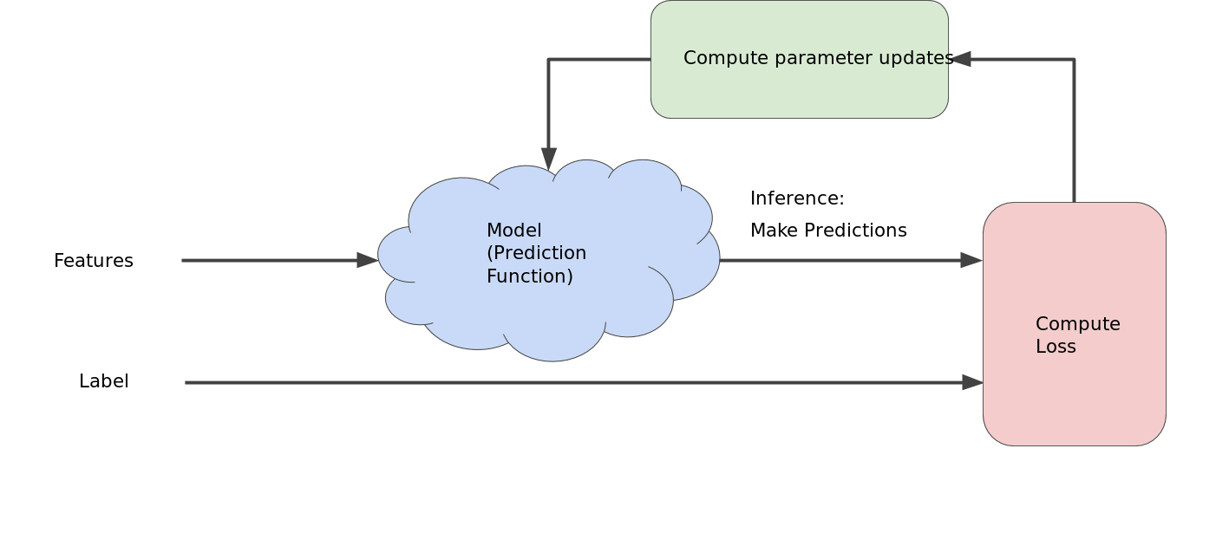
Reducing loss: an iterative approach
This figure suggests the iterative trial-and-error process that machine learning algorithms use to train a model:
backpropagation
The "model" takes one or more features as input and returns one prediction () as output.

Slide 10
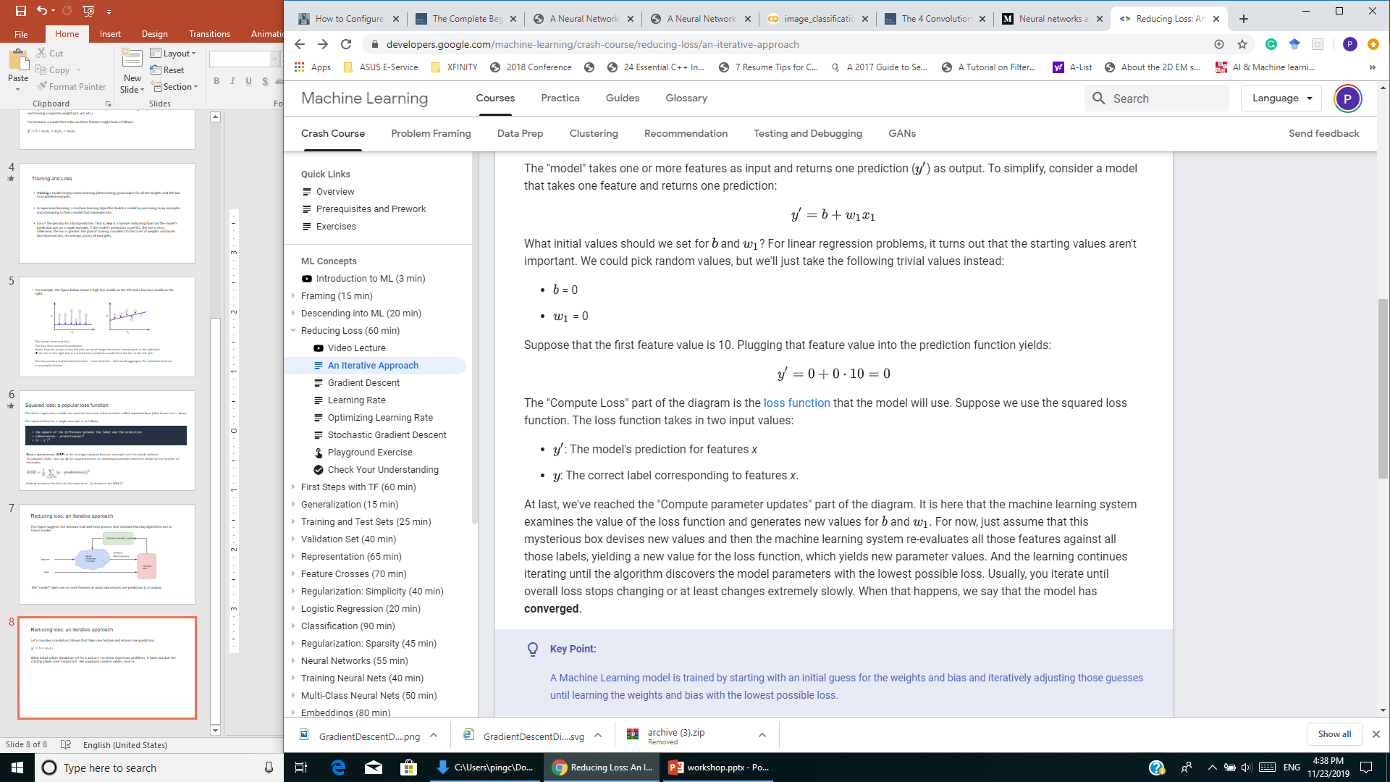
Reducing loss: an iterative approach
Let’s consider a model just shown that takes one feature and returns one prediction:
What initial values should we set for b and w₁? For linear regression problems, it turns out that the starting values aren't important. We could pick random values, such as:
Assume that the first feature value is 10; plugging that feature value into the prediction function yields:
The "Compute Loss" part of the diagram is the loss function that the model will use

Slide 11
Reducing loss: an iterative approach
Suppose we use the squared loss function. The loss function takes in two input values:
y′: The model's prediction for features x
y: The correct label corresponding to features x
The machine learning system examines the value of the loss function and generates new values for b and w₁
Then the machine learning system re-evaluates all those features against all those labels, yielding a new value for the loss function, which yields new parameter values. And the learning continues iterating until the algorithm discovers the model parameters with the lowest possible loss.
Usually, it iterates until overall loss stops changing or at least changes extremely slowly. → the model has converged.

Slide 12
A simple numerical example
Build a model to predict the output column given the three input columns
 | input |  | Output
0 | 0 | 1 | 0
1 | 1 | 1 | 0
1 | 0 | 1 | 1
0 | 1 | 0 | 1
As shown previously, a model that relies on three features might look as follows:

Slide 13
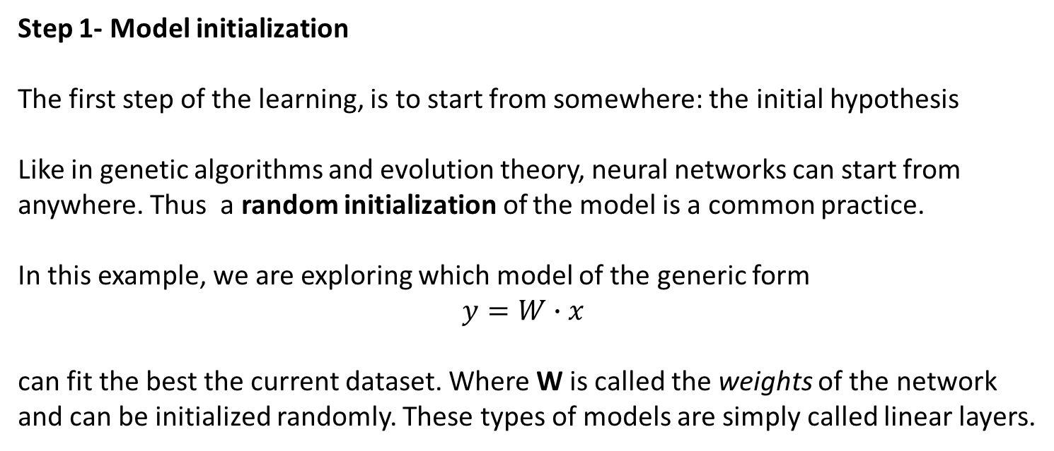
Step 1- Model initialization
The first step of the learning, is to start from somewhere: the initial hypothesis
Like in genetic algorithms and evolution theory, neural networks can start from anywhere. Thus a random initialization of the model is a common practice.
In this example, we are exploring which model of the generic form
$$y=W∙x$$
can fit the best the current dataset. Where W is called the weights of the network and can be initialized randomly. These types of models are simply called linear layers.

Slide 14
On Colab Jupyter Notebook, move your cursor (or use ‘Down’ arrow button on your keyboard) to the cell containing
Press Shift + Enter to execute the cell
import numpy as np
# input dataset
X = np.array([ [0,0,1],
[0,1,1],
[1,0,1],
[1,1,1] ])
# output dataset
y = np.array([[0,1,1,0]]).T
# seed random numbers to make calculation deterministic (just a good practice)
np.random.seed(1)
# initialize weights randomly with mean 0
W0 = 2*np.random.random((3,1)) - 1
print('X = \n {} \n y =\n {}'.format(X, y))
print('init weights = \n {}'.format(W0))

Slide 15
Step 2- Forward propagation
The next natural step to do after initializing the model at random is to check its performance.
We start from the input we have, we pass them through the network layer and calculate the actual output of the model straightforwardly.
This step is called forward-propagation, because the calculation flow is going in the natural forward direction from the input -> through the neural network -> to the output.
What is the dimension of l1
hint:
# forward propagation
l0 = X # layer 0 (input layer)
l1 = np.dot(l0,W0) # layer 1 (output layer)
print(l1.shape)

Slide 16
Step 3- Calculate loss value via the loss function
Right now, in one hand, we have the actual output of our randomly initialized neural network. On the other hand, we have the desired output we would like the network to learn.
Let’s put them both in the same table.
In order to be able to generalize to any problem, we define what we call: loss function. Basically it is a performance metric on how well the neural network manages to reach its goal of generating outputs as close as possible to the desired values.
The most intuitive loss function is simply loss = (Desired output — actual output). However, if we want the loss function to reflect an absolute error on the performance regardless weather it’s overshooting or undershooting we can define it as:
loss = Absolute value of (desired — actual ).
input | predicted output | desired output (labels)
(0, 0, 1) | -0.99977125 | 0
(1, 1, 1) | -0.55912226 | 0
(1, 0, 1) | -1.16572724 | 1
(0, 1, 0) | -0.72507825 | 1

Slide 17
Several situations can lead to the same total sum of errors.
For instance, lot of small errors or few big errors can sum up exactly to the same total amount of error.
Since we would like the prediction to work under any situation, it is more preferable to have a distribution of lot of small errors, rather than a few big ones.
To encourage the neural network to converge to such situation, we can define the loss function to be the sum of squares of the absolute errors (which is one of the most famous loss functions in neural networks). This way, small errors are counted much less than large errors!
What we care about, is to minimize the overall error over the whole dataset (total of the sum of the squares of the errors!).
We can now just transform our problem now to an optimization process that aims to minimize this loss function.

Slide 18
Step 4- Differentiation
Obviously we can use any optimization technique that modifies the internal weights of neural networks in order to minimize the total loss function that we previously defined.
In mathematics differentiation can guide us how to optimize the weights called.
Basically it deals with the derivative of the loss function. the derivative of a function at a certain point gives the rate or the speed of which this function is changing its values at this point.
The learning process is actually saying this:
Let’s check the derivative.
If it is positive, meaning the error increases if we increase the weights, then we should decrease the weight.
If it’s negative, meaning the error decreases if we increase the weights, then we should increase the weight.
If it’s 0, we do nothing, we reach our stable point.

Slide 19
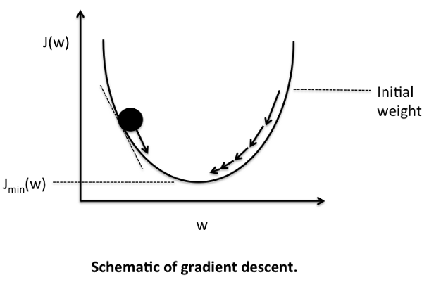

Slide 20
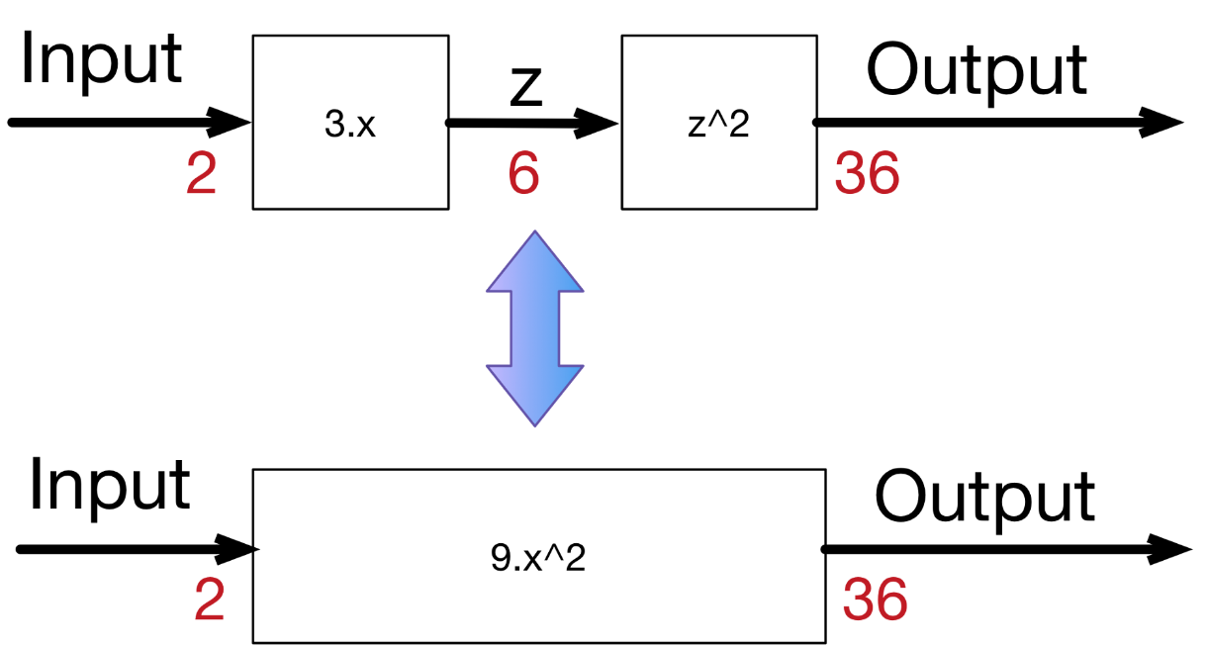

Step 5- Back propagation
In many cases, more layers are needed to reach more variations in the functionality of the neural network. Certainly we can always create one complicated function that represent the composition over the whole layers of the network.
For example, if layer 1 is doing: $3∙x$ to generate a hidden output $z$, and layer 2 is doing: $z²$ to generate the final output, the composed network will be doing $(3∙x)² = 9∙x²$

Slide 21
However, in most cases composing the functions is very hard.
In addition, for every composition one has to calculate the dedicated derivative of the composition (which is not at all scalable and very error prone).
Because derivative is decomposable, we can use back-propagation to solve the problem.
We have the starting point of errors, which is the loss function, and we know how to calculate its derivative. If we know how to calculate the derivative of each function from the composition, we can propagate back the error from the end to the start.

Slide 22
Let’s consider the simple linear example: where we multiply the input 3 times to get a hidden layer, then we multiply the hidden (middle layer) 2 times to get the output.
input -> 3.x -> 2.x -> output.
A 0.001 delta change on the input, will be translated to a 0.003 delta change after the first layer, then to 0.006 delta change on the output, which is the case if we compose both functions into one:
input -> 6.x -> output.
Similarly an error on the output of 0.006, can be back-propagated to an error of 0.003 in the middle hidden stage, then to 0.001 on the input.
If we create a library of differentiable functions or layers where for each function we know how to forward-propagate (by directly applying the function) and how to back-propagate (by calculating the derivative of the function), we can compose any complex neural network. We only need to keep a stack of the function calls during the forward pass and their parameters, in order to know the way back to back-propagate the errors using the derivatives of these functions.

Slide 23
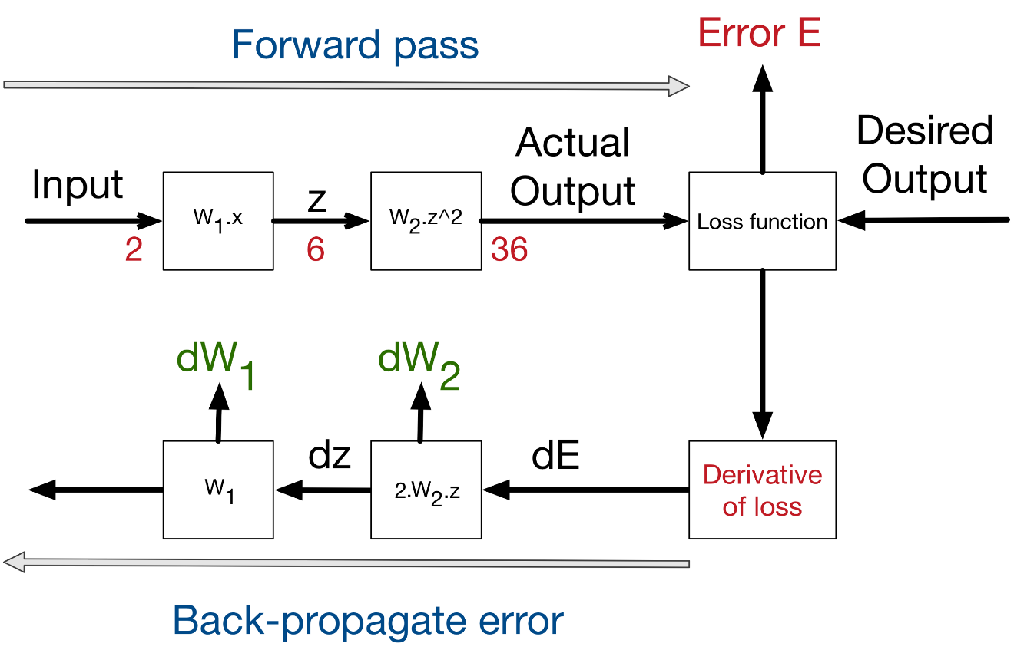
In neural network, any layer can forward its results to many other layers, in this case, in order to do back-propagation, we sum the deltas coming from all the target layers. Thus our linear calculation stack can become a complex calculation graph.
The process of back-propagating errors follows this schemas:
Input -> Forward calls -> Loss function -> derivative -> back-propagation of errors.

Slide 24
Image Classification
The problem of Image Classification goes like this: Given a set of images that are all labeled with a single category, we are asked to predict these categories for a novel set of test images and measure the accuracy of the predictions.
There are a variety of challenges associated with this task, including viewpoint variation, scale variation, intra-class variation, image deformation, image occlusion, illumination conditions, background clutter etc.
How might we go about writing an algorithm that can classify images into distinct categories? Computer Vision researchers have come up with a data-driven approach to solve this. Instead of trying to specify what every one of the image categories of interest look like directly in code, they provide the computer with many examples of each image class and then develop learning algorithms that look at these examples and learn about the visual appearance of each class.
In other words, they first accumulate a training dataset of labeled images, then feed it to the computer in order for it to get familiar with the data.

Slide 25
Given that fact, the complete image classification pipeline can be formalized as follows:
Our input is a training dataset that consists of N images, each labeled with one of K different classes.
Then, we use this training set to train a classifier to learn what every one of the classes looks like.
In the end, we evaluate the quality of the classifier by asking it to predict labels for a new set of images that it has never seen before. We will then compare the true labels of these images to the ones predicted by the classifier.

Slide 26
Convolutional Neural Networks
Convolutional Neural Networks (CNNs) is the most popular neural network model being used for image classification problem.
The big idea behind CNNs is that a local understanding of an image is good enough. The practical benefit is that having fewer parameters greatly improves the time it takes to learn as well as reduces the amount of data required to train the model.
Instead of a fully connected network of weights from each pixel, a CNN has just enough weights to look at a small patch of the image. It’s like reading a book by using a magnifying glass; eventually, you read the whole page, but you look at only a small patch of the page at any given time.

Slide 27
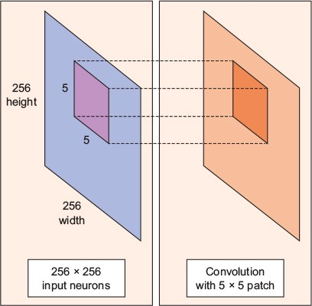
Consider a 256 x 256 image. CNN can efficiently scan it chunk by chunk — say, a 5 × 5 window. The 5 × 5 window slides along the image (usually left to right, and top to bottom), as shown above.
How “quickly” it slides is called its stride length. For example, a stride length of 2 means the 5 × 5 sliding window moves by 2 pixels at a time until it spans the entire image.
A convolution is a weighted sum of the pixel values of the image, as the window slides across the whole image. Turns out, this convolution process throughout an image with a weight matrix produces another image (of the same size, depending on the convention). Convolving is the process of applying a convolution.

Slide 28
A typical CNN has multiple convolution layers. Each convolutional layer typically generates many alternate convolutions, so the weight matrix is a tensor of 5 × 5 × n, where n is the number of convolutions.
As an example, let’s say an image goes through a convolution layer on a weight matrix of 5 × 5 × 64. It generates 64 convolutions by sliding a 5 × 5 window. Therefore, this model has 5 × 5 × 64 (= 1,600) parameters, which is remarkably fewer parameters than a fully connected network, 256 × 256 (= 65,536).

Slide 29
The beauty of the CNN is that the number of parameters is independent of the size of the original image. You can run the same CNN on a 300 × 300 image, and the number of parameters won’t change in the convolution layer.

Slide 30
Data Augmentation
Data augmentation is often used in order to improve generalization properties. Typically, random cropping of rescaled images together with random horizontal ﬂipping and random RGB color and brightness shifts are used.
Different schemes exist for rescaling and cropping the images (i.e. single scale vs. multi scale training). Multi-crop evaluation during test time is also often used, although computationally more expensive and with limited performance improvement.
Note that the goal of the random rescaling and cropping is to learn the important features of each object at different scales and positions.

Slide 31
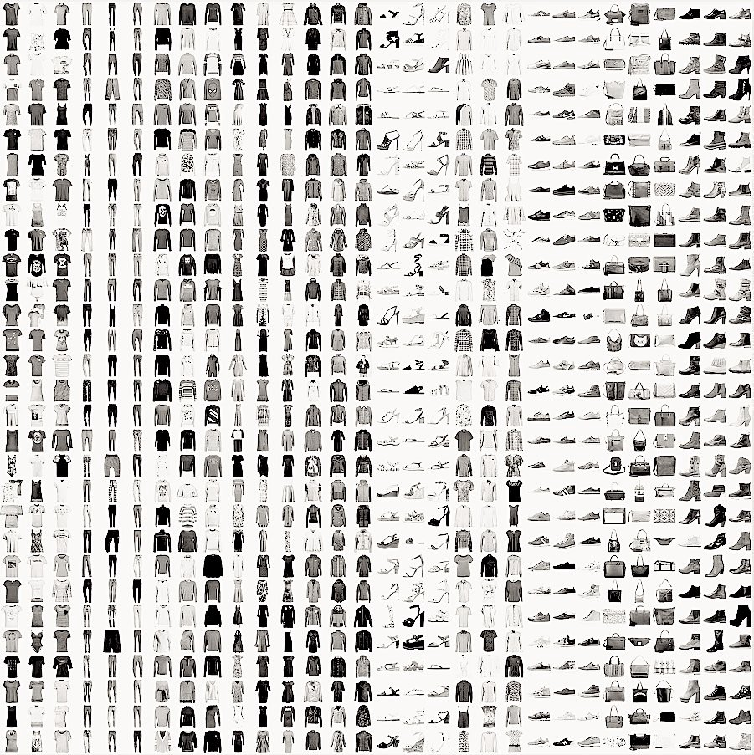
Fashion MNIST Dataset

Slide 32
Training CNN Models on Fashion MNIST
For all the models (except for the pre-trained one), here is the approach:
Split the original training data (60,000 images) into 80% training (48,000 images) and 20% validation (12000 images) optimize the classifier, while keeping the test data (10,000 images) to finally evaluate the accuracy of the model on the data it has never seen.
This helps to see whether we are over-fitting on the training data and whether we should lower the learning rate and train for more epochs if validation accuracy is higher than training accuracy or stop over-training if training accuracy shift higher than the validation.
Train the model for 10 epochs with batch size of 256, compiled with categorical crossentropy loss function and Adam optimizer.
Then, add data augmentation, which generates new training samples by rotating, shifting and zooming on the training samples, and train the model on updated data for another 50 epochs.

Slide 33
https://medium.com/datathings/neural-networks-and-backpropagation-explained-in-a-simple-way-f540a3611f5e
https://iamtrask.github.io/2015/07/12/basic-python-network/
https://towardsdatascience.com/the-4-convolutional-neural-network-models-that-can-classify-your-fashion-images-9fe7f3e5399d

