Slide 1
Introduction to translating between Python and R
RCC virtual workshop
March 9, 2021

Slide 2
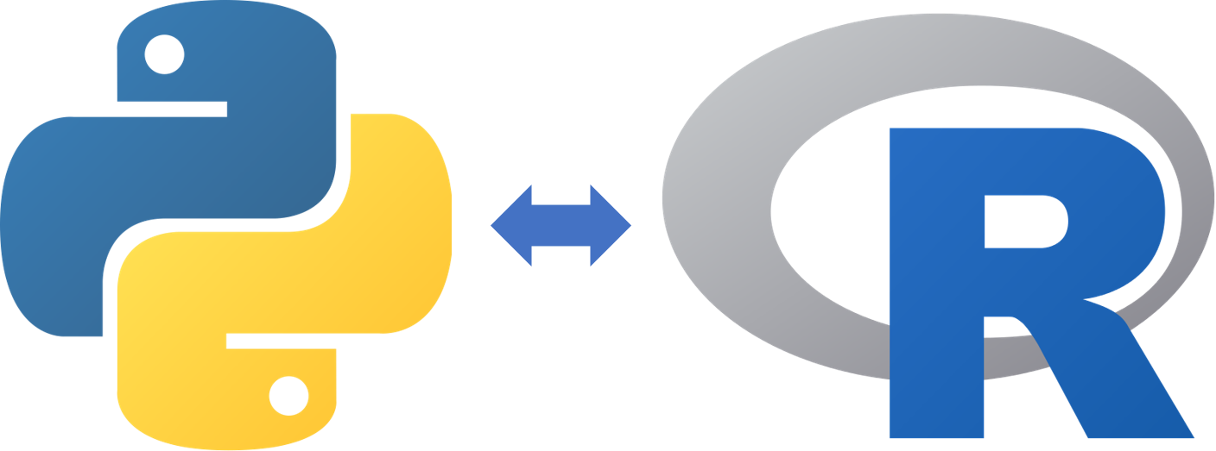

Slide 3
When you learn a second programming language, you have the benefit of translating concepts from the language you know to the new language to learn more efficiently and quickly.
This workshop will guide participants to connect R and Python for easy translation between the two.

Slide 4
KEY DIFFERENCES:
R is mainly used for statistical analysis while Python provides a more general approach to data science
The primary objective of R is Data analysis and Statistics whereas the primary objective of Python is Deployment and Production
R users mainly consists of Scholars and R&D professionals while Python users are mostly Programmers and Developers
R provides flexibility to use available libraries whereas Python provides flexibility to construct new models from scratch
R is difficult to learn at the beginning while Python is Linear and smooth to learn
R is integrated to Run locally while Python is well-integrated with apps
Both R and Python can handle huge size of database
R can be used on the R Studio IDE while Python can be used on Spyder and Ipython Notebook IDEs
R consists various packages and libraries like tidyverse, ggplot2, caret, zoo whereas Python consists packages and libraries like pandas, scipy, scikit-learn, TensorFlow, caret

Slide 5
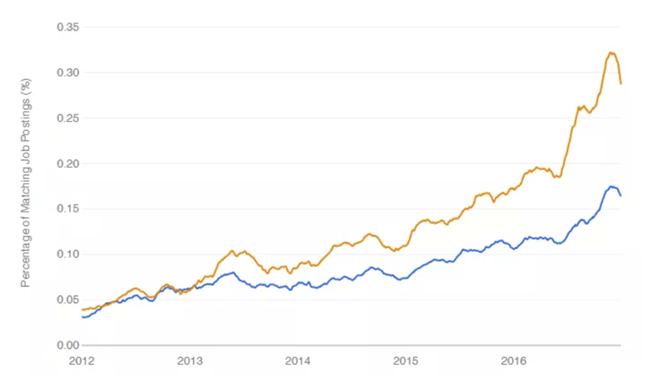
Job Opportunity

Slide 6
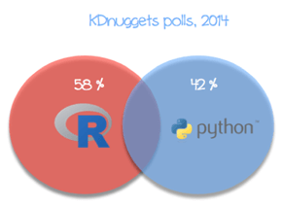
Analysis done by R and Python

Slide 7
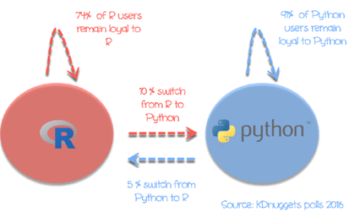
Percentage of people switching

Slide 8
R or Python Usage
There are infinite parallels between Python and R and with both languages at your disposal, you can solve challenges in the best way possible rather than the limiting yourself to half of the tool shed.
Below is a simple guide to connecting R and Python for easy translation between the two.

Slide 9
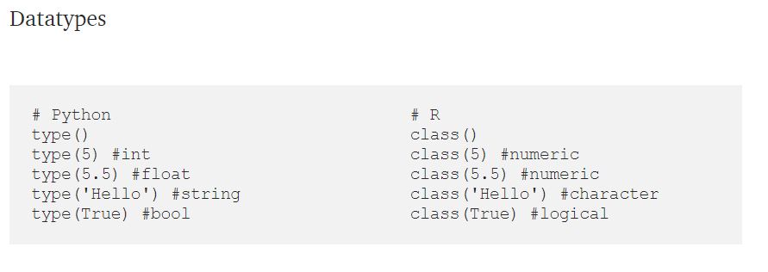
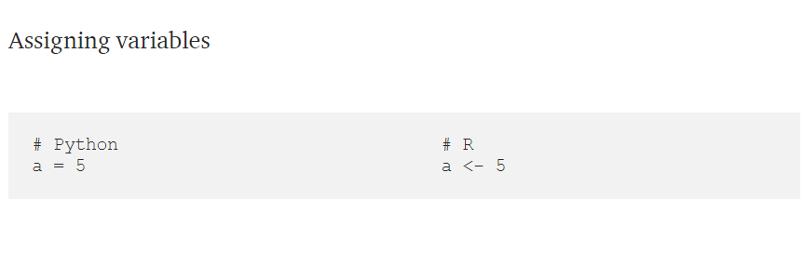
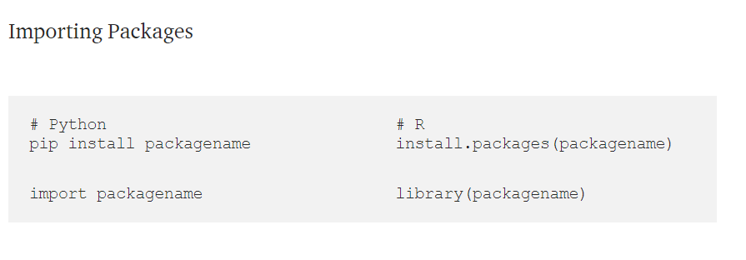
The Basics

Slide 10
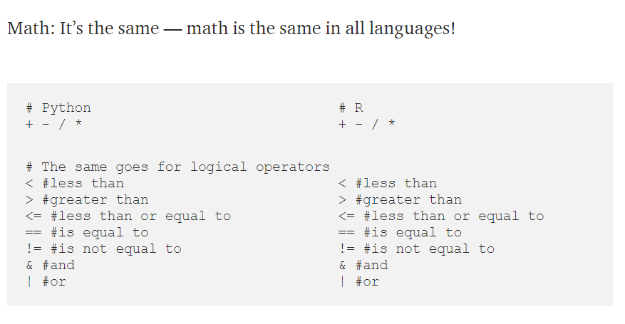
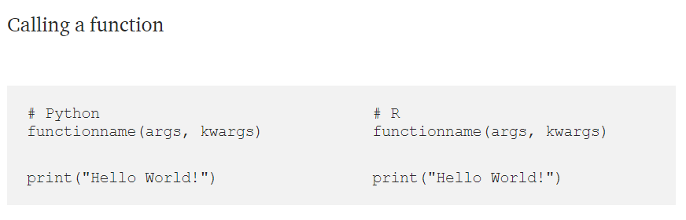
The Basics

Slide 11
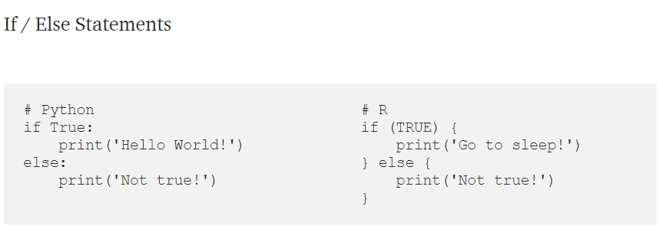
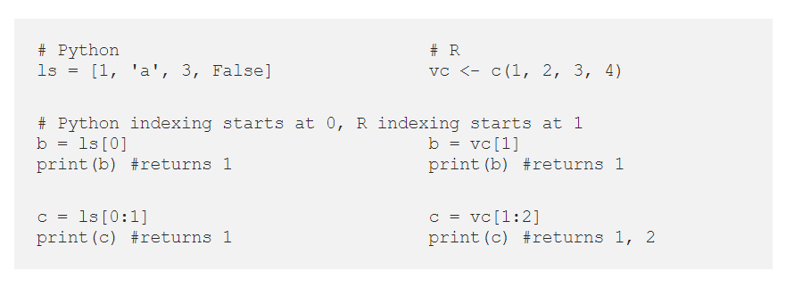
The Basics
Lists and Vectors

Slide 12
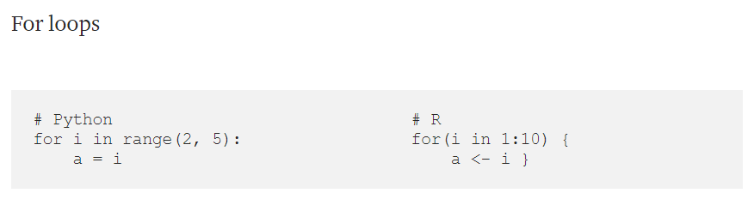
The Basics

Slide 13
Data Manipulation
Both languages are equipped with packages that enable loading, cleaning, and processing of data frames.
In python, pandas is the most common library used for loading and manipulating data frames using the DataFrame object.
In R, tidyverse is a similar library that enables simple data frame manipulation using the data.frame object.

Slide 14
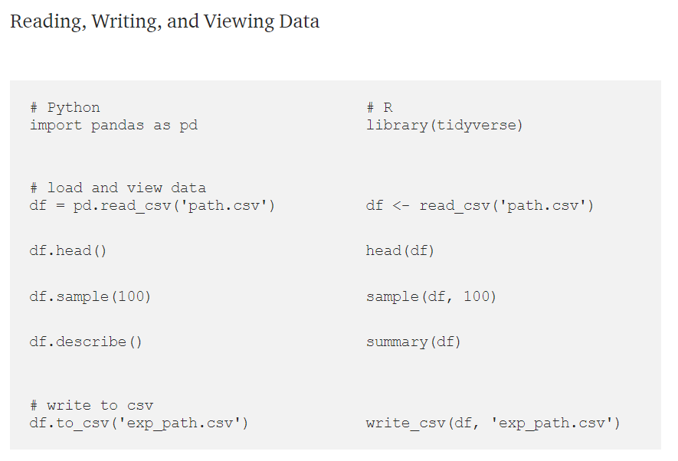
Data Manipulation

Slide 15
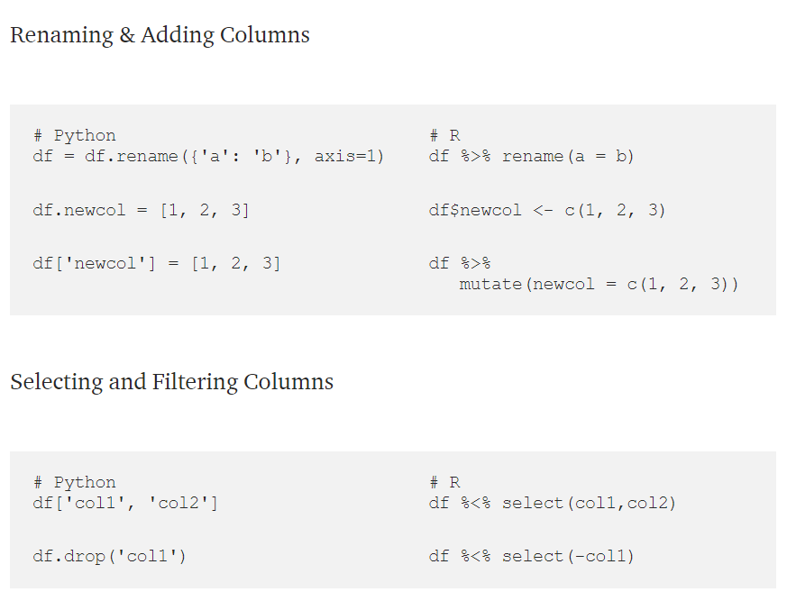
Data Manipulation

Slide 16
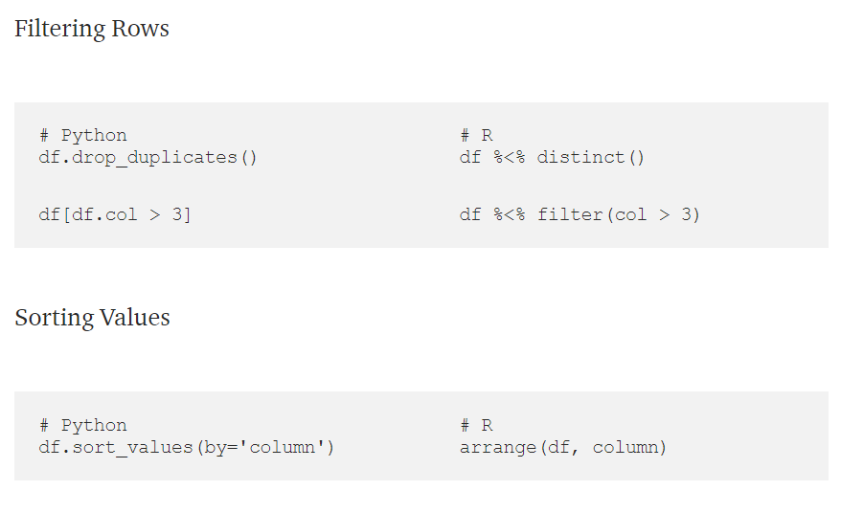
Data Manipulation

Slide 17
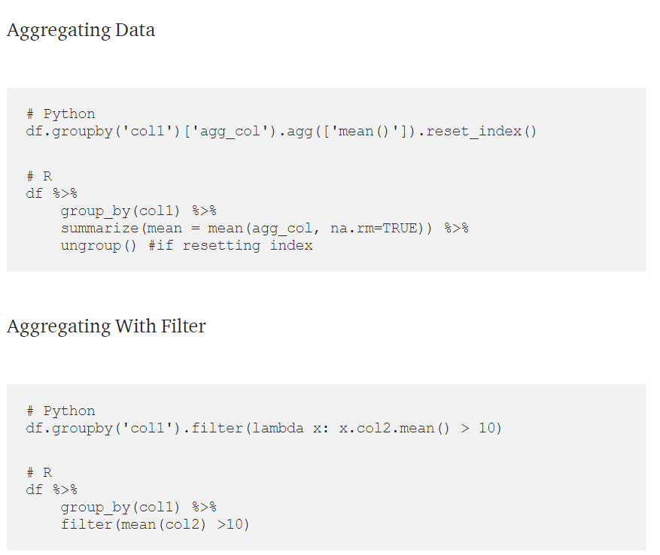
Data Manipulation

Slide 18
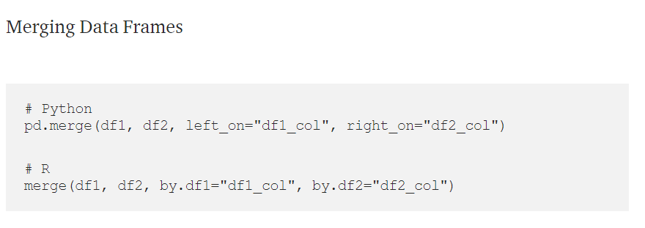
Data Manipulation

Slide 19
Exercise of online translating a given R script into Python and vice versa
You can use any IDE you prefer; otherwise, if you do not have either a python IDE or an R IDE, you are welcome to use the online IDE with the link:
https://www.codabrainy.com/en/python-compiler/ for python3
https://rstudio.cloud for R (you have to sign up and verify your email address before accessing a new project)

Slide 20
Executing R from Python and vice versa
While in Python we use rpy2 to use R (check out this post for more info), in R we have the reticulate package to use Python.
Other references:
https://code.likeagirl.io/walking-the-python-r-bridge-66b63bab0fbd
https://blog.rstudio.com/2020/08/13/how-to-deliver-maximum-value-using-r-python
https://rstudio.github.io/reticulate/
https://blog.dataiku.com/introducing-polyamor-the-two-way-translator-between-python-and-r

