Slide 1

Parallelization in time – a new dimension to exploit in supercomputing
Debasmita Samaddar, RCC, University of Chicago
Dec 6, 2022

Slide 2
“Take Home Message”
Complex nonlinear simulations at long timescales is computationally intensive.
  Need methods to speed up.
Space and other existing parallelization methods – not enough to achieve Exascale computational goals.
Parareal algorithm parallelizes time domain - is an innovative technique that may be applied for parallelization to achieve computational speedup.
‘Parallel in time’ works for complex non-linear problems.

Slide 3
Outline
Motivation
A little background
A Hands-on session
Behind the scenes analysis
Some cool examples (if time permits)

Slide 4
Motivation

Slide 5
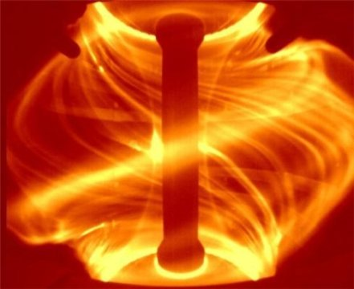
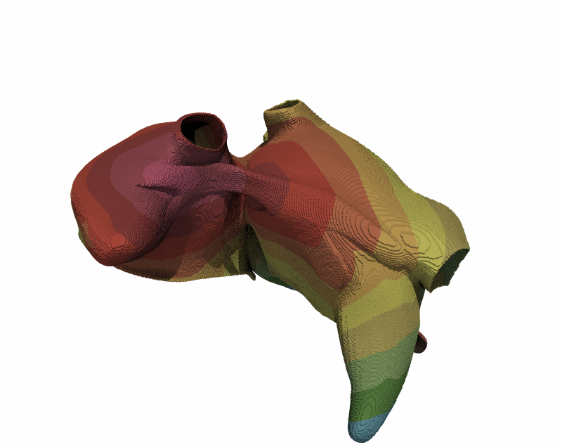
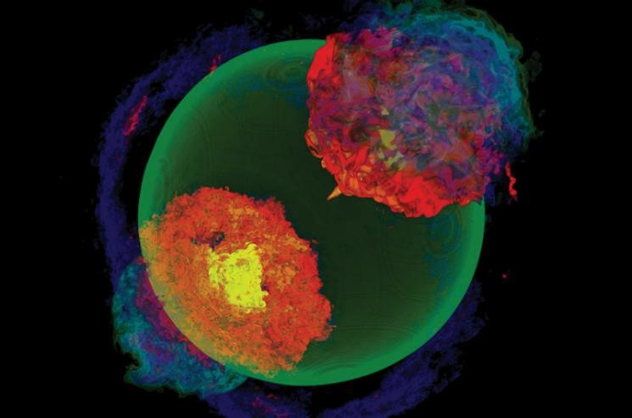
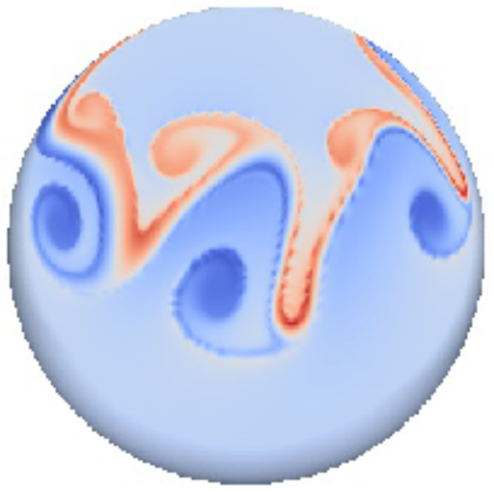
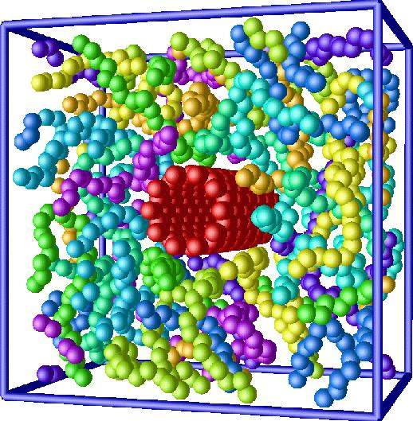
Supercomputing – how important is it?
Ref: CCFE
Fusion
Ref: DOE
Medicine
Astrophysics
Ref: R. Krause
Material Science
Ref: J. Shipton
Ref: NIST
Weather & Climate
… and many more

Slide 6
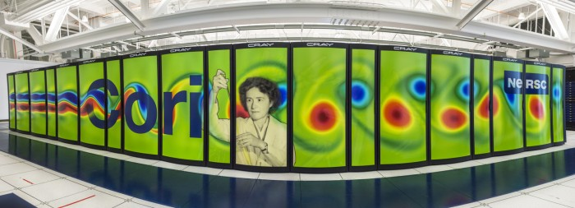
Petascale to Exascale – are we ready?
Exascale machines: More than millions of cores per supercomputer!

Slide 7
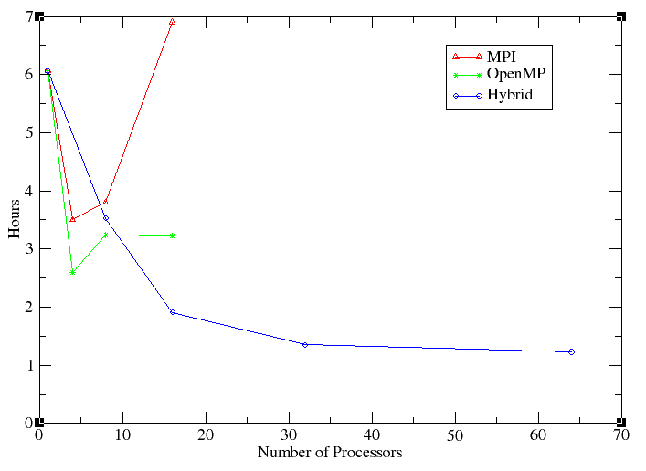
Most of our codes don’t fully utilize current resources
Original spectral code - serial. Enhanced speed up to some extent with parallelization using MPI, openMP, hybrid, but faced saturation.
Time parallelization may be the next option...

Slide 8
What is time parallelization ?

Slide 9
Parallelize time
F is a propagator evolving the function (energy(t)) from initial time, t0, to a later time ...
Actual
energy (t)
t0
t1
t2
t3
t4
t5
t6
Time

Slide 10
Parallelize time – solve multiple time slices simultaneously
F is a propagator evolving the function (energy(t)) from initial time, t₀, to a later time ...
Actual
energy (t)
t0
}
t1
}
t2
}
t3
}
t4
}
t5
}
t6
P0
P1
P2
Time
P3
P4
P5

Slide 11
Various algorithms exist for this purpose
RIDC
Parareal
PFASST

Slide 12
Various algorithms exist for this purpose
RIDC
Parareal
PFASST
Use a predictor-corrector technique

Slide 13
Various algorithms exist for this purpose
RIDC
Parareal
PFASST
Use a predictor-corrector technique

Slide 14
Overview of the
Parareal Algorithm ...

Slide 15

F is a propagator evolving the state, λ. The function, energy(λ,t) thus changes from initial time, t0,to a later time ...
Actual
energy (t)
t0
}
t1
}
t2
}
t3
}
t4
}
t5
}
t6
P0
P1
P2
Time
P3
P4
P5

Slide 16
F is a propagator evolving the state, λ. The function, energy(λ,t) thus changes from initial time, t0,to a later time ...
G - faster but inaccurate propagator
Actual
1st G
energy (t)
t0
}
t1
}
t2
}
t3
}
t4
}
t5
}
t6
P0
P1
P2
Time
P3
P4
P5

Slide 17
F is a propagator evolving the state, λ. The function, energy(λ,t) thus changes from initial time, t0,to a later time ...
G - faster but inaccurate propagator
Actual
1st G
1st F
energy (t)
t0
}
t1
}
t2
}
t3
}
t4
}
t5
}
t6
P0
P1
P2
Time
P3
P4
P5

Slide 18

F is a propagator evolving the state, λ. The function, energy(λ,t) thus changes from initial time, t0,to a later time ... G - faster but inaccurate propagator. Solvers G & F alternate.
Actual
1st G
1st F
2nd G
energy (t)
t0
}
t1
}
t2
}
t3
}
t4
}
t5
}
t6
P0
P1
P2
Time
P3
P4
P5
New G
Old G

Slide 19
F is a propagator evolving the function (energy(t))
from initial time, t0, to a later time ...
G - faster but inaccurate propagator
Solvers G & F alternate
Actual
1st G
1st F
2nd G
2nd F
3rd G
3rd F
energy (t)
t0
}
t1
}
t2
}
t3
}
t4
}
t5
}
t6
P0
P1
P2
Time
P3
P4
P5
New G
Old G

Slide 20
Success of Algorithm Depends on Multiple Factors
Algorithm always converges if k=N.
But, success in achieving significant speedup if k<<N
G is much cheaper than F.
“Good” G: Solutions
converge
“Bad” G: Solutions
diverge
No “fixed recipe” for G !
Despite solutions being very sensitive to initial conditions - it is possible to choose G.

Slide 21
Selecting Optimum Coarse Solver is Important
Different approaches can/should be explored to find G. Any one of them, or a combination of them, may work :
Some of the physics may be ignored when solving with G, to achieve speedup.
G can be same as F, but may be solved over a coarser k-mesh (or spatial grid).
G may be same as F, but may be solved with a larger timestep (dt) and less accuracy.
Use a different G.

Slide 22
Let’s try out a hands on exercise!

