Slide 1
Modification to the algorithm ...

Slide 2
A Modiﬁcation to the Algorithm
In standard parareal algorithm, at the k^{th} iteration, the sequential solver, G is started from processor Pk . However, if the algorithm is working successfully, n processors have attained convergence at the k^{th} iteration, where n > k. We have used this characteristic to improve the algorithm.
We replaced Pk by Pn as the starting point for G and all subsequent calculations at iteration k. This change led to a quicker convergence of the entire time series.

Slide 3


F is a propagator evolving the function (energy(t))
from initial time, t0, to a later time ...
G - faster but inaccurate propagator
Solvers G & F alternate
Actual
1st G
1st F
2nd G
2nd F
3rd G
3rd F
energy (t)
t0
}
t1
}
t2
}
t3
}
t4
}
t5
}
t6
P0
P1
P2
Time
P3
P4
P5
New G
Old G

Slide 4
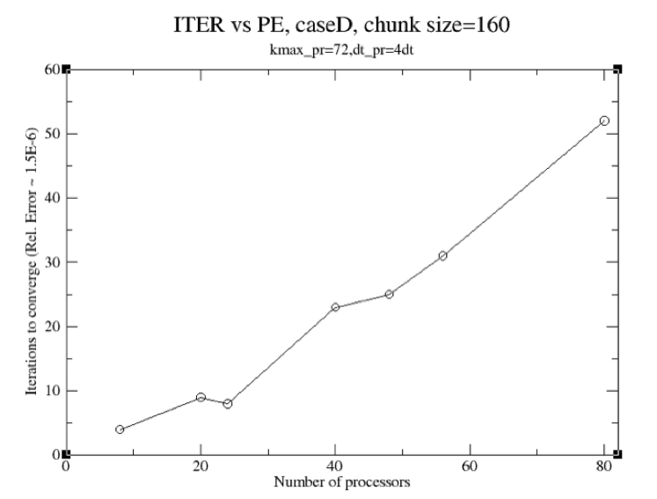
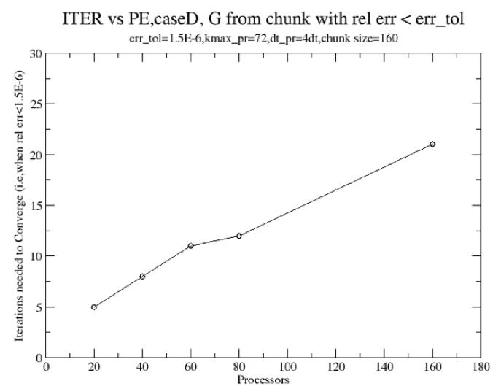
Modification to the Algorithm significantly reduces the Number of Iterations needed for Convergence
For a fixed chunk size=160, convergence occurs at 22 iterations for 160 processors with the modification to the scheme.
With the unmodified version, for the same chunk size with 80 processors, 53 iterations were required for convergence!

Slide 5
Parareal Algorithm
Using the IPS Framework

Slide 6
Advantages of using the IPS Framework
portable parareal framework (L.Berry, W. Elwasif, ORNL) –written in python.
exploring multiple cases with relative ease.
hybrid parallelization (space + time).
Less focus on numerics of parareal scheme.
Prime focus on coarse solver.
Reuse of processors already having attained convergence.

Slide 7
Event driven scheme – multiple processes assigned a new task once a task or ‘event’ is complete
Actual
1st G
1st F
2nd G
2nd F
3rd G
3rd F
energy (t)
t0
}
t1
}
t2
}
t3
}
t4
}
t5
}
t6
P0
P1
P2
Time
P3
P4
P5

Slide 8
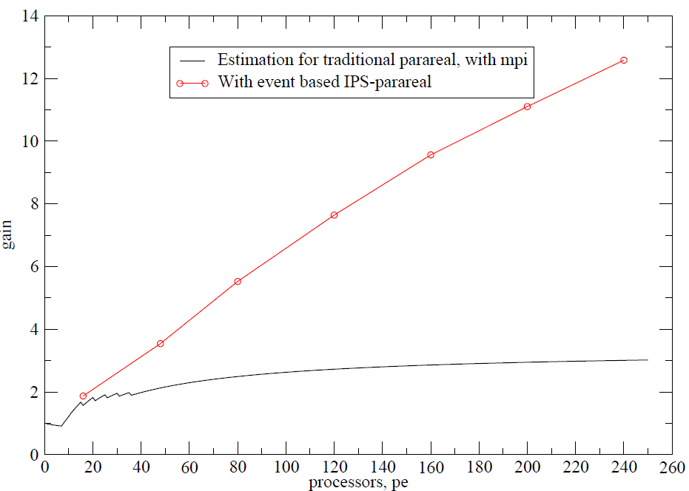



Event based implementation greatly enhances performance
Case: “G with no Eirene”.
Gain estimate for traditional parareal using MPI:
Using IPS-parareal is way better than traditional MPI implementation!

Slide 9
Event driven parareal performs better than standard parareal
Advanced Computing Talk

Slide 10
Application of the
Parareal Algorithm to Turbulence...

Slide 11

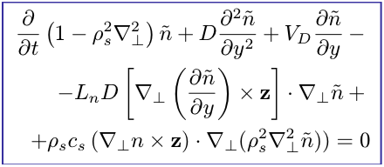
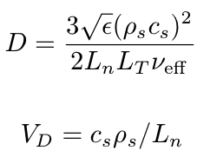
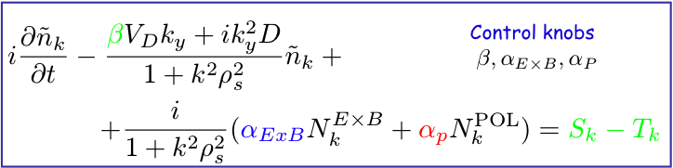
Two-nonlinearity Model for DTEM
Evolution solved by spectral code in kx, ky space, often of size 385 x 385:
to which sources Tk (in k space) and sinks Sk may be added

Slide 12
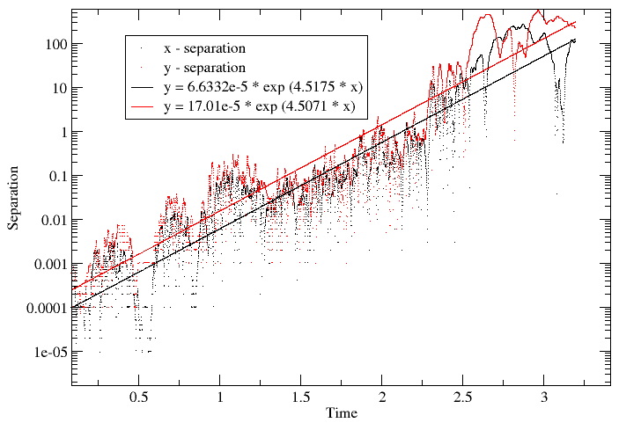
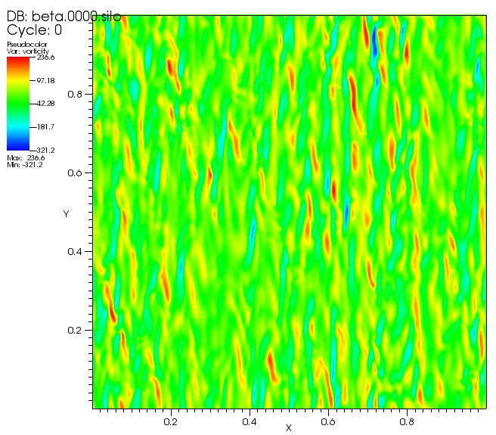
A System of fully developed plasma turbulence
296450 non-linearly coupled equations hence, the turbulent system is much more complex
Has positive Lyapunov exponent
Vorticity in turbulent system with polarization non linearity

Slide 13
Reducing the Grid Size in K-space speeds G.
Grid for F
Grid for G
Ky
Kx
Since most energy is concentrated at core,
only the core portion of the grid used in F was used in G. But, core should be big enough to include dissipation scales.
Also, reduced grid allows larger dt for simulations.

Slide 14
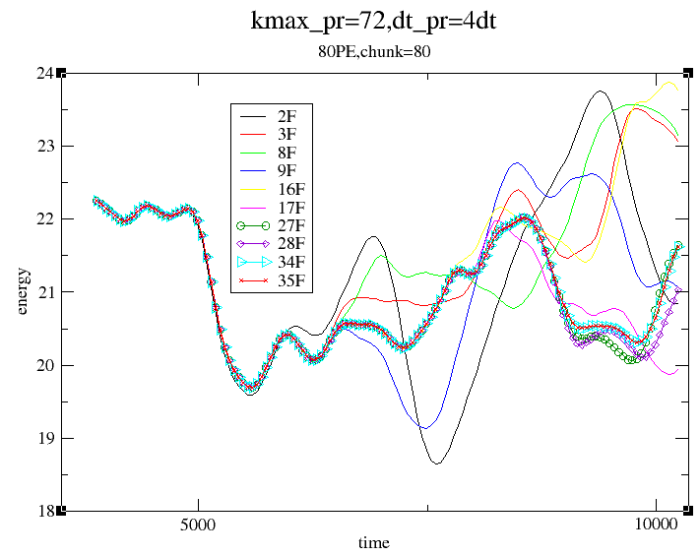
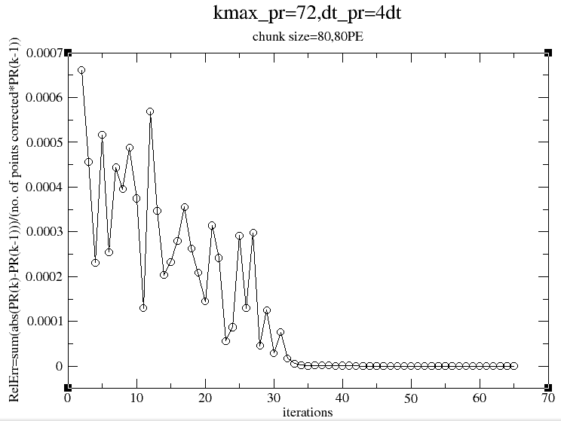
Convergence is found with reduced k-space & larger dt in G
Turbulent system with E X B non linearity
Convergence at 34 iterations for 80 processors.
The error falls off with iterations.
Total energy of the system is used for convergence measurement.

Slide 15
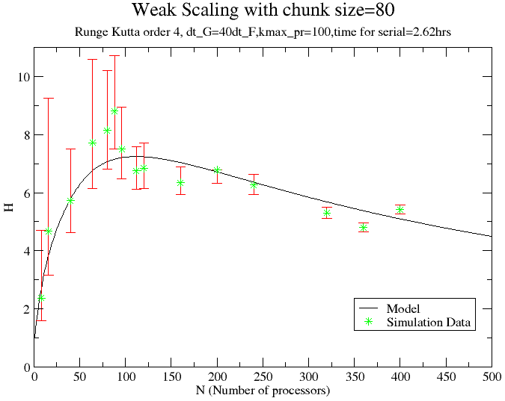
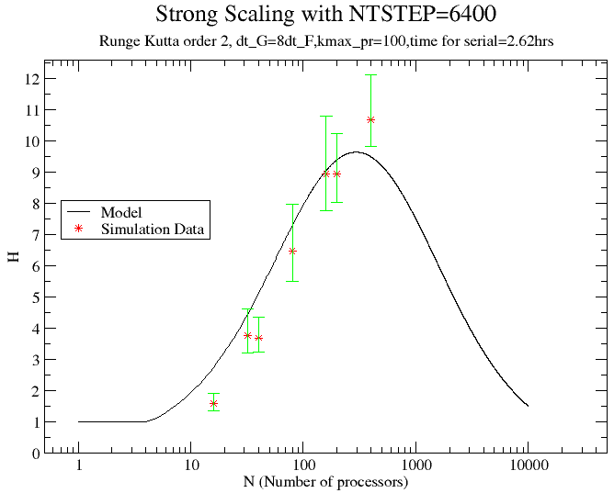
Weak & Strong Scaling : Using Runge-Kutta solver in G with reduced grid greatly enhances the gain, H
H = Tser / T_{PA}
Weak scaling: H=8.805 with 88 processors.
Strong scaling: H=10.69 with 400 processors.

