Slide 1
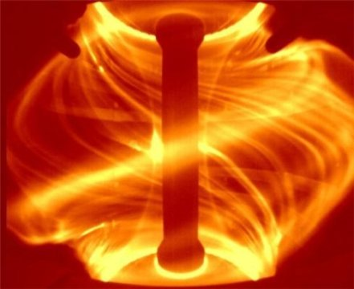
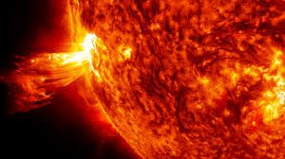
Edge Localized modes (ELMs) are observed in tokamaks
Ref: NASA
ELMs are akin to solar flares.
Ref: CCFE
Uncontrolled ELMs can damage plasma facing components of the machine.

Slide 2
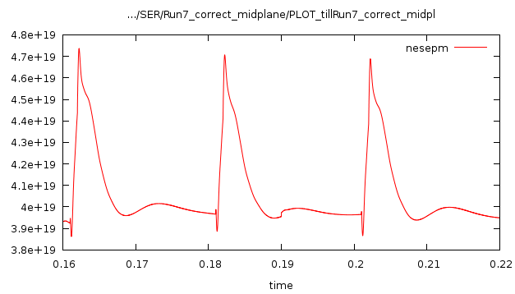
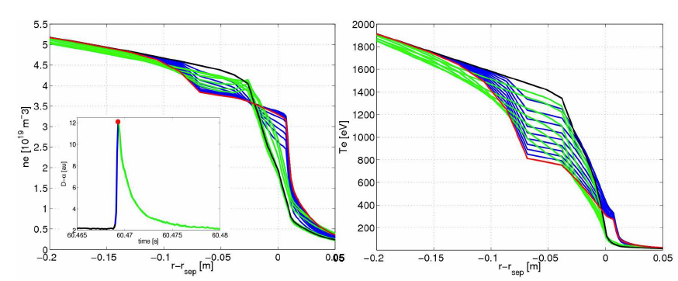
ITER Plasma with ELMS
After multiple sets of 39 hrs computations…
Ref: GULEJOVÁ (PhD Thesis)

Slide 3
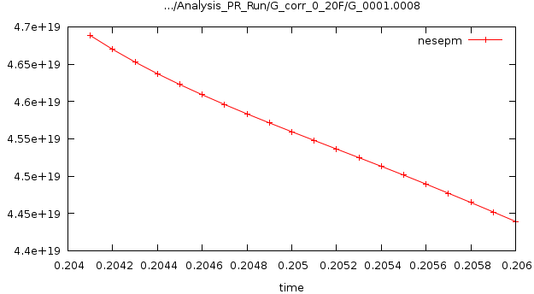
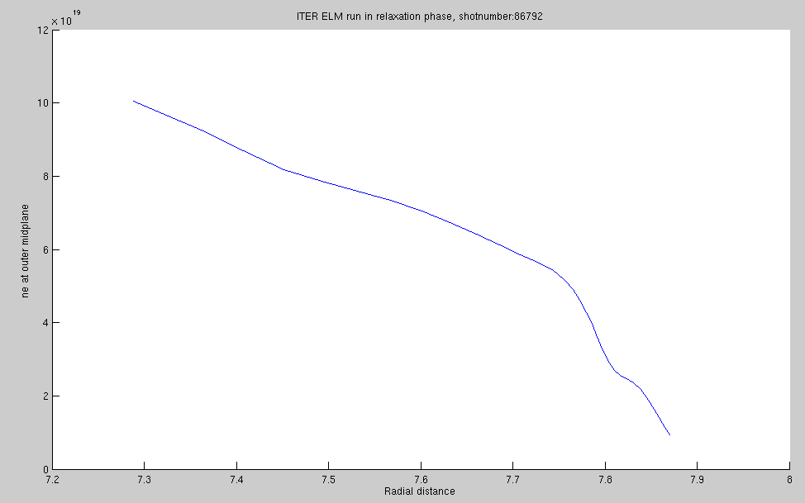
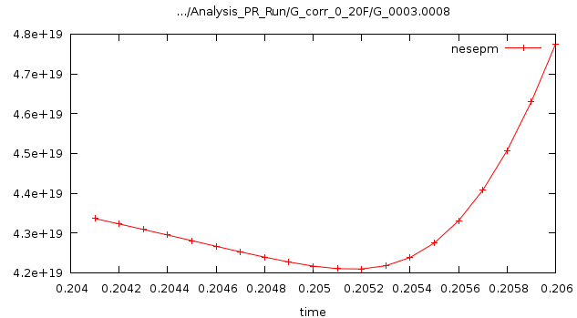
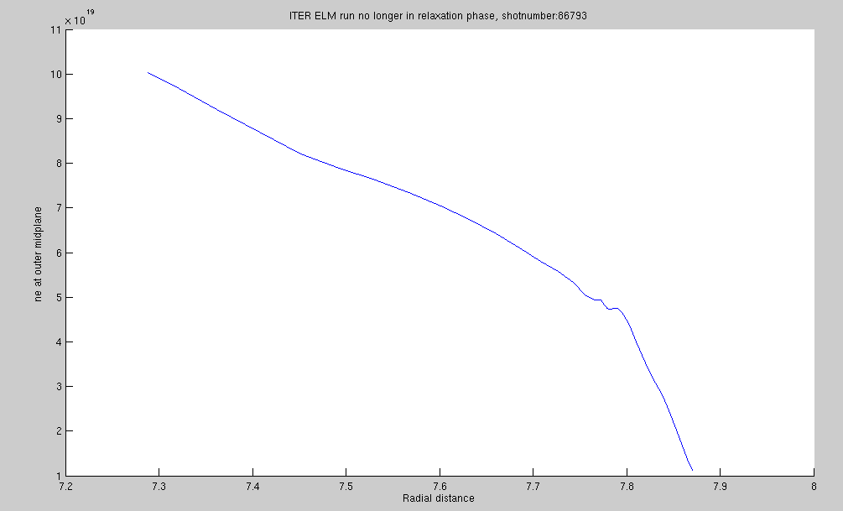
Restrictions in Parareal correction
Simple algebraic correction to individual cells in mesh can generate unwanted ELM rise.
So what options do we have for restricting parareal corrections?

Slide 4
Options for Parareal correction
Restrict correction at k^{th} iteration to x% of fine value from last parareal iteration, k-1.
x = 1, 5, 20, 40, 50 …
x = 1 seems to work best.
Price we may pay: Slower parareal convergence. But, computational gain can still be achieved.

Slide 5
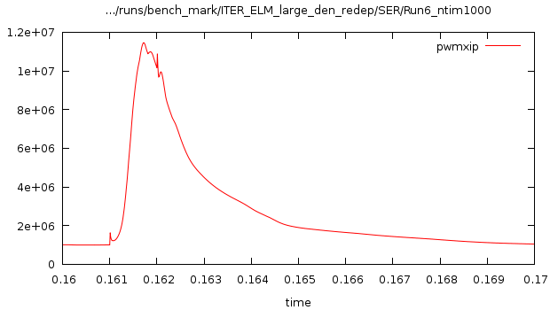
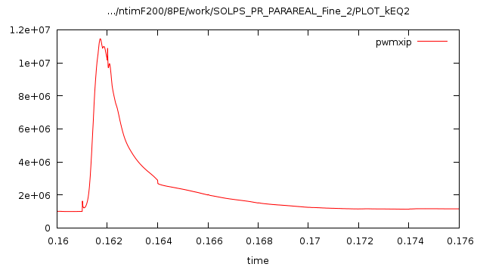
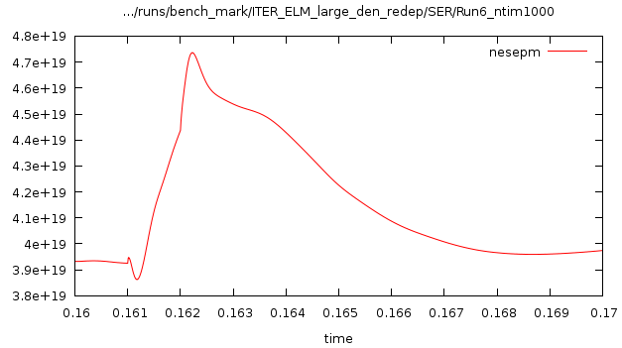
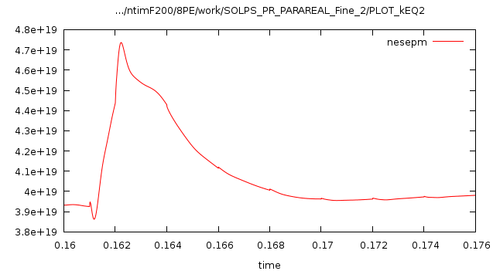
Parareal works with reduced grid in G (48X36)
Fine solution:
Parareal solution:
Fine run: Grid: 96X36
Coarse Run: Grid: 48X36
Dt_F=dt_G=1E-5
But, only for slice (ntim)=200 timesteps
Gain: 7.8 with 48 processors

