Slide 1

Exploring Geospatial Raster Images
RCC Workshop Aug 12, 2021
Parmanand Sinha

Slide 2
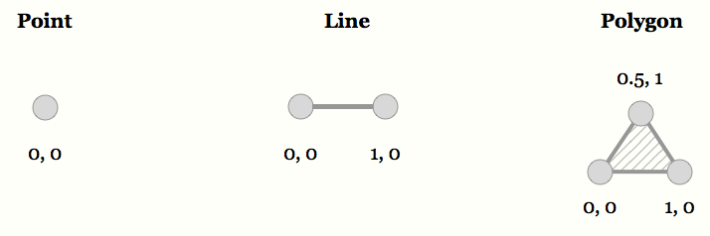
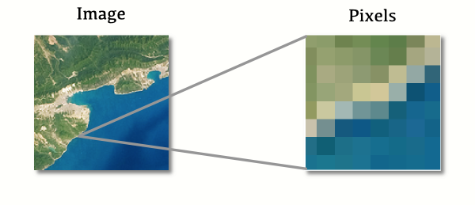
Content
Raster data models
Type of Sensors
Night at Light
GHSL, GUF, and Building Footprint
Gridded population

Slide 3
Raster Data Model
Study area is covered by grid
Conventionally, stored row by row from the top left corner
Equal sized cells
Cells are often called pixels
Attributes are recorded by assigning each cell a single
value
E.g., landuse type
Simple data structure
Directly store each layer as a single table
□ basically, each is analogous to a ''spreadsheet'' or ''matrix''

Slide 4
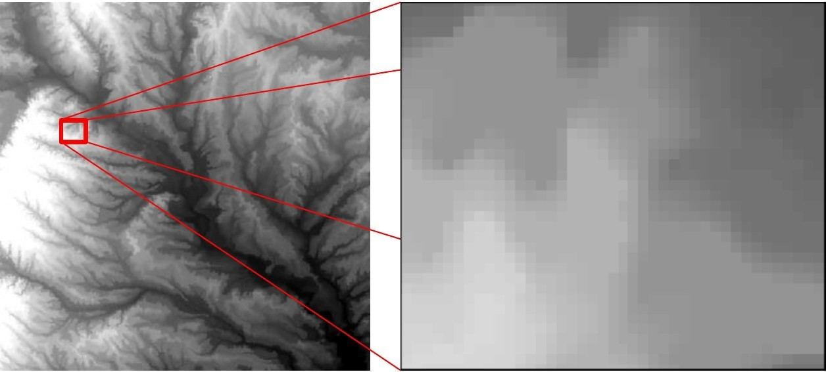

Example
Elevation
- High : 262
Elevation in Dallas county
The whole county and a small area in thecounty
(Data Source: USGS)
- Low: 73

Slide 5

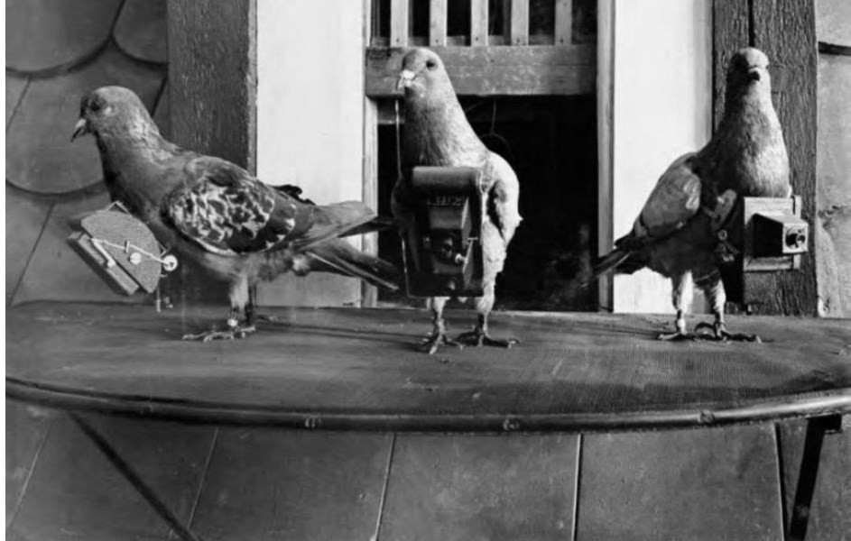
Remote Sensing – Quick Overview
in Germany
1860 Nadar taking photograph using a hot air balloon
Image Credit: Online Collection of the Brooklyn Museum

Slide 6
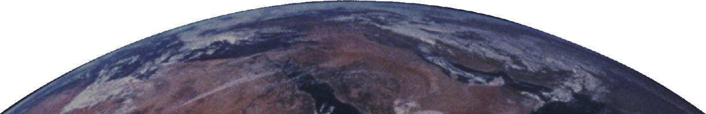
Remote Sensing
Hearing, seeing, smelling are all remote sensing, but here we focus on one kind:
Measurement, by sensors, of the electromagnetic energy reflected or emitted from objects on the Earth’s surface.
Specifically, we will focus on observations of Earth’s land and water surfaces by means of reflected and emitted electromagnetic energy

Slide 7
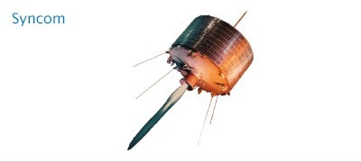
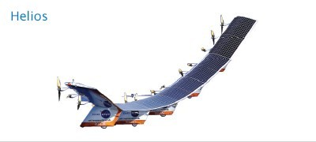
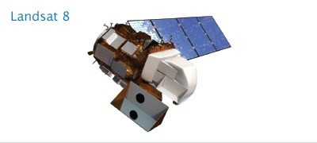
Remote Sensing – Quick Overview
Sensor altitude plays a role in determining purpose
Geosynchronous—22,236 miles
Atmospheric satellite—100,000 feet
onous—375–500 miles

Slide 8
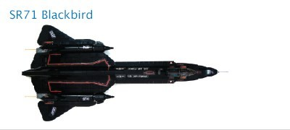
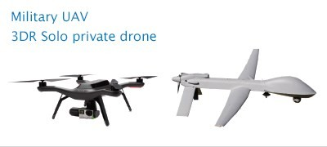
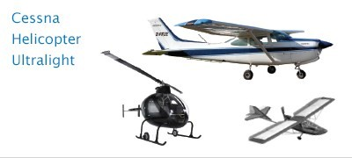
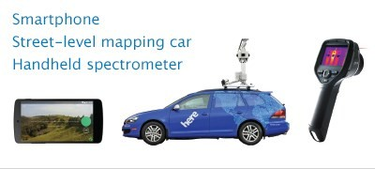
Remote Sensing – Quick Overview
Jet aircraft—90,000-30,000 feet
Drones—100-500 feet
Aviation aircraft—
-10,000 feet
Ground based/handheld—
Ground

Slide 9
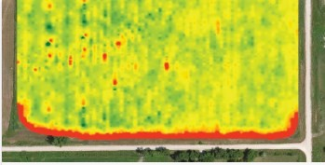
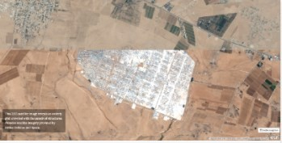
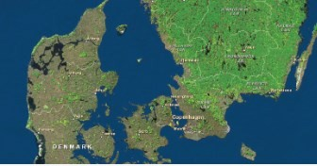
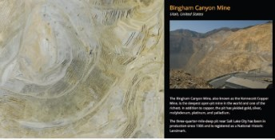
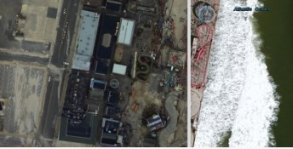
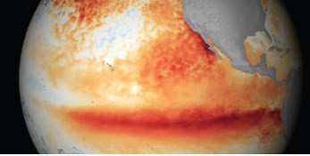
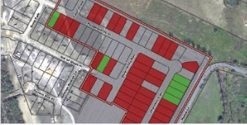
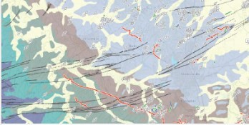
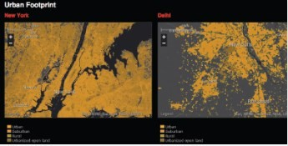
Imagery Applications
Precision Agriculture
Humanitarian Aid
Forestry
Mining
Natural Disasters
Climate/Weather
Engineering
Natural Resources
Urban Planning

Slide 10
Fundamental Principle of Studies Using Remote Sensing
For any given material, the amount of radiation that is reflected (absorbed, transmitted) varies with wavelength.
Different materials have different reflectance characteristics.

Slide 11
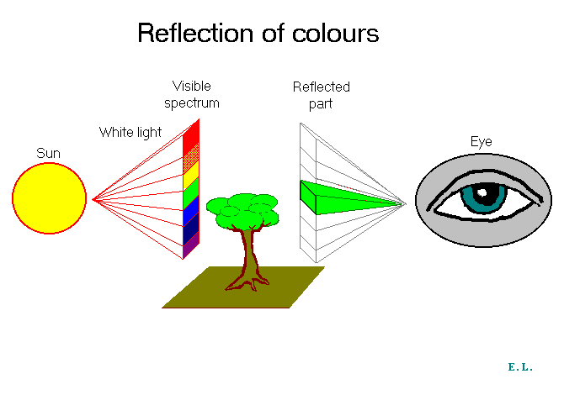
In remote sensing, we are largely concerned with REFLECTED RADIATION.
This is the radiation that causes our eyes to see colors, causes infrared film to record vegetation, and allows radar images of the earth to be created.
The source of a vast majority of this reflected radiation is the sun.

Slide 12
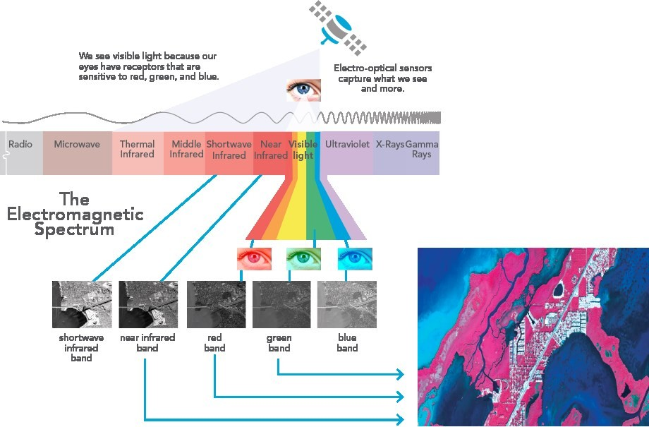
Remote Sensing
Long Wavelength Low Frequency Low Energy
Short Wavelength High Frequency High Energy
Remote sensing is the science of collecting and interpreting electromagnetic information about the earth using sensors on platforms in our atmosphere

Slide 13
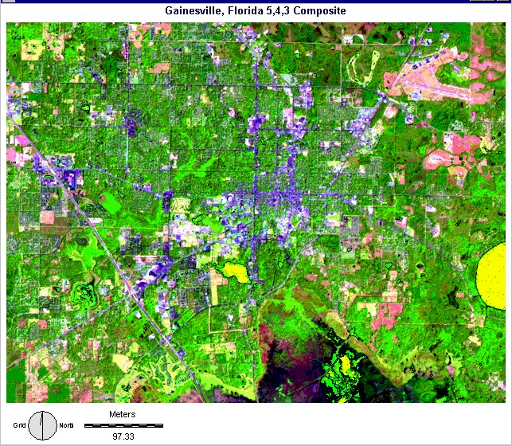
Nature of Remote Sensing Data
Quantized grid of small areas on the Earth’s surface. The energy of reflected electromagnetic radiation in each grid cell is a function of the characteristics of the objects in that cell.
127 156 144 5
₁ 127 156 144 5
₁ ₁ 127 156 144 5
₁ ₁ 127 156 144 5
₅ ₁ ₁ 127 156 144 5
₁₁ ₅ ₁ ₁ 127 156 144 5
₁₁ ₅ ₁ ₁ 127 156 144 5
₁₁ ⁵ ₅ ₁ 127 5 5 127
27 5 5 127
27 5 127 127
5 127 127
5 134 117 115
27 5 5 127
27 5 127 127
5 127 127
5 134 117 115
27 5 5 127
27 5 127 127
5 127 127
5 134 117 115
27 5 5 127
27 5 127 127
5 127 127
5 134 117 115
27 5 5 127
27 5 127 127
5 127 127
5 134 117 115
27 5 5 127
27 5 127 127
5 127 127
5 134 117 115
AN IMAGE, NOT A PHOTOGRAPH!
Digital Numbers (DN), that are
11 127 5 127 127
11 ⁵
proportional to the reflectance, or Brightness Value (BV) in some
11 ⁵
5 127 127
115 134 117 115
7 Landsat Bands –
Individual Data Files
subset (band) of the EM spectrum.

Slide 14
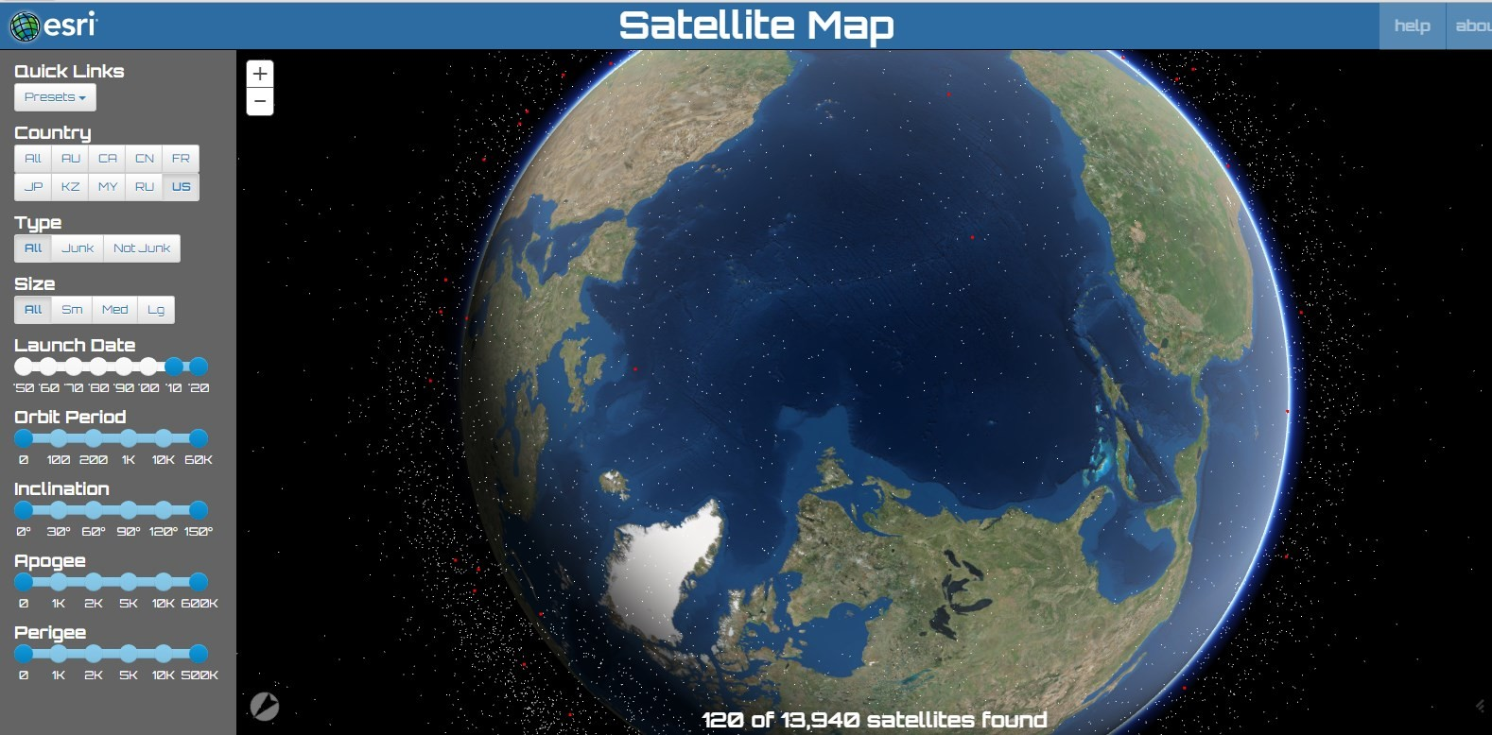

Slide 15
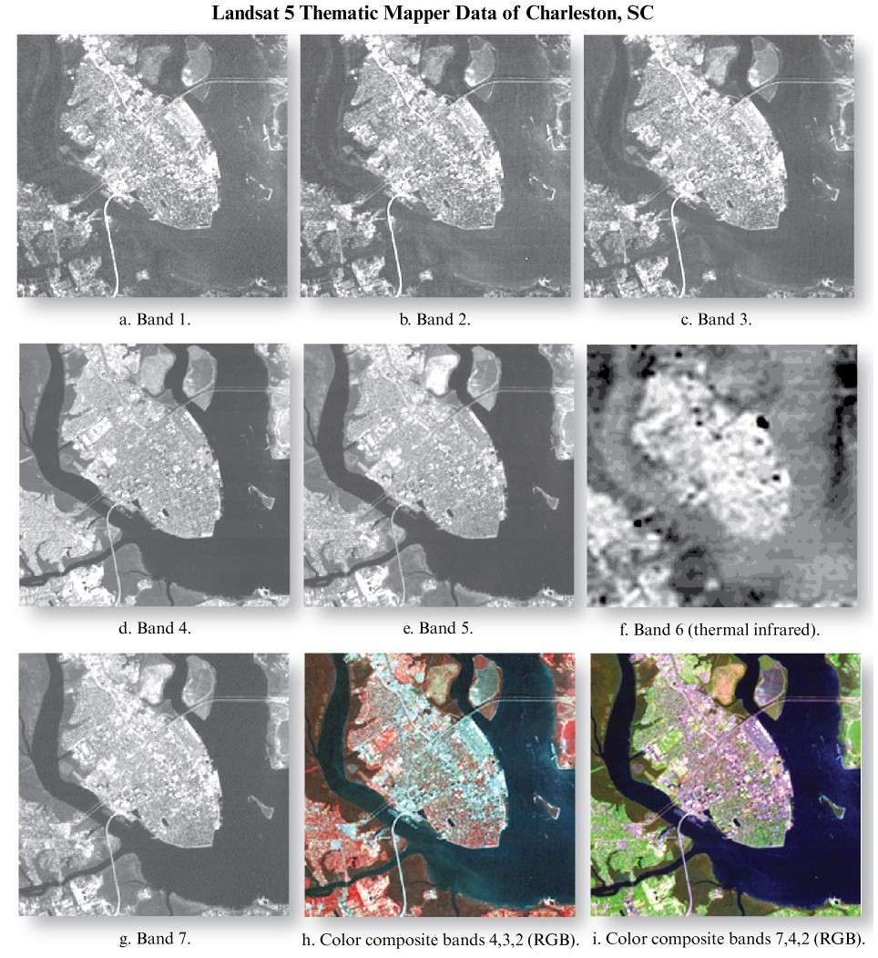
Landsat TM 5 – Charleston, SC
Seven spectral bands, including a thermal band:
Band 1 Visible (0.45 - 0.52 µm) 30 m
Band 2 Visible (0.52 - 0.60 µm) 30 m
Band 3 Visible (0.63 - 0.69 µm) 30 m
Band 4 Near-Infrared (0.76 - 0.90 µm) 30 m
Band 5 Near-Infrared (1.55 - 1.75 µm) 30 m
Band 6 Thermal (10.40 - 12.50 µm) 120 m
Band 7 Mid-Infrared (2.08 - 2.35 µm) 30 m

Slide 16
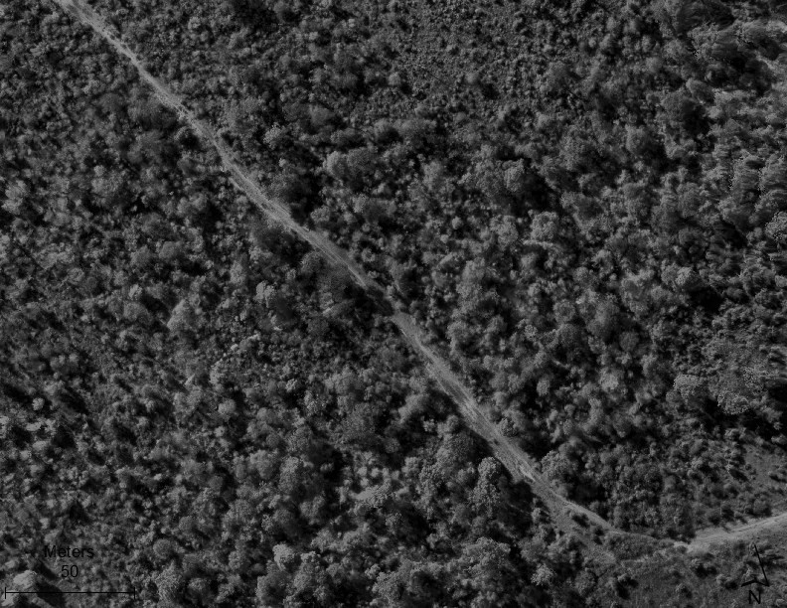
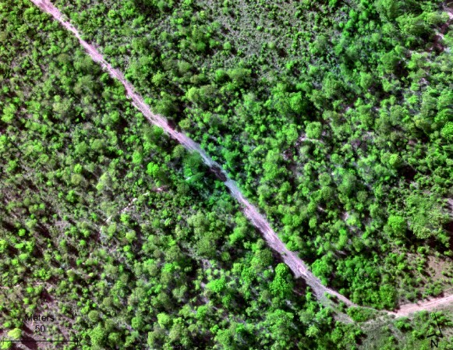
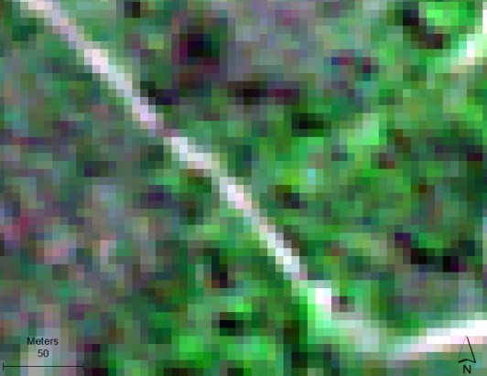
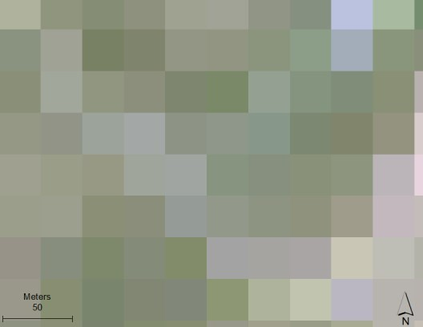
Multiscale Remote Sensing
What does this look like in practice?
10 cm
5 m
30 m

Slide 17
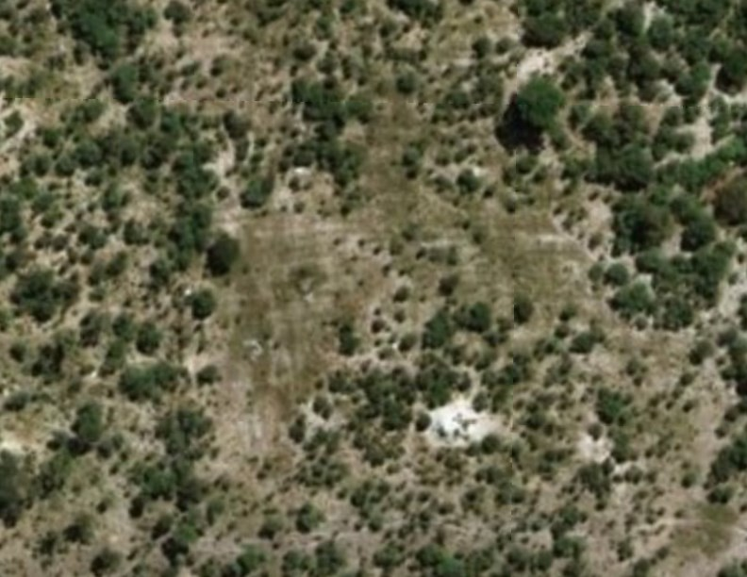

Digital Globe, ESRI Basemap

Slide 18
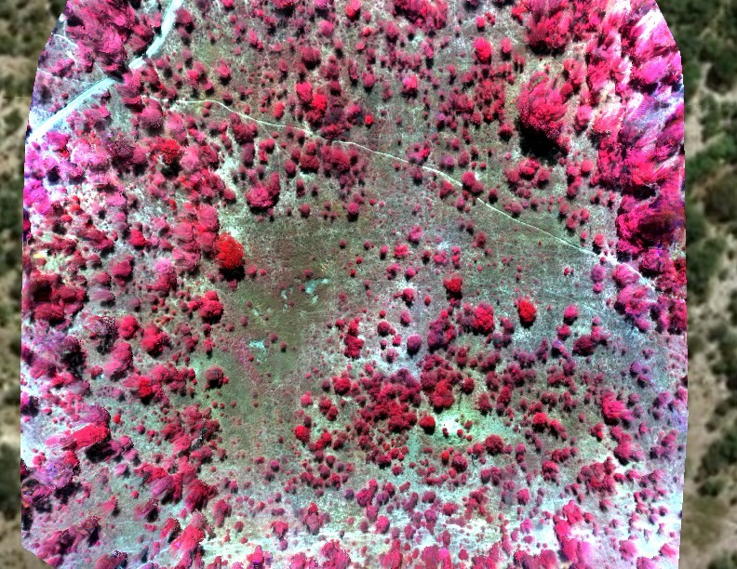
Drone: Parrot Sequoia, 10 cm

Slide 19
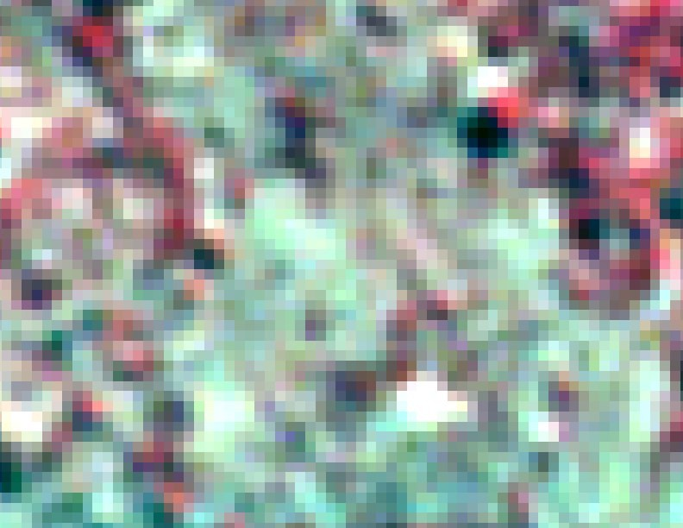
Rapideye, 5 m

Slide 20

Landsat 8 Operational Land Imager (OLI), 30 m

Slide 21
https://worldview.earthdata.nasa.gov
Global Imagery Browse Services (GIBS)

Slide 22
Using ArcGIS Online
Navigate to https://livingatlas.arcgis.com
Sign in using CNETid
Search “Global Imagery Browse Services”

Slide 23
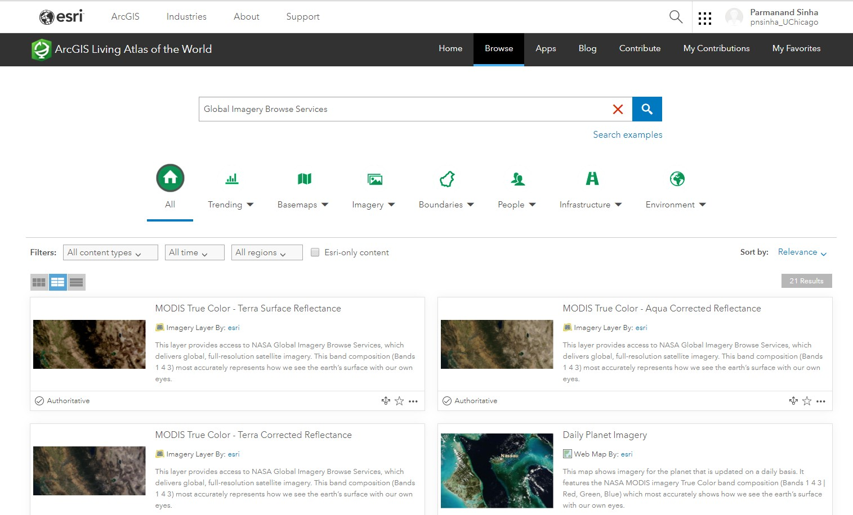
Using ArcGIS Online
Navigate to https://livingatlas.arcgis.com
Sign in using CNETid
Search “Global Imagery Browse Services”

Slide 24
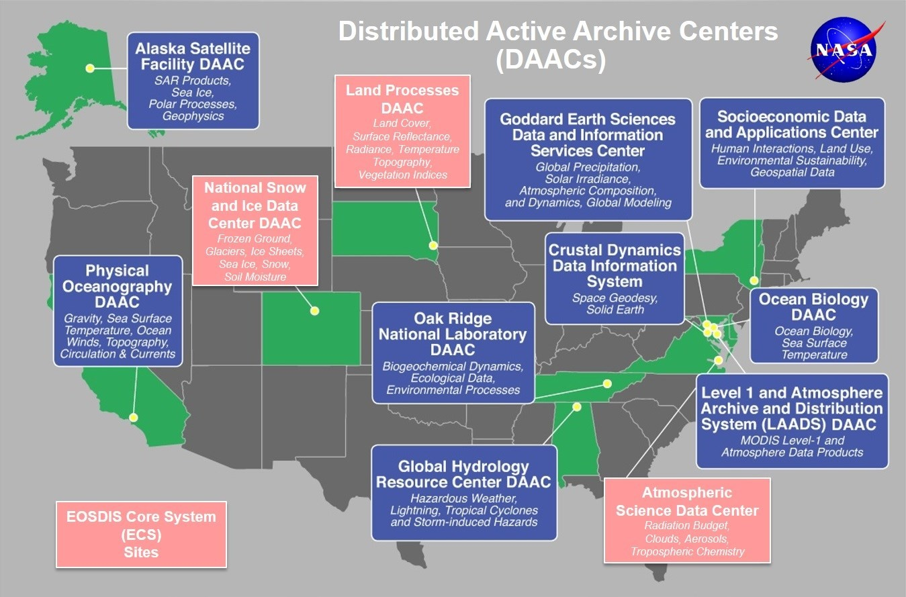
EOSDIS Distributed Active Archive Centers (DAACs)

Slide 25
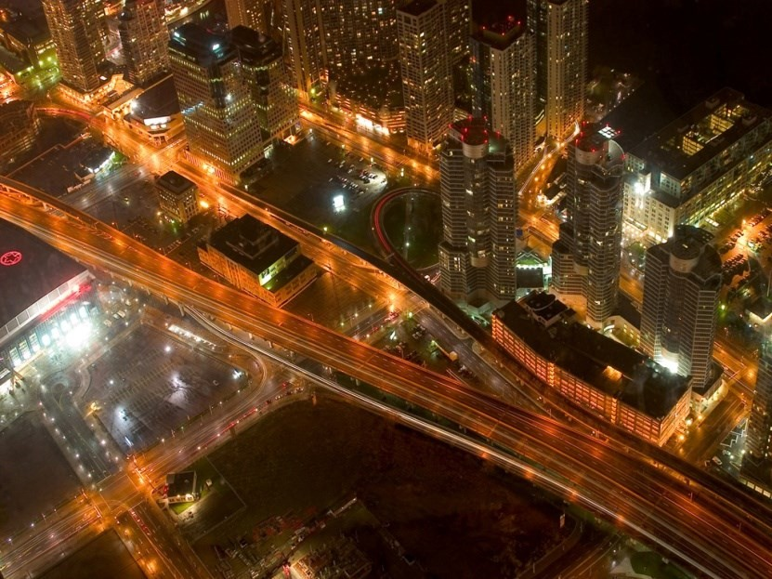
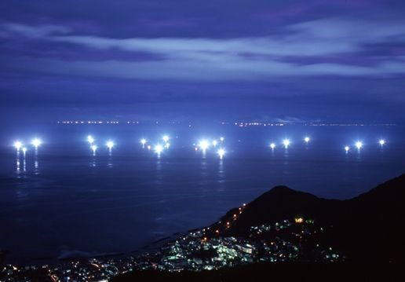
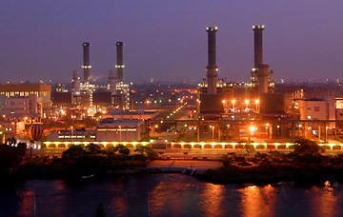
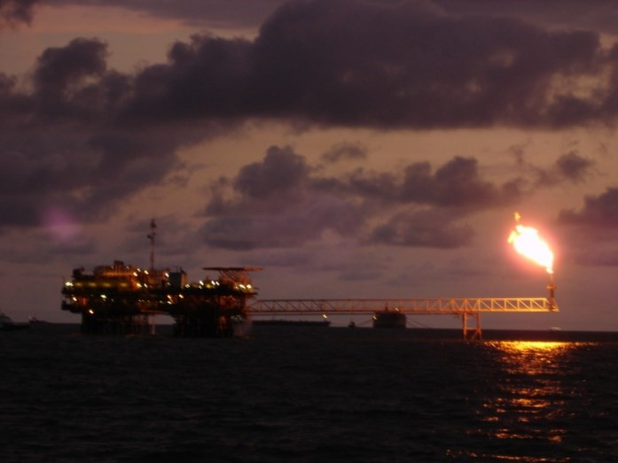
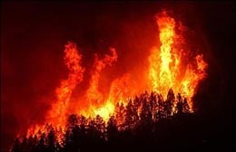
Lights At Night!
Boats
Cities
Industrial Sites
Gas Flares
Fires
Artificial lighting is a excellent remote sensing observable!

Slide 26
Two Satellite Systems Collect Global Low Light Imaging Data at Nights
The fundamental purpose of both DMSP and VIIRS low-light imaging is to enable the detection of clouds using moonlight instead of sunlight as the illumination source.
https://ngdc.noaa.gov/eog/dmsp/downloadV4composites.html
U.S. Air Force Defense Meteorological Satellite Program (DMSP) Operational Linescan System (OLS). 1972 to present.
NASA-NOAA Suomi NPP Visible Infrared Imaging Radiometer Suite (VIIRS). Launched October 28, 2011.
https://ncc.nesdis.noaa.gov/VIIRS/

Slide 27
Secondary Products
GHSL: Global human Settlement layer 1973, 2000, 2012
https://ghsl.jrc.ec.europa.eu/datasets.php
GUF: Global Urban Footprint 2015
https://www.dlr.de/eoc/en/desktopdefault.aspx/tabid- 9630/#gallery/24114

Slide 28
Sample Building Footprints from Maxar (DG)
Download San Francisco Download Berlin Download Hong Kong Download Washington DC Download Santiago Download Mexico City Download Yaounde
•

Slide 29
https://www.digitalglobe.com/products/building-footprints
Facebook
Microsoft

Slide 30
Popgrid
https://sedac.ciesin.columbia.edu/mapping/popgrid/

Slide 31
Thank You

