Slide 1
NEEDFINDING
UI / UX Design and Programming

Slide 2
Garbage disposal
Every day, we have to deal with different type of garbage because every product that we use comes with a garbage especially for a third world country like us, we are using a lot of single use and disposable products. Therefore, we can say that garbage is part of our daily lives whether we like it or not. Many of the garbage that ends up in landfills or oceans were not properly segregated.

Slide 3
User observation
Questions:
What type of garbage do you usually dispose? (Biodegradable or Non-biodegradable)
How often do you dispose your garbage?
Do you dispose your garbage properly?

Slide 4
User observation
Questions:
Can you describe how you dispose a garbage? (If the user says that he/she properly segregates it, ask why and how’s the experience, if not ask why)
Did you encounter some waste in your surroundings that wasn’t dispose properly? (If the user says he/she encounter, ask what he/she do and how’s the experience)
If you were given a chance to design a trash bin based on your preferences, how would it look like?

Slide 5
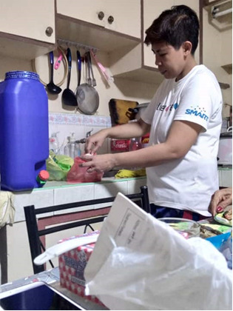
User #1
Nancy Martinez
Occupation: full-time security guard
Photo was taken at Nancy's house

Slide 6
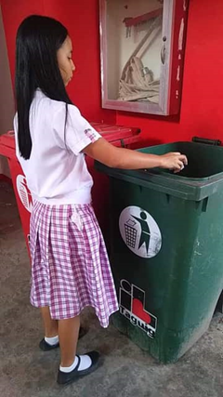
USER #2
Ivy Rochelle Reyes
Senior high school student (STEM)
Photo was taken at Senator Renato Companero Cayetano Memorial Science and Technology High School

Slide 7
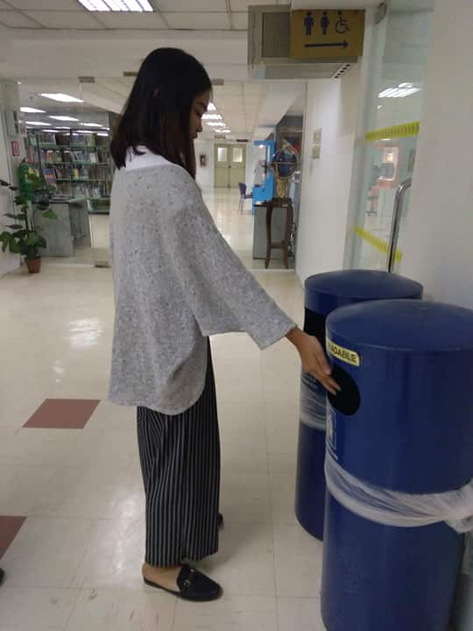
USER #3
Frances Abengaña
College student (ABMA)
Photo was taken at Asia Pacific College

Slide 8
What type of garbage do you usually dispose? (Biodegradable or Non-biodegradable)
User #1
She usually disposes biodegradable waste more than residual waste.
User #2
In most cases, she disposes biodegradable waste.
User #3
She usually disposes biodegradable waste.

Slide 9
How often do you dispose your garbage?
User #1
She often disposes waste after taking her daily meal.
User #2
She disposes garbage approximately 10 times a day
User #3
she often disposes garbage 2 to 3 times a day but sometimes she put her trash inside her bag

Slide 10
Do you dispose your garbage properly?
User #1
She disposes her waste properly at home and at work.
User #2
. She maintains disposing garbage properly
User#3
, she doesn't usually maintain a proper disposing of waste especially at home. sometimes she didn't segregate, she only segregate comply with segregation of waste when there is label at the trash bins that could guide her on waste segregation.

Slide 11
Can you describe how you dispose a garbage? (If the user says that he/she properly segregates it, ask why and how’s the experience, if not ask why)
User #1
She disposes her waste properly at home and at work. Yes, she feels satisfaction after she segregates
User #2
She segregates the biodegradable from non-biodegradable, it was fulfilling because she likes helping the garbage man to segregate the trashes.
User #3
She segregates the biodegradable from non-biodegradable, it was fulfilling because she likes helping the garbage man to segregate the trashes.

Slide 12
Did you encounter some waste in your surroundings that wasn’t dispose properly? (If the user says he/she encounter, ask what he/she do and how’s the experience)
User #1
she encountered it every day but she were not able to put the trash that were scattered around to the nearest trash bin
User #2
Whenever she see some trash that were not disposed properly in the trash bin, she always pick up the trash and throw it in the nearest trash bin. She also feel disgusted to those people who were not able to do s simple task like putting a trash in the right place.
User #3
She encountered it every day. As someone who experienced it and has a knowledge what will happen if garbage aren’t disposed properly, she always try to follow the 3r’s especially in public places if they do have and she also recycle stuff especially in her major course. She said that we can’t just throw things because maybe in our future projects, we will make use of it.

Slide 13
If you were given a chance to design a trash bin based on your preferences, how would it look like?
User #1
She would like to make a design a trash bin for biodegradable and non-biodegradable waste at home
User #2
She would like to design a big garbage can with a division in between, separating the biodegradable and non-biodegradable.
User #3
She would like to make a trash bins labeled with biodegradable waste, non-biodegradable waste and recyclable materials located at the same place.

Slide 14
USER NEEDS
People should have a better understanding of the importance of segregating garbage when disposing.
People needs to have a much better plan on how to segregate garbage.
A household needs to have at least three trash bins for their biodegradable, non-biodegradable, and recyclable waste.
Every trash bin needs to have a label.
Every public place needs to have a trash bins for biodegradable, non-biodegradable, and recyclable waste.

Slide 15
USER NEEDS
Trash bins needs to have a more engaging design to entice people to throw their garbage at the right place.
People need to take advantage of the existing solutions that we already have.
People should have alternative trash bin with them whenever there’s no trash bin around.
Every member of the household should be aware about the segregation of waste
People need to be efficient on proper waste disposal such as single-use plastic and hazardous materials which could cause danger to our health and environment.
Waste could be divided in several categories more than people have been familiar to.

Slide 16
OUR POINT OF VIEW
Garbage? Why segregate it? Just automate it.

Slide 17
NEEDFINDING TALK
What activity did you choose to examine?
The activity that we chose to examine is the garbage disposal where we aim to identify if people are utilizing the concepts or solutions that we already have, and we also want to observe how every individual dispose their garbage.
How did you examine it, with what methods?
We asked the users some questions about how they dispose their garbage and we also observe the way they do it.

Slide 18
NEEDFINDING TALK
What major insights or breakdowns did you discover?
We noticed the users were aware and able to comply in segregation of waste and segregation of wastes at home reduces the pollution rates and the spaces that it occupies in the landfill/ material recovery facility. Some of breakdowns are lack of trash bins in household, inconsistency to maintain the segregation of waste, lack of trash bin in public places

Slide 19
NEEDFINDING TALK
What promising unmet needs were identified as a result?
The most promising needs that we identified as a result is lack of waste segregation trash bins in households and public place resulting in improper segregation of waste that was supposed to be managed before it goes to material recovery facilities and landfills

