Slide 1
Client Side Development
An overview of developing a REACT.js web application

Slide 2
Tools Needed
Visual Studio Code / Atom / notepad
Node.js (download and install from this link)
React dev tool on chrome
Note: We’ll use VScode for the exercises on this module

Slide 3
Prerequisite
At least you know how to code ☺
And a little bit of javascript
And a lot of patience and hardwork :P

Slide 4
Overview
To further appreciate React.js development, we’ll cover some of the following tools that we need:
  Node.js
  Javascript crash course
  Webpack
  REACT
  Redux

Slide 5
Node.js
Server side javascript programming –running a javascript outside of a browser!
It’s like coding a .net code with the javascript language
https://www.w3schools.com/nodejs/nodejs_intro.asp

Slide 6
Getting our hands dirty

Slide 7
Starting with Node.js
Create a project folder
Open a cmd terminal (ctrl ~ for VS code)
run “npm init” and fill up the needed fields

Slide 8
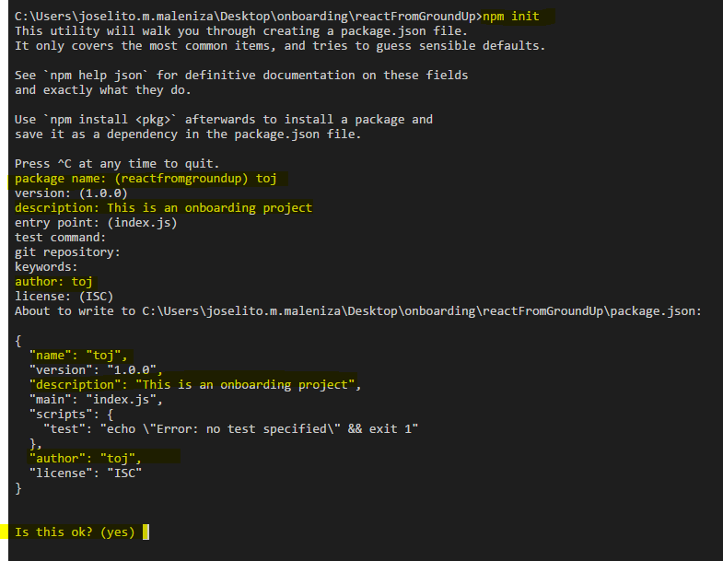

Slide 9
what is npm?
npm means node package manager
npm let us install, share, or distribute reusable javascript software known as “packages”
Example of those packages are React, webpack, express..
These packages are managed in a file called “package.json”

Slide 11
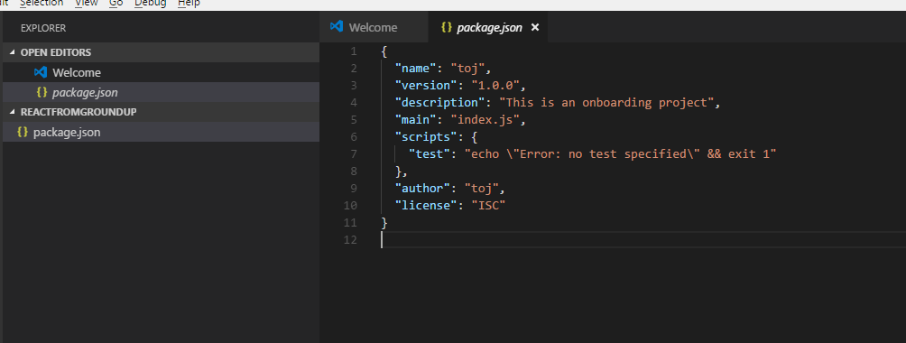
notice the package.json?

Slide 12
what is package.json?
It is a json.file that contains the details for your node.js projects including the packages which your project is dependent
The node will read this file when you execute “npm install”
More of it here: https://docs.npmjs.com/files/package.json

Slide 13
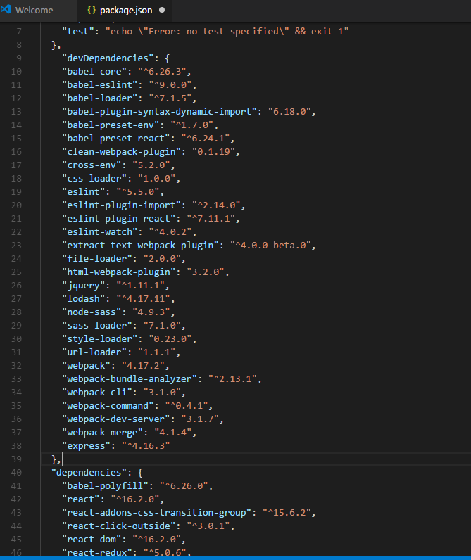
still on package.json
add the dependencies and devDependencies from the attached package.json to your package.json (exercise_1)
-These dependencies are the packages
that we’ll be needing in this execrise
run “npm install”

Slide 14
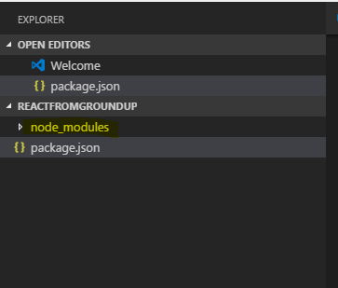
notice the node_modules?

Slide 15
what is node_module?
Consider modules to be the same as JavaScript libraries.
A set of functions you want to include in your application.
You can find all the packages here

Slide 16
npm start!
On your project directory, create a folder named “app”
Inside “app” folder create a javascript file and name it “index.js”
Insidethe index.js, add the following statements
      var http = require('http');
      http.createServer(function (req, res) {
      res.writeHead(200, {'Content-Type': 'text/html'});
      res.end("My First Node Scripts!");
      }).listen(8080);
Go to the package.json and add the script node below:
      "scripts": {
      “start": "node app/index.js"
      },
On the terminal, execute “npm run start”
Open http://localhost:8080/ on your browser

Slide 17
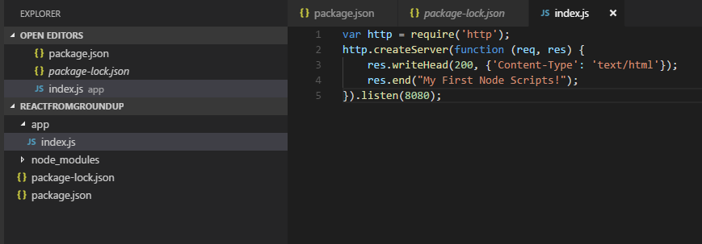
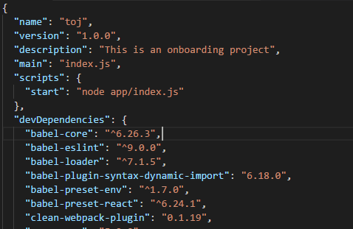
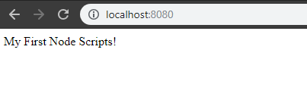

Slide 18
Let’s add hot-reload!
On the terminal, run “npm i –d nodemon”
  i means install (same as npm install)
  -d means that we need to save the package on the devDependencies in the package.json
  Nodemon is the package that we need to hot reload the node.js
  Hot Reload means that the node.js will run automatically each time there are changes on the code. This means that we do not need to execute “npm start” each time we modify our code
  Nodemon however wont refresh your browser (let’s refresh the browser manually for now)
  Modify the start script : "start": "nodemon app/index.js"
  Execute “npm start”
  Modify the res.end("My First Node Scripts!"); line on you index.js
  With any text you want and notice that the text on the localhost:8080
  changes after we refresh the browser

Slide 19
Crash Course Alert!
Before we dive to the ocean of javascript libraries, let’s make sure you know how to swim first!

Slide 20
Variables and Datatypes

Slide 21
Declaring Variables
On the index.js Declare a variable called “displayedText” and assign it with “variables”
Replace the text on the res.end("My First Node Scripts!"); line with the displayedText
Check on your browser, you should see that the displayed text would change

Slide 22

String
On the index.js add variable called “firstName” and “lastName” and assign it with your first name and last name
Set the displayedText variable as the sum of firstName and lastName:
  displayedText = “My name is ” + firstName + “ ” + lastName + “.”;
Check on your browser, you should see something like the image below.

Slide 23
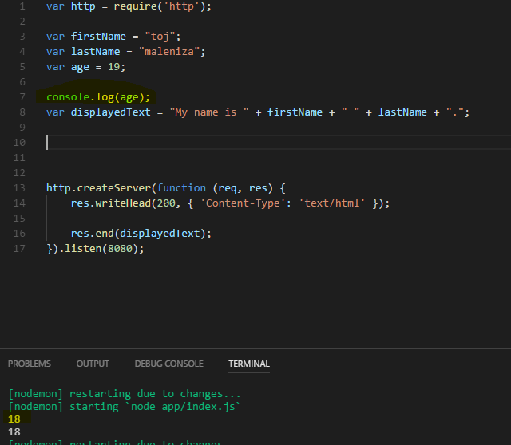
Integers
On the index.js add variable called “age” and assign it with the number 18.
Log it on the console:
console.log(age);
You should be able to see a number 18 on your terminal

Slide 24
Integer + Integers
On the index.js add variables called “decade” and “dozen”assign it with the numbers 10 and 12 repectively.
Log it on the console the sum of the two
You should be able to see a number 22 on your terminal

Slide 25
Integer + String
On the index.js add variable called “centuryString” and assign it with “100” string
Log it on the console the sum of dozen, decade and centuryString
What did you got?
Note: in javascript, te datatypes of the varibles depends on the values assigned to it.
Adding string and integer will convert the integer to a string and concatenate it with the added string

Slide 26
Integer + parseInt(String)
If you want to add the number in string format as an integer, you must convert it first to integer using parseInt
Log on the console the sum of dozen, decade and parseInt(centuryString)
What did you got?

Slide 27
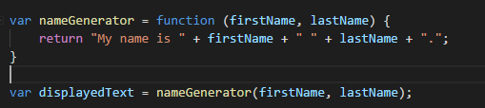
Functions
On the index.js, create a function called nameGenerator that accepts firstName and lastName as parameters and returns the following statement:
“My name is ” + firstName + “ ” + lastName + “.”;
Set the displayedText as the output of the nameGenerator

Slide 28
Take a quick break

Slide 29

Array
Create an array varialble called favFoods and assign “tapa”, “sinangag”, “itlog” on it
log it on the console. You should be able to see something like this:
Using .push(), add “tuyo”, “kape” and “kamatis”
Get the index of “tuyo” and log it on the console. You should get the number 3 (note: js array is of index 0)
Using splice(), remove “tuyo” from the array and log on the console the new value of favFoods

Slide 30
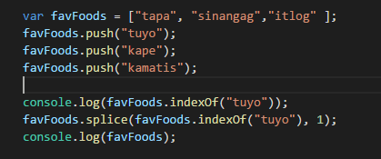
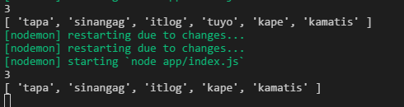

Slide 31
Array Iteration - forEach
Remove the other console logs
Create a function called forEachFunction which accepts an array as a parameter and returns and html:
Set the displayedText as the output of the forEachFunction with the favFoods as an input

Slide 32
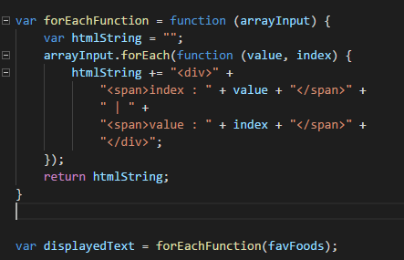
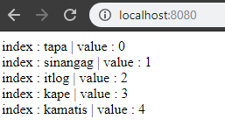

Slide 33
Array Iteration - map
Remove the other console logs
Create a function called mapFunction which accepts an array as a parameter and returns and html:
Set the displayedText as the output of the mapFunction with the favFoods as an input

Slide 34
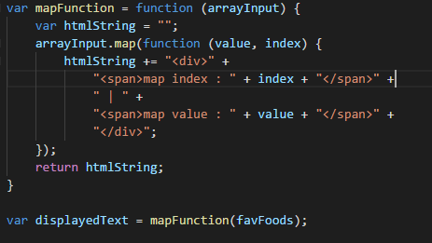
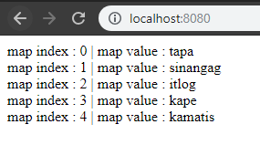

Slide 35
Array Iteration – for loop
Unlike .map and .forEach which are array methods, the for loop is a javascript method. This means that .map and .forEach can only be used for array while for loop can be use as it is.
Remove the other console logs
Create a function called forLoopFunction which accepts an array as a parameter and returns and html:
Set the displayedText as the output of the forLoopFunction with the favFoods as an input

Slide 36
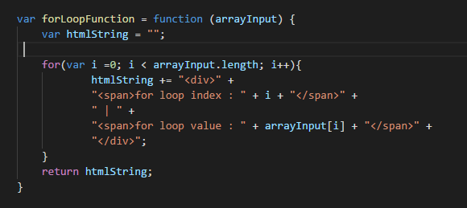
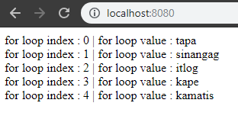

Slide 37
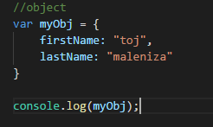

Object
Create an object called myObj
Assign following key-value pairs to myObj
  firstName: “<your first name>”
  lastName: “<your last name>”
  Log it on the console

Slide 38
Object – Property Accessors
  An object is a set of key-value pairs.
  You can access the value of the keys(or properties) using two methods:
    Dot notation
      Object.key
    Bracket notation
      Object[key]

Slide 39
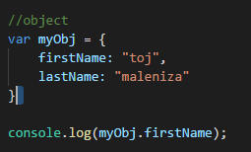

Object – dot notation
  We log on the console the value of the firstName property( or key) of the myObj variable using dot notation

Slide 40
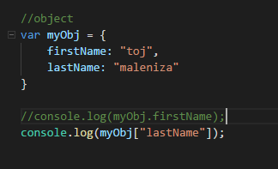

Object – bracket notation
  We log on the console the value of the lastName property( or key) of the myObj variable using dot notation

Slide 41
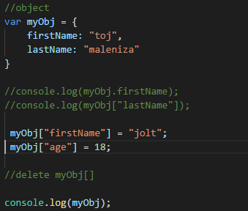
Object – assign value to properties
  Comment out the console logs
  Still on the myObj variable, change the value of firstName and add a new property called age and assign it with the number 18

Slide 42
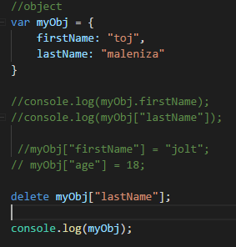
Object – remove a key
  Comment out the console logs
  Using delete, remove the lastName property

Slide 43
Array vs Object
  Array is enclosed with [] while object is enclosed with {}
  Values in an array are accessed via index while values in an array are accessed via keys (or properties)
  An array may contain an object and object may contain array
  Arary is used to contain values of similar properties while an object is used for key-value pairs

Slide 44
Take a quick break

Slide 45
Conditional Statements

Slide 46
If, else if, else
Comment out all console logs
Create a function that accepts an array(favFoods) and modifies the the value of an array if the index is greater than 3 (add “gt 3” to the value). If the index is less than three, check if it is 3 then add the value to “ eq 3”. Add “else” string to everything else that does not fit the criteria. Log the new array on the console. Use any of the array iteration functions you created earlier to get a markup string using the new array as the input, this will be the output of your function.
Set the displayedText as the output of the ifElseifElse with the favFoods as an input

Slide 47
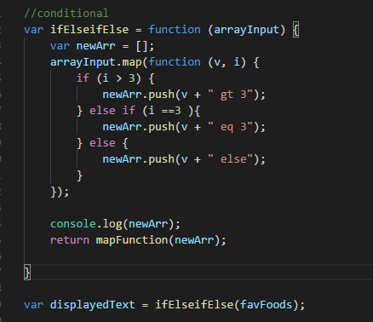
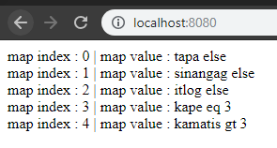

Slide 48
switch
Comment out all console logs
Create a function called switchFunction which accepts the favFoods array. Create a new array based favFoods’ value. If it is “tapa”, change it to “bacon”. If it is sinangag, change it to “bread”, if it is “itlog” change it to “scrambled egg”. Everything else should be changed to “- - -”
Set the displayedText as the output of the switchFunction with the favFoods as an input

Slide 49
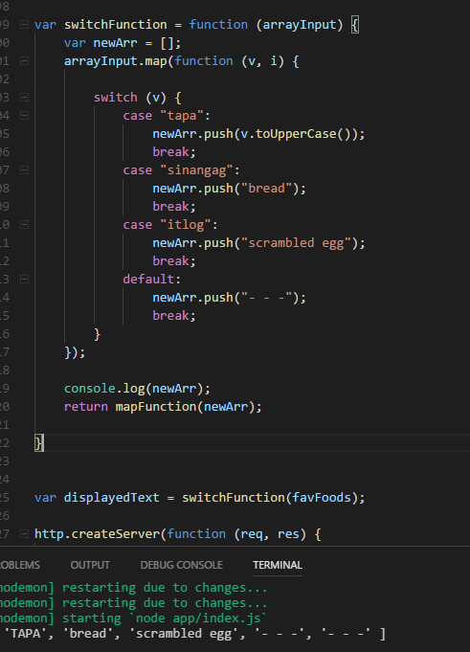
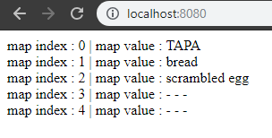

Slide 50
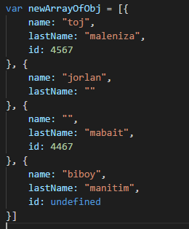
Null check and ternary
Comment out all console logs
Create a new array called “newArrayOfObj” with the ff values
Create a function that returns a markup string
given the newArrayOfObj. You must be able to
handle null and empty values using a ternary
statement
Set the displayedText as the output
of the your function with the newArrayOfObj
as your input

Slide 51
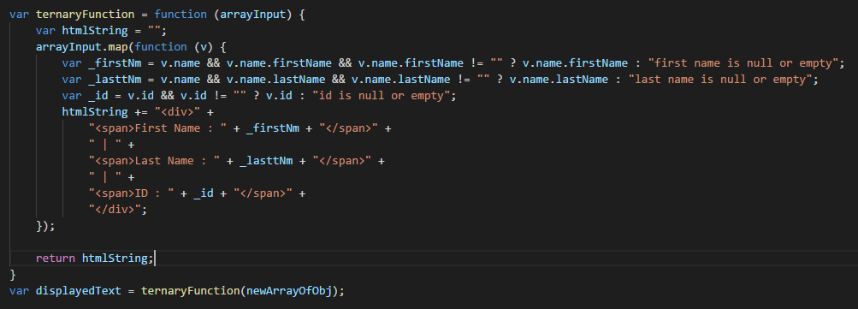
Null check and ternary

Slide 52
Still on null check and ternary
The statement below is called a ternary statement. It’s a short-hand if statement. The statement behind the ? Is the condition. The statement before the “: “ is returned if the condition is true. The statement after the “:” is returned if the condition is false
Still on the statement above, notice the condition?
  v.name on the condition will return true if v.name has a value (not null or undefined). This goes the same with v.name.firstName
  The statement above checks if the v object has a “name” property, if it has a “name” property, it will check the v.name object if it has a firstName property before checking if v.name.firstName is an empty string.
  What do you think would happen if we directly check if the v.name.firstName is equal to empty string without checking if the v.name is not null?
    try using this statement on your code and find out ☺

Slide 53
Take a quick break

Slide 54
webpack

Slide 55
What is a webpack?
Webpack bundles your modules
We may have a lot of components in our project – js, css and html. webpack allows us to create a package that we can execute/deploy.
In a nutshell, it summarizes our application ☺
More of it here https://survivejs.com/webpack/what-is-webpack/

Slide 56
Add the webpack config
Stop all running processes on the terminal – ctrl + c
On your project directory, add the webpack.config.dev.js
  Add index.html
  Rename the index.js to index_old.js and add new index.js
  Change the “start” script with the value given
  Add the .bablerc file

Slide 57
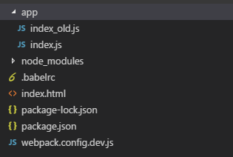
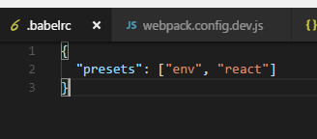
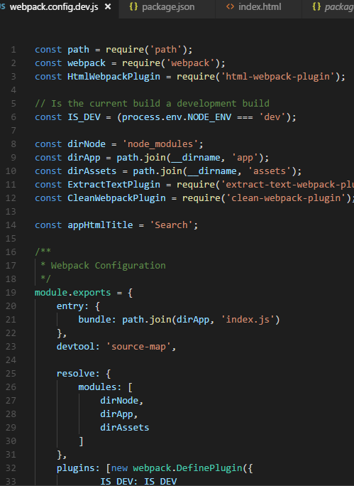
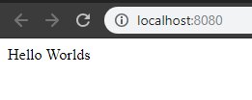
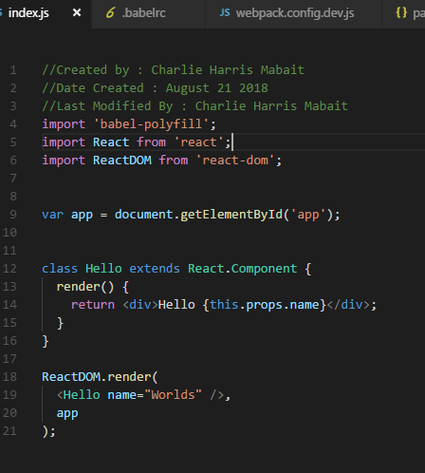

Slide 58
What is babel?
If you already created started coding a react, you’ll notice that react components uses jsx (html like elements on javascrit code). Ordinary javascript file will throw an error if we will put a jsx code on it because the browser will not be able to interpret it.
Babel converts the jsx syntax back to a javascript version that is understood by a browser.
In a sense, babel is the one that allows us to code React. Thanks babel! ☺
More of it here https://babeljs.io/docs/en/

Slide 59
React

Slide 60
Create an component
On the app directory, create a folder and name it home
  Under the home directory, create home.js file
  In the home.js file, create a react component named “Home” and export it
  In the index.js, import the home component and render it on the app

Slide 61
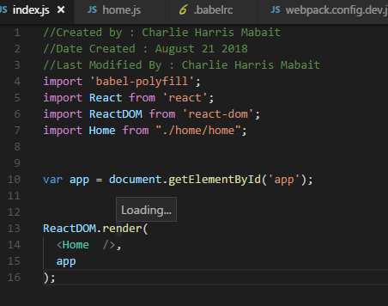
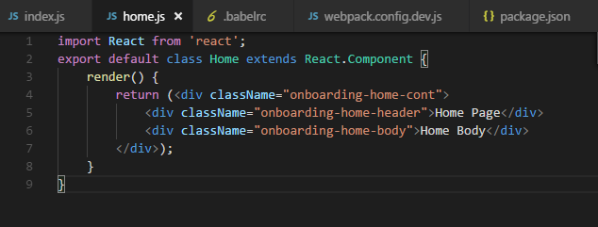
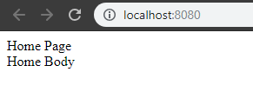

Slide 62
Let’s add styles!
In the home directory, add _styles.scss
In the _styles.scss, add styles as you want for your component
In the home.js, import the _styles.scss
Check your browser

Slide 63
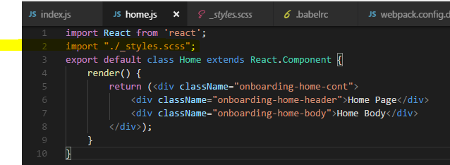
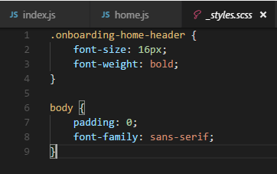
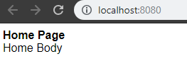

Slide 64
How about the routes?
In the app directory, create another folder and name it “about”
Inside the about folder, create a component similar to that of home component, just change “home” to “about”
Now that we have two components, let’s create a navigation component
  Still in the app drectory, create another folder and name it “nav”
  Inside the nav directory, create a nav component
  Add the links to the about page and home page
  Reference the nav component to the home and about components and add it to the rendered elements

Slide 65
Still on the routes…
In the index.js, reference the router package of react
Create the routing for home and app
Import the home and about components
Check your browser and play with the routing

Slide 66
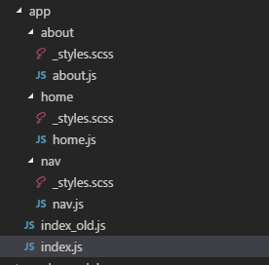
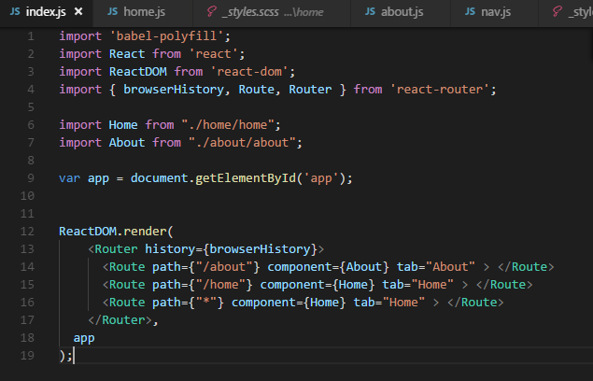
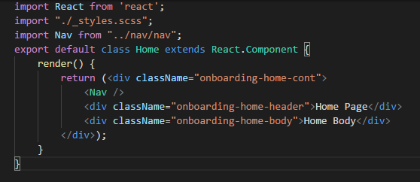
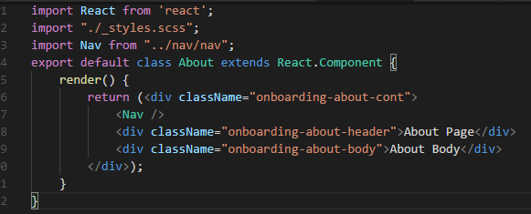
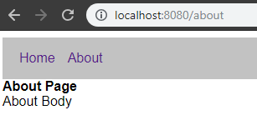

Slide 67
noticed the aria?
The “aria” [Accessible Rich Internet Applications (ARIA)], are attributes that enables the content of our web application to be more accessible to people with disabilities
The “aria-label” attribute is read by a screen readers (NVDA, JAWS)

Slide 68
React lifecycles

Slide 69
What are the lifecycles anyway?
Unlike jquery, REACT.js has its own lifecycle – meaning, we have a way to know when a react component will be drawn in the web app (componentWillMount), after it was drawn (componentDidMount) and if the component will be removed from the markup (componentWillUnmount)
We also know what are the props and states of a component on each lifecycle and we even know if the component will receive a props (componentWillReceiveProps)
We can even prevent our react components from updating (shouldComponentUpdate)
There’s a diagram next page ☺

Slide 70
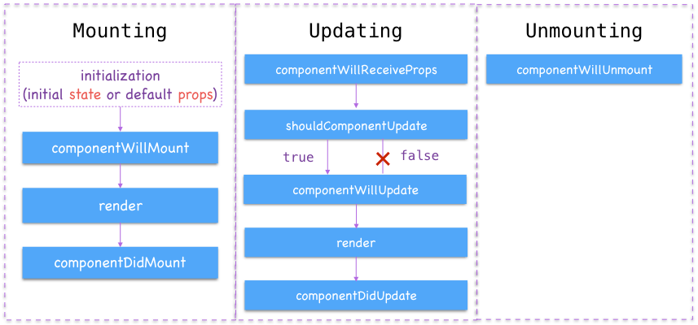

Slide 71
Still on lifecycles
To experience the lifecycles, let’s add some of the lifecycles on the home component (constructor, componentWillMount and componentWillMount)
  Inside each lifecycles, add a console log to log the name of each lifecycles
  Check the dev tool of your browser (F12)
  Note: the constructor property is for the ES6 syntax which is used for this module

Slide 72
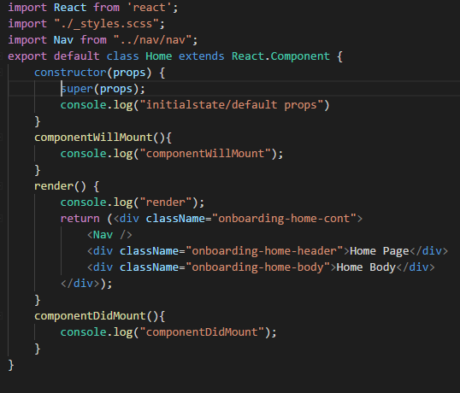
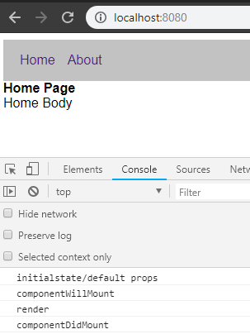

Slide 73
states
In the body of the home component, let’s add an input box
  This inputbox is tied up to a state called text
  Let’s bind the input box to an onchange event which will set the state
  Let’s add another element which reads the text state
  Check your browser, notice that the other element changes as we change the value of the input box
  Also on you console, notice that the render method is called each time we set a state? What would you think will happen if we trigger a setState inside the render?

Slide 74
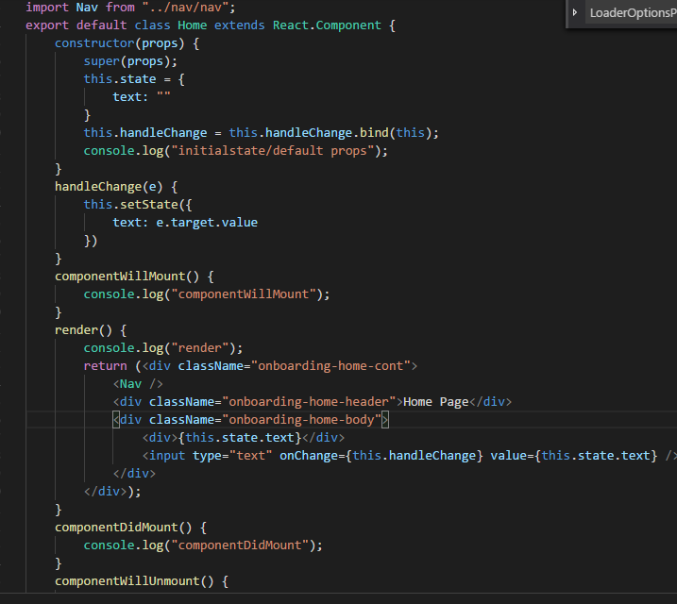
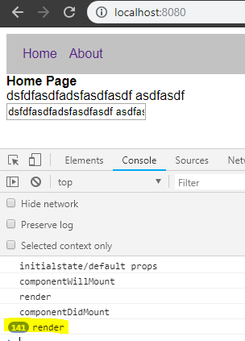

Slide 75
props
Inside the home directory add another component and name it homeChild
  The homeChild will receive the value of the text input from home and render it
  Add a ternary statement that will return the homeChild component if the input has a value, else it will return null
  Add a shouldComponentUpdate Lifecycle which will only return true if the length of the text is less than or equal to 2
  Add console log to the homeChild component’s lifecycles
  Check your browser

Slide 76
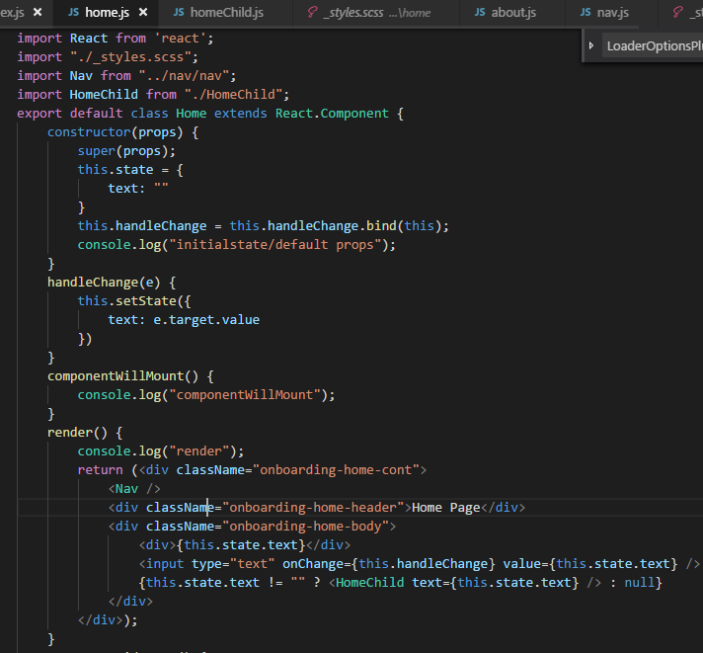

Slide 77



Slide 78
Still on props
Notice that inside the homeChild, we use this.props.text while inside the home component we use this.state.text?
Also noticed that the homeChild component stopped updating when the length of the text is greater than 2?
Try deleting the value of the input box, when was the componentWillUnmount lifecycle of the homeChild component was triggered?

Slide 79
Take a quick break

Slide 80
redux

Slide 81
redux?
Let’s imagine we have an application with a structure as below.
Home
header
body
leftnav
footer
Header text
text
Footer text

Slide 82
What is redux?
From the structure in our diagram, we have a text property, which is a state inside the body component. When this property changes, the text on the header and the footer should change.
Without redux, we could accomplish this by lifting the state up to the home component, the three children would read this state as their props. But what if we have a complex structure? Isn’t it more convenient if we could pass states directly from each component (header-body-footer) instead of passing it up to their parents?
With redux, we can do this.
Redux helps us manage the state of our components into a single store. All components that needs a common state will just have to read inside the store.

Slide 83
actions
store
reducers
state
components

Slide 84
Still on redux
The diagram from previous slide is the overview of how redux works.
We have a store which contains the state and the reducers.
To further simplify it, let’s divide the flow into two
  Reading from store
    If a component needs a state, that component should be connected to the store
  Setting a state
    If a component needs to update a state, it must trigger an action which then triggers the reducer which will update the state.
    Grasp the idea so far? If not, let’s code it ☺

Slide 85
More on redux
Let us first create a store by creating a “store” directory inside the app
    Add appReducers, initialState.json and index.js
    In the Home component, create the following files:
      index.js, reducers.js, constants.js, actions.js,
In the app’s index.js, reference the redux and create a store
Check your browser

Slide 86
Too sudden, too much?
Let’s take it step by step then

Slide 87
Code level
Let us first create a store by creating a “store” directory inside the app
    Add appReducers, initialState.json and index.js
    In the Home component, create the following files:
      index.js, reducers.js, constants.js, actions.js,
In the app’s index.js, reference the redux and create a store
Check your browser

Slide 88

/store/appReducer
This will be our main reducer for our application
It will combine all the other reducers in our project
See the updateText reducer? We’ll create it inside the home directory later

Slide 89

/store/initialState.json
This will be our “initial” state – this means that this will be the value of our properties when we load the app

Slide 90

/store/index.js
This will be our store factory
Using middlewares, it gets the reducers and set the state for the store which we’ll create later in the app’s index.js

Slide 91

/home/reducers
This will be the reducer for the home component
The updateText method is triggered by the action UPDATE_TEXT and returns the value on the payload
The UPDATE_TEXT action will be dispatched by the home’s actions (next slide)

Slide 92

/home/actions
This will be the action for the home component
The updateText method dispatch and action which triggers the reducer when executed
An action may accept a parameter (value)/multiple parameters and dispatch it on the payload property
It’s just an ordinary function with he dispatch method

Slide 93
/home/constants
Notice the constants
The constants are just used to make sure that the type property used in the actions and reducers are sync.
What do you think will happen if the type property in the actions and reducers are not sync?

Slide 94

/home/index
Inside the index.js, we can read the states inside the store (mapStateToProps) and as well as map the actions to the component (mapDispatchToProps)
The index.js is where we add the redux to a react component

Slide 95
/app/index
Inside the index.js, we set the “store” (code on the next slide)
  Importing store from “/store” directory means that we are actually reading the “store/index.js” which contains the middlewared reducers.
  Wrapping the component inside the Provider means that we are providing a redux “store”to our components. Each components inside of it can access the “state” using mapStateToProps (remember the index)
  Notice how the home component was referenced?
    If the reference is “/home/home”, it is getting the react component only
    If the reference is “/home” it gets the “home/index.js” which gets the home component with the mapStateToProps and the mapDispatchToProps

Slide 96

/app/index

Slide 97

Checking the browser

Slide 98
Checking the browser
Notice the connect? This means that the component is already connected to the redux store
Also the “storeText” props? What do you notice if you change the value in the input ?

Slide 99
Got the hang of it?
component
action
reducer
store

Slide 100
Let’s read from store
Let’s take the nav component and read the “text” state from the store
To do this, go to the nav directory and create index.js
Add a mapStateToProps reading the “state’s” text property
Create a markup inside the nav which displays the text property
In the home component, reference the nav’s index.js
Check you browser
Type anything in the input box

Slide 101



Slide 102



Slide 103
Hang on!
store
component

Slide 104
Take a quick break

Slide 105
webpack again ☺
Now that we have a working app, let’s create a package

Slide 106
Creating a package
Create a new webpack config and name it webpack.config.prod.js (get the config from the attached file – execise_2.zip)
Modify the package.json and add a prodPackage script
  "prodPackage": "webpack -p --progress --mode production --config webpack.config.prod.js"
Run the prodPackage
Check the directory of the solution

Slide 107


Slide 108
packages
Notice that after running the prodPackage script, a dist folder is created.
Inside the dist folder are the bundled js and css along with and index.html
We can deploy the items on the dist in our app
There are also 2 js bundles,
  The bundle.js contains all the js that we created
  The vendor.js contains the js inside the dependencies of the package.json (note that the devDependencies will not be included in the package since we only needed them while we are developing an not when we deploy our code)
If you want to remove the guid in the filename of the bundles, just remove the chunkhash in the webpack.config.prod.js

Slide 109
That’s it! ☺

Slide 110
TGBTG!

