Slide 1

Welcome
Notes:
My name is [NAME] the [POSTITION] of Infrared Medical Technology.

Slide 2
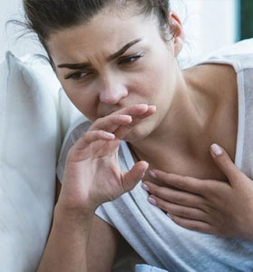
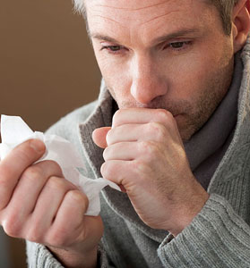
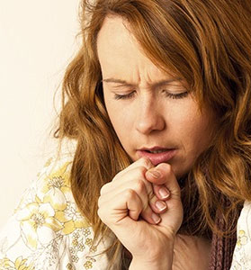
Influenza
Tuberculosis
Ebola
Imagine having to get inches away from the coughing, wheezing patient in order to take their temperature… risking infection.
Notes:
Whether it’s the Common Flu, Tuberculosis or Ebola? Imagine any airborne disease that you want to avoid. Now imagine it's your job to take the temperature of a person who is sick with one of these illnesses. You could use the standard "thermometer" where you can get up close and personal with the patient … risking infection … OR…

Slide 3
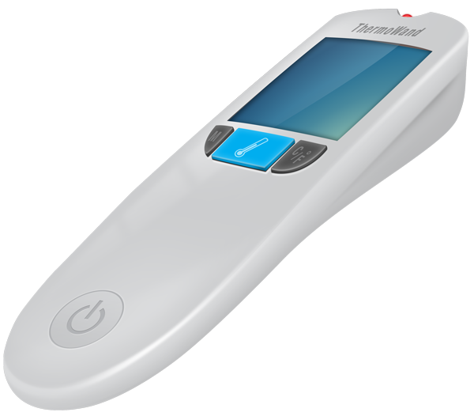
Introducing ThermoWand® Taking Temperatures Safer and Smarter
THERMOWAND®
Infrared Medical Technologies (IMT) is preparing to Launch ThermoWand® and the Temperature Data Access Plan (TDAP) to healthcare providers in the US.
Patent Pending ThermoWand® is the 1st long range “safer” medical grade thermometer as well as a “smarter” thermometer connected to the Internet.
Early prototype rendering.
Notes:
ThermoWand, the first long range medical thermometer. Taking temperatures from over 3 feet away.

Slide 4
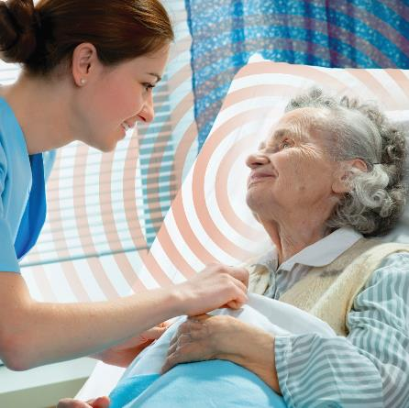
ThermoWand® - Steps Ahead of the Competition
HOW WE ARE SAFER
RANGE: ThermoWand's Patent Pending, industry leading technology enables caregivers to take temperature readings safely outside the “contagious zone” at 3 feet plus arm’s length.
SPEED: ThermoWand's speed will enable the caregiver to collect the reading in a matter of seconds with no wipe downs or disposables, less time spent around infected patients - less costs.
ACCURATE: ThermoWand's accuracy will also ensure consistent reliability while taking temperatures. Better than ±0.1°C
COMPETITION
3-6in
6x the range of its competitors
THERMOWAND
36 inches
The medical community is familiar with the “contagious zone” and already try to minimize close contact with infected patients. The contagious zone is a 2-3 feet range around a sick patient. This is how far airborne pathogens can travel from the breath of a sick patient.
Notes:
How are we different? How are we better? The maximum distance for our competition is 6 inches. Thermowand’s patent-pending technology allows people to take temperatures from over 3 feet away, which is outside the “contagious zone” that surrounds a patient. (PAUSE) Thermowand is QUICK. It takes readings in seconds. No waiting, no wipe downs, disinfecting or disposables. Less time spent around infected patient. Less costs. Thermowand is also extremely accurate

Slide 5
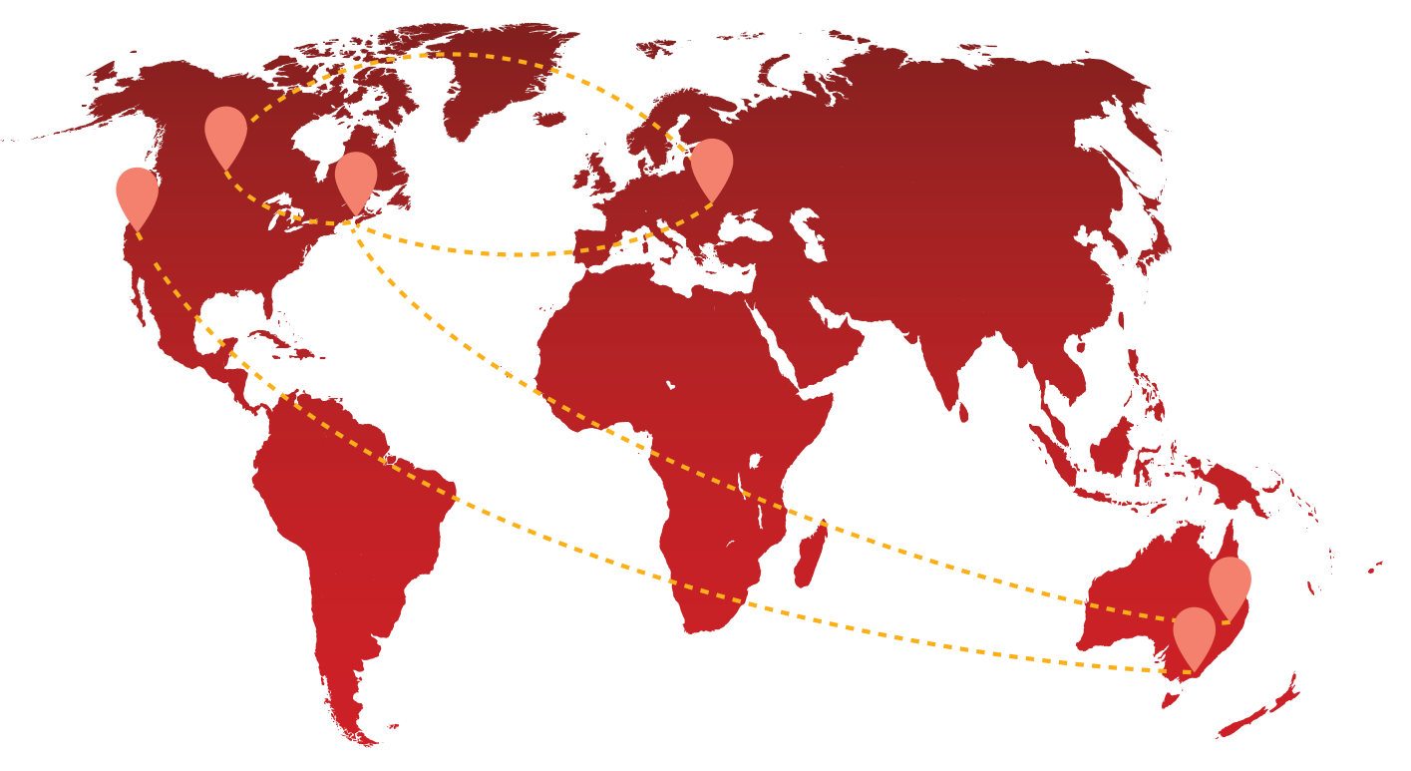
Smarter Advantage
SMARTER ADVANTAGE
Every temperature taken using a ThermoWand® device can be forwarded to a patient’s electronic medical record (EMR) via interfacing with EPIC. This will greatly impact the cost and efficiency compared to the current standards (sterilizing devices, manually transcribing data, etc.).
All readings will also be stored in the cloud in the 1st of its kind Temperature Database. This data will allow us to create rich Mobile and Web applications providing online services for the thermometers.
We will leverage a new technology called Internet of Things (IoT). IoT allows diagnostics and software upgrades to be performed remotely thus reducing our service management costs.
IoT also allows us to practice design through the use of visualization tools and Cloud technology. By using these technologies IMT will be able to create rich Mobile and Web applications providing online services for the thermometers.
Notes:
ThermoWand is smarter. Every temperature taken will be stored in the cloud, in the 1st of its kind Temperature Database
Using Web and Mobile applications, users will be able to view the data for easy analysis.
Doctors will be able to store patient data and monitor temperature fluctuation over time.
Users will be able to setup alerts and watch for spikes in temperatures in specific areas.
User will even be able to track the spread of illnesses over distance.
see when temperatures in a region are on the rise
track the progression of your illness
view the history of a patient’s temperatures
setup alerts when there are spikes in the area

Slide 6
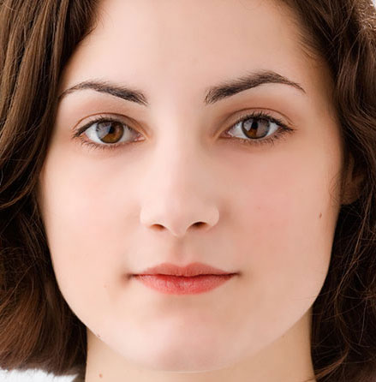
Why hasn’t this been done before?
ADVANCEMENTS IN TECHNOLOGY
ThermoWand® utilizes the latest infrared technology. Sensor technology that was not available in the past.
We utilize zoom camera technology to target the patient’s face, which allows for accurate readings from a distance.
Old Technology
New Technology
Wider area, less accurate
Tighter target area, more accurate
Notes:
Why hasn’t this been done before?
First, ThermoWand utilized the LATEST infrared technology, which has a smaller target area, allowing for more accuracy.
ThermoWand also utilizes zoom camera technology to target a patient’s face – allowing for more accurate temperatures readings.

Slide 7
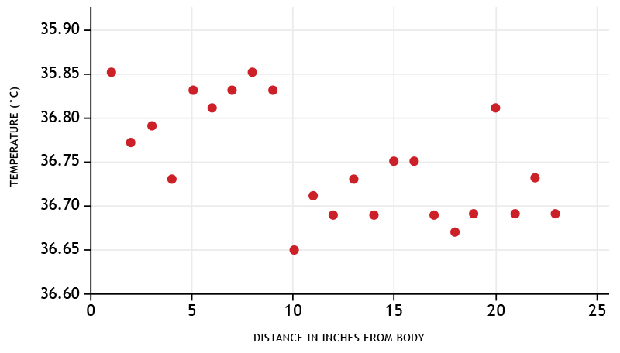
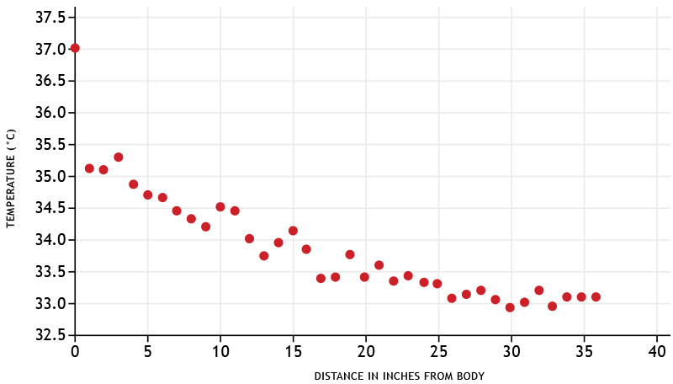
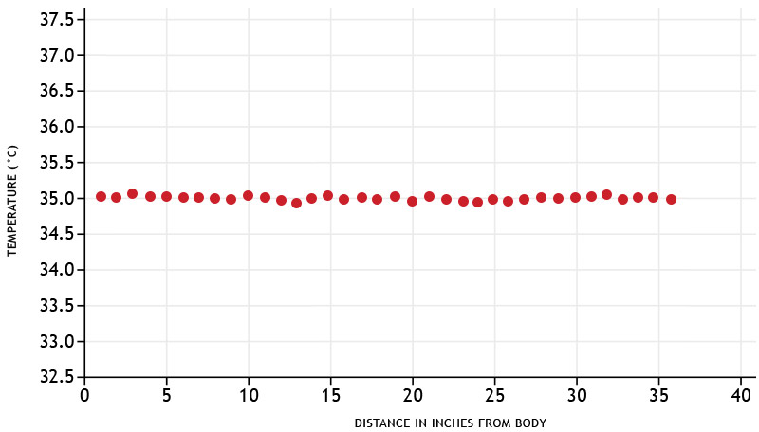
Why hasn’t this been done before?
DYNAMIC FILTERING
This is a results of a distant reading. The randomness is due to the confluence of the ambient temperature present in a room …
Patent-pending ThermoWand’s dynamic filtering process cleans up the mess
and our distance algorithm produces an accurate reading.
Notes:
And… here is a chart of several distance readings for a standard non-contact thermometer. The randomness is due to the confluence of the ambient temperature present in the room.
<<CLICK>>
PatentPending ThermoWand’s dynamic filtering process collects reliable data, and our distance algorithm results in a clear medical-grade temperature
. Isn’t that beautiful?

Slide 8
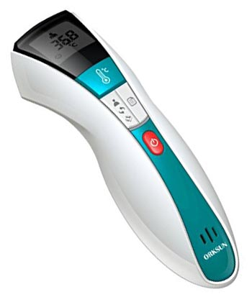












Competition
COMPETITION
Competition includes the entire medical thermometer market, including temperature strips, oral, ear, forehead and non-contact thermometers.
The maximum distance for medical grade non-contact thermometers is 6 inches. None of our competition can boast the distance of ThermoWand.
Medical grade thermometers must be accurate within ±0.2°C. Non-medical thermometers exist that claim to take temperatures at a distance, but have an accuracy of ±1.0°C (at best). In addition, their accuracy decreases, and the target area increases, as the distance grows.
Major competitors in the medical field include:
Notes:
There’s plenty of competition in the thermometer market. Temperature strips, oral, ear, forehead and non-contact thermometers. However, no medical thermometers can take temperatures from over 6 inches away. (OPTIONAL – IF TIME PERMITS) There are non-medical thermometers, but they are highly inaccurate, and their accuracy decrease even more with distance. Regarding pricing … non-contact thermometers are at the higher end of the market, compared to oral thermometers. ThermoWand will be launched at price aligned with the competition.

Slide 9
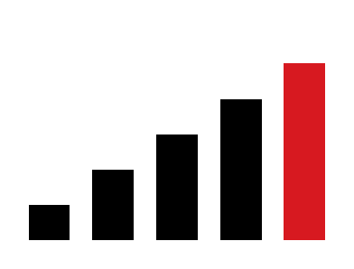
The Thermometer Industry
THERMOMETER INDUSTRY
The global medical devices market is expected to reach $428.97 billion by 2020. The global thermometer market, for reading temperatures in humans, is expected to be $850 million by 2017.
The global thermometer market is expected to be
$850,000,000 this year
The United States The Largest Market
Market projected to reach US$1.0 billion by 2020
Notes:
The medical device market is expected to reach 428 BILLION by 2020.
The global thermometer market for reading temperatures in humans is expected to be $850 MILLION by the end of the year.

Slide 10

Initial Target Audience
TARGET AUDIENCE
There are over 650,000 MDs and 2,600,000 RNs in the United States. That’s 3.25 million initial targets for the initial roll out of ThermoWand®.
MD’s and RN’s have higher than average yearly household incomes compared to the nation. MD’s earning’s range from 100k up to 1 million per year while RN’s earnings range from 70k up to 200k per year. They’re a tech savvy group who generally adapt to new technologies such as ThermoWand®.
Upon successful market penetration, Infrared Medical Technology, LLC will also create a less costly version of ThermoWand® that will be focused on the consumer market.
“The distance, speed, accuracy and wireless aspects that ThermoWand has makes it a tool that I look forward to using in my practice.” Dr. Sayegh
Notes:
There are over 650,000 MDs and 2.6 million registered nurses in the US alone. 3.2 million target audience for our initial roll out.
(PAUSE) Upon successful market penetration, we will roll out a less costly version of ThermoWand that will focus on the consumer market. (a much larger market) This is anticipated and reflected in FY3 of the Financials.

Slide 11
Revenue Streams
REVENUE STREAMS
In Fiscal Year 1 IMT will launch ThermoWand®
ThermoWands® will be sold Direct-to-Consumer targeting Health Care Providers with a suggested retail price of $400. IMT's cost is $175.
Currently, the cheapest non-contact medical-grade thermometer on the market costs around $600 (by Exergen) and only reads temperatures from 3-6” away. ThermoWand® will be priced extremely competitive.
IMT will rely heavily on a direct marketing campaign designed to drive targets to our website, setup a reseller network and a straight commissioned 1099 sales force to drive sales
The Temperature Database Access Plan (TDAP) will be launched to device owners
In Fiscal Year 3 (or sooner) IMT will launch ThermoWand® II, A scaled down, less expensive version for home use.
ThermoWand® II sold DTC, via direct marketing a reseller network and 1099 sales force
The Temperature Database Access Plan (TDAP) will be made available to the public
Notes:
IMT will launch ThermoWand with a competitive suggested retail price of $400. Our costs are $175.
IMT will conduct a Direct Marketing Campaign designed to drive targets to our website.
IMT will also setup a reseller network and commissioned only, 1099 contract sales force.
IMT will also launch our Temperature Database Access Plan.
In fiscal year 3 … or sooner,
the launch a cheaper version of ThermoWand for home use.

Slide 12
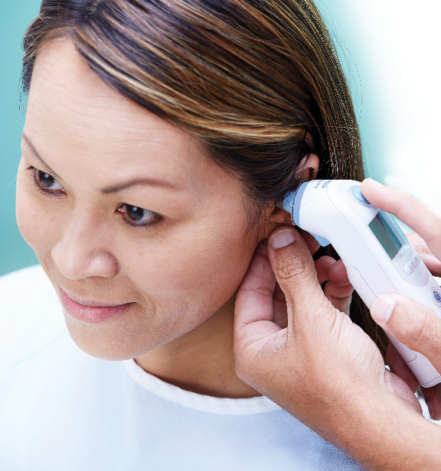
Case Study 1
CASE STUDIES
In 2000, a company named System Application of Advanced Technology (SAAT) introduced the latest technology (digital ear thermometers) and sold 240,000 units in their first year. In 2001, 310,000 units were sold. In 2002, up to 360,000 units sold. And in 2004, estimated 500,000 units.
SAAT’s “technology advancement” essentially shifted the orifice that the thermometer used from the mouth to the ear—resulting in hundreds of thousands of units being sold every year.
Case Study 2
In the late ’90s, an American company named ThermoScan had developed a digital ear thermometer using infrared and was manufacturing it. ThermoScan was acquired by Gillette for $100 million
Notes:
Some important case studies.
In 2000, A company called System Application of Advance Technology introduced a digital ear thermometer. They sold 240,000 units in year one, and increased sales significantly each year.
(PAUSE)
In the late 90s, ThermoScan developed a digital ear thermometer (PAUSE) ThermoScan was acquired by Gillete for $100 million.

Slide 13
Financials
FINANCIALS
While it is IMT's intention to become the market share leader in the thermometer industry, the financial projections are based on very conservative assumptions.
For a detailed financials, outline all assumptions, please request our finance documents.
 | FY1 | FY2 | FY3 | FY4 | FY5
Revenues | $1,403,780 | $2,987,260 | $7,281,090 | $10,074,510 | $13,364,330
Direct Expenses | $776,500 | $1,628,400 | $3,374,800 | $4,524,400 | $5,810,900
Gross Profit | $627,280 | $1,358,860 | $3,906,290 | $5,550,110 | $7,552,430
Gross Profit (%) | 44.7% | 45.5% | 53.6% | 55.1% | 56.5%
Other Expenses | $1,238,200 | $1,395,300 | $1,575,210 | $1,661,060 | $1,752,603
EBITDA | ($610,920) | ($36,440) | $2,331,080 | $3,889,049 | $5,799,827
Depreciation | $6,000 | $21,600 | $58,800 | $117,800 | $195,800
Amortization | $0 | $0 | $0 | $0 | $0
Preliminary Exp Written off | $0 | $0 | $0 | $0 | $0
Interest Expense | $0 | $0 | $0 | $0 | $0
Income Tax Expense | $0 | $0 | $559,000 | $1,319,900 | $1,961,400
Net Income | ($616,920) | ($58,040) | $1,713,280 | $2,451,349 | $3,642,627
Notes:
This is a brief overview of our 5 year financial plan.
I’d like to point out that these numbers are based off very conservative assumptions. I mentioned the SAAT case study selling 240,000 units in year 1. These projections have us selling under 5 thousand units in year 1 with gradual growth over the next 5 year. FY3 onward includes the launch of ThermoWand II, the less expensive version for home use.

Slide 14
Funding Breakdown
FUNDING BREAKDOWN
We are seeking a $500K investment in order to
Solidify our proof of concept in a controlled peer-reviewed setting.
Complete filing of our utility patent (provisional patent filed 8/16)
Produce a shelf-ready prototype.
Conduct a pre-order soft launch and initial marketing
We are already in the process of solidifying the proof of concept in a controlled laboratory setting. Other objectives require capital and 9-12 months.
Notes:
Infrared Medical Technology is looking to raise 500k, preferably in Convertible Notes with a negotiated discount. We are open to any and all offers.

Slide 15
Milestones
FUNDING BREAKDOWN
Completed
Future
5/17 Build Shelf-Ready Prototype
8/17 Utility Patent Filing Date
9/17 Conduct Pre-order Soft Launch
11/15 IMT Founded
5/16 Preliminary Proof of Concept
9/16 Preliminary Portable Proof of Concept
2-3 months
2016
2017
2018
8/16 Provisional Patent Filed
2/17 Prof. Johnson’s Doctoral Dissertation on Emissivity and Temperature Reading
7/17 Solidify Proof of Concept
10/15 Copyrighted name ThermoWand®

Slide 16
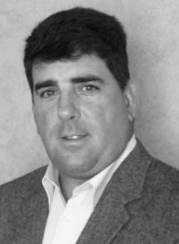
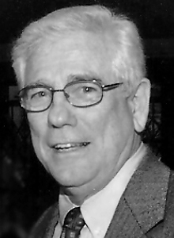
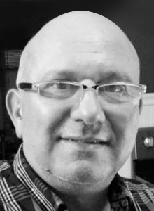
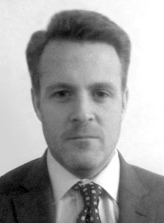
Management Team
MANAGEMENT TEAM
David N. Johnson Chief Executive Officer, Co-founder MS Marketing NYU ‘03, 20 years of healthcare industry sales experience.
Timothy Johnson Chief Engineer, Founder Managing Member MSEE, NYIT ’97. Retired Professor Electrical Eng. Wentworth Inst. of Tech ‘15
Richard Centauro Chief Technical Officer ASEE Elec. Tech, ’84 Wentworth Inst. of Tech. Ret. AVP State St. Bank Technological guru
Douglas Gallagher Chief Marketing Officer BS Business, University of Virginia, Founder of Amazing Design Group, Web Entrepreneur
Advisory Committee: Dr. Robert Young, PhD; Edward T. Leuschner, CPA, P. C.;
Stephen Kuperberg, MD; Dr. Nadem Sayegh
Notes:
Here’s our management team. We have full bios on our website.

Slide 17
Thank You
THANK YOU
For more information (including financials and business plan), please contact: David Johnson at david.johnson@imt.solutions or Doug Gallagher at dj@imt.solutions
ThermoWand® Taking Temperatures Safer and Smarter
Notes:
Thank you for your time. We’d love for you to become part of this great company.

